Slide 1
Deep Learning in the Kalahari
Session 1 of 3 · Chapters 1–4
Models · ML Reading Group
Notes:
Session 1 of 3: about 20 minutes of slides, then 60-70 minutes of hands-on puzzles in the Colab notebook. All data are synthetic, set in a meerkat field station.

Slide 2
The series: model → loss → fit → measure
Ch 1
Ch 2
Ch 3
Ch 4
Ch 5
Ch 6
Ch 7
Ch 8
Introduction
Supervised
Shallow nets
Deep nets
Loss functions
Fitting
Gradients & init
Performance
TODAY
SESSION 1
SESSION 2
SESSION 3
Models. What function? y = f[x, ϕ]: lines, then ReLU nets that fold space
Losses and training. What is 'good', and how do we find it? Likelihood; GD, SGD, Adam
Backprop and performance. Gradients at scale, initialisation, and does it generalise?
Pup weigh-in · burrows · dune sea
Alarm calls · scorpions · race to the burrow
Backprop by hand · call classifier · condensates
Notes:
Three sessions across chapters 1-8. Today is session 1: chapters 1–4.

Slide 3
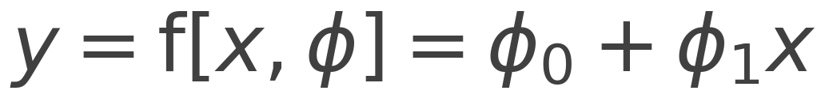
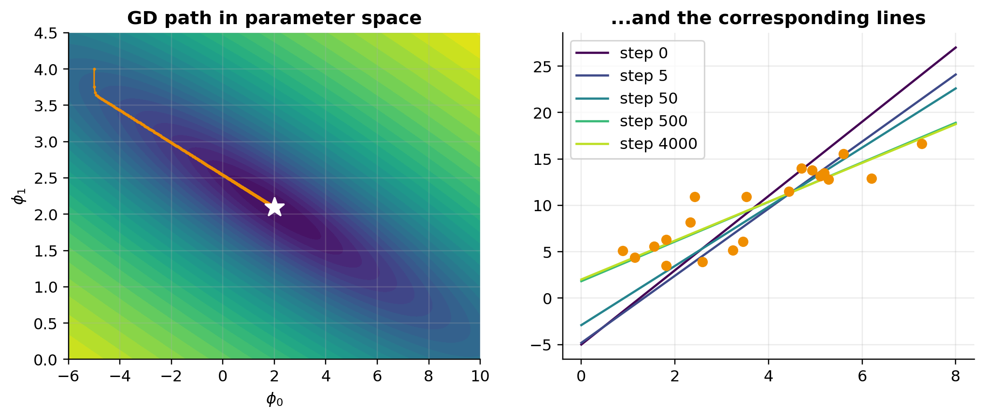
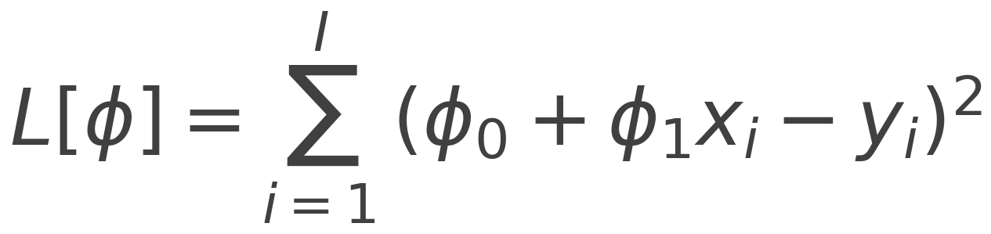
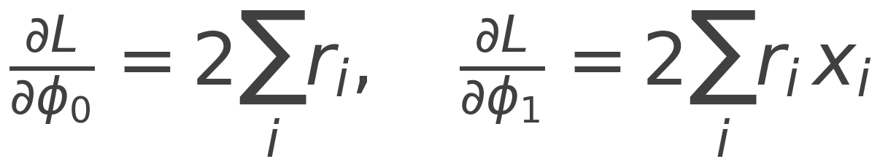
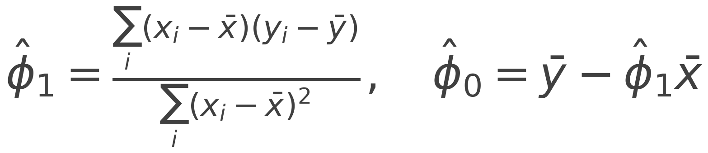
Chapter 2: the Great Pup Weigh-in
MODEL
LEAST SQUARES LOSS
GRADIENT (PUZZLE 2.1)
CLOSED FORM (PUZZLE 2.2)
Gradient descent zig-zags down a narrow valley to the closed-form optimum (Fig 2.4).
Notes:
Model, loss, gradient, closed form. Puzzle 2.3: the generative fit x = g[y] inverted is NOT the same line, because it minimises horizontal rather than vertical errors.

Slide 4
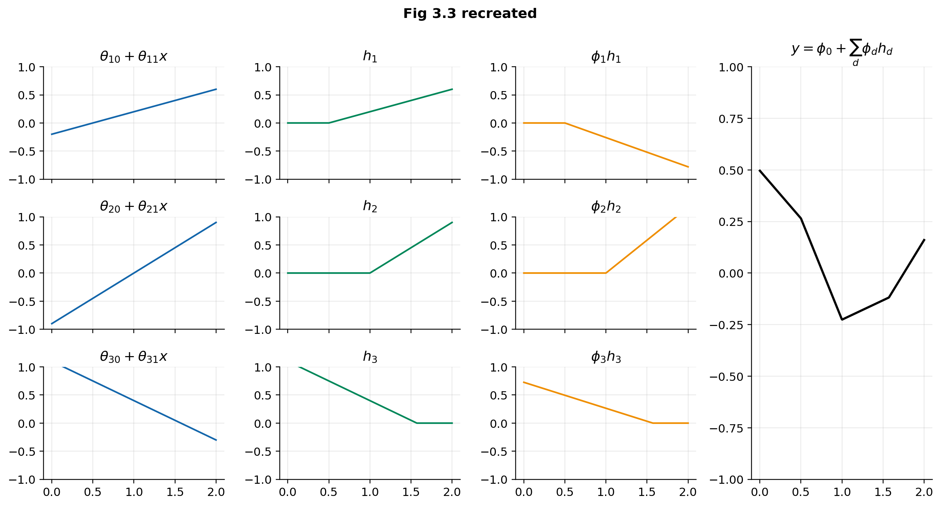
Chapter 3: sums of clipped lines
READ IT LIKE A MAP
Linear → clip (ReLU) → weighted sum
Joint of unit d at x = −θd0/θd1
Slope in a region = Σ ϕ_d θ_d1 over the active units
D units → at most D + 1 linear regions
Puzzles 3.1–3.4: joints, activation patterns, homogeneity, swapping activations
Notes:
Recreates Fig 3.3 with the book's own parameters. Joints sit at -theta0/theta1. Puzzle 3.2: slope of region 3 = region 1 + region 4 because units switch on from different sides.

Slide 5
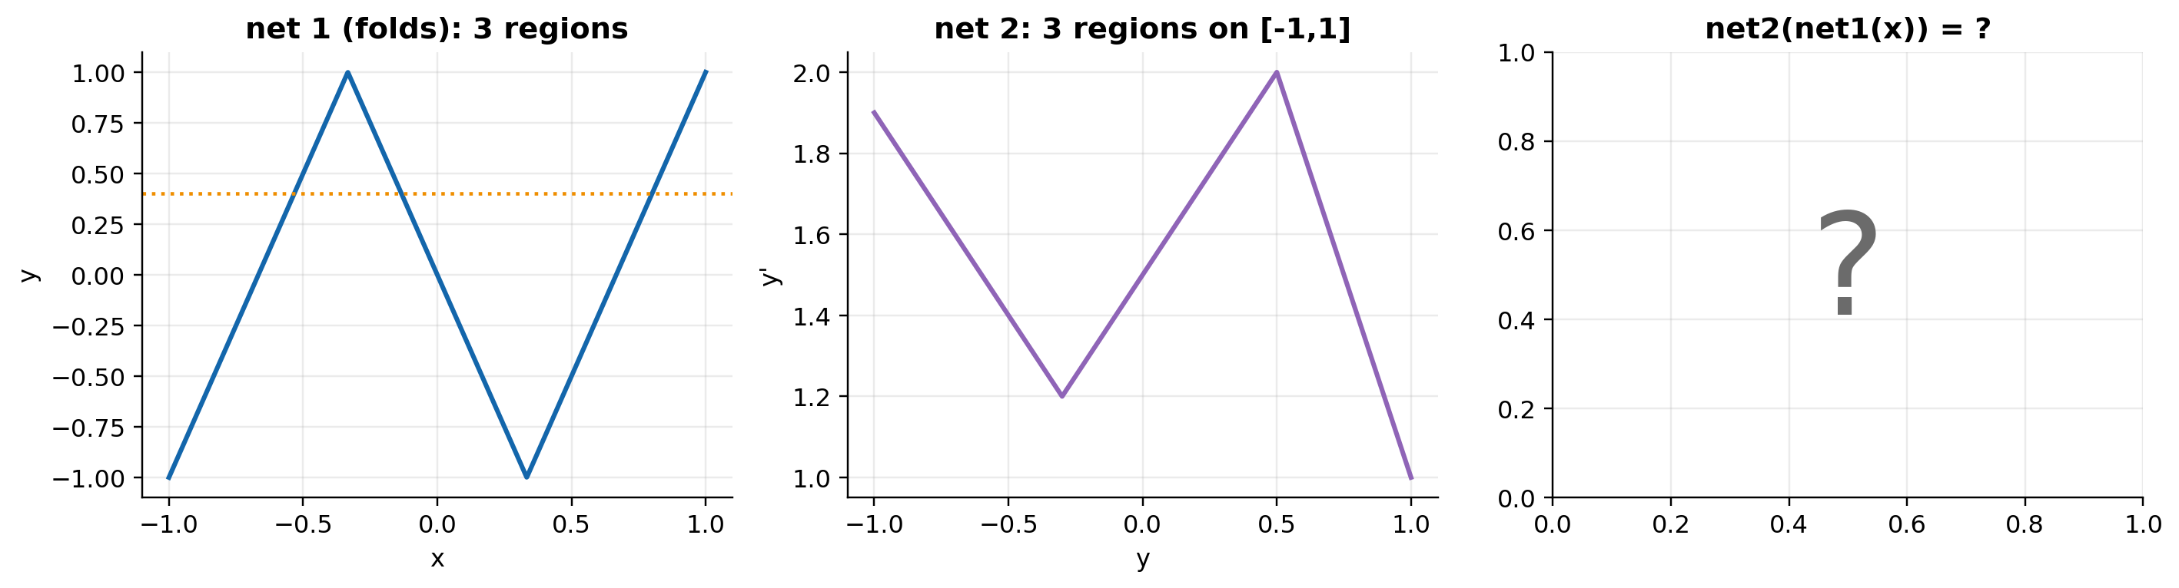
Chapter 4: deep networks fold space
Composition = folding
Net 1 maps 3 different x's to each y, so net 2's function is replicated (and flipped) on every fold: 3 folds × 3 regions = 9 regions.
Ωₖ is (size of next layer) × (size of this layer). Puzzle 4.2: one deep_forward for every MLP.
Notes:
Puzzle 4.1: predict the region count before running. Net 1 maps each of its three pieces onto the whole of [-1,1], so net 2's three regions are copied three times: nine regions.

Slide 6
Hands-on: 15 puzzles, 2 challenges
Part | Puzzles | Time
1 · Intro | Sort the field-station requests · 160 M-parameter layer | ~10 min
2 · Supervised | Gradient · closed form · generative vs discriminative ★★★ | ~15 min
3 · Shallow | Joints & slopes · activation patterns · homogeneity · activation zoo · universal approx. · counting · challenge: dig the burrow | ~25 min
4 · Deep | Predict the folds · deep_forward · shape bingo · regions per parameter · challenge: the dune sea | ~20 min
Open: TBio_UDL_S1_….ipynb in Colab, run Setup, then work top to bottom.
Short on time? Leave stretch puzzles 2.3, 3.4, 4.4 for afterwards. Stuck? Run the solution cell so later parts work.
Next time: Session 2 · Losses and training (Ch 5–6). Optional reading: book chapters 5–6.
Notes:
Hand over to the notebook. Suggested pacing per part is in the table and in the notebook's intro.

Slide 7
Questions?
Deep Learning in the Kalahari
Transition Bio ML Reading Group

