Slide 1
Deep Learning in the Kalahari
Session 1 of 3 · Chapters 1–4
Models · ML Reading Group
Notes:
Session 1 of 3: about 20 minutes of slides, then 60-70 minutes of hands-on puzzles in the Colab notebook. All data are synthetic, set in a meerkat field station.

Slide 2
How it works: maths, code and meerkats
1
2
3
4
Maths
From scratch
Puzzles
Challenges
The book's equations, derived step by step in the notebook
Everything built first in NumPy; PyTorch appears only once it's earned
15 auto-checked puzzles today, ★ to ★★★. Peeking halves the points
2 medal challenges today: bronze / silver / gold
Your rank in the mob: 28 points available today, 72 across the series
Pup
Babysitter
Scorpion Hunter
Sentinel
Dominant Female
In meerkat mobs the dominant female runs the group. Everything is synthetic, so every answer can be auto-checked.
Notes:
Three sessions, same rhythm each time. Points are tallied; peeking at a solution halves them.

Slide 3
The series: model → loss → fit → measure
Ch 1
Ch 2
Ch 3
Ch 4
Ch 5
Ch 6
Ch 7
Ch 8
Introduction
Supervised
Shallow nets
Deep nets
Loss functions
Fitting
Gradients & init
Performance
TODAY
SESSION 1
SESSION 2
SESSION 3
Models. What function? y = f[x, ϕ]: lines, then ReLU nets that fold space
Losses and training. What is 'good', and how do we find it? Likelihood; GD, SGD, Adam
Backprop and performance. Gradients at scale, initialisation, and does it generalise?
Pup weigh-in · burrows · dune sea
Alarm calls · scorpions · race to the burrow
Backprop by hand · call classifier · condensates
Notes:
Three sessions across chapters 1-8. Today is session 1: chapters 1–4.

Slide 4
Chapter 1: three ways a machine can learn
SUPERVISED
UNSUPERVISED
REINFORCEMENT
Learn x → y from labelled pairs {xᵢ, yᵢ}
Find structure in {xᵢ} with no labels
Act → change state → receive reward
Regression: pup mass from 30-day mass
Classification: which predator is this alarm call for?
Cluster foraging tracks into styles
Generative: synthesise new meerkat calls
A robot sentinel learning when to stand guard
Hard part: temporal credit assignment
Also in Ch 1: structured inputs. 10 s of 16 kHz audio into one 1,000-unit dense layer = 160,001,000 parameters (Puzzle 1.2). Ethics: bias, explainability and environmental cost.
Notes:
Puzzle 1.1 asks people to sort eight field-station requests into these families. Point out the TBio cameo (H).

Slide 5
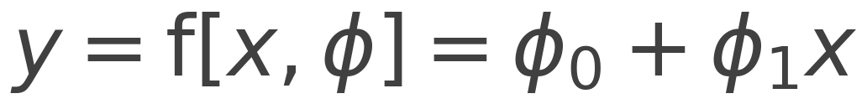
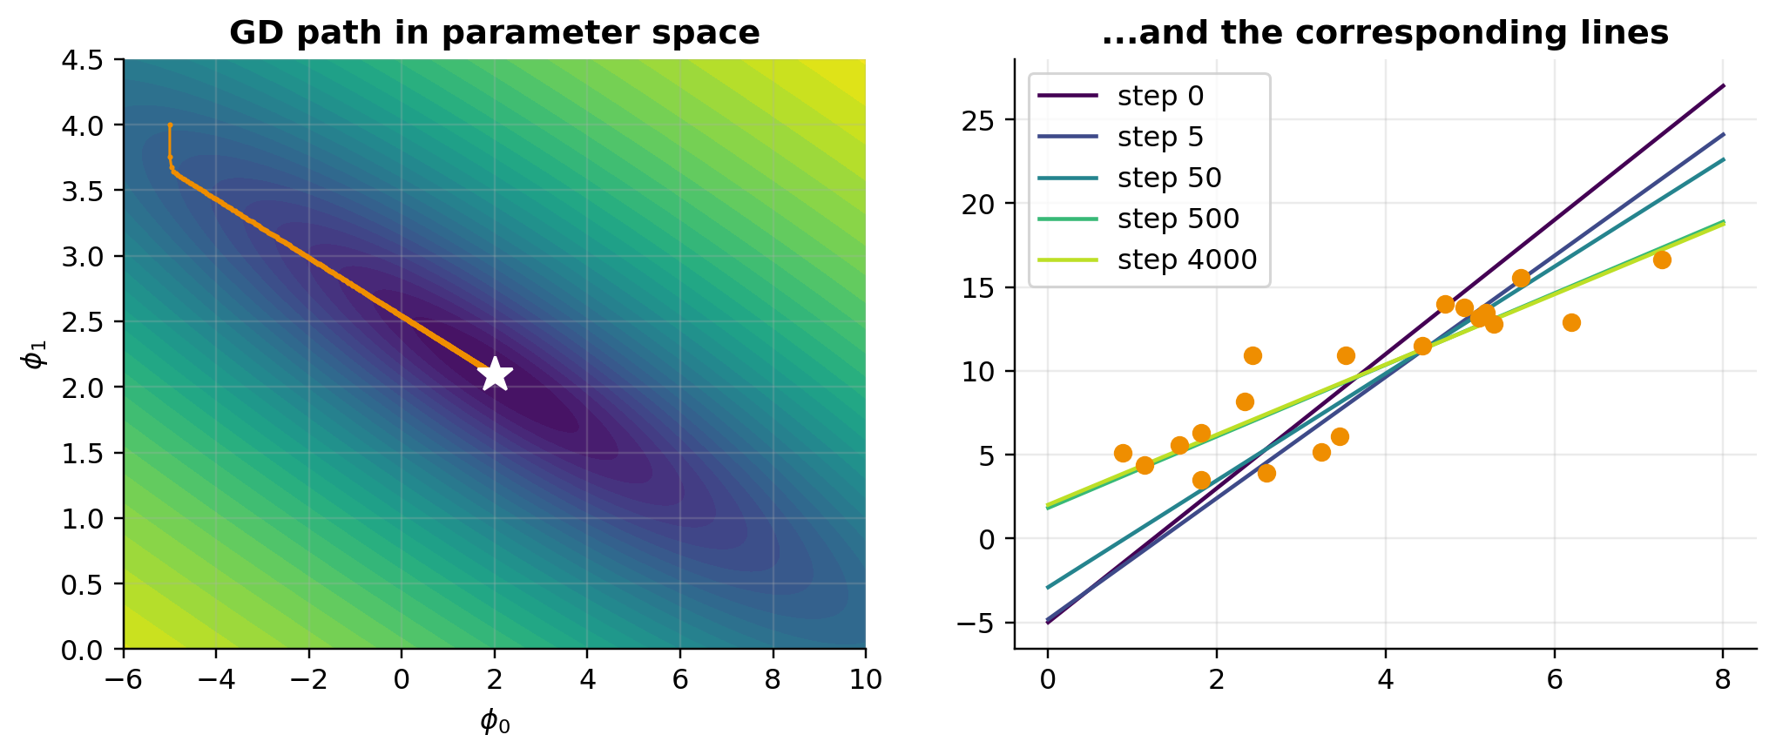
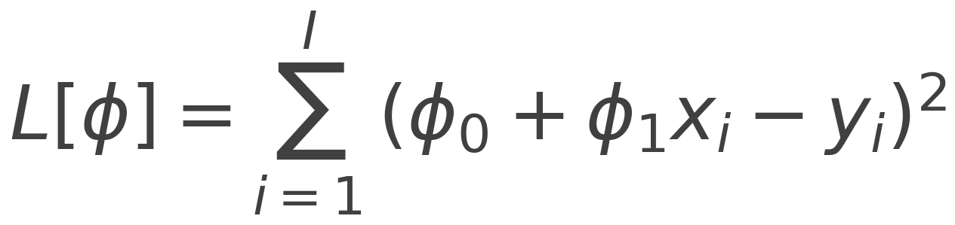
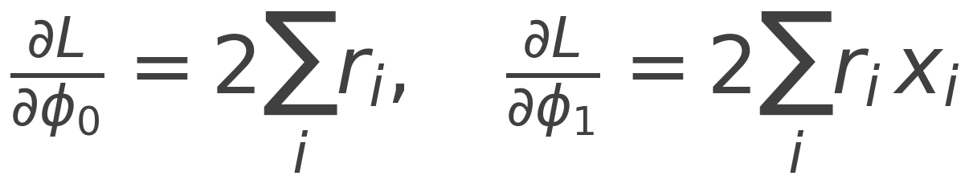
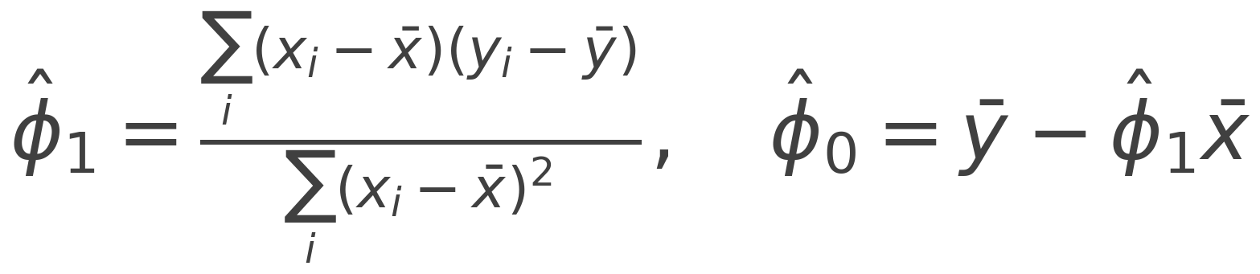
Chapter 2: the Great Pup Weigh-in
MODEL
LEAST SQUARES LOSS
GRADIENT (PUZZLE 2.1)
CLOSED FORM (PUZZLE 2.2)
Gradient descent zig-zags down a narrow valley to the closed-form optimum (Fig 2.4).
Notes:
Model, loss, gradient, closed form. Puzzle 2.3: the generative fit x = g[y] inverted is NOT the same line, because it minimises horizontal rather than vertical errors.

Slide 6
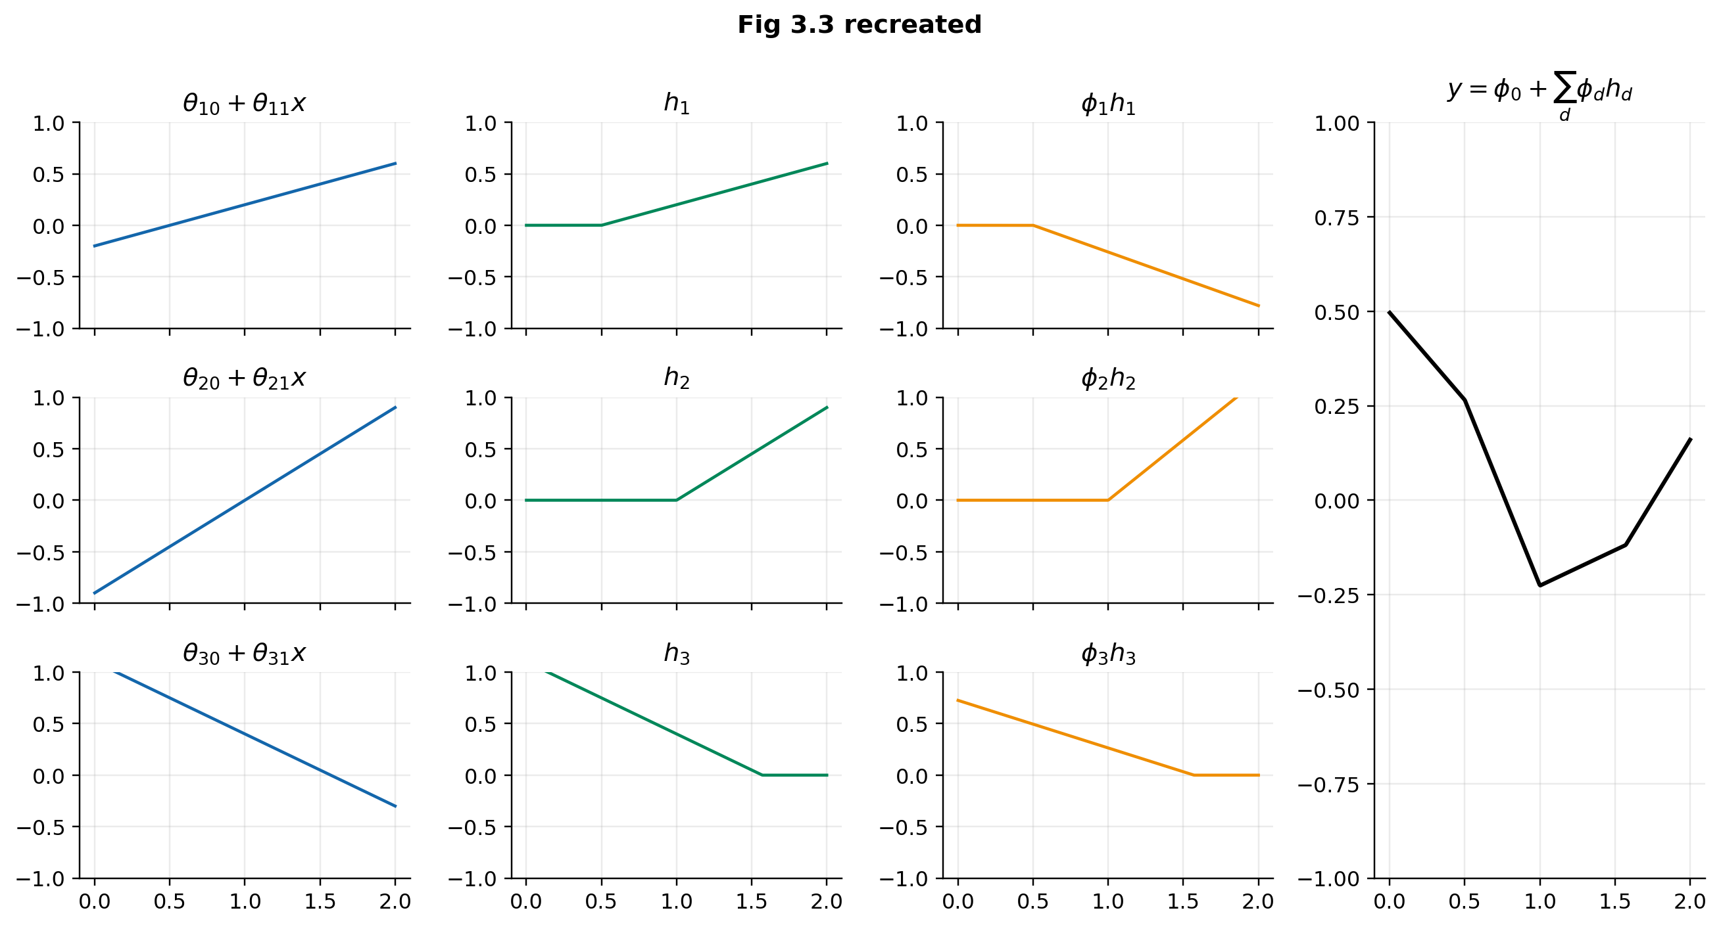
Chapter 3: sums of clipped lines
READ IT LIKE A MAP
Linear → clip (ReLU) → weighted sum
Joint of unit d at x = −θd0/θd1
Slope in a region = Σ ϕ_d θ_d1 over the active units
D units → at most D + 1 linear regions
Puzzles 3.1–3.4: joints, activation patterns, homogeneity, swapping activations
Notes:
Recreates Fig 3.3 with the book's own parameters. Joints sit at -theta0/theta1. Puzzle 3.2: slope of region 3 = region 1 + region 4 because units switch on from different sides.

Slide 7
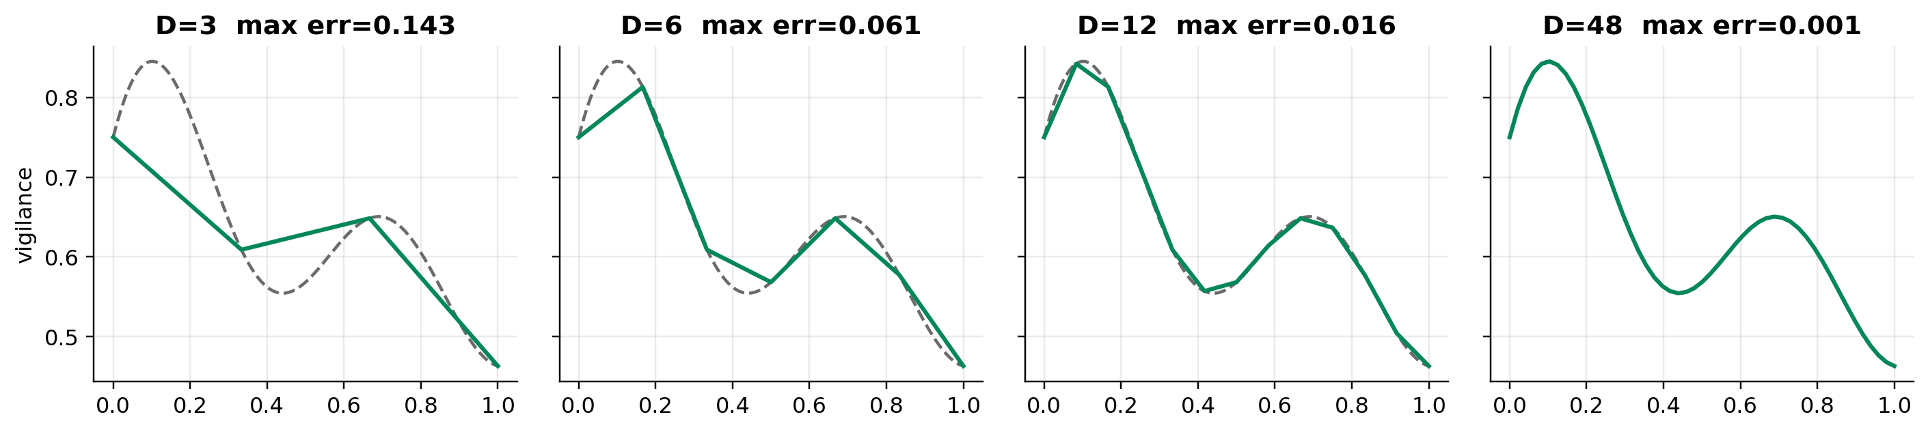
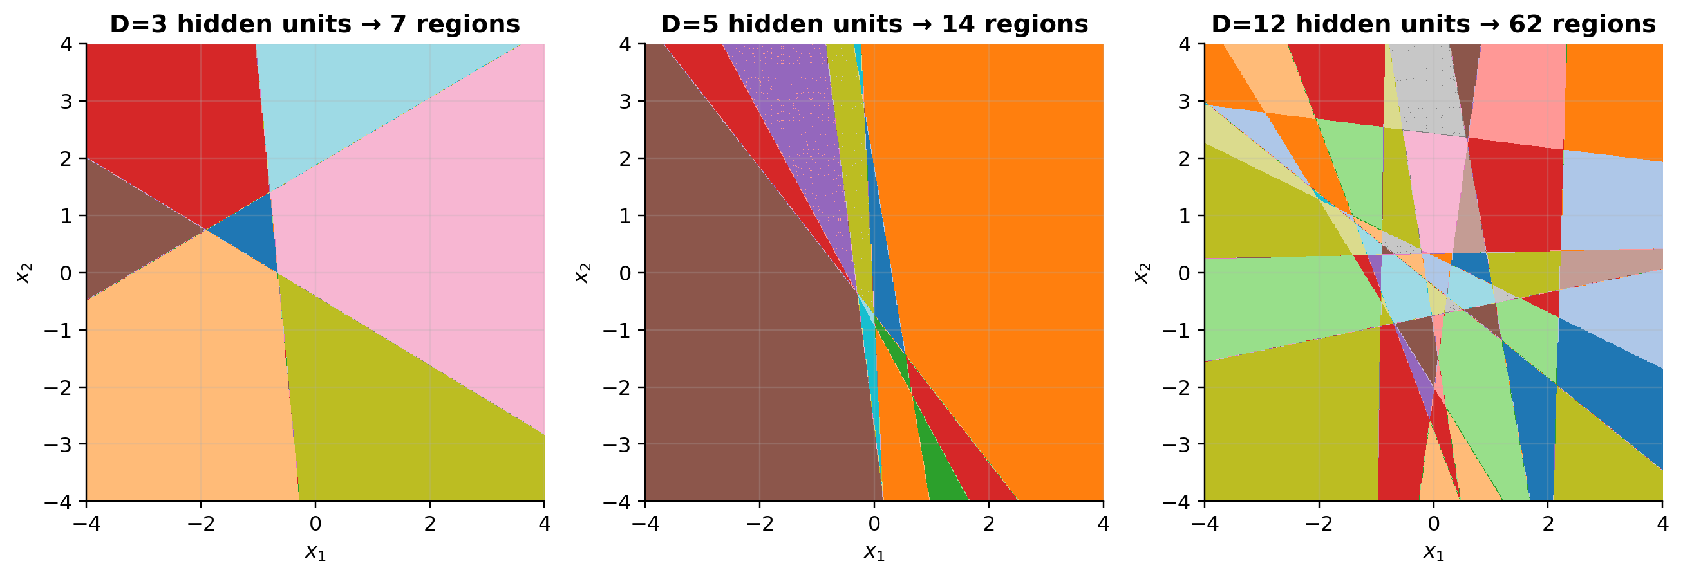
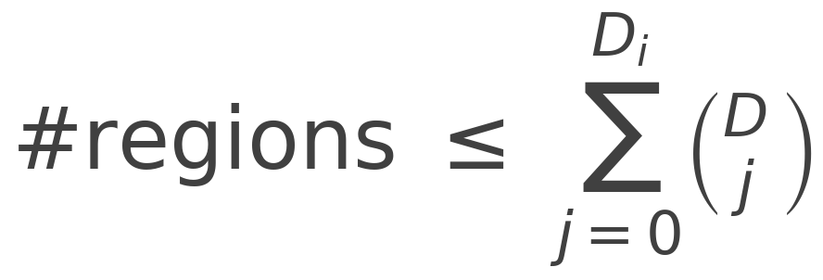
Chapter 3: approximation and regions
D = 500, Dᵢ = 100: 51,001 parameters, more than 10¹⁰⁷ regions
Notes:
Puzzle 3.5 builds an interpolating network by construction: units ReLU(x - t_d) with weights equal to the slope changes. Zaslavsky's bound counts regions for multivariate inputs.

Slide 8
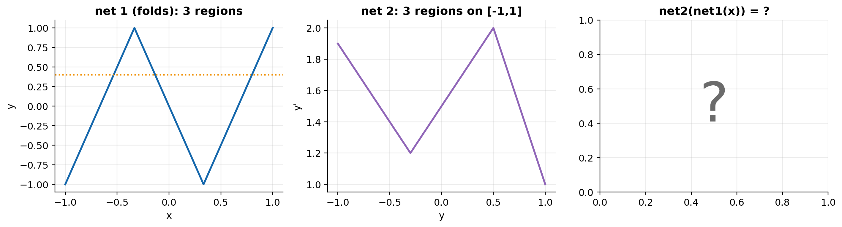
Chapter 4: deep networks fold space
Composition = folding
Net 1 maps 3 different x's to each y, so net 2's function is replicated (and flipped) on every fold: 3 folds × 3 regions = 9 regions.
Ωₖ is (size of next layer) × (size of this layer). Puzzle 4.2: one deep_forward for every MLP.
Notes:
Puzzle 4.1: predict the region count before running. Net 1 maps each of its three pieces onto the whole of [-1,1], so net 2's three regions are copied three times: nine regions.

Slide 9
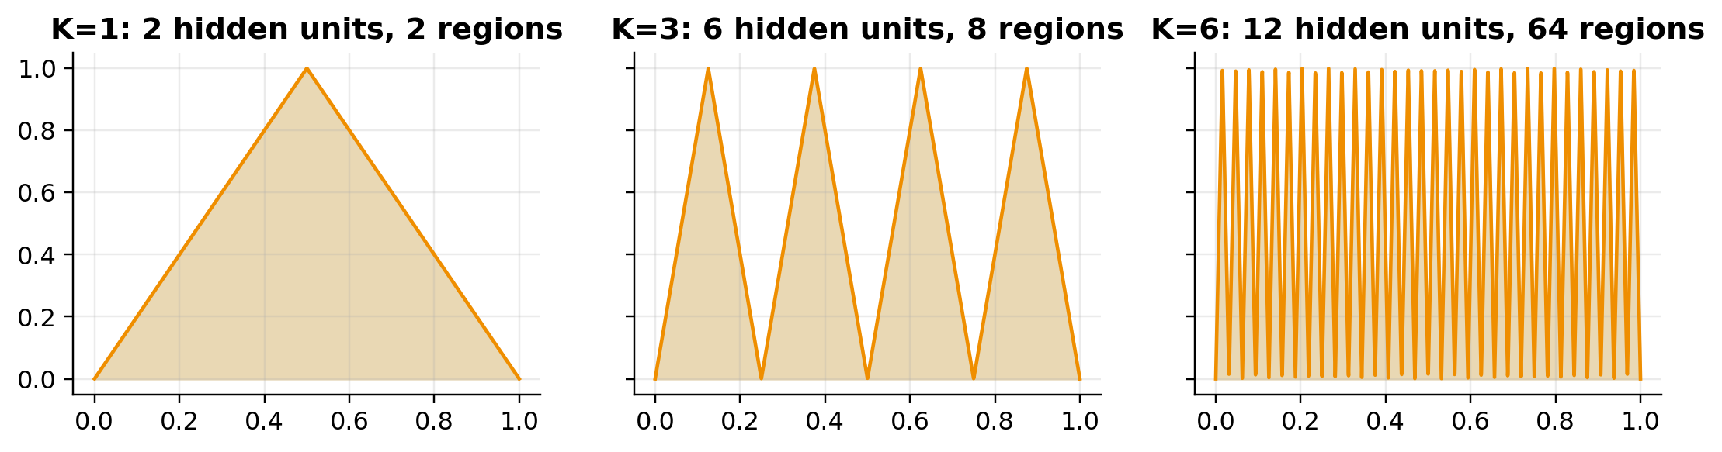
Chapter 4: depth efficiency in the dune sea
1 input, 1 output | parameters | max regions
shallow, D units | 3D + 1 | D + 1
K layers of D units | 3D+1+(K−1)D(D+1) | (D+1)ᴷ
K = 5, D = 10 | 471 | 161,051
20 vs 1,023
hidden units for a 1,024-region sawtooth: deep (K = 10) vs shallow
Caveat (§4.5.2): random deep nets realise only a tiny fraction of their maximum region count.
Notes:
The tent layer uses two ReLUs. Composing it K times gives 2^K regions from 2K units; a shallow net needs 2^K - 1 units. But random nets come nowhere near the maximum (last notebook cell of Part 4).

Slide 10
Hands-on: 15 puzzles, 28 points
Part | Puzzles | Points | Time
1 · Intro | Sort the field-station requests · 160 M-parameter layer | 2 | ~10 min
2 · Supervised | Gradient · closed form · generative vs discriminative ★★★ | 6 | ~15 min
3 · Shallow | Joints & slopes · activation patterns · homogeneity · activation zoo · universal approx. · counting · challenge: dig the burrow | 11 | ~25 min
4 · Deep | Predict the folds · deep_forward · shape bingo · regions per parameter · challenge: the dune sea | 9 | ~20 min
Open: TBio_UDL_S1_….ipynb in Colab, run Setup, then work top to bottom.
Short on time? Leave stretch puzzles 2.3, 3.4, 4.4 for afterwards; they still count. Stuck? Run the solution cell so later parts work.
Notes:
Hand over to the notebook. Suggested pacing per part is in the table and in the notebook's intro.

Slide 11
Next time: Session 2
LOSSES AND TRAINING · CH 5–6
HOMEWORK
Where loss functions come from: maximum likelihood
Sentinels, alarm calls, scorpions and lost burrows
Gradient descent, SGD, momentum and Adam from scratch
Challenge: race to the burrow
Finish any puzzles from today, especially the stretch ones (2.3, 3.4, 4.4).
Note your score from scoreboard(): the series total is out of 72.
Optional reading: book chapters 5–6.
Notes:
Preview of the next session, plus homework.

Slide 12
Questions?
Deep Learning in the Kalahari
Transition Bio ML Reading Group

