Slide 1
Deep Learning in the Kalahari
Session 2 of 3 · Chapters 5–6
Losses and training · ML Reading Group
Notes:
Session 2 of 3: about 20 minutes of slides, then 60-70 minutes of hands-on puzzles in the Colab notebook. All data are synthetic, set in a meerkat field station.

Slide 2
Last time: models (Ch 1–4)
SUPERVISED LEARNING
SHALLOW NETS
A model is a family y = f[x, ϕ]; training = argmin of a loss. Least squares + gradient descent.
Linear → ReLU clip → weighted sum = piecewise linear. D units give at most D + 1 regions; universal approximation.
DEEP NETS
OPEN QUESTIONS
Each layer folds space: up to (D+1)ᴷ regions. 20 deep units vs 1,023 shallow for the dune sea.
Why least squares? What about classes, counts, angles? How do we train non-convex models? → today
Notes:
Two-minute recap before today's material.

Slide 3
The series: model → loss → fit → measure
Ch 1
Ch 2
Ch 3
Ch 4
Ch 5
Ch 6
Ch 7
Ch 8
Introduction
Supervised
Shallow nets
Deep nets
Loss functions
Fitting
Gradients & init
Performance
TODAY
SESSION 1
SESSION 2
SESSION 3
Models. What function? y = f[x, ϕ]: lines, then ReLU nets that fold space
Losses and training. What is 'good', and how do we find it? Likelihood; GD, SGD, Adam
Backprop and performance. Gradients at scale, initialisation, and does it generalise?
Pup weigh-in · burrows · dune sea
Alarm calls · scorpions · race to the burrow
Backprop by hand · call classifier · condensates
Notes:
Three sessions across chapters 1-8. Today is session 2: chapters 5–6.

Slide 4
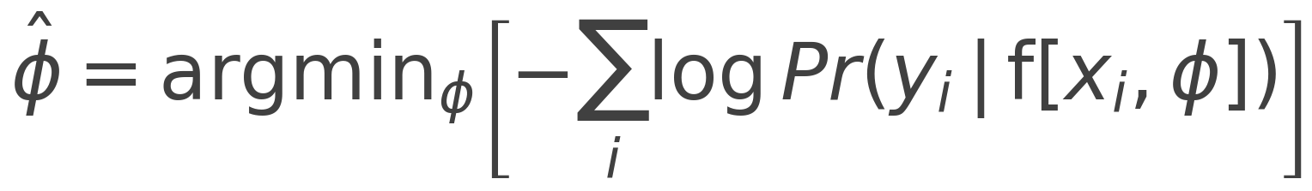
Chapter 5: the recipe for any loss function
1
Choose a distribution Pr(y | θ) over the output domain
output | distribution | activation | loss | meerkat example
y ∈ ℝ | normal | none | least squares | pup growth
y ∈ {0,1} | Bernoulli | sigmoid | binary CE | sentinel duty
y ∈ {1..K} | categorical | softmax | cross-entropy | alarm calls
y ∈ ℕ | Poisson | exp | Poisson NLL | scorpions / hour
y ∈ (−π, π] | von Mises | none | −κ cos(y − μ) | burrow heading
2
Let the network predict its parameters: θ = f[x, ϕ]
3
Train by minimising the negative log-likelihood
4
Inference: the full distribution, or its maximum
Same punchline every time: with the matching link function, ∂ℓ/∂f = prediction − truth.
Notes:
Least squares is not arbitrary: it is the negative log-likelihood of a Gaussian. Same recipe gives BCE, cross-entropy, Poisson and von Mises losses, all used in Part 5 of the notebook.

Slide 5
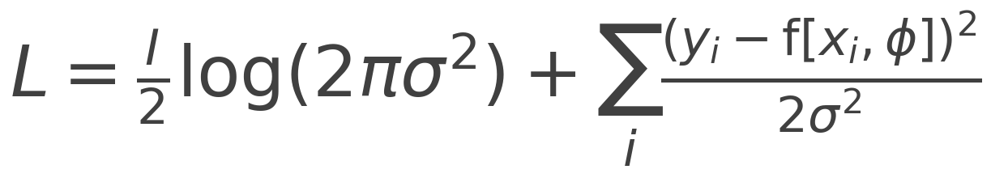
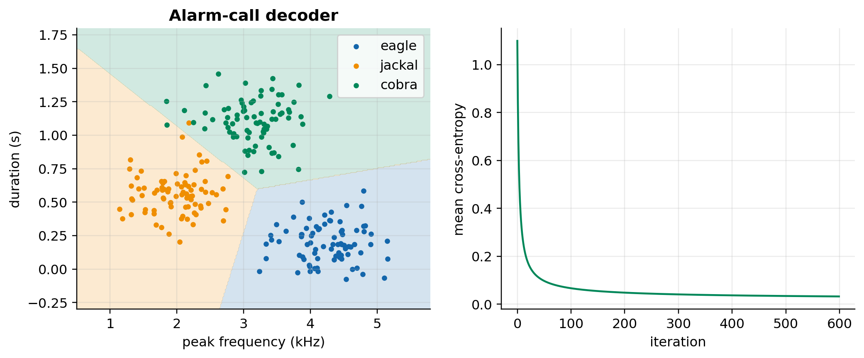
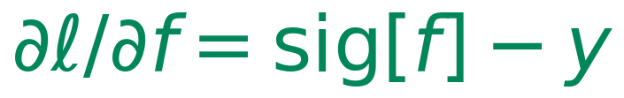
Chapter 5: three losses, one recipe
NORMAL → LEAST SQUARES
BERNOULLI → BINARY CE
CATEGORICAL → CROSS-ENTROPY
Puzzle 5.6: which way is the burrow?
Headings cluster around ±180°. The naive mean says 7.6° (due east). The von Mises MLE atan2(Σ sin yᵢ, Σ cos yᵢ) gives −179.6°.
Notes:
Normal NLL: the first term doesn't depend on phi, so argmin is least squares. Binary CE gradient sig(f)-y. Softmax gradient softmax(f)-onehot. Puzzle 5.6: averaging angles naively sends the mob east instead of west.

Slide 6
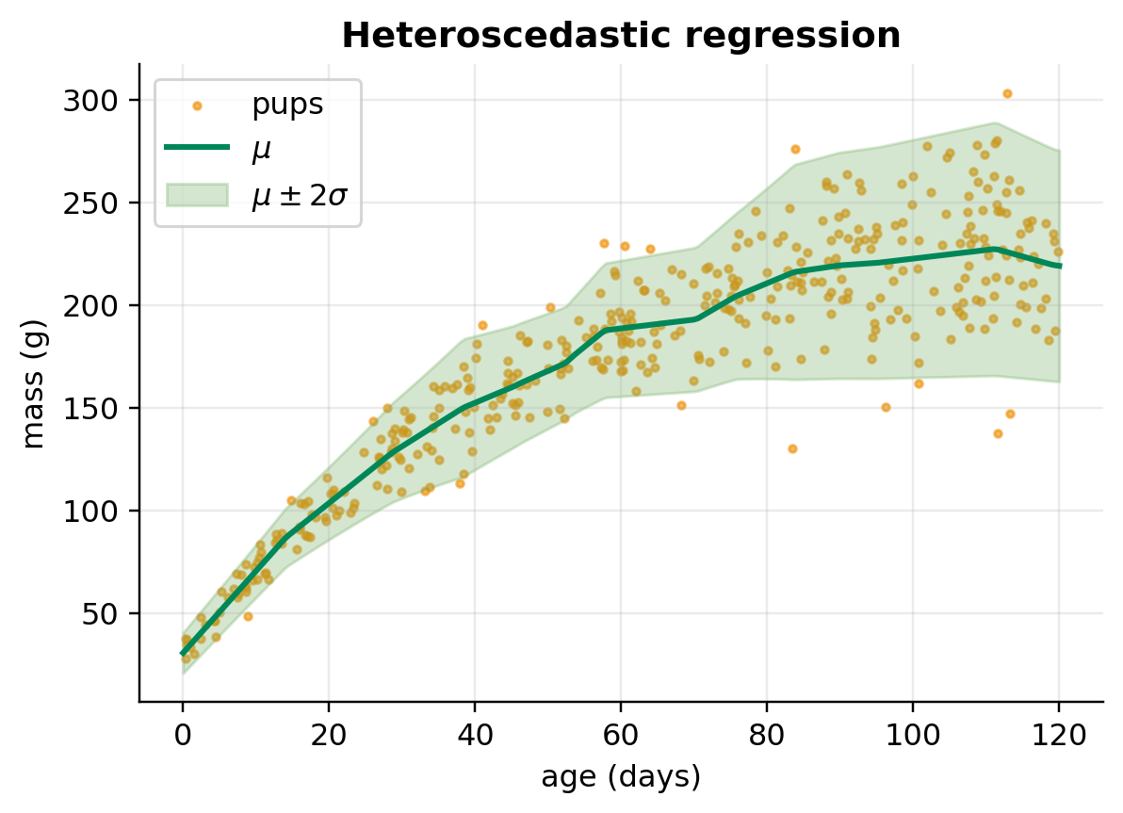
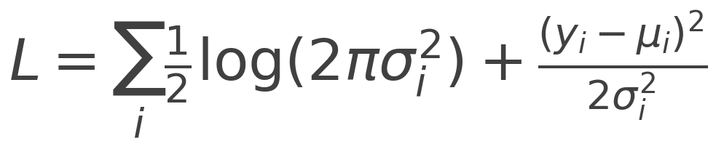
Chapter 5: predicting uncertainty
HETEROSCEDASTIC REGRESSION (§5.3.4)
Two outputs: a mean and a variance
Softplus keeps the variance positive
Pups get more variable as they grow, and the band widens with age
Assay data often look like this too
Notes:
Heteroscedastic regression: the network outputs mu and a raw variance, passed through softplus. Trained with Adam in PyTorch.

Slide 7
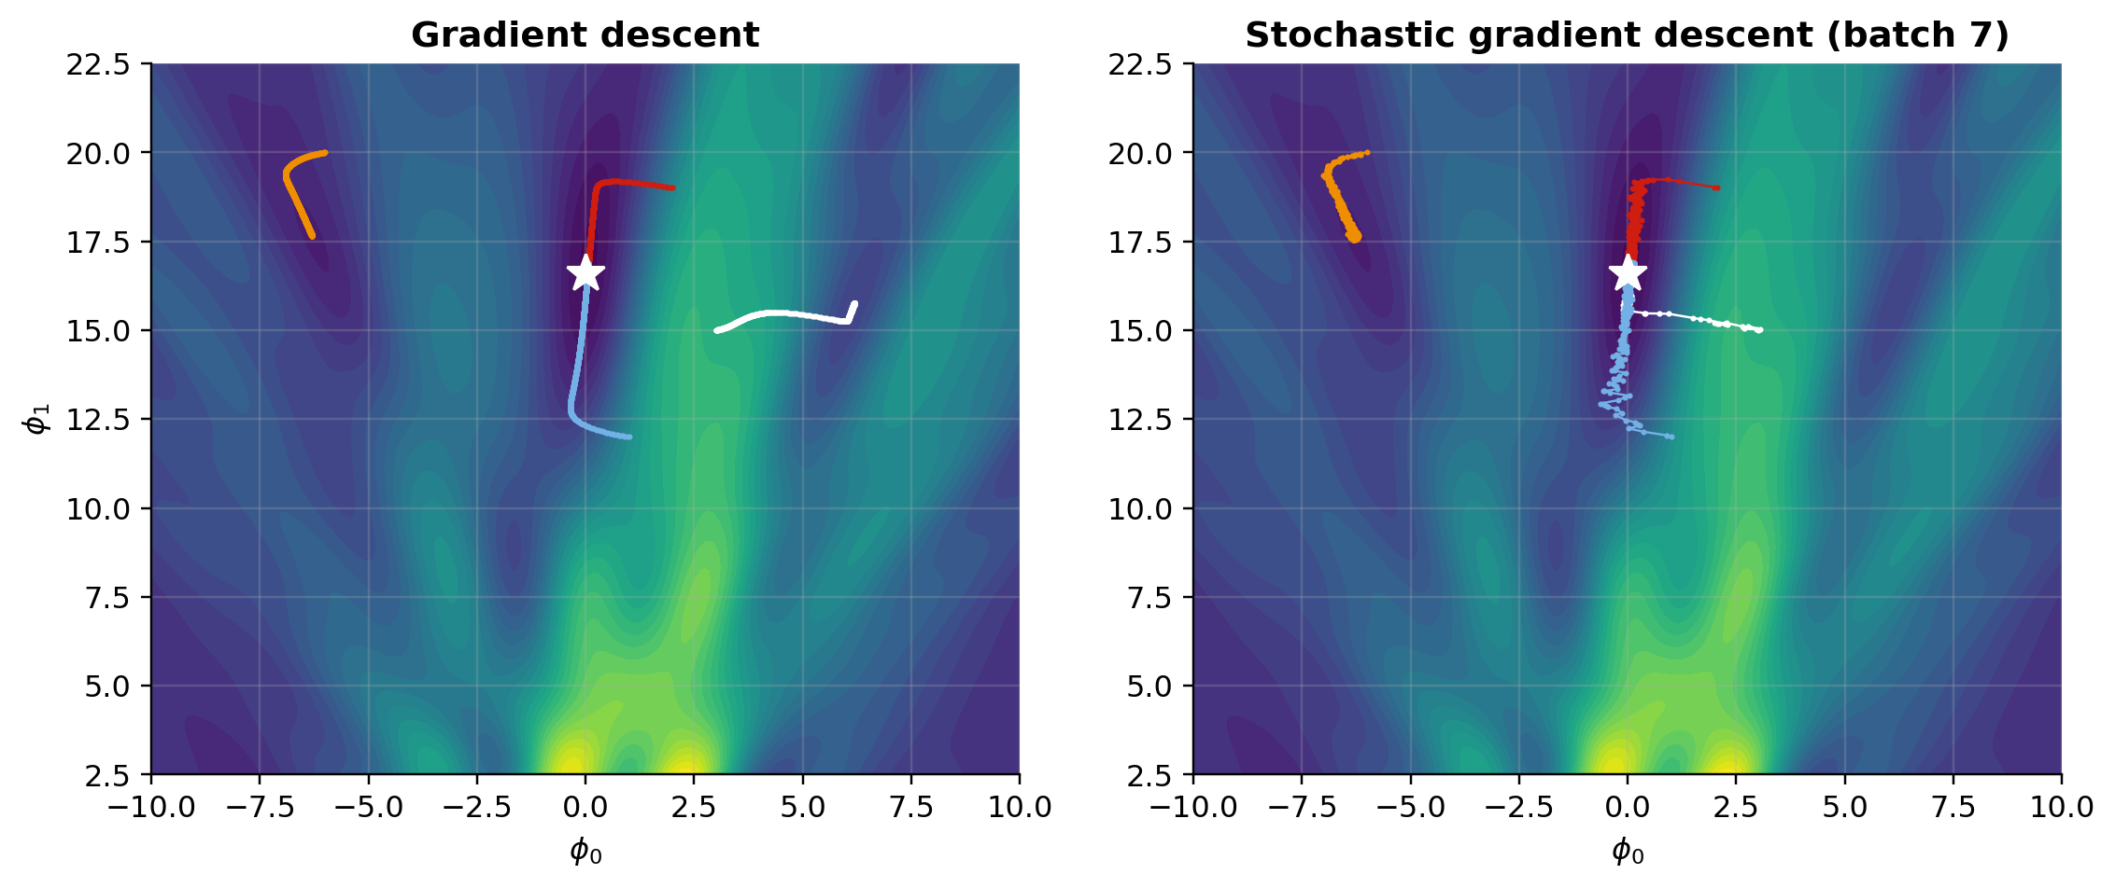
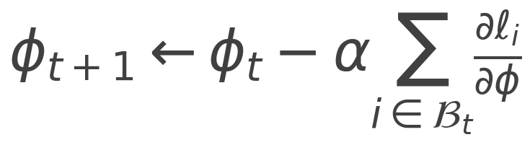
Chapter 6: where you start matters
SGD (EQ 6.10)
Random minibatches add noise that can hop valleys, but there's no guarantee
1 epoch = one pass over the data
Puzzle 6.2: a 10⁶-parameter Hessian has 10¹² entries (4 TB)
Notes:
Gabor model eq 6.8. GD from (1,12) and (2,19) reaches the global min; from (-6,20) and (3,15) it gets stuck. SGD occasionally escapes: from (3,15) it reached the global min in about 2 of 20 runs. No guarantees.

Slide 8
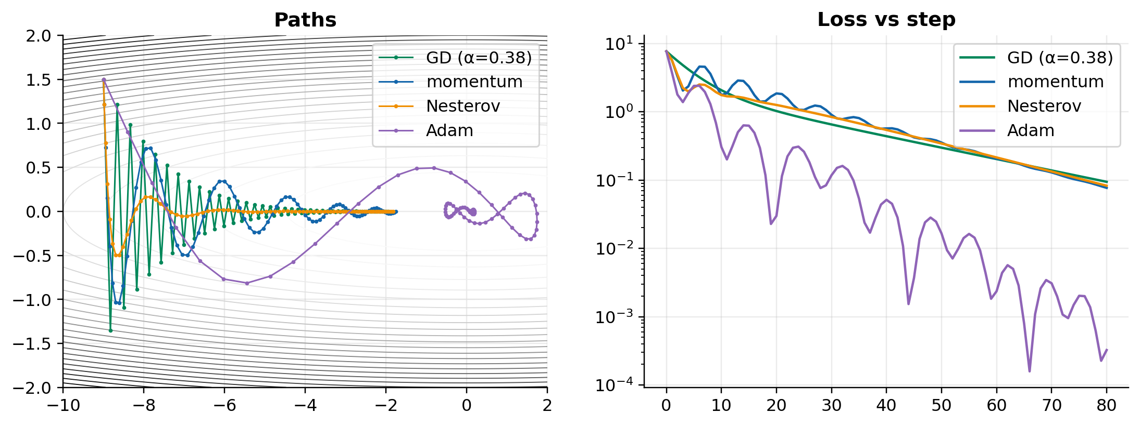
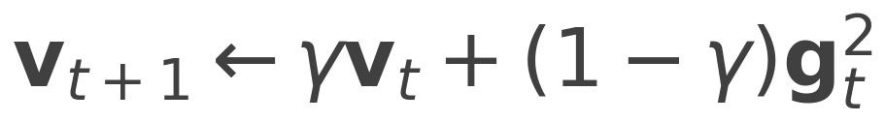
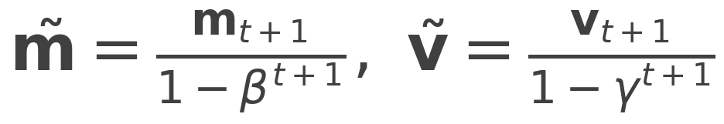
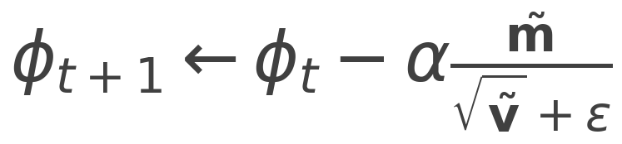
Chapter 6: momentum and Adam
MOMENTUM (6.11)
ADAM (6.15–6.17)
Challenge 6: race to the burrow
L(a, b) = (1 − a)² + 20(b − a²)². Fewest steps wins: bronze < 2,000, silver < 600, gold < 200.
Notes:
Momentum is an exponential moving average of gradients, weight (1-beta)beta^k (Puzzle 6.3). Adam normalises the step size per direction. Challenge 6: race to the burrow on a banana-shaped valley; Adam reaches it in 160 steps.

Slide 9
Hands-on: 10 puzzles, 21 points
Part | Puzzles | Points | Time
5 · Loss | Normal NLL & σ² · heteroscedastic (PyTorch) · BCE gradient · stable softmax · Poisson scorpions · von Mises burrow ★★★ | 12 | ~35 min
6 · Fitting | Gabor gradient · epochs & Hessians · momentum weights · momentum / Nesterov / Adam · challenge: race to the burrow | 9 | ~35 min
Open: TBio_UDL_S2_….ipynb in Colab, run Setup (and the carry-over cell), then work top to bottom.
Short on time? Leave stretch puzzles 5.2, 5.6, 6.3 for afterwards; they still count. Stuck? Run the solution cell so later parts work.
Notes:
Hand over to the notebook. Suggested pacing per part is in the table and in the notebook's intro.

Slide 10
Next time: Session 3
BACKPROP AND PERFORMANCE · CH 7–8
HOMEWORK
Backpropagation by hand, then for any MLP
Initialisation: whispers down the burrow
Bias, variance and double descent
Capstone: from meerkats to molecules
Finish any puzzles from today, especially the stretch ones (5.2, 5.6, 6.3).
Note your score from scoreboard(): the series total is out of 72.
Optional reading: book chapters 7–8.
Notes:
Preview of the next session, plus homework.

Slide 11
Questions?
Deep Learning in the Kalahari
Transition Bio ML Reading Group

