Slide 1
Deep Learning in the Kalahari
Session 3 of 3 · Chapters 7–8
Backprop and performance · ML Reading Group
Notes:
Session 3 of 3: about 20 minutes of slides, then 60-70 minutes of hands-on puzzles in the Colab notebook. All data are synthetic, set in a meerkat field station.

Slide 2
Last time: losses and training (Ch 5–6)
LOSSES FROM LIKELIHOOD
PREDICTION − TRUTH
Pick a distribution over y, predict its parameters, minimise the negative log-likelihood.
Normal, Bernoulli, categorical, Poisson: with the matching link, ∂ℓ/∂f = prediction − truth.
NON-CONVEX FITTING
MOMENTUM AND ADAM
Where you start matters. SGD's minibatch noise can hop valleys, with no guarantee.
Smooth the gradient history; normalise step sizes per direction. Adam won the race in 160 steps.
Notes:
Two-minute recap before today's material.

Slide 3
The series: model → loss → fit → measure
Ch 1
Ch 2
Ch 3
Ch 4
Ch 5
Ch 6
Ch 7
Ch 8
Introduction
Supervised
Shallow nets
Deep nets
Loss functions
Fitting
Gradients & init
Performance
TODAY
SESSION 1
SESSION 2
SESSION 3
Models. What function? y = f[x, ϕ]: lines, then ReLU nets that fold space
Losses and training. What is 'good', and how do we find it? Likelihood; GD, SGD, Adam
Backprop and performance. Gradients at scale, initialisation, and does it generalise?
Pup weigh-in · burrows · dune sea
Alarm calls · scorpions · race to the burrow
Backprop by hand · call classifier · condensates
Notes:
Three sessions across chapters 1-8. Today is session 3: chapters 7–8.

Slide 4
Chapter 7: backprop is chain rule + caching
β₀+ω₀x
sin
β₁+ω₁h
exp
β₂+ω₂h
cos
β₃+ω₃h
(f−y)²
x
f₀
h₁
f₁
h₂
f₂
h₃
f₃
ℓ
forward pass: store every fₖ, hₖ · backward pass: multiply by the local derivative and reuse
VECTOR FORM FOR DEEP RELU NETS
Puzzle 7.2: implement these three lines and you've written loss.backward() for an MLP. The checker compares with torch autograd.
Notes:
Forward pass stores every f_k and h_k. Backward pass multiplies by local derivatives. Puzzle 7.1 does the toy model by hand; Puzzle 7.2 does a deep ReLU net and is checked against torch autograd.

Slide 5
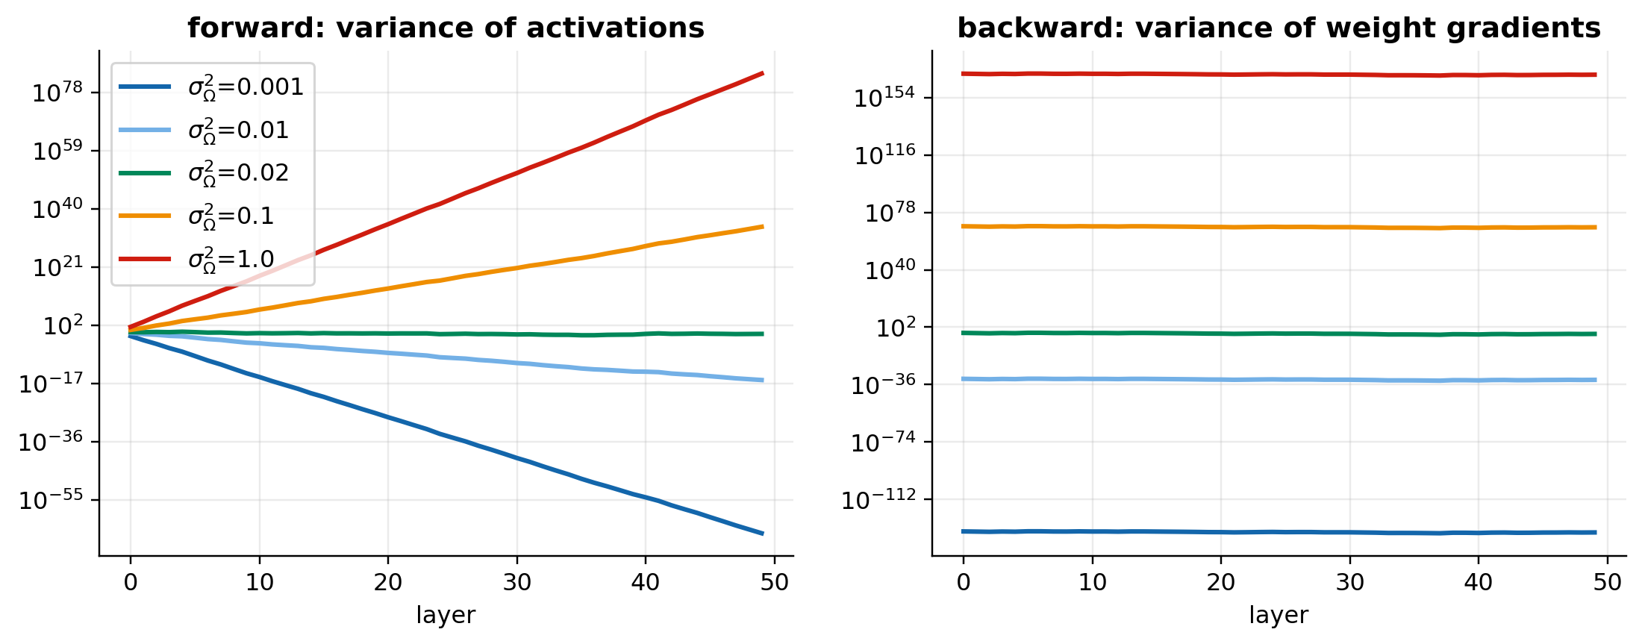
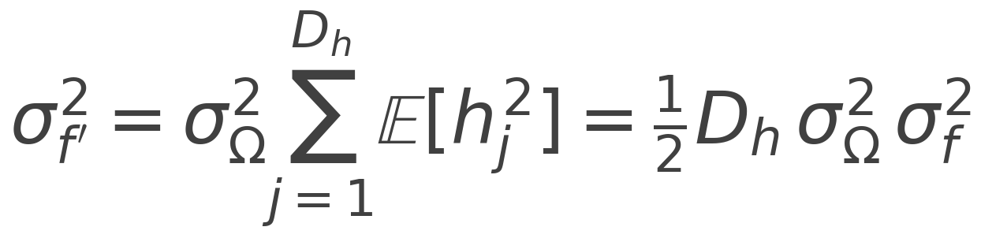
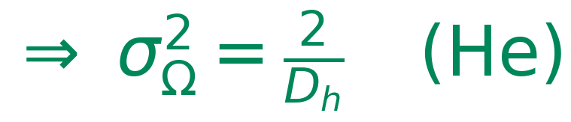
Chapter 7: whispers down the burrow
WHY ½?
For z ~ N(0, σ²), a ReLU keeps only the positive half:
E[h] = σ/√(2π), E[h²] = σ²/2
So each layer multiplies the variance by Dₕσ²/2. Anything other than 1 vanishes or explodes exponentially with depth (Puzzles 7.3, 7.4).
Backward pass: same argument with Dₕ′. Compromise: σ² = 4/(Dₕ + Dₕ′).
Notes:
Variance of pre-activations multiplies by Dh*sigma^2/2 at each layer. He init sets that factor to 1. The figure recreates Fig 7.7 with our own numpy forward/backward code: 50 layers of 100 units.

Slide 6
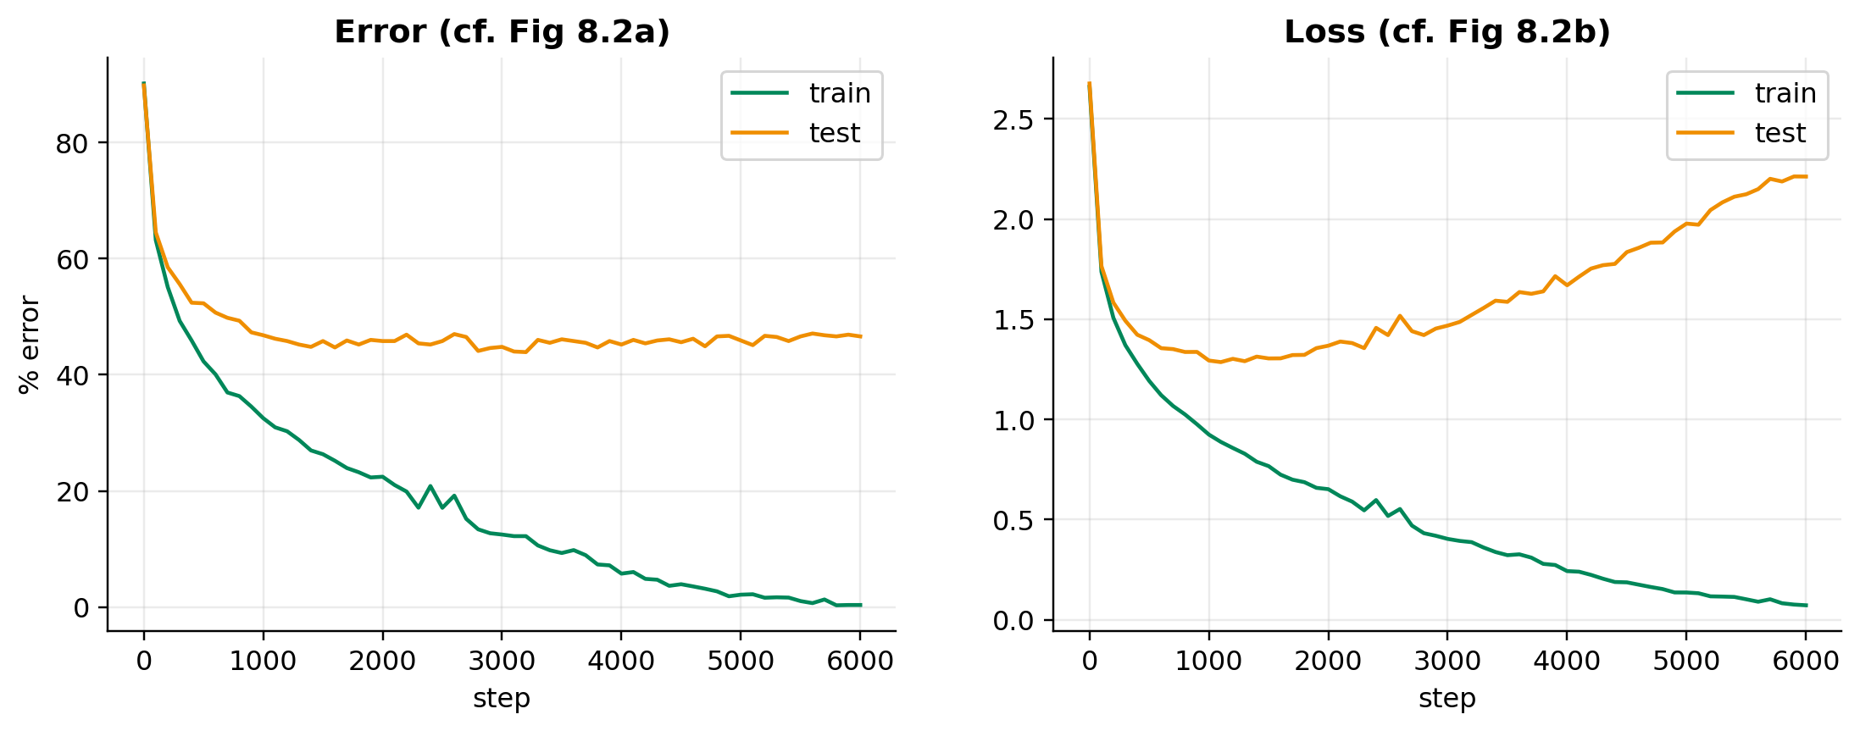
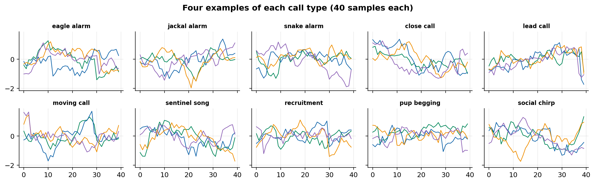
Chapter 8: memorising the call data
§8.1 set-up | value
architecture | 40 → 100 → 100 → 10
optimiser | SGD, lr 0.1, batch 100
training | 6,000 steps (150 epochs)
train / test error | ~0% / ~47%
Puzzle 8.1: why does the test loss climb while the test error stays flat?
The model makes the same mistakes with growing confidence. Softmax logits are driven to extremes, and the log in the cross-entropy punishes confident errors.
Notes:
An MNIST-1D-style dataset: 10 call types, 40 samples each, random stretch, shift, slope and noise. The section 8.1 model (two layers of 100, SGD lr 0.1, batch 100, 6000 steps) reaches ~0% training error but about 47% test error. Test loss rises because the model becomes confidently wrong.

Slide 7
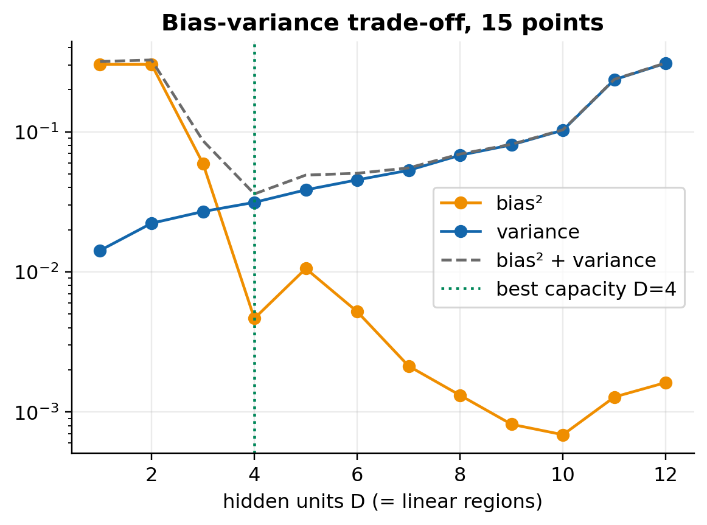
Chapter 8: noise, bias and variance
VARIANCE
BIAS²
NOISE
Proof idea: add and subtract μ, then f_μ. The cross terms vanish in expectation.
More data → less variance
More capacity → less bias, but more variance
Noise is a hard floor
Simulation check: 0.0595 + 0.0245 + 0.09 = 0.174 vs measured 0.175
Notes:
Using the fixed-joint network of Fig 8.4, fit in closed form, we estimate bias and variance from 300 datasets. Puzzle 8.3 checks eq 8.7: bias^2 + variance + noise matched the measured test MSE (0.174 vs 0.175).

Slide 8
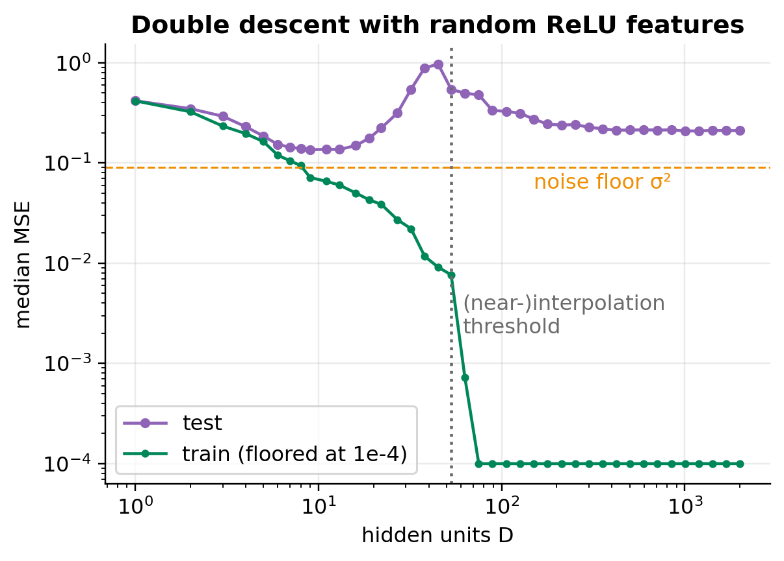
Chapter 8: double descent and high-D
10³⁶
bins per training example: 40 dims × 10 bins each, 10⁴ examples
3 × 10⁻²¹
fraction of a 40-D cube inside its inscribed sphere
→ 1
ratio of farthest to nearest neighbour as the dimension grows
Test error peaks around where the model first (almost) memorises the training set.
Notes:
Random frozen ReLU features plus min-norm least squares, 30 noisy points. The test error peaks at the interpolation threshold and then falls again. In this tiny 1D example it doesn't beat the classical sweet spot; on MNIST-1D with label noise in the book it does. Curse of dimensionality: in 40-D the inscribed sphere holds 3e-21 of the cube's volume.

Slide 9
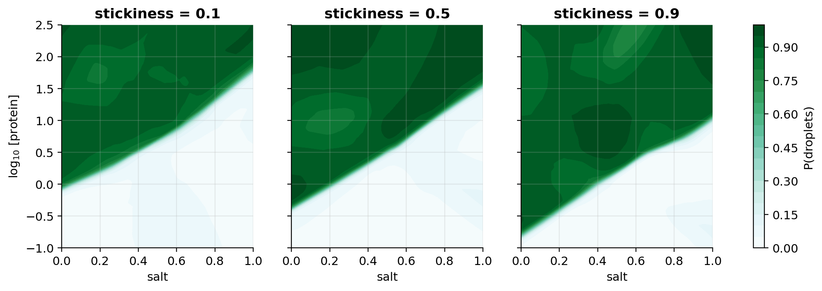
Capstone: from meerkats to molecules
Ch 5
Bernoulli + sigmoid → BCE
Ch 3–4
3-layer ReLU MLP
Ch 7
He initialisation
Ch 6
Adam on minibatches
Ch 8
Tune on validation, test once
Toy synthetic data with 6% of labels flipped. Reference model: 93% validation accuracy (ceiling ≈ 94%).
Notes:
Toy synthetic phase-separation data, NOT TBio data: log concentration, salt, stickiness; 6% of labels flipped. Students combine every chapter. The reference solution reaches 93% validation accuracy against a ~94% label-noise ceiling.

Slide 10
Hands-on: 10 puzzles, 23 points
Part | Puzzles | Points | Time
7 · Gradients | Toy backprop · deep backprop vs autograd ★★★ · ReLU moments · predict the explosion | 8 | ~25 min
8 · Performance | Confident mistakes · closed-form fit · bias & variance ★★★ · double descent · curse of dim. · challenge: Call Classifier Cup | 12 | ~30 min
9 · Capstone | Condensate phase diagram (≥ 88% validation accuracy) | 3 | ~15 min
Open: TBio_UDL_S3_….ipynb in Colab, run Setup (and the carry-over cell), then work top to bottom.
Short on time? Leave stretch puzzles 7.4, 8.5, Challenge 8 for afterwards; they still count. Stuck? Run the solution cell so later parts work.
Notes:
Hand over to the notebook. Suggested pacing per part is in the table and in the notebook's intro.

Slide 11
Discussion and next session
1
Bias vs variance on our data
With ~100 measured proteins, where does variance dominate? What would reduce it?
NEXT: CHAPTER 9
Regularisation
Why do over-parameterised networks generalise at all? Weight decay, early stopping, ensembling, dropout, implicit regularisation of SGD.
2
Choosing a distribution
Condensate count per cell? Droplet size? Partition coefficient? Pick a distribution and link for each.
3
When is bigger not better?
Double descent says over-parameterised models can generalise. When does that fail for assay data?
Notebooks: TBio_UDL_S1–S3 (open in Colab). Book: Prince, Understanding Deep Learning, MIT Press, free at udlbook.github.io
Notes:
Use these prompts after the notebook. Next session: chapter 9, regularization.

Slide 12
Questions?
Deep Learning in the Kalahari
Transition Bio ML Reading Group

