Slide 1




Deep Learning in the Kalahari
Understanding Deep Learning, chapters 1–8, in one hands-on hour
Transition Bio · ML Reading Group
Notes:
Welcome. One hour, eight chapters, one meerkat mob. The slides set up each puzzle; you solve it in the notebook; then we reveal the answer together.

Slide 2



WELCOME TO THE FIELD STATION
You've just joined a meerkat field station
The station studies a wild mob of about thirty meerkats. It has plenty of data and no deep-learning expert. Guess who that is now.
Every chapter of the book becomes a problem from the field: weighing pups, decoding alarm calls, finding the way home.
Colab: Runtime → Run all, then work top to bottom.
Stuck? Run the solution cell so later parts still work.
1 · The problem
A problem slide sets up the field problem in plain words, with the task you'll code.
2 · Your turn
Open the notebook in Colab, fill in the TODO, and run the check cell.
All data are synthetic, generated in the notebook, so every answer can be checked automatically.
3 · The solution
A solution slide explains the answer: first in plain words, then the maths.
Confidential and Proprietary | 2
Notes:
Set the scene: the field station has data and no deep-learning person. Explain the rhythm: problem slide, try it in Colab, solution slide. Everything is synthetic so the notebook can check answers automatically.

Slide 3










THE ROADMAP
Four questions, eight chapters, twelve puzzles
Ch 1–4
Ch 5
Ch 6–7
Ch 8
What function?
What is good?
How to find it?
Does it generalise?
Models: lines, clipped lines, folded space
Loss functions from probability
Optimisers, backprop, initialisation
Bias, variance, double descent
Puzzles
Puzzles
Puzzles
Puzzles
2.1 · 3.1 · C3 · 4.1
5.3 · 5.4 · 5.6
6.4 · C6 · 7.1
8.1 · 8.4
Confidential and Proprietary | 3
Notes:
The whole book in four questions. Chapters 1–4: what function? 5: what counts as good? 6–7: how do we find it? 8: does it work on new data?

Slide 4





CHAPTER 1 · INTRODUCTION
Three ways a machine can learn
Supervised
Unsupervised
Reinforcement
Learn x → y from labelled pairs.
Learn from x alone, no labels.
Act, change the state, get rewards.
Regression: a number (pup mass)
Classification: a category (which predator)
At TBio: sequence → does it form condensates?
Generative models make new examples
Latent variables z: simple hidden causes
At TBio: propose new sequences that look natural
Rewards arrive late: credit assignment
Which past action earned the reward?
Like: which of 20 protocol steps made it work?
Ethics (§1.3): bias, explainability and environmental cost matter here too. What data we train on shapes what the model believes.
Confidential and Proprietary | 4
Notes:
Three families. Supervised is most of what we do at TBio (sequence in, property out). Unsupervised and generative: learning structure, designing new sequences. RL: actions, delayed rewards, credit assignment. Ethics closes chapter 1: what we train on shapes what the model believes.

Slide 5
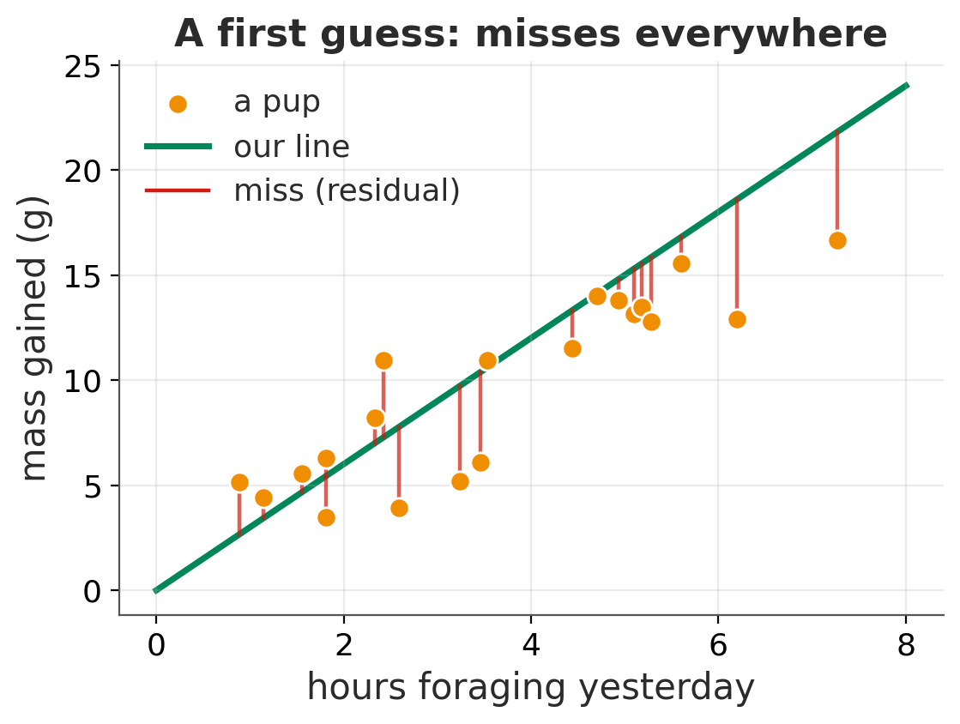


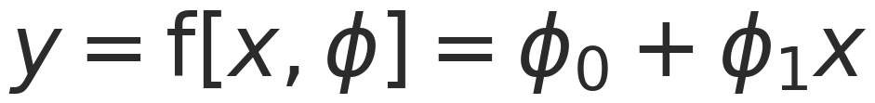
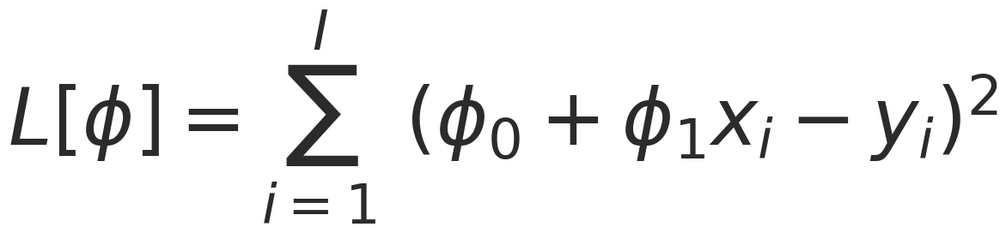
CHAPTER 2 · SUPERVISED LEARNING
The Great Pup Weigh-in: fitting a line
In plain words
Every morning the station weighs the pups (a boiled egg keeps them on the scale). Predict mass gained from hours foraging yesterday.
The model is a family of lines. Two knobs, intercept and slope, pick one line.
The loss adds up the squared misses. Training turns the knobs until the loss is smallest.
The detail
Confidential and Proprietary | 5
Notes:
Linear regression as the template for everything: a model family, a loss, and a search for the best parameters.

Slide 6


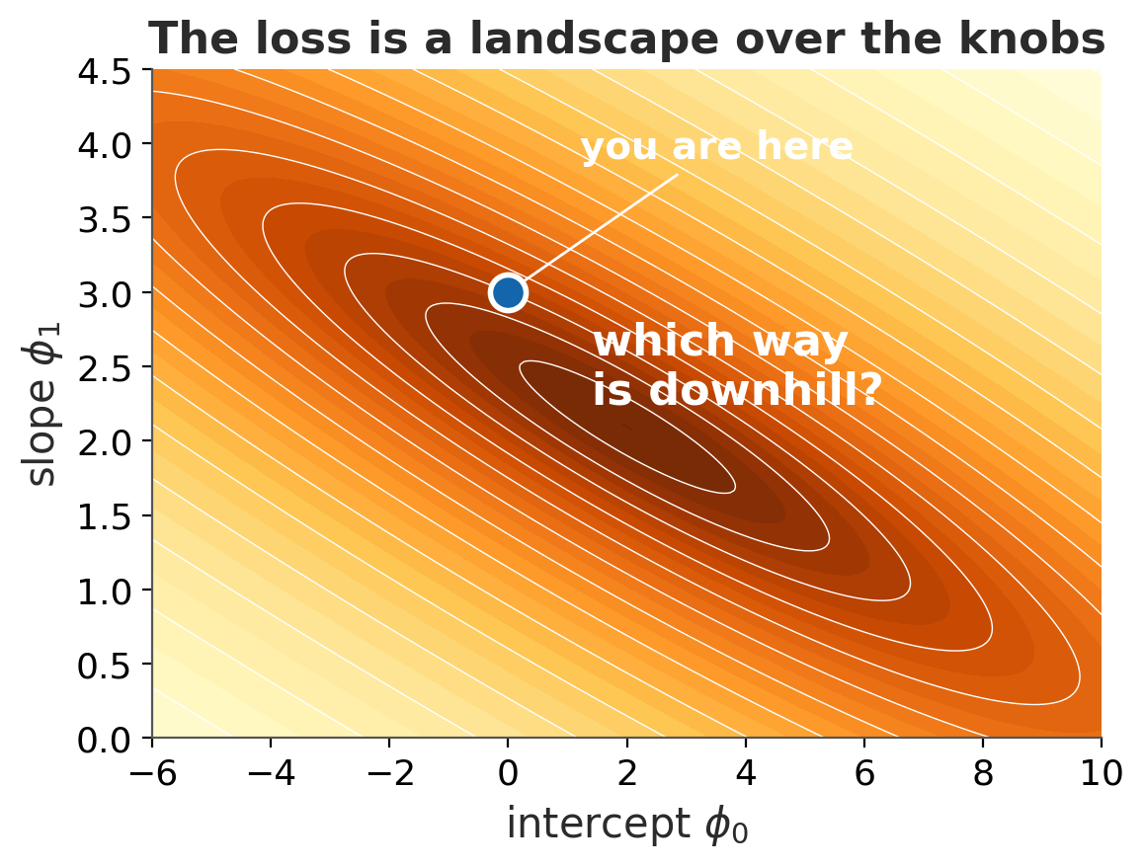

PUZZLE 2.1 · THE PROBLEM
Which way is downhill?
In the field
Every combination of the two knobs gives a line, and every line has a loss. Together they form a landscape: position = knob settings, height = how badly the line misses the pups.
You're standing at φ = [0, 3] in thick fog. Which direction takes you downhill fastest?
Your task (in the notebook)
Differentiate the loss with respect to each knob. Write rᵢ = φ₀ + φ₁xᵢ − yᵢ for each pup's miss.
Then implement:
def grad_ls(phi0, phi1, x, y):
return dL_dphi0, dL_dphi1
Confidential and Proprietary | 6
Notes:
Give people 3 minutes. The checker compares their gradient with a finite-difference estimate.

Slide 7

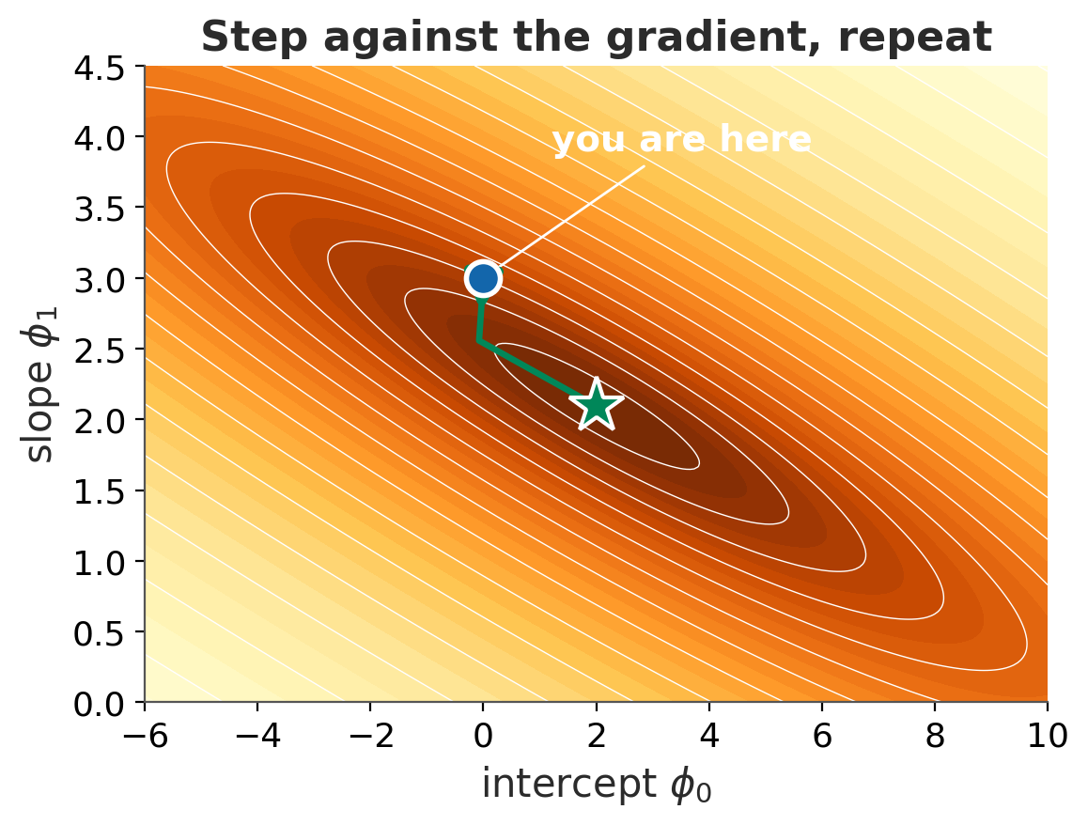
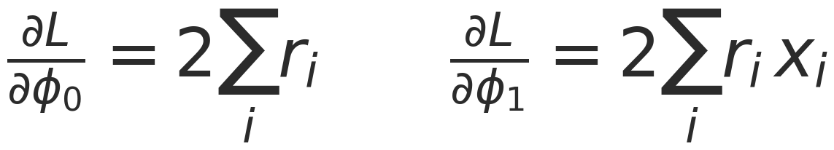
PUZZLE 2.1 · THE SOLUTION
Every pup tugs the line by its miss
In plain words
Each pup pulls on the line. The intercept feels the total of all the misses: if the line sits too high on average, lower it.
The slope feels each miss weighted by that pup's foraging hours. Pups far out on the x-axis have more leverage, like a longer lever arm.
Step against the tug, then repeat: that's gradient descent.
The detail
r = phi0 + phi1 * x - y
return 2 * np.sum(r), 2 * np.sum(r * x)
Confidential and Proprietary | 7
Notes:
The gradient points uphill; we step the other way. The notebook then runs gradient descent and shows it zig-zag along the valley (Fig 2.4).

Slide 8
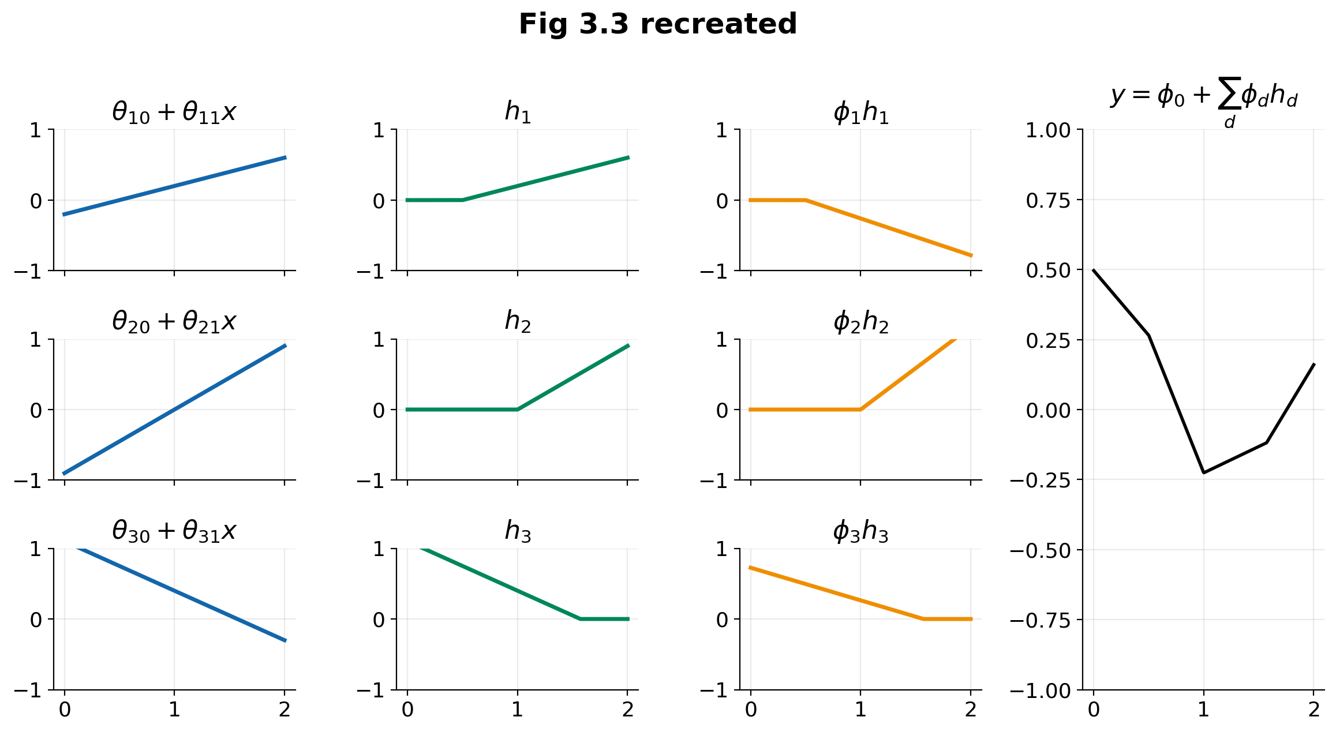
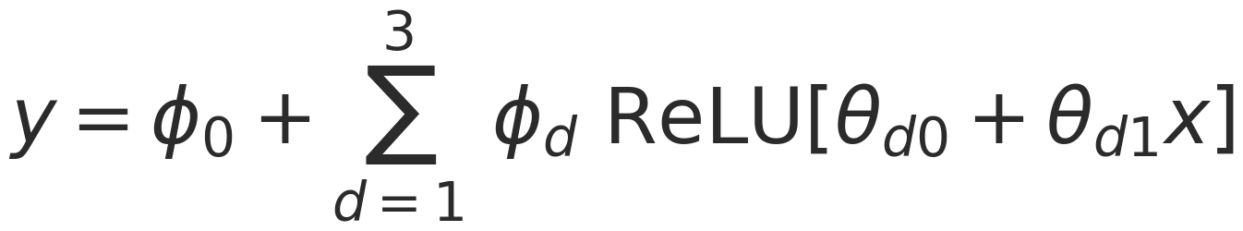
CHAPTER 3 · SHALLOW NEURAL NETWORKS
Neural networks are sums of clipped lines
In plain words
Each hidden unit is a straight line with its negative part clipped to zero (a ReLU). Think of a dose–response with a threshold: nothing happens until the input passes it.
Scale each clipped line and add them up, and you get a bendy line with joints. Enough units can draw any shape: the universal approximation theorem.
The detail
Three stages: linear functions → clip at zero → weighted sum. D units give at most D+1 linear regions.
Confidential and Proprietary | 8
Notes:
This is Fig 3.3 recreated: three pre-activations, clipped, weighted, summed. Ten parameters in total.

Slide 9
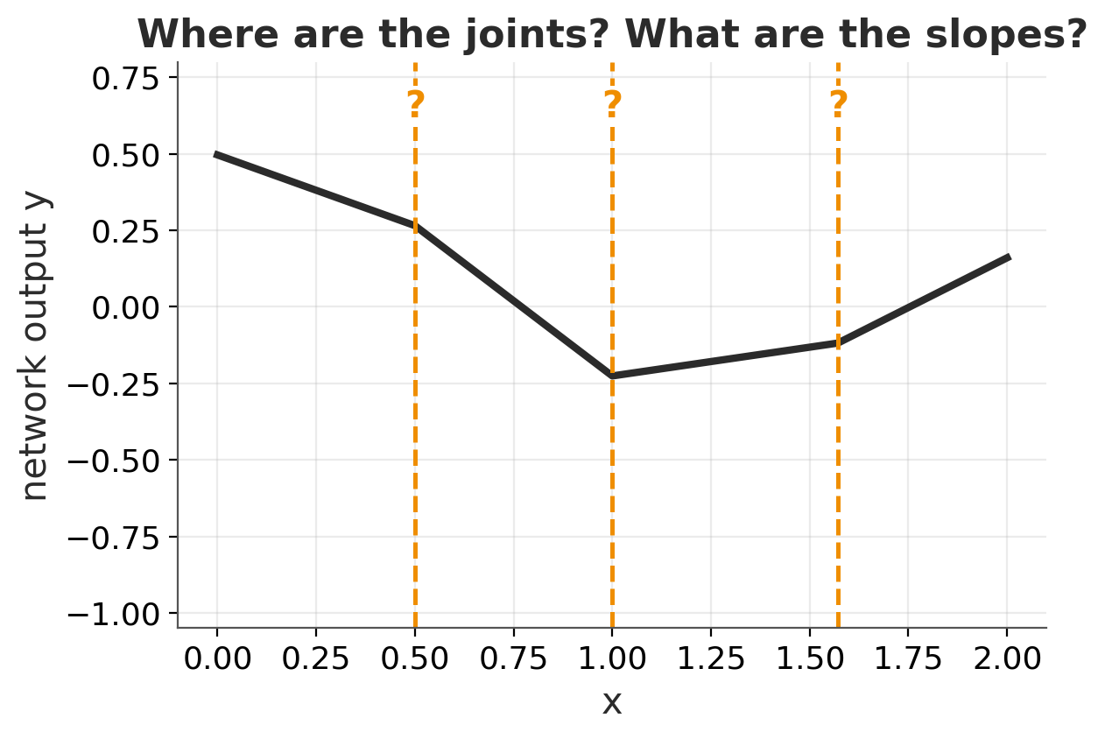

PUZZLE 3.1 · THE PROBLEM
Where are the joints? What are the slopes?
In the field
The book's 3-unit network turns ten numbers into the bent line on the right.
Before running anything: could you predict where it bends and how steep each piece is, just from the ten numbers?
Your task (in the notebook)
Implement two functions. region_slopes returns the slopes left to right: four values for three joints.
def joints(theta): # sorted x of each bend
def region_slopes(phi, theta):
Confidential and Proprietary | 9
Notes:
Hint if people are stuck: a unit switches where its linear function crosses zero.

Slide 10
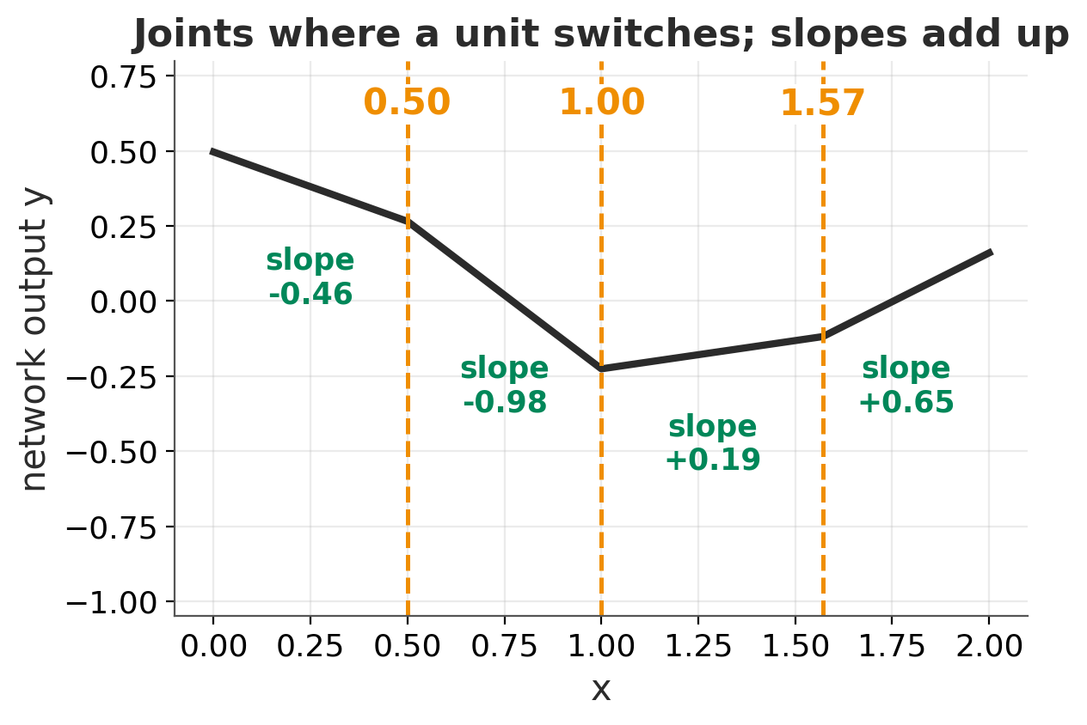
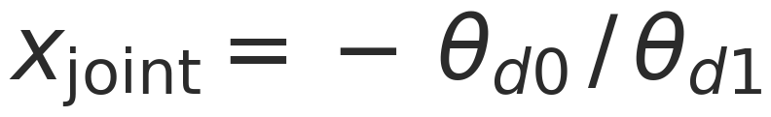
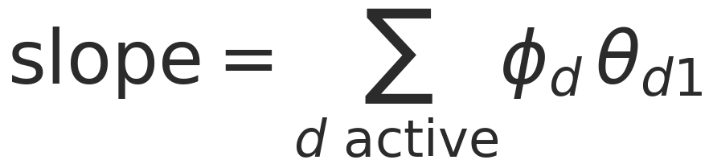
PUZZLE 3.1 · THE SOLUTION
A joint is where one unit switches on or off
In plain words
Each unit is a switch with a threshold, like a receptor that only fires above a ligand concentration. The curve bends exactly where a unit switches.
Between bends, the slope is the sum of the units that are on.
The detail
j = np.sort(-theta[:, 0] / theta[:, 1])
on = theta[:, 0] + theta[:, 1] * x_mid > 0
slope = np.sum(phi[1:][on] * theta[on, 1])
Confidential and Proprietary | 10
Notes:
Each region is one activation pattern: which units are on and which are clipped.

Slide 11

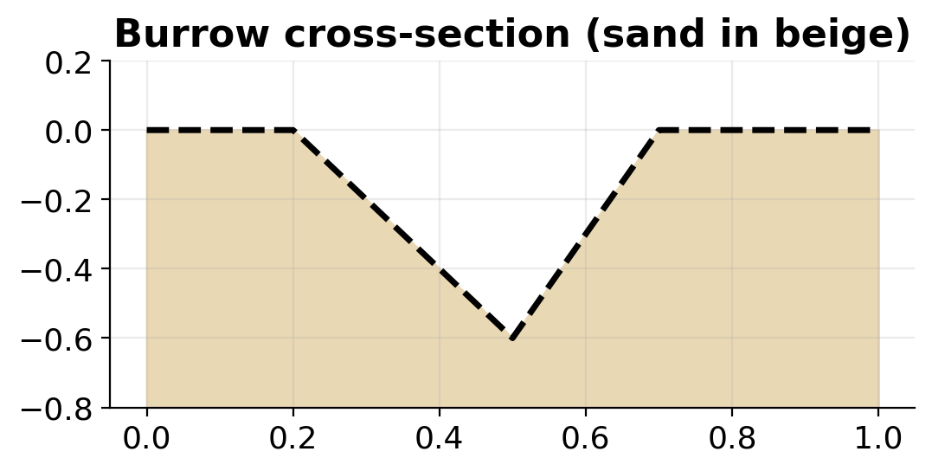



CHALLENGE 3 · THE PROBLEM
Dig the burrow
In the field
The mob's main burrow has a known cross-section: flat, down, up, flat.
Hand-pick the ten parameters of a 3-unit network so that it traces the burrow exactly on x ∈ [0, 1].
Your task (in the notebook)
Set my_phi and my_theta in the notebook.
my_phi = [phi0, phi1, phi2, phi3]
my_theta = [[th10, th11], [th20, th21],
[th30, th31]]
MSE < 0.01
< 0.001
exact
Confidential and Proprietary | 11
Notes:
Strategy hint: find the three bends and how much the slope changes at each one.

Slide 12
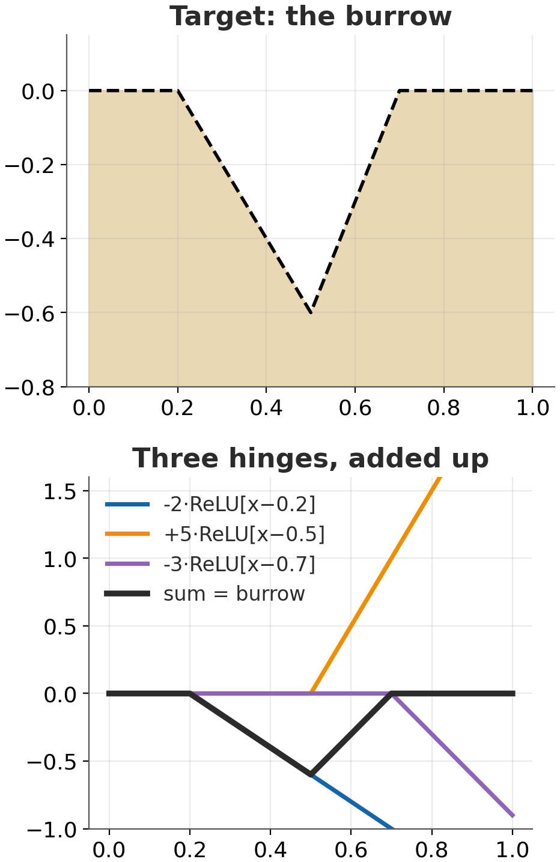
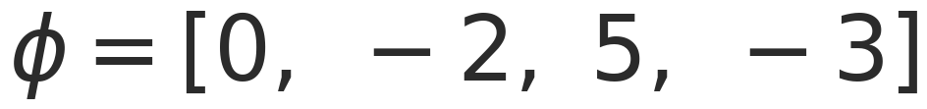
CHALLENGE 3 · THE SOLUTION
One hinge at each bend, sized by the change in slope
In plain words
Walk along the burrow from the left:
At 0.2 the slope goes 0 → −2: add a hinge of −2.
At 0.5 it goes −2 → +3: a change of +5.
At 0.7 it goes +3 → 0: a change of −3.
Each unit φ ReLU[x − c] is flat until c, then rises with slope φ. Three bends, three units.
The detail
MSE = 0: gold
Confidential and Proprietary | 12
Notes:
A neat way to see that a shallow net is a sum of hinges. The same logic with many units gives universal approximation.

Slide 13
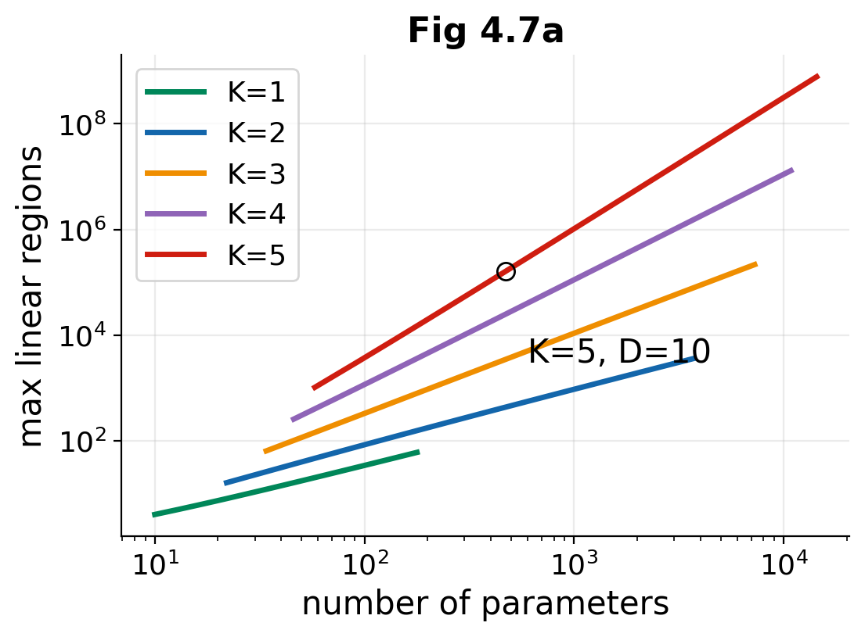
CHAPTER 4 · DEEP NEURAL NETWORKS
Deep networks fold space
In plain words
Feed one network's output into another. The first network folds the input like paper: several inputs land on the same point.
Whatever the second network draws is then copied onto every fold. Depth multiplies the number of regions; width only adds to it.
The detail
Max linear regions, D units per layer:
Shallow: D + 1
K layers: (D + 1)ᴷ, with far fewer parameters per region
Confidential and Proprietary | 13
Notes:
The plot shows regions per parameter: deeper networks get many more regions for the same parameter budget.

Slide 14
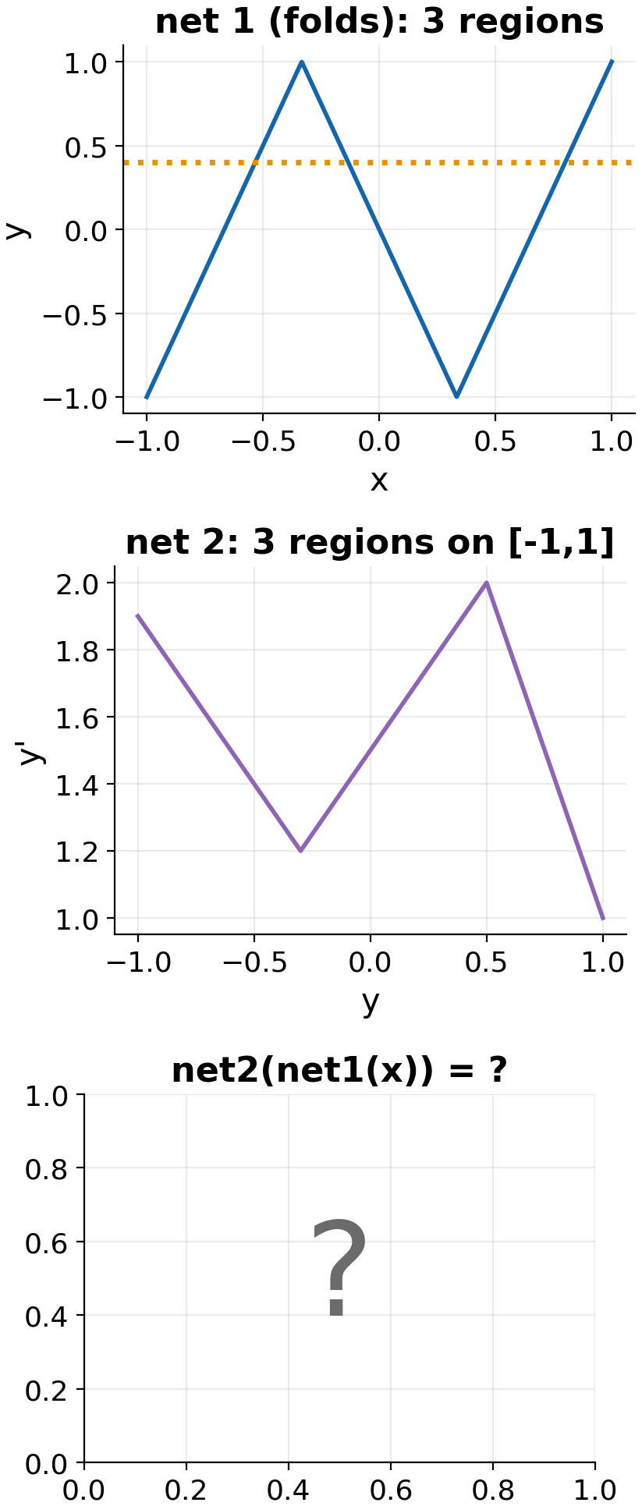
PUZZLE 4.1 · THE PROBLEM
Predict the folds
In the field
Net 1 zig-zags across [−1, 1] in three pieces: up, down, up. Net 2 has three linear regions on [−1, 1].
Now chain them: net2(net1(x)). How many linear regions does the result have on [−1, 1]?
Your task (in the notebook)
Write down your prediction before you run the cell that plots it.
my_prediction = ?
Confidential and Proprietary | 14
Notes:
Quick one, 3 minutes. Ask for a show of hands before revealing.

Slide 15
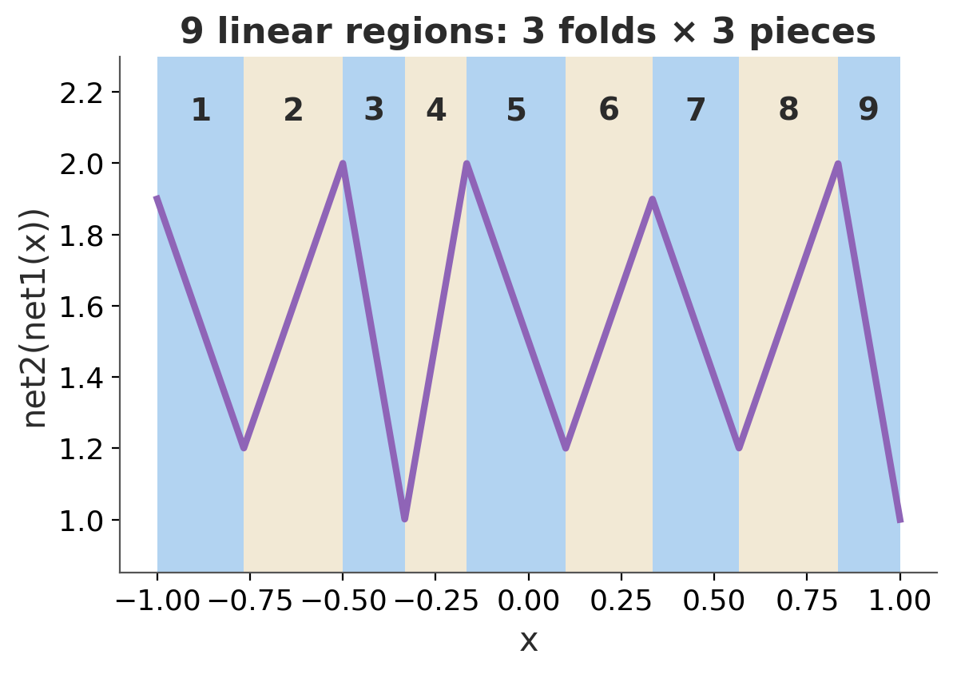
PUZZLE 4.1 · THE SOLUTION
Nine regions: three folds × three pieces
In plain words
Net 1 sweeps across the whole range three times. On each sweep, the input passes through all three of net 2's regions.
So net 2's shape is replayed three times (mirrored on the downward sweep): 3 × 3 = 9.
The detail
Composition multiplies region counts. With K layers of D units:
my_prediction = 9
Confidential and Proprietary | 15
Notes:
This is why depth is efficient: exponential regions for polynomial parameters (§4.5).

Slide 16
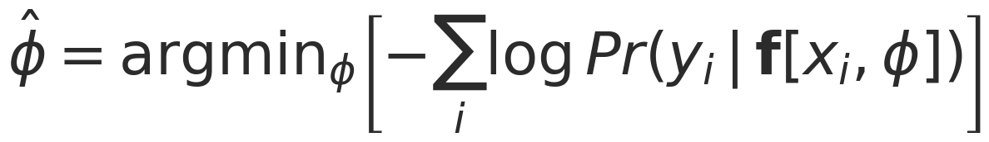

CHAPTER 5 · LOSS FUNCTIONS
One recipe for every loss function
In plain words
 | You measure | Distribution | Final activation | Loss | Meerkat example
 | A number | Normal | none | least squares | pup mass gain
 | Yes / no | Bernoulli | sigmoid | binary cross-entropy | sentinel duty?
 | One of K | Categorical | softmax | cross-entropy | eagle, jackal or cobra
 | A count | Poisson | exp | Poisson NLL | scorpions per hour
 | An angle | von Mises | none | −κ cos(y − μ) | heading home
Don't predict the answer. Predict a probability distribution over answers, then pick the knobs that make the observed data most likely.
1. Choose a distribution that fits what you measure
2. The network predicts its parameters
3. Minimise the negative log-likelihood
4. Predict with the distribution's peak
Least squares isn't an arbitrary choice: it is maximum likelihood under Gaussian noise.
Confidential and Proprietary | 16
Notes:
The single most useful idea in chapter 5: choose a distribution that matches what you measure, have the network predict its parameters, and minimise the negative log-likelihood.

Slide 17
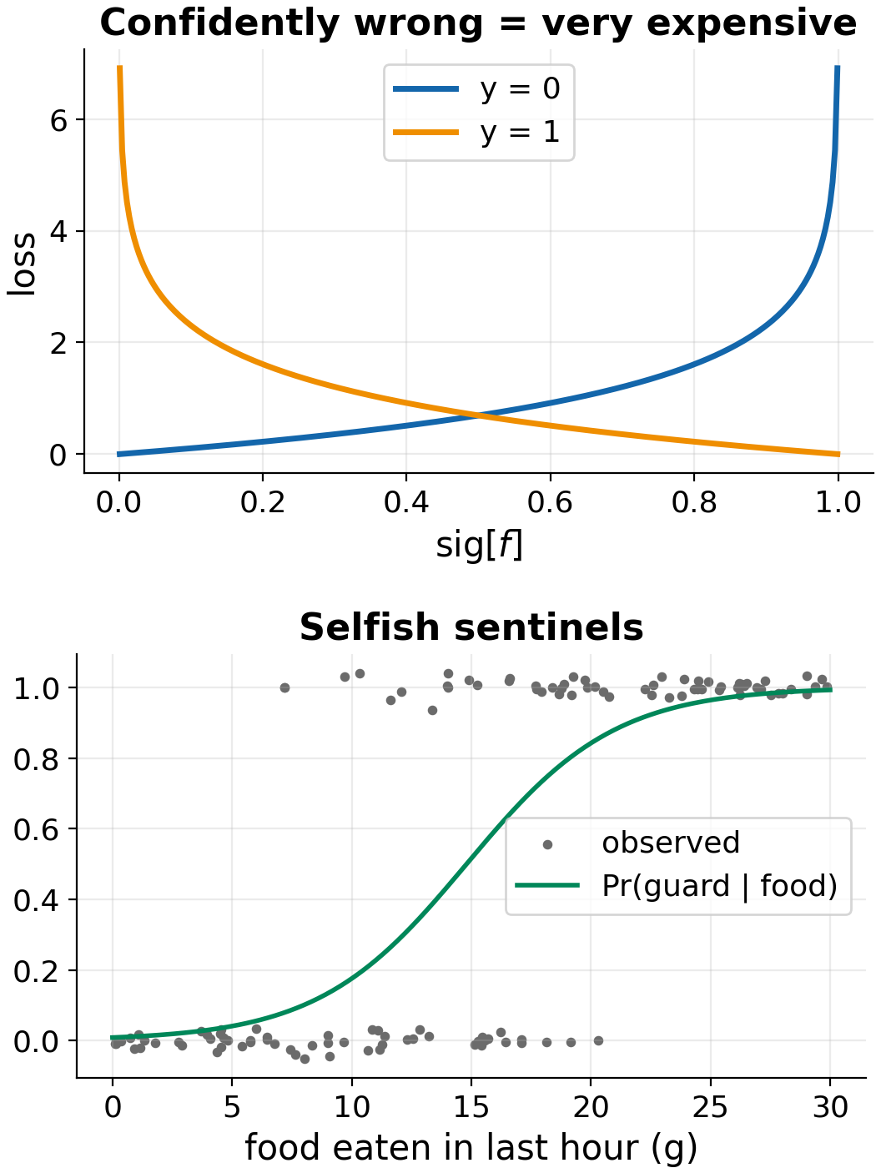
PUZZLE 5.3 · THE PROBLEM
Will this meerkat go on sentinel duty?
In the field
Meerkats tend to stand guard once they've eaten well: a full stomach makes guarding cheap.
From grams eaten in the last hour, the network outputs a score f. The sigmoid turns it into a probability of going on guard.
Your task (in the notebook)
Show that the gradient of the loss with respect to f is sig[f] − y. Then write a numerically stable loss: no log(0) when |f| is large.
def bce_from_logits(f, y):
def bce_grad_logits(f, y):
Confidential and Proprietary | 17
Notes:
Left plot: being confidently wrong is very expensive. Right: the fitted 'selfish sentinel' curve. Hint: −log sig[f] = softplus[−f], and np.logaddexp(0, z) is a safe log(1 + eˣ).

Slide 18
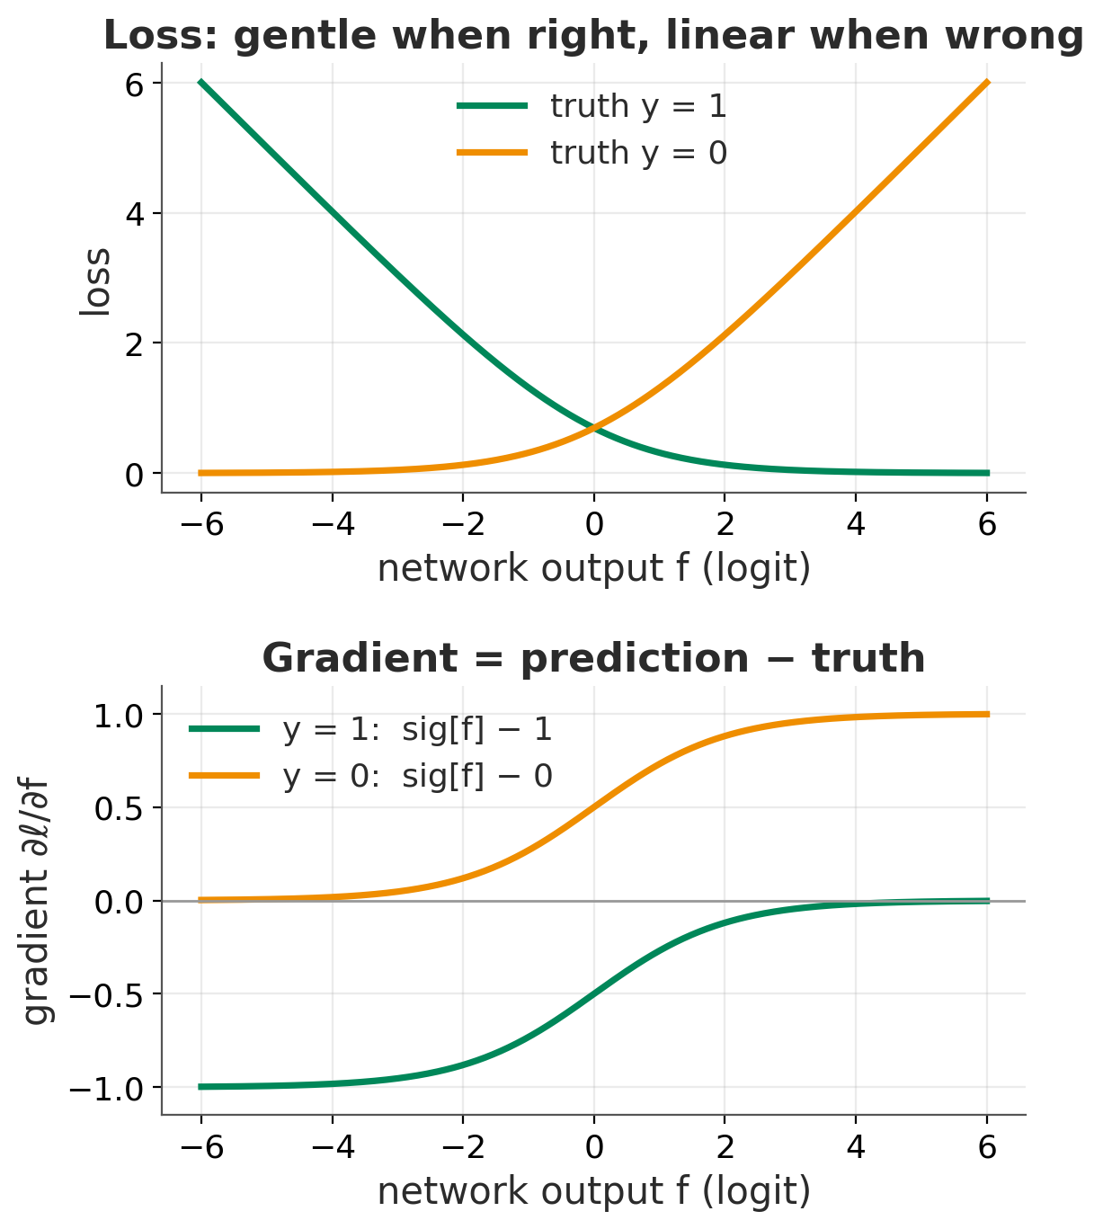
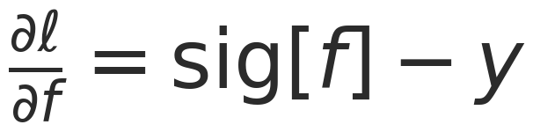
PUZZLE 5.3 · THE SOLUTION
The gradient is prediction minus truth
In plain words
The correction is simply how surprised the model was.
Said 90% guard, the meerkat didn't: push down by 0.9.
Said 95%, it did: nudge by just 0.05.
Confident and wrong gets a full push, but never more than 1.
The detail
loss = np.sum(y * np.logaddexp(0, -f)
+ (1 - y) * np.logaddexp(0, f))
grad = 1 / (1 + np.exp(-f)) - y
Confidential and Proprietary | 18
Notes:
The same 'prediction minus truth' gradient appears for softmax with multiclass cross-entropy and for least squares. It's why these pairings train so well.

Slide 19
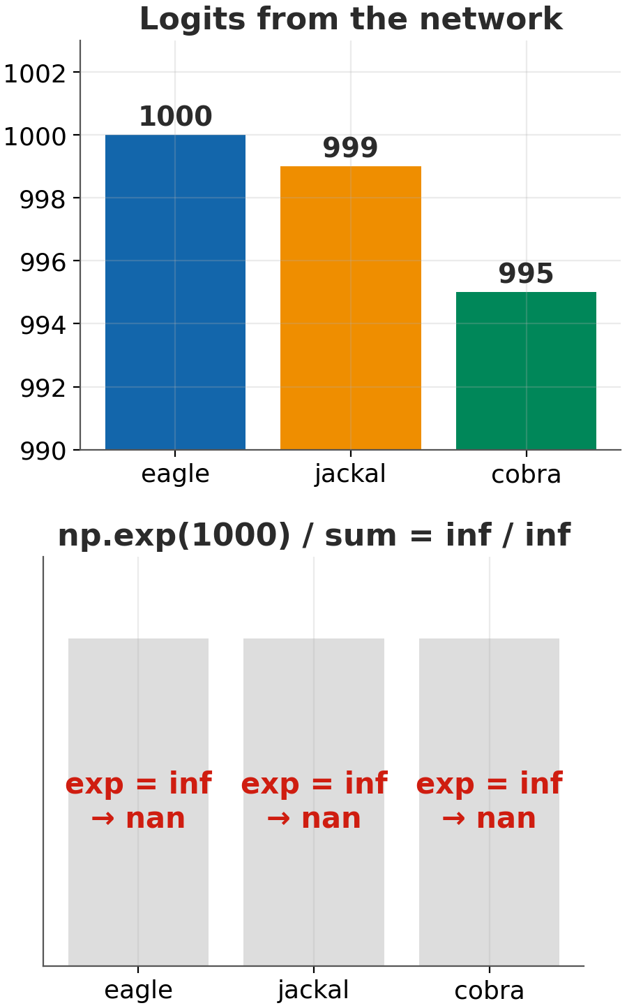
PUZZLE 5.4 · THE PROBLEM
Decoding alarm calls without blowing up
In the field
Meerkats use different alarm calls for eagles, jackals and cobras. From a call's pitch and duration, the network outputs three scores, and softmax turns them into probabilities.
A very confident network can output scores like 1000, and np.exp(1000) is inf. Then inf / inf = nan.
Your task (in the notebook)
Write a softmax that never overflows. Columns are examples, so normalise over axis 0.
def softmax(z): # (K, N) -> (K, N)
Confidential and Proprietary | 19
Notes:
Hint: you can subtract the same constant from every score without changing the answer.

Slide 20
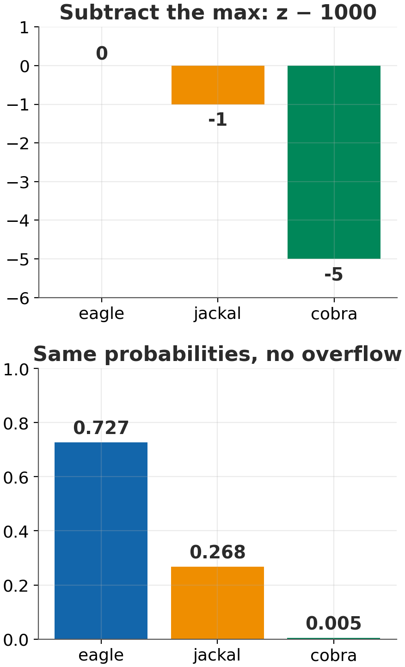
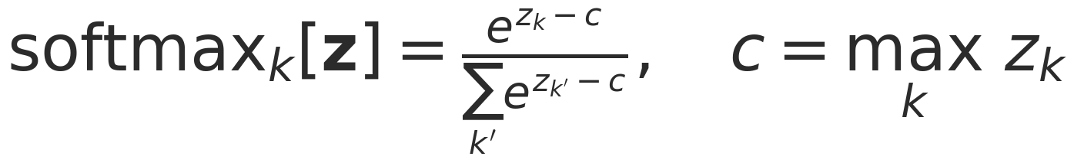
PUZZLE 5.4 · THE SOLUTION
Subtract the biggest score first
In plain words
Softmax only cares about the differences between scores. It's like relative fluorescence: subtracting the same background from every channel doesn't change the ratios.
Subtract the largest score and the biggest exponent becomes e⁰ = 1, so nothing can overflow.
The detail
e = np.exp(z - z.max(axis=0, keepdims=True))
return e / e.sum(axis=0, keepdims=True)
Confidential and Proprietary | 20
Notes:
Every deep-learning library does this internally (log-sum-exp trick). It's why you pass logits, not probabilities, to the loss.

Slide 21
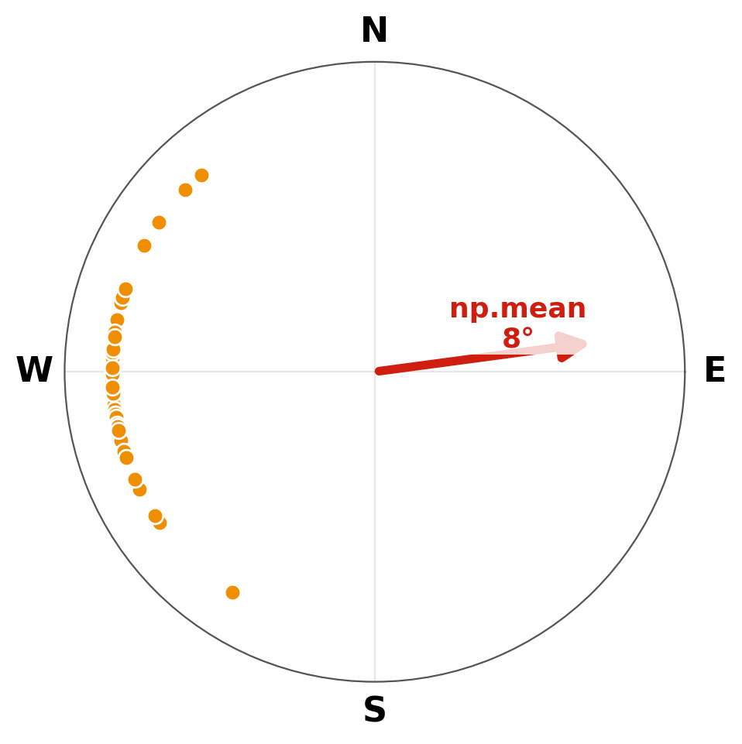
PUZZLE 5.6 · THE PROBLEM
Which way is the burrow?
In the field
At dusk, each foraging group heads home: roughly due west.
But headings are angles, and angles wrap around: +179° and −179° are only 2° apart. Take the ordinary average of these headings and see where it sends the mob.
Your task (in the notebook)
For a constant model μ, minimise the von Mises loss and show that the best μ satisfies Σ sin(yᵢ − μ) = 0. Then implement it and compare with np.mean.
def vonmises_mu_mle(angles):
Confidential and Proprietary | 21
Notes:
np.mean on these headings gives about 8°, which is due east: the opposite of home.

Slide 22
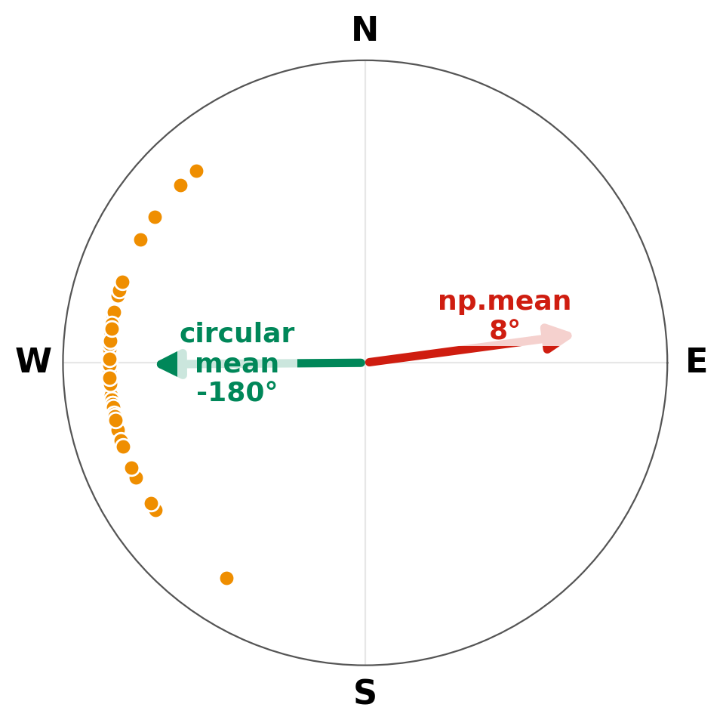
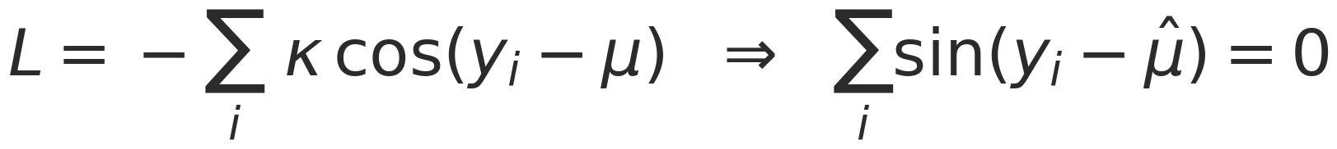
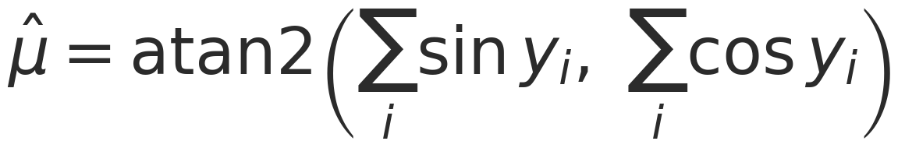
PUZZLE 5.6 · THE SOLUTION
Average the arrows, not the numbers
In plain words
Treat each heading as a little arrow. Add the arrows head to tail and read off where the total points.
Same trick as for circadian phase or cell-migration direction: the ordinary mean of angles breaks at the wrap-around.
The detail
np.arctan2(np.sin(a).sum(), np.cos(a).sum())
Confidential and Proprietary | 22
Notes:
Least squares on raw angles would send the mob off due east. Picking the right distribution matters.

Slide 23
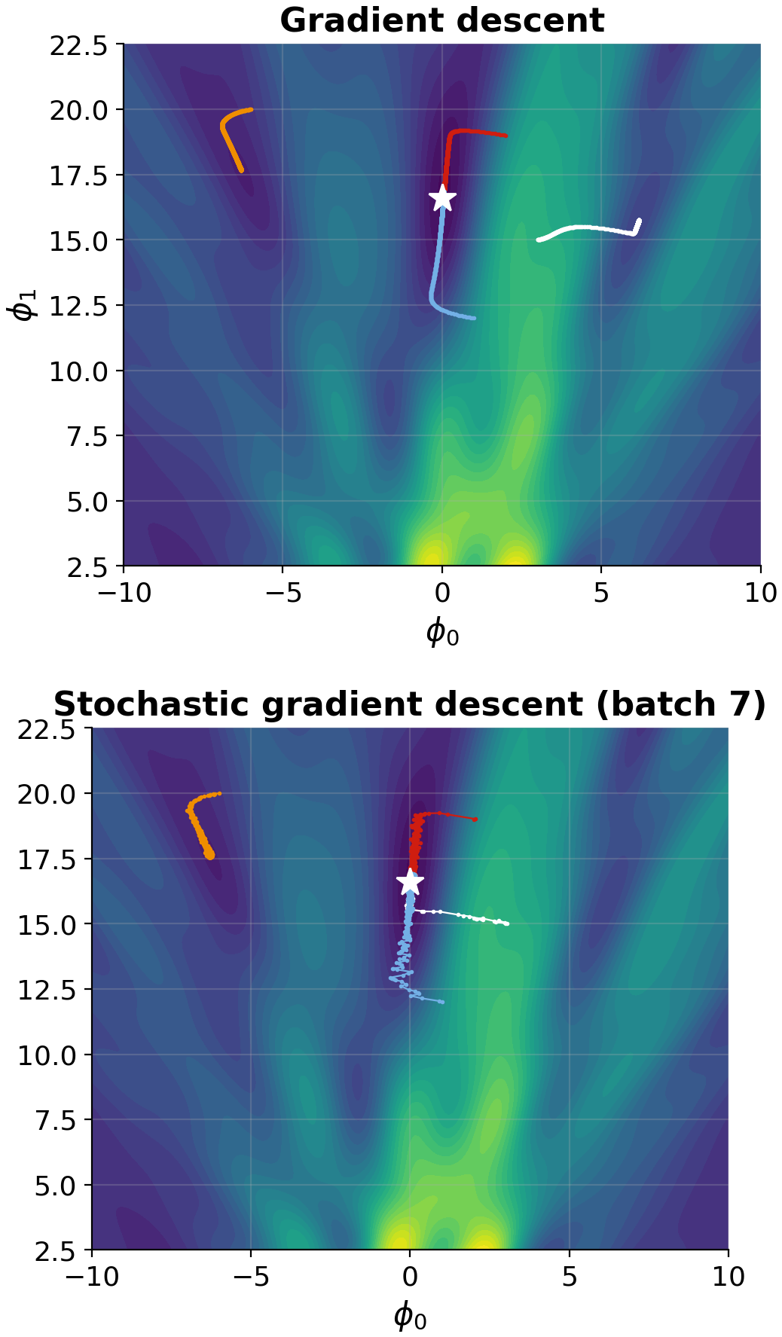
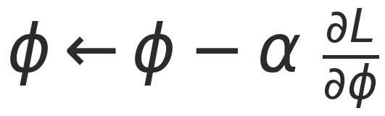
CHAPTER 6 · FITTING MODELS
Walking downhill in the fog
In plain words
Gradient descent: feel the slope, take a step downhill, repeat. Real network losses are bumpy, with many dips and flat stretches.
SGD uses a random handful of examples per step: cheap and noisy, and the noise helps it escape bad dips.
Momentum builds up speed like a rolling ball. Adam also gives every direction a similar step size.
The detail
α is the learning rate: the step length. One pass through all the data is an epoch.
Confidential and Proprietary | 23
Notes:
The plot is Fig 6.5: full-batch gradient descent gets stuck in local minima of the Gabor model; SGD's noise lets it escape.

Slide 24
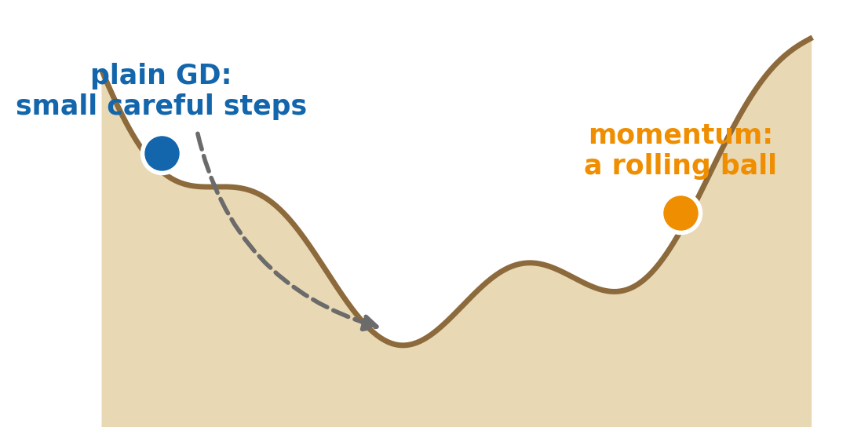
PUZZLE 6.4 · THE PROBLEM
Build three better walkers
In the field
Plain gradient descent zig-zags across narrow valleys and crawls along flat ones.
Build the three upgrades straight from the book's equations, then race them on a long, narrow valley.
Your task (in the notebook)
Each optimiser returns its path, including the start:
def momentum(grad_fn, phi, alpha, beta, n_steps):
def nesterov(...): # grad at phi - alpha*beta*m
def adam(grad_fn, phi, alpha, beta, gamma, ...):
Confidential and Proprietary | 24
Notes:
Equations 6.11 (momentum), 6.12 (Nesterov) and 6.15–6.17 (Adam). For Adam, use t+1 in the bias-correction exponents.

Slide 25
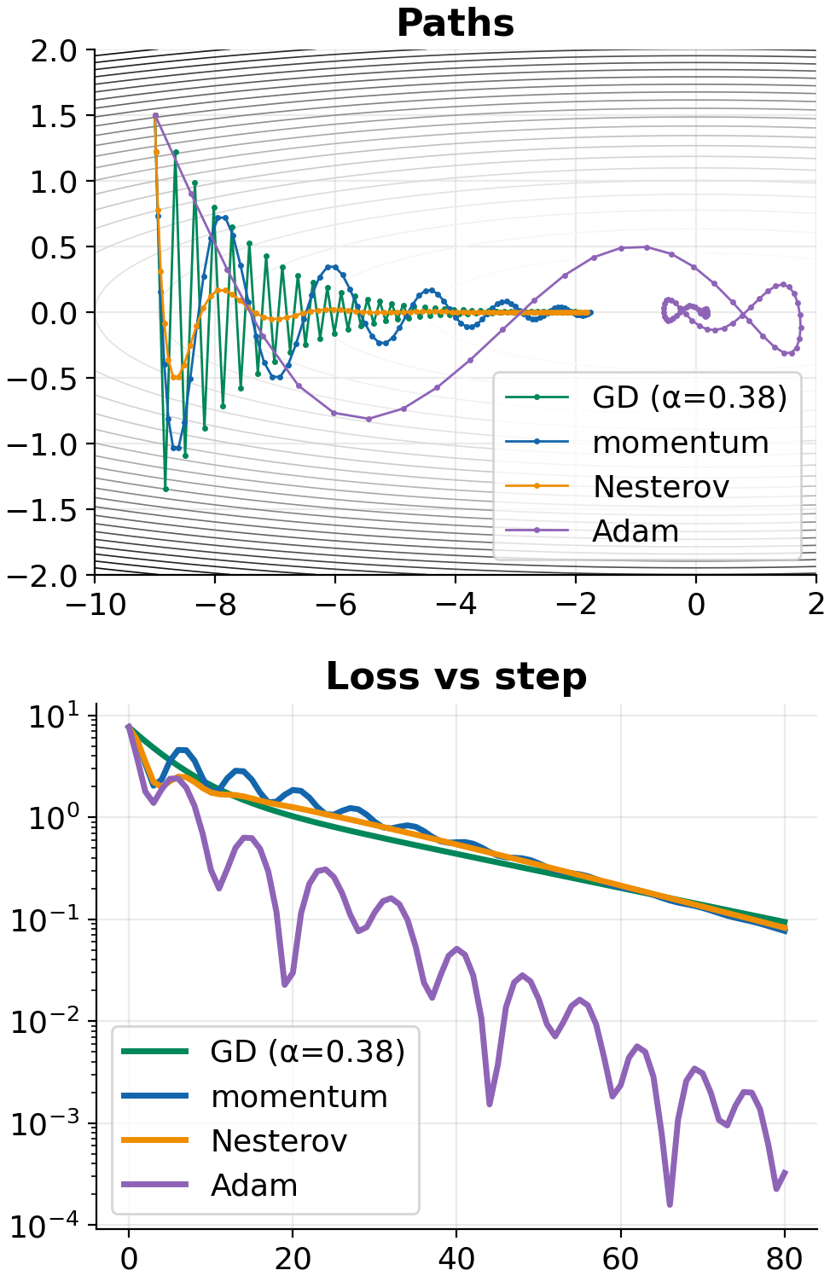
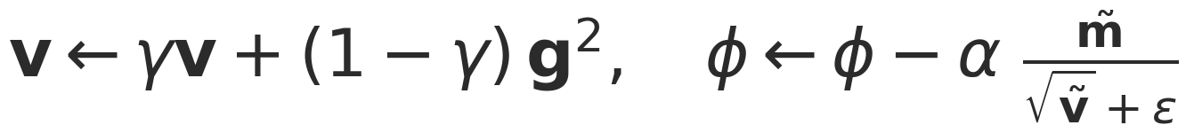
PUZZLE 6.4 · THE SOLUTION
Momentum remembers; Adam rescales
In plain words
Momentum keeps a running average of recent gradients, so consistent directions add up and zig-zags cancel out.
Nesterov peeks at where momentum is about to carry you and measures the slope there.
Adam also tracks each knob's typical gradient size and divides by it, so every knob moves at a similar pace.
The detail
m = beta*m + (1-beta)*g
v = gamma*v + (1-gamma)*g**2
mt, vt = m/(1-beta**(t+1)), v/(1-gamma**(t+1))
phi = phi - alpha*mt/(np.sqrt(vt)+eps)
Confidential and Proprietary | 25
Notes:
The tilde terms are the bias correction: m and v start at zero, so early estimates are too small without it.

Slide 26
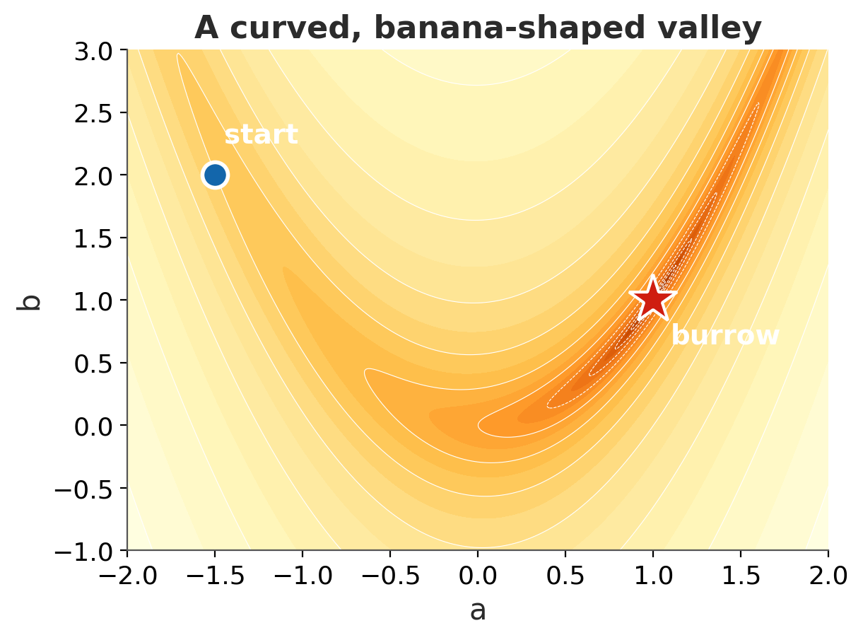

CHALLENGE 6 · THE PROBLEM
Race to the burrow
In the field
The dune function has a curved, banana-shaped valley. You start at (−1.5, 2); the burrow is at (1, 1).
Pick an optimiser and tune it. You arrive when the loss drops below 10⁻⁴. Fewer steps wins.
Your task (in the notebook)
Swap in momentum, nesterov or adam and tune the hyperparameters.
my_path = gd(dune_grad, [-1.5, 2.0],
lr=0.001, n=3000) # beat this
< 2,000 steps
< 600
< 200
Confidential and Proprietary | 26
Notes:
L(a, b) = (1 − a)² + 20 (b − a²)², a cousin of the Rosenbrock function.

Slide 27
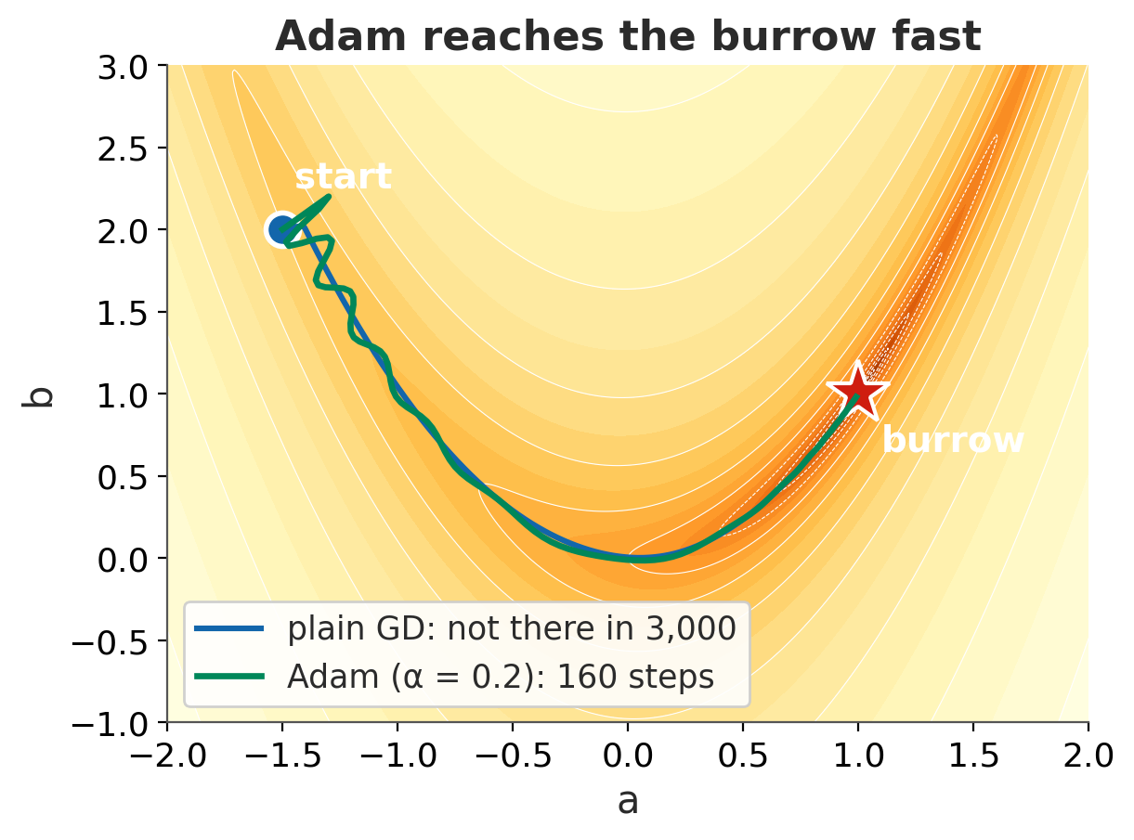
CHALLENGE 6 · THE SOLUTION
Adam reaches the burrow in 160 steps
In plain words
The valley floor is long and nearly flat, but its walls are steep.
Plain gradient descent has to take tiny steps so it doesn't bounce off the walls, so it crawls: still not home after 3,000 steps.
Adam divides by each direction's typical gradient size, so it can stride along the flat floor without bouncing.
The detail
adam(dune_grad, [-1.5, 2.0], alpha=0.2,
beta=0.9, gamma=0.99, n_steps=3000)
160 steps: gold
Momentum with a bigger learning rate can also reach silver or gold.
Confidential and Proprietary | 27
Notes:
Good moment to ask who got the fewest steps, and with what settings.

Slide 28
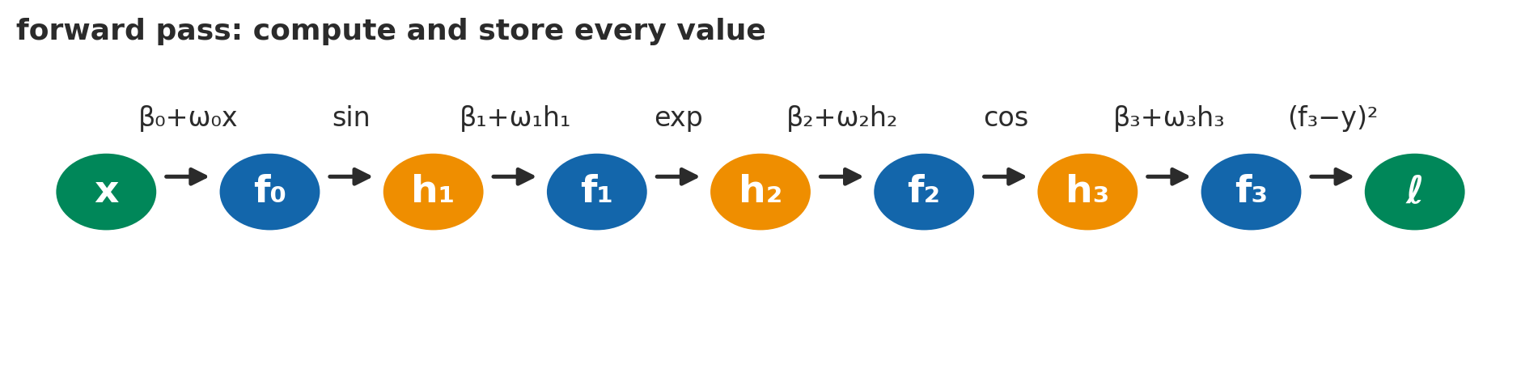
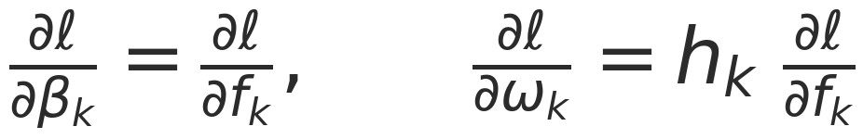
CHAPTER 7 · GRADIENTS AND INITIALISATION
Backprop: the chain rule with a good memory
In plain words
The detail
To learn, every knob needs to know how it affects the loss. Pass the error backwards, one stage at a time, like tracing a signalling cascade back from the phenotype.
Each stage multiplies by how sensitive it is to its input. Store every value on the way forward so nothing is computed twice.
For a deep ReLU net the same rule becomes matrix products (eqs 7.24–7.26). PyTorch's loss.backward() does exactly this.
Confidential and Proprietary | 28
Notes:
Forward pass: compute and cache. Backward pass #1: gradients with respect to the intermediate values. Backward pass #2: gradients with respect to the parameters.

Slide 29
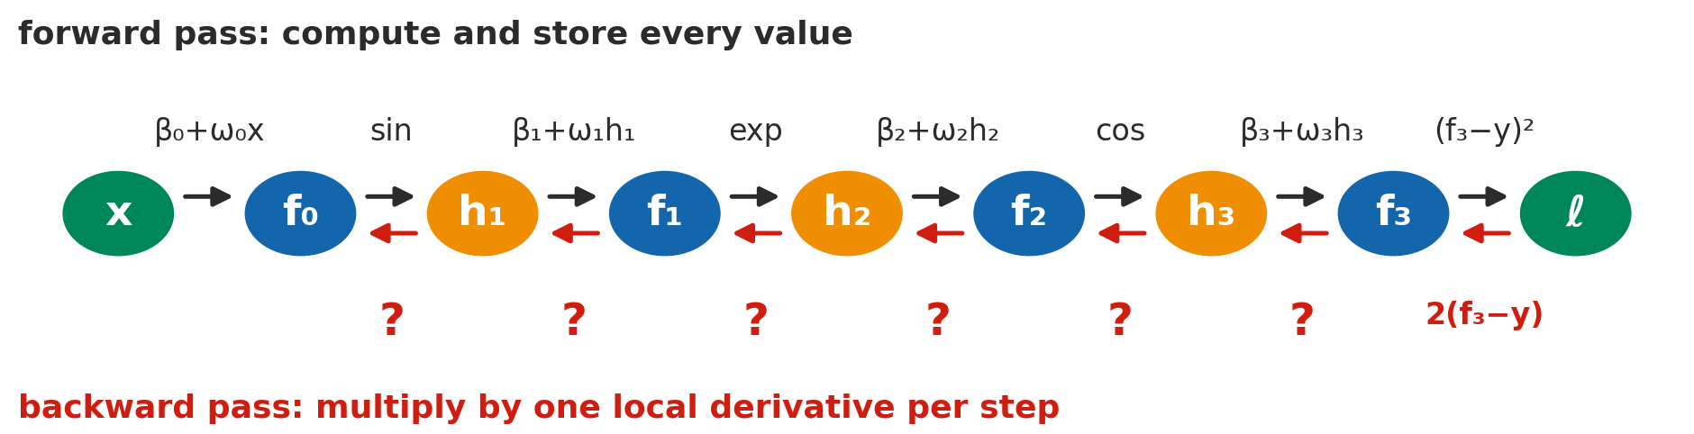
PUZZLE 7.1 · THE PROBLEM
Backprop the toy model by hand
In the field
Your task (in the notebook)
The book's toy model chains sin, exp and cos, one unit per layer. The forward pass is done and every value is stored.
Your job: send the error signal back down the chain, one link at a time.
Fill in toy_backward: every line is one multiplication by a local derivative.
dl_df3 = 2 * (v['f3'] - y)
dl_dh3 = ? # TODO
dl_df2 = ? # TODO ... down to dl_df0
Confidential and Proprietary | 29
Notes:
6 minutes. The checker compares with finite differences. Remind people: derivative of sin is cos, of exp is exp, of cos is −sin.

Slide 30
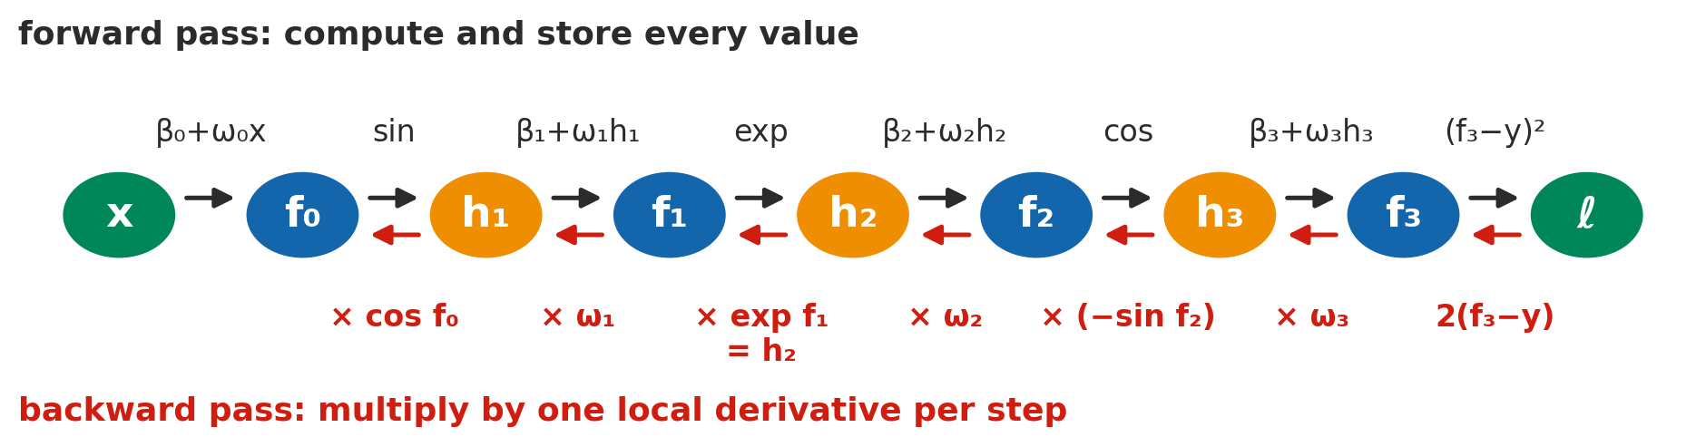
PUZZLE 7.1 · THE SOLUTION
One local derivative per link
In plain words
The detail
Walk backwards along the chain. At each link ask: if this changed a little, how much would the next one change? Then multiply.
For the weights, multiply by what flowed into them: ∂ℓ/∂ωₖ = hₖ · ∂ℓ/∂fₖ.
dl_dh3 = p['omega3'] * dl_df3
dl_df2 = -np.sin(v['f2']) * dl_dh3
dl_dh2 = p['omega2'] * dl_df2
dl_df1 = v['h2'] * dl_dh2 # exp' = exp
dl_dh1 = p['omega1'] * dl_df1
dl_df0 = np.cos(v['f0']) * dl_dh1
Confidential and Proprietary | 30
Notes:
Note the reuse: h2 = exp(f1) was cached in the forward pass, so the derivative of exp costs nothing.

Slide 31

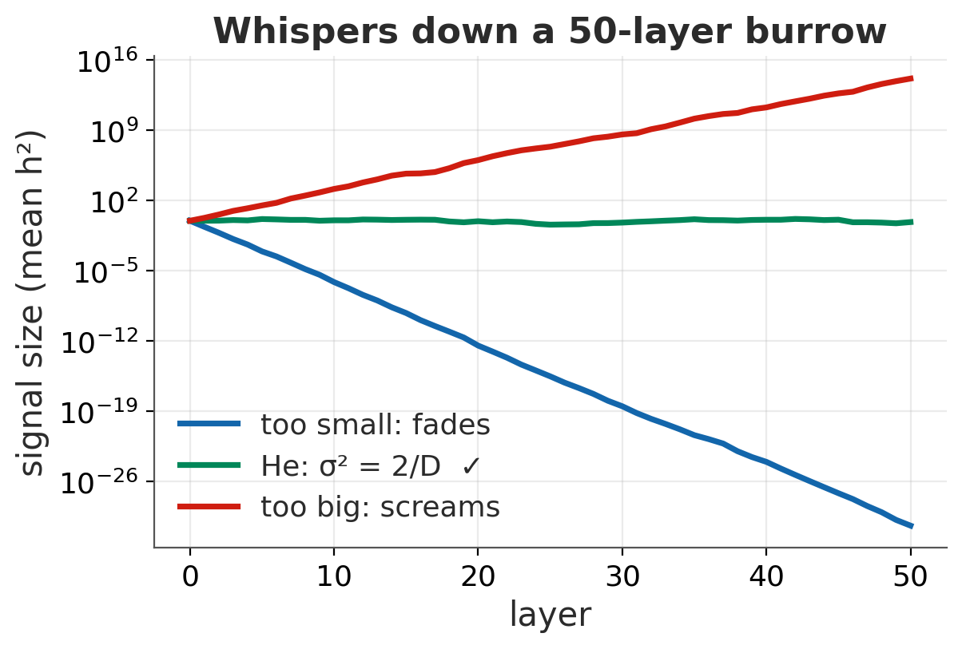
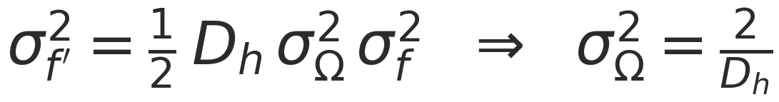
CHAPTER 7 · GRADIENTS AND INITIALISATION
Keep the whisper audible: He initialisation
In plain words
Whisper a message down a line of 50 meerkats and it either fades to nothing or becomes a scream. The signal in a deep network does the same.
So choose the random starting weights so that each layer keeps the signal the same size. For ReLU that means variance 2 / D: the 2 makes up for ReLU zeroing half the signal.
The detail
The same argument backwards uses the next layer's width; a compromise is 4 / (Dₕ + Dₕ′).
Confidential and Proprietary | 31
Notes:
Recreates the idea of Fig 7.7: 50 layers of 100 units. Too small fades, too big explodes, He stays flat.

Slide 32
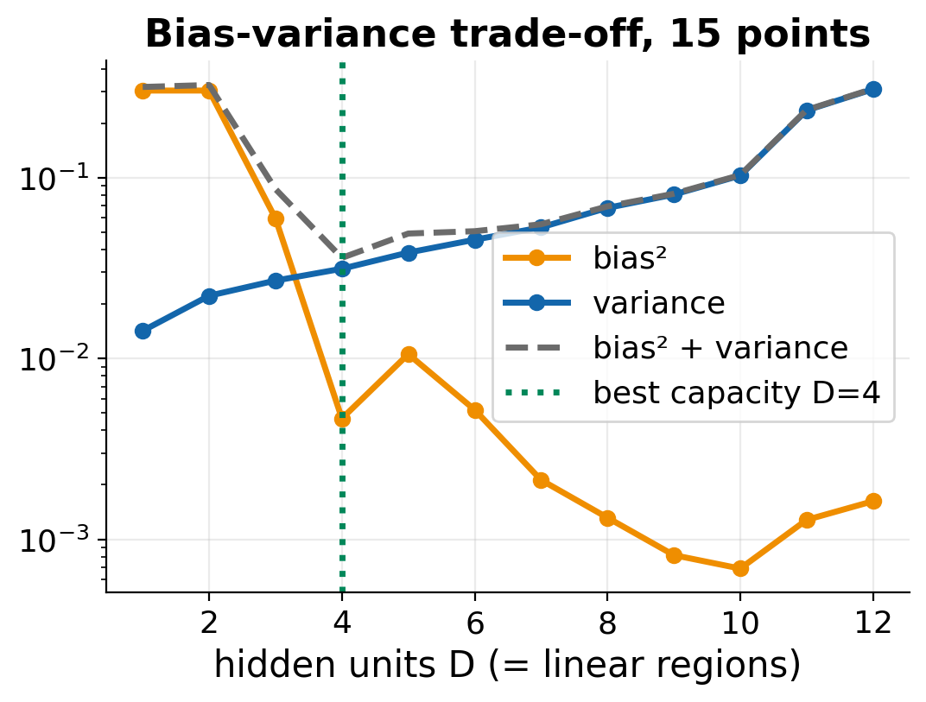
CHAPTER 8 · MEASURING PERFORMANCE
Does it work on meerkats it has never heard?
In plain words
Always test on data the model has never seen. Test error comes from three places:
Noise: the measurement itself. You can't beat it.
Bias: the model is too simple to capture the truth.
Variance: the model chases the quirks of this particular training set.
More data cuts variance. More capacity cuts bias but usually raises variance.
The detail
Choose hyperparameters on a validation set; touch the test set once.
Confidential and Proprietary | 32
Notes:
The plot measures bias² and variance exactly by refitting on many synthetic datasets (Fig 8.9). Best capacity balances the two.

Slide 33
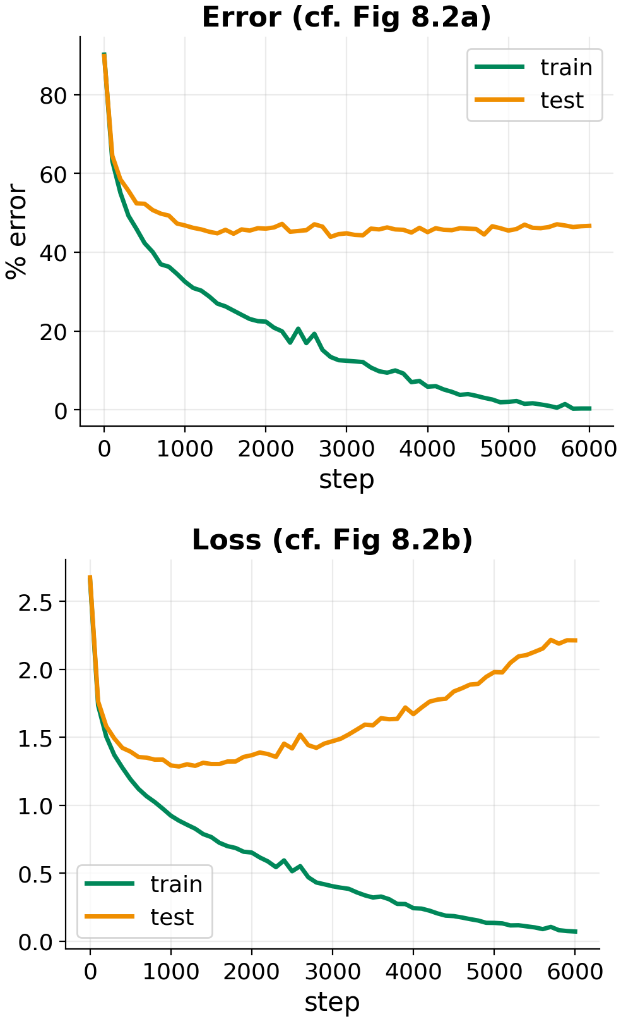
PUZZLE 8.1 · THE PROBLEM
Test loss goes up, test error stays flat?
In the field
Training the meerkat call classifier: late in training, the test loss climbs while the test error stays flat. Why?
Your task (in the notebook)
(a) the learning rate is too high, so the optimiser diverges
(b) the model makes the same mistakes, with growing confidence
(c) the test set is mislabelled
(d) ReLUs die during training
answer_8_1 = '?'
Confidential and Proprietary | 33
Notes:
Quick question, 1 minute. Vote with fingers: 1 to 4.

Slide 34
PUZZLE 8.1 · THE SOLUTION
(b) Same mistakes, more confidence
In plain words
The classifier keeps getting the same test calls wrong, but becomes ever more certain about them.
Error only counts wrong answers. Cross-entropy also charges for confidence, and a confident wrong answer is very expensive (remember 5.3).
Like a reviewer who doesn't change their verdicts but argues them more and more loudly.
The detail
(a) would raise the training loss too. (c) doesn't change over time. (d) would hurt the error, not just the loss.
Confidential and Proprietary | 34
Notes:
Callback to the binary cross-entropy curves: confidently wrong is very expensive.

Slide 35
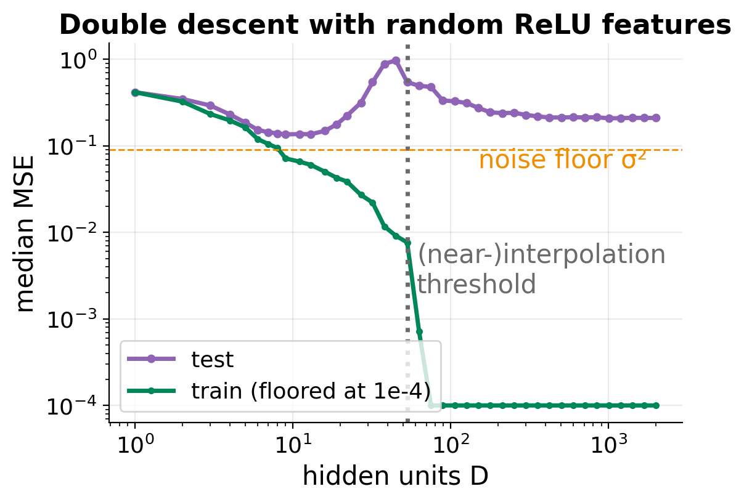

PUZZLE 8.4 · THE PROBLEM
Where is the bump?
In the field
Grow a network from 1 to 2,000 hidden units on just 30 noisy training points, and track the test error.
Classical wisdom says bigger means more overfitting. Look at the curve: where does the test-error peak sit?
Your task (in the notebook)
(a) at D = 1, where the model is too simple
(b) around the width where it can first memorise the training data
(c) at the largest width, with the most parameters
(d) at exactly D = 30, one unit per data point
answer_8_4 = '?'
Confidential and Proprietary | 35
Notes:
Random ReLU features, minimum-norm least squares fit. 1 minute.

Slide 36
PUZZLE 8.4 · THE SOLUTION
(b) Right where it can first memorise the data
In plain words
At the threshold the model has just enough knobs to pass through every noisy point, and only one way to do it: a wild, wiggly one.
With many more knobs there are endless ways to fit. Picking the smoothest (minimum norm) makes the test error fall again: double descent.
Not exactly D = 30: random hinges rarely land between every pair of points.
The detail
Interpolation threshold: training error first hits ≈ 0.
Second descent: the inductive bias (smoothness) does the work.
Confidential and Proprietary | 36
Notes:
In this tiny 1D problem the second descent recovers but doesn't beat the classical sweet spot. On real problems it often does.

Slide 37


BACK AT TBIO
From meerkats to molecules
Bias or variance?
Which distribution?
Is bigger better?
A deep network is a flexible classifier. With ~100 measured proteins, where would bias dominate, and where would variance?
Which output distribution suits a condensate count per cell? A droplet size? A partition coefficient?
Double descent says bigger can be better. When is that not true for our assay data?
Next time · Chapter 9 (Regularisation): why do over-parameterised networks generalise at all?
Go further: the book's notebooks 3.3, 6.5, 7.2 and 8.3 (udlbook.github.io), and MNIST-1D, the real version of our call dataset.
Confidential and Proprietary | 37
Notes:
Open discussion for the last 5 minutes. Pick one prompt.

Slide 38
Questions?
Deep Learning in the Kalahari · next: chapter 9, regularisation
Based on Prince, Understanding Deep Learning (MIT Press, 2023; CC-BY-NC-ND). All data synthetic; not Transition Bio data. Emoji art: Twemoji (CC-BY 4.0). Internal training material: Confidential and Proprietary, Transition Bio.
Notes:
Thanks. Questions.

