Slide 1

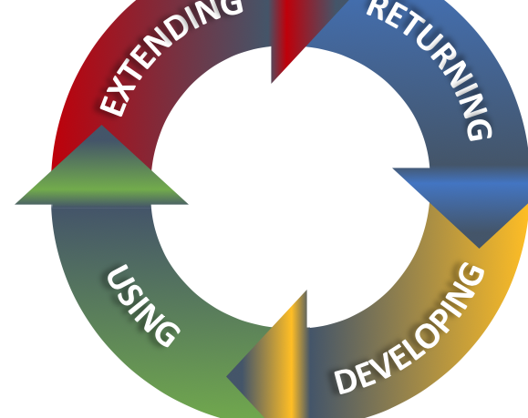
Why translate5
Mission
Business Model
Strengths of translate5
Translation Quality
Cloud-Based and Open Source Translation Management System

Slide 2
Mission
From the language industry, for the language industry
The mission of translate5 is the community-driven and continuous development of the open source and cloud-based translation management system of the language industry.

Slide 3
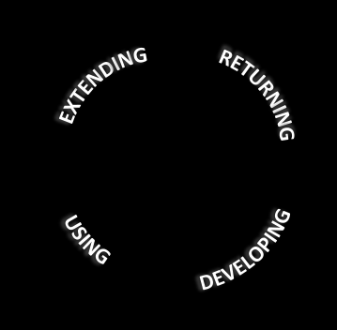
Business Model
Joining the community and enhancing the strengths of translate5
All users have the control of their own relevant software development
Extension of translate5 according to special needs
Open source is the conceptual base
Give new versions and features back to the community and into translate5 as core product
Based on both the AGPLv3 as well as the GPL3 license models
Using a stable and user-friendly cloud-based TMS
Target groups: language service providers, industrial companies, state institutions, freelancers, software developers
Collaboration of professionals
Communicating and discussing of technical needs and expectations to realise the cloud-based TMS
MittagQI as lead development company:
  Coordinates the roadmap with the community
  Ensures good architecture and high code quality

Slide 4
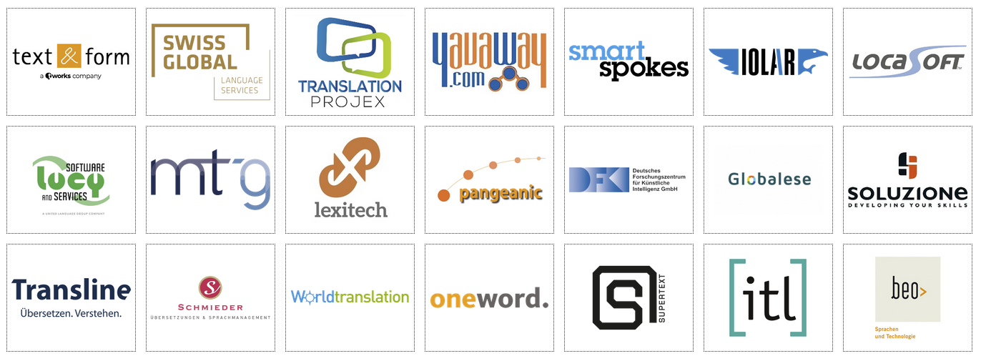
Continuous Cycle of Development
Strengths of translate5
Rooted in Community, joining
Outstanding features
Cloud-based, open source, extendable
Approved solution provider with LSP
Reliable, fast-driven support and competent collaboration with customers
EXTENDING
USING
RETURNING
DEVELOPING
DEVELOPING
RETURNING
USING
EXTENDING
USING
DEVELOPING
RETURNING
USING
RETURNING
EXTENDING
EXTENDING
EXTENDING
USING
DEVELOPING
RETURNING
DEVELOPING
1: Companies of the translate5 community - extendable
2: Process of the translate5 continuous cycle of development, usage and improvement

Slide 5
Enabling Translation Quality
EXTENDING
EXTENDING
USING
USING
process
quality
product
quality
translation
quality
RETURNING
work
quality
RETURNING
DEVELOPING
DEVELOPING
text
quality

Slide 6
translate5
MittagQI – Quality Informatics
translation software development company
contact
service@MittagQI.com
www.translate5.net
Cloud-Based and Open Source Translation Management System

