Slide 1

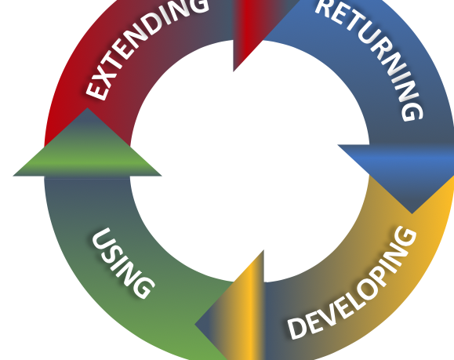
Why translate5
Mission
Business Model
Strengths of translate5
Translation Quality
Cloud-Based and Open Source Translation Management System
Notes:
1

