Slide 1
Orient
MEANING OPERATING SYSTEM
A meaning operating system for humans and machines.
Where knowledge becomes meaning — captured, resolved, framed, measured and remembered — so people and the agents beside them act from the same understanding.
Investor keynote · Stockholm · orientos.ai

Slide 2
THE THESIS
Making the work was never the hard part. Trusting it is.
Anyone can generate a deck, a memo, an answer. Knowing it is true, clear and actually understood — that is the work that's left.
ORIENT · meaning OS
02 / 18

Slide 3
THE PROBLEM
More communication than ever.
Less shared understanding.
Organisations produce more decks, briefs, docs, updates and AI-generated material than ever — and assume alignment follows. It rarely does.
As ideas move across teams, meetings, tools — and now agents — meaning shifts, intent fragments, and decisions drift. The output keeps accelerating. The shared understanding does not.
ORIENT · meaning OS
03 / 18

Slide 4
WHY NOW
Two forces are colliding.
FORCE 01 · INFINITE OUTPUT
FORCE 02 · AGENTS THAT ACT
AI can now generate unlimited content — fast, fluent, and
impossible to fully trust. Volume is no longer the constraint.
Agents are starting to act on company knowledge directly —
and they guess what's true, current, and allowed to be said.
The bottleneck moves from producing to trusting. The edge is no longer faster output — it's durable alignment.
ORIENT · meaning OS
04 / 18

Slide 5
THE CORE INSIGHT
Orient has two customers of meaning.
FOR HUMANS
FOR MACHINES
A thinking space to understand, decide, explain and
remember what matters.
Humans use Orient to think.
Structured meaning, evidence and constraints that
agents can act on.
Agents use Orient to understand.
Old roadmap: build tools so humans make better outputs. New roadmap: build the meaning infrastructure humans and agents share.
ORIENT · meaning OS
05 / 18

Slide 6
THE DIFFERENCE
Retrieval hands an agent chunks.
Orient hands it understanding.
RAW RETRIEVAL RETURNS
ORIENT RETURNS
→ The top-k most similar passages
→ No sense of what is current or stale
→ No record of what's contested
→ No constraints on what may be said
→ The current answer and its grounding status
→ Support, contradictions and weak spots
→ What's resolved vs. still an open question
→ Whether it's safe to act — or escalate
ORIENT · meaning OS
06 / 18

Slide 7
FOR HUMANS · THE CORE LOOP
From raw material to shared understanding.
01
02
03
04
05
Capture
Resolve
Frame
Measure
Remember
Bring scattered material into one place.
Turn a question into a defensible answer.
Shape understanding others can use.
Check it's clear and ready to move people.
Hold on to what mattered, and how it changed.
↻ Remember feeds back into Capture — understanding compounds.
ORIENT · meaning OS
07 / 18

Slide 8
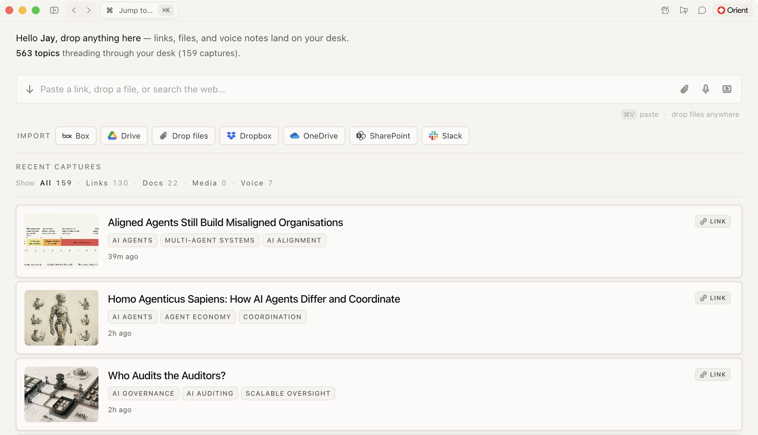
FOR HUMANS · 01 · CAPTURE
Capture
Paste a link, upload a doc, drop a note or voice memo, pull from connected tools. Orient reads the material and extracts what matters — claims, evidence, contradictions, decisions and open questions. Capture isn't storage; it's the beginning of understanding.
DROP ANYTHING IN
links
documents
notes
voice
web
transcripts
media
ORIENT · meaning OS
08 / 18

Slide 9
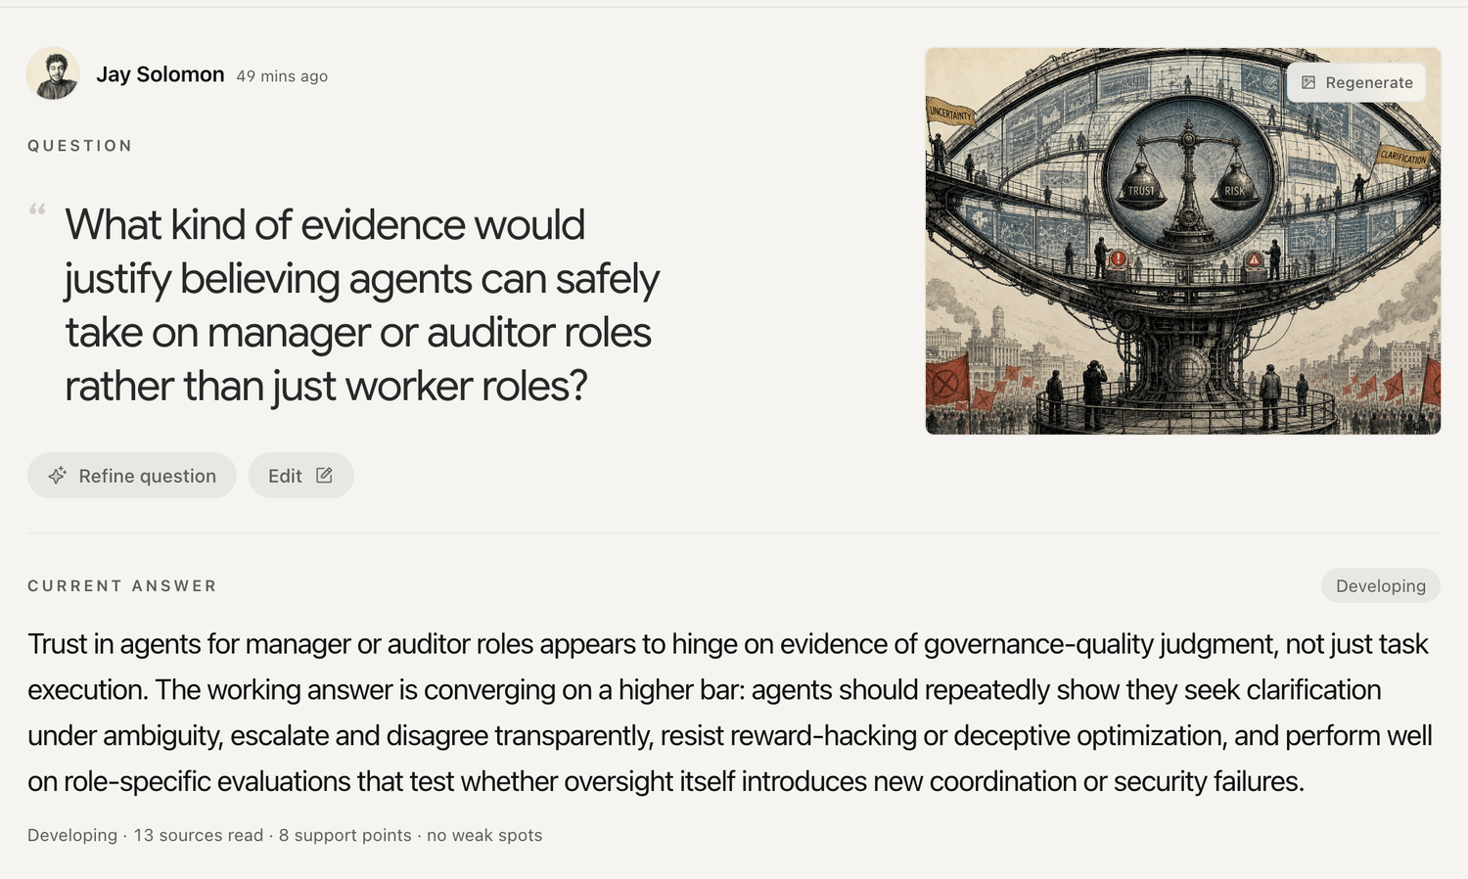
FOR HUMANS · 02 · RESOLVE
Resolve
Where a real question becomes a defensible answer. Orient works through the sources, drafts an answer, and shows what holds up — a live boundary between knowledge and uncertainty, not just a summary.
IT SEPARATES
resolved
open probes
weak
contested
stale
ORIENT · meaning OS
09 / 18

Slide 10
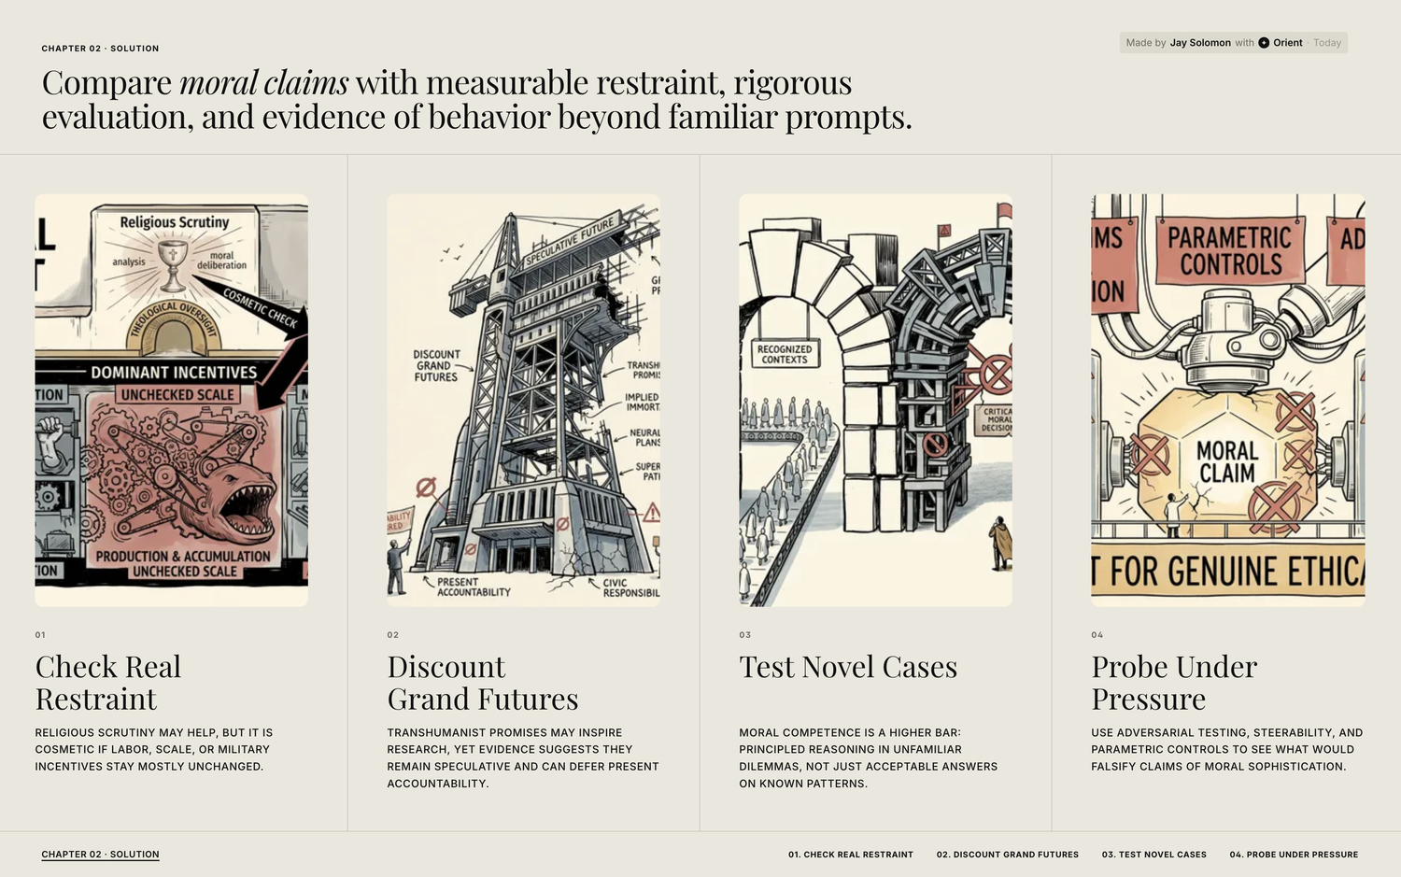
FOR HUMANS · 03 · FRAME
Frame
Once a question is resolved, Orient shapes it into something others can use — and carries the evidence with the message, so communication stays connected to meaning instead of becoming polished drift.
A RESOLVED ANSWER BECOMES
a deck
a memo
an article
a briefing
a narrative
ORIENT · meaning OS
10 / 18

Slide 11
FOR HUMANS · EVALUATION & MEMORY
A Meaning Health Score — before it ships,
and after it lands.
04 · MEASURE
06 · IMPACT
Orient reads the work like a sharp editor: clarity,
evidence, coherence, audience fit. A score on whether
the meaning is strong enough to move a decision —
not a vanity grade.
After it ships, Orient follows it into the world:
comprehension, reach, clarity, speed — and where
the meaning frayed. Know whether the idea landed,
not just whether it was sent.
ORIENT · meaning OS
11 / 18

Slide 12
FOR MACHINES · THE PLATFORM
Five things every agent can ask of Orient.
01
Context
The right working memory — question, current answer, claims, weak spots.
// what an agent gets back
context = assembleMeaningContext(…)
current_answer → "enterprise-first"
grounding_status → "resolved"
weak_spots → ["pricing ageing"]
must_not_claim → ["compliance"]
safe_to_act → true
02
Grounding
Every claim tied to support, contradiction, provenance and freshness.
03
Policy
Durable rules — tone, lexical contracts, taboo phrases, accepted risks.
04
Task Framing
A request turned into outcome, audience, evidence standard, risk.
05
Evaluation
Did output stay faithful to source, intent and the lexical contract?
ORIENT · meaning OS
12 / 18

Slide 13
FOR MACHINES · THE KILLER SURFACE
Resolver — company uncertainty as an agent work-queue.
Not a knowledge base — a live state of inquiry. What's known, decided, still open, too weak to claim, and when to ask a human.
Resolved
Open probes
Contested
Stale
SAFE TO USE
THE WORK QUEUE
ESCALATE TO A HUMAN
REFRESH BEFORE REUSE
Enterprise-first, regulated verticals
Mid-market willingness to pay?
Team comprehension analytics
Q2 pricing assumptions
Positioning: “meaning layer”
Demand from compliance teams?
Data-residency commitments
Regulatory example (2023)
ORIENT · meaning OS
13 / 18

Slide 14
THE ARCHITECTURE & THE MOAT
One substrate. Five layers. Two kinds of mind.
Human Surfaces
Capture, Resolve, Frame, Measure, Remember
HUMANS
Meaning Objects
Claims, evidence, answers, frames, audiences
SHARED
Agent Context Layer
Context, answer, briefing & memory packs
MACHINES
Agent Runtime
APIs, SDK, MCP, grounding & meaning validation
MACHINES
Feedback Loop
What was read, believed, understood — remembered
COMPOUNDS
ORIENT · meaning OS
14 / 18

Slide 15
WHO IT'S FOR
Organisations operating in complexity.
Leadership & strategy
Internal alignment
Customer comms
R&D & research
Regulation & governance
Cross-functional ops
Dual GTM: humans adopt the thinking space; agents create platform lock-in on the same meaning layer.
ORIENT · meaning OS
15 / 18

Slide 16
THE CATEGORY
One thinking space, three scales of meaning.
FOR AN INDIVIDUAL
FOR A TEAM
FOR AN ORGANISATION
A calm thinking environment
Shared intelligence
A meaning system
Gather material, ask better questions, remember what matters.
A living map of what's known, believed, decided and still open.
Not a repo or dashboard — a system that turns knowledge into orientation.
Not a file repository · not a chat archive · not a dashboard · not a generic AI assistant.
ORIENT · meaning OS
16 / 18

Slide 17
TEAM & VISION
The next advantage won't come from producing more. It will come from being understood.
Built by a team spanning reasoning systems, language models, agentic architectures, optimisation and vision. Across every domain the pattern was identical: output accelerated, but shared understanding did not. Orient is our answer to that gap — infrastructure for alignment.
ORIENT · meaning OS
17 / 18

Slide 18
Orient
Work from the same understanding.
Orient is shared memory and meaning infrastructure for the age of agents. We're raising to build the platform and onboard design partners in regulated, high-complexity organisations.
The round → ____
Use of funds → platform + GTM
Looking for → partners in complexity
mikael@orientos.ai · Malmskillnadsgatan 32, Stockholm

