Slide 1
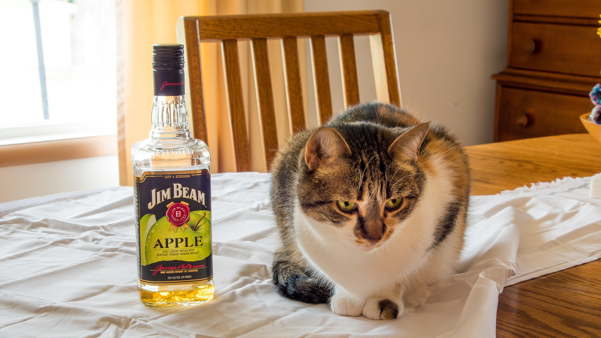


Are You Drunk Sql Server?
Where did that estimate come from?

Slide 2
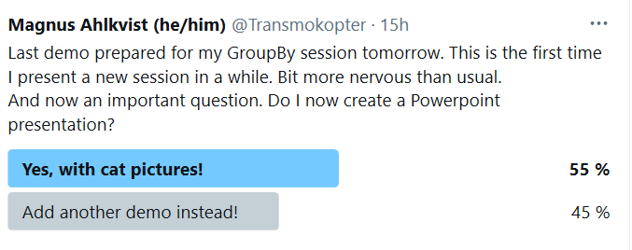

Slide 3
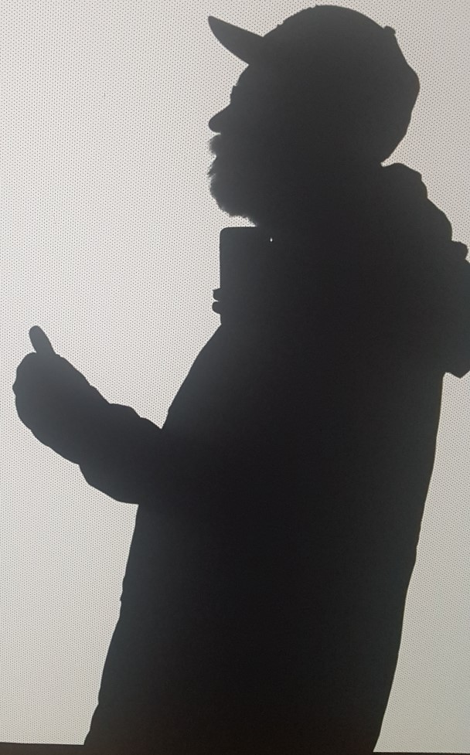
Magnus Ahlkvist
Transmokopter SQL AB – SQL Server Specialist
Swede
MVP Data Platform, MCT
#sqlrun
#sqlfamily
github.com/transmokopter
@Transmokopter on Twitter

Slide 4
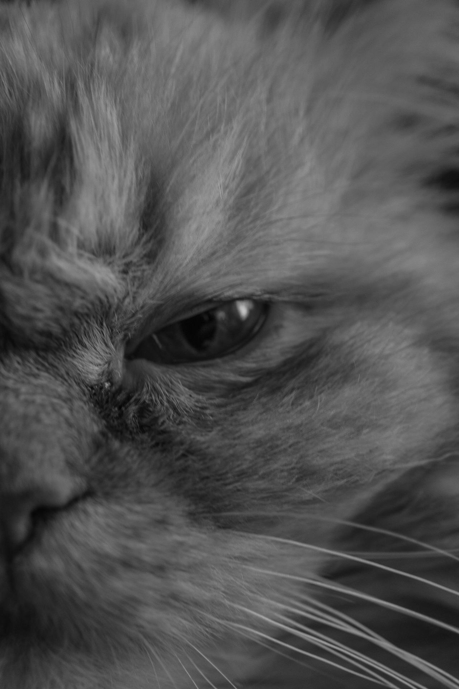
Session Content
Cats [x]
Demos [ ]

Slide 5
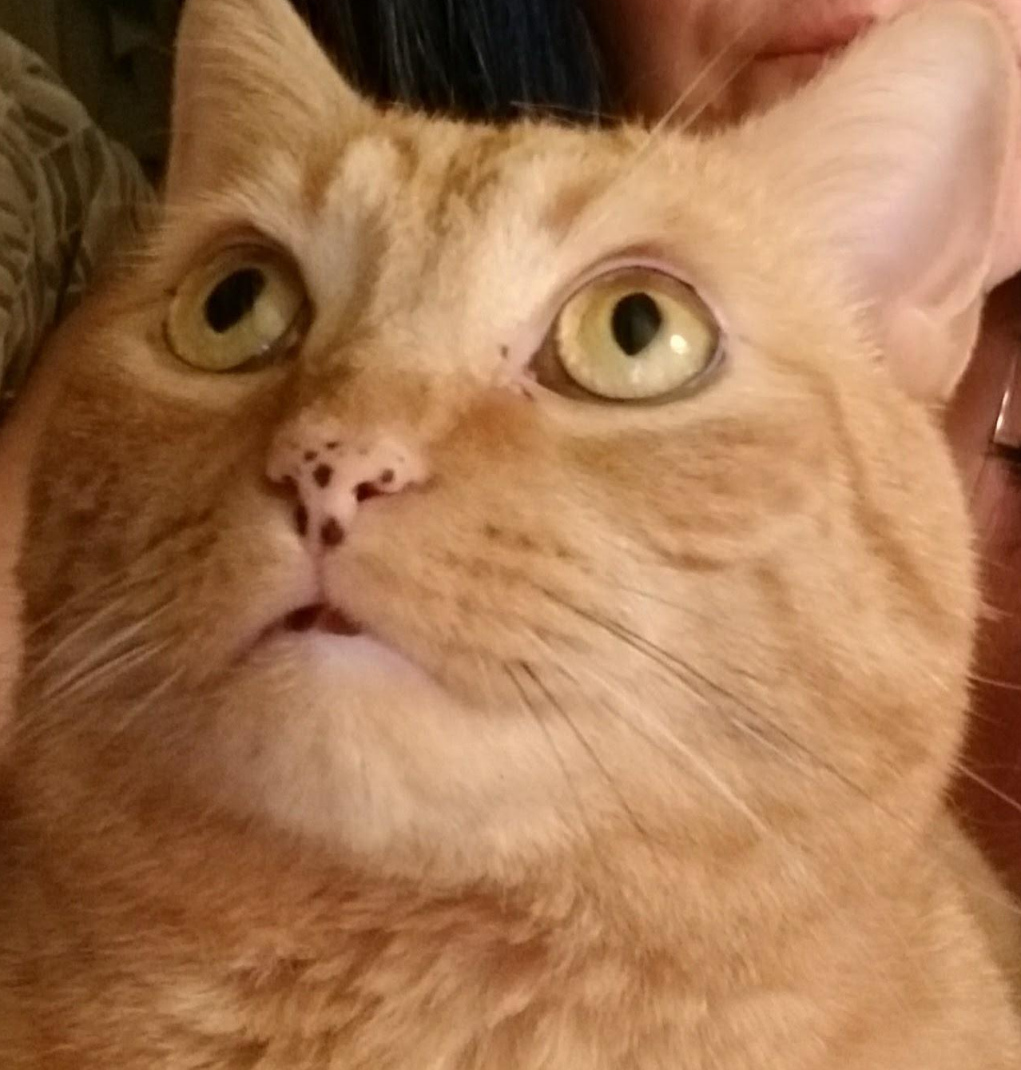
No more cats?

