Slide 1

DBA? Sure. But you’re also a developer.
Magnus Ahlkvist

Slide 2

















Thank you to our sponsors

Slide 3
Some of my tasks as an accidental DBA in year 2000
Check if disks are near capacity
Order new disks and controllers and build a new RAID array in the server
Replace faulty disks
Add a new CPU to the database server
Deploy database changes with manual script execution
And most of this happened IN a datacenter. Standing next to servers and network equipment.

Slide 4
Main job though:
Take backups
Move backups off-site

Slide 5
These are still a DBAs top priorities

Slide 6
BUT WE HAD TWO DATABASE SERVERS

Slide 7
They had five databases each

Slide 8
A VLDB was 50 GB

Slide 9
We backed up to tape. Off-site was my bedroom.

Slide 10
My current client has around 80 SQL-instances, only for test

Slide 11
The main system has 1TB databases, and not just one of them.

Slide 12
We can’t tape them, can we? I can’t have the backups in my bedroom, can I?

Slide 13
Automation:
Replace random mistakes with consistent errors.

Slide 14

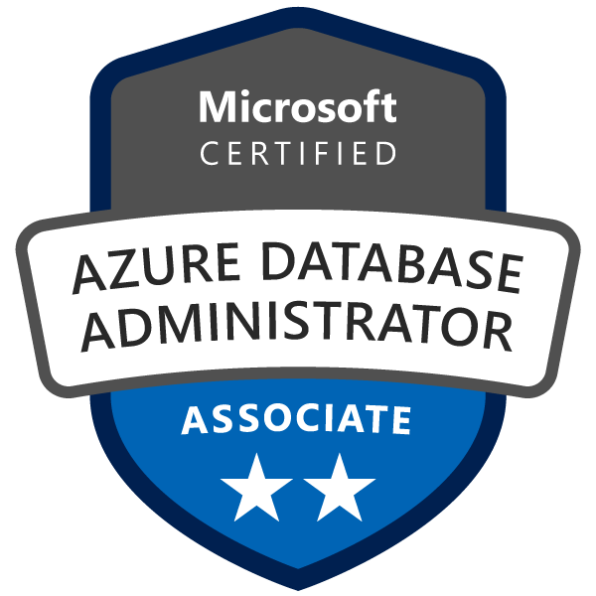

Magnus Ahlkvist
He/him
Mail: magnus@transmokopter.se
Twitter: @transmokopter
Github: github.com/transmokopter
ww.tsql.nu - some sort of blog
www.sqlfriday.net - free weekly online event
www.transmokopter.se - pays my bills

Slide 15
Today’s contents
Git for source control
Vscode for writing code
dbatools to help you stay awesome at scale
Azure DevOps pipelines to safeguard your mental health
If time allows: Pode – create pages and RestAPIs from awesome PowerShell-code

Slide 16
git
Protect your stable version of the code base
Work in feature branches
Use pull requests to merge your feature into the stable code base
Peer review is a good thing!
Get your new team members up to speed faster

Slide 17
Some useful git commands
git branch
Inspect which branches you have
git checkout
Switch your working branch. With the –b option, create a new branch
git pull
Download changes from the remote branch and merge them with your local branch
git pull origin <branchname>
pull the changes made to _another_ branch than your working branch into your working branch. Very useful for updating your working branch with changes made to the stable branch.
git add
Stage your local changes into a working changeset
git commit
Commit your working changeset
git push
Push your changes to a remote location (your central repository eg)

Slide 18
What goes into source control?
Everything!
Really. Everything.

Slide 19
DEMO git

Slide 20
vscode
Free IDE for just about everything about code
THE development text editor
If you now say “What about vi”, feel free to leave the room ☺
Has darkmode
But also cute-mode, Twilight Sparkle-mode, PowerShell ISE-mode etc
Missing something? There’s an extension for it, 100%
Git integration
SQL Server Database projects
Awesome terminal integration

Slide 21
DEMO git

Slide 22
dbatools
Open source PoSh-module
Community driven – by DBAs, for DBAs
Is it in Management Studio? Then it’s in dbatools as well.
Stay awesome – at scale.

Slide 23
DEMO dbatools

Slide 24
Azure DevOps pipelines
Build an application
Deploy an application
Run tasks against a remote target in a controlled way
If a pipeline (or rather an agent) has permission to do xyz, I don’t need to have those permissions

Slide 25
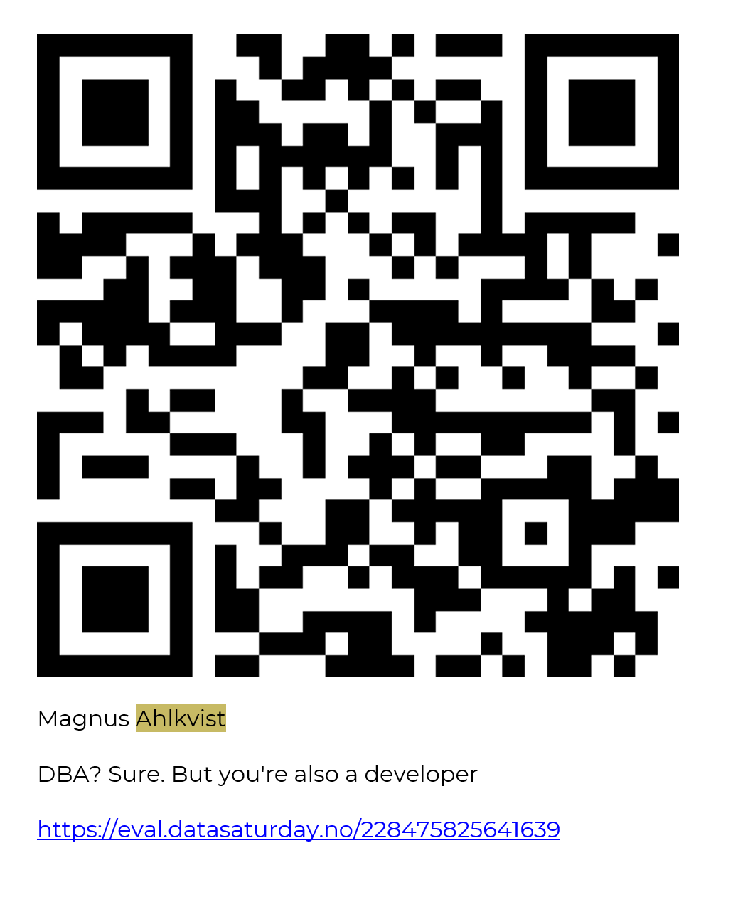

Slide 26
DEMO pipelines

