Slide 1
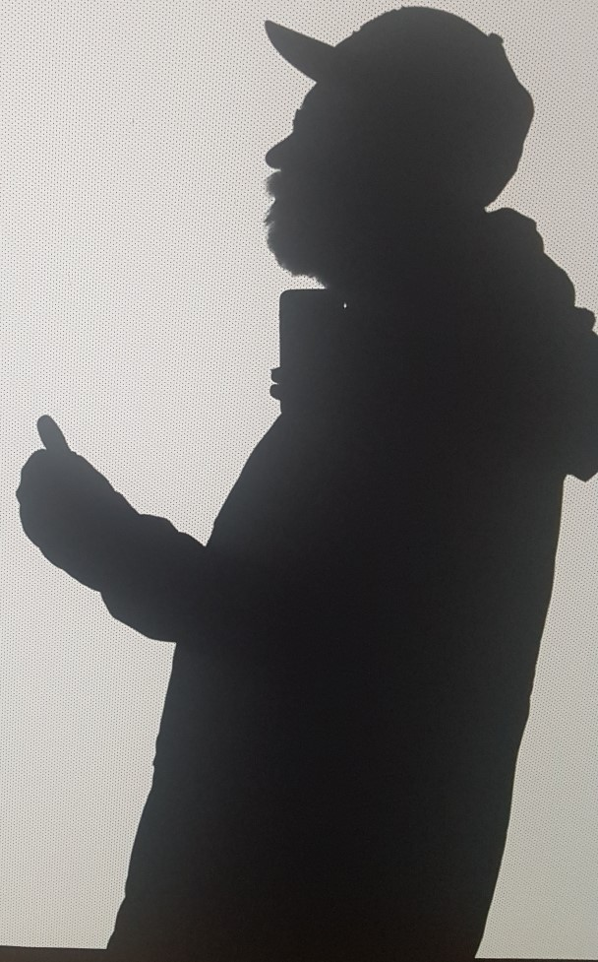
Serverless Infrastructure With Azure Containers
Magnus Ahlkvist

Slide 2
Magnus Ahlkvist
Mail: magnus@transmokopter.se
Twitter: @transmokopter
Github: github.com/transmokopter
Blogg: www.tsql.nu
SQL Friday: www.sqlfriday.net
Transmokopter: www.transmokopter.se

Slide 3
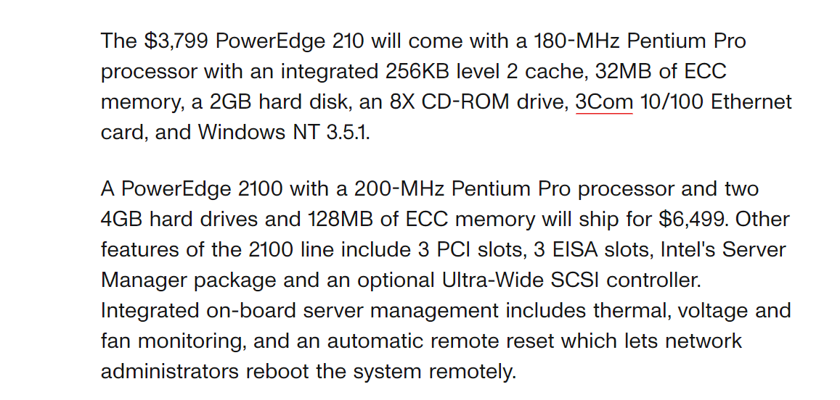
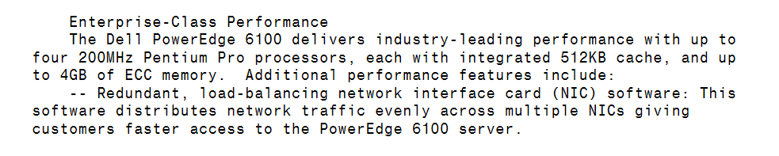

Slide 4
Magnus Ahlkvist
Mail: magnus@transmokopter.se
Twitter: @transmokopter
Github: github.com/transmokopter
Blogg: www.tsql.nu
SQL Friday: www.sqlfriday.net
Transmokopter: www.transmokopter.se

