Slide 1
Are you drunk SQL Server?
Where did that estimate come from?

Slide 2

Are You Drunk Sql Server?
Where did that estimate come from?

Slide 3
Why learn about cardinality estimation?
Too many times I found myself thinking: Why the %#*! did you estimate that number of rows, SQL Server?
Performance tuning is veeeeery often about Memory and/or I/O. If Cardinality estimation is wrong, you may get a plan that reads too much I/O and that allocates too much or too little memory.

Slide 4

Session Content
Statistics
Histograms and vectors
Parameter sniffing
CE for complex queries
CE for joins
Missing statistics
Configuration
Ascending Key
Missing but not ascending key
Scratching the surface of the deep dives
Why it’s good and why it’s sometimes bad
Not THAT complex. But at least more than one predicate.
Joining two tables – what does it mean for us?
Look into the different steps of cardinality estimation.

Slide 5
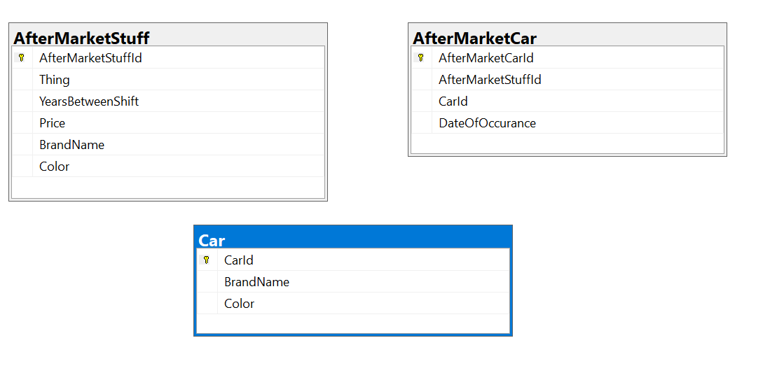
This is today’s data model
Cars
Number of cars per brand is representative for Sweden for the bigger brands
Colors are just made up
AfterMarketStuff contains some stuff that car-owners pay for, like break pads, washerflud etc, Paint etc
Some of the AfterMarketStuff is per brand, some is general. Paint is per color, the rest isn’t
AfterMarketCar is stuff that car-owners bought for their cars, so it’s a per AfterMarketStuff, per Car data set.

Slide 6
And for full transparency
SQL Server 2022
Standard Edition
Linux version, running in an Ubuntu container
Database will run in Compatibility Modes 110 (SQL Server 2012) and 150 (SQL Server 2019)

Slide 7

Magnus Ahlkvist
Transmokopter SQL AB – SQL Server Specialist
Swede
MVP Data Platform
github.com/transmokopter
@Transmokopter on Twitter

Slide 8
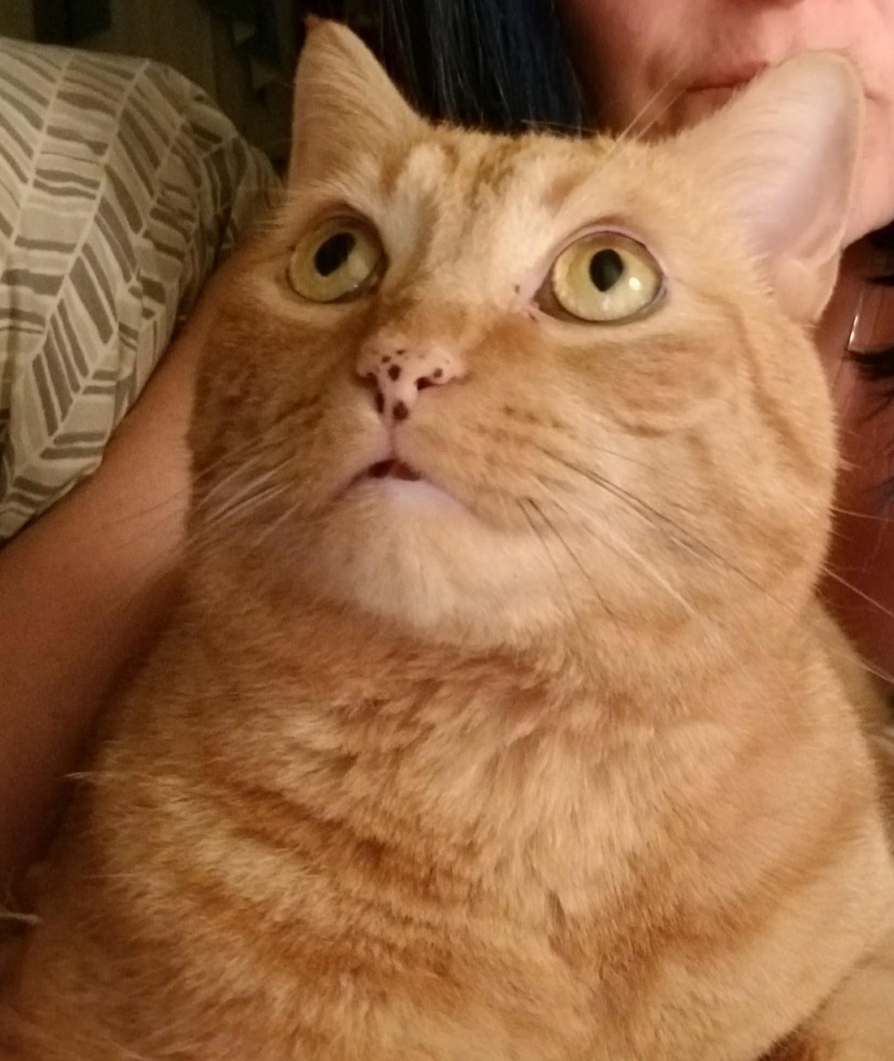

Introduction to Cardinality Estimation …and then we move into more complex territory

Slide 9
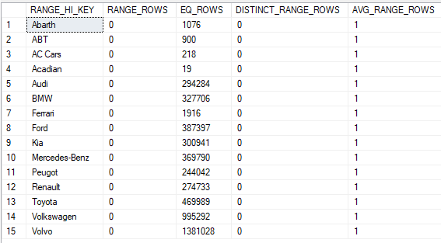
The basics, statistics and histograms
Sql Server uses statistics to figure out how many rows are returned from different operators
Statistics are stored in histograms (think of tables, they really are)
SELECT * FROM dbo.Car WHERE BrandName = ’Renault’;
Renault is in the histogram. SQL Server will estimate 274733 rows
SELECT * FROM dbo.Car WHERE BrandName = ’SAAB’;
Saab is not in the histogram. SQL Server will look at Toyota and AVG_RANGE_ROWS and estimate 1 row.

Slide 10

There’s more to statistics: Density
Histograms are only created on leading columns.
Imagine this index:
CREATE INDEX ix_Car_BrandName_Color ON dbo.Car (BrandName, Color) WITH (DATA_COMPRESSION=PAGE);
Two key columns. How to figure out cardinality of a combination of these two? Histogram only show BrandName, not Color.
Density Vector
Density = Distinct combinations / total number of rows

Slide 11

Want to force use density vector instead of histogram?
OPTION(OPTIMIZE FOR (@parameter UNKNOWN))
Introduce Implicit Conversion
Really, don’t do this!

Slide 12

DEMO

Slide 13
When SQL Server knows it all, but is still wrong
Setup:
Perfectly updated statistics
SQL Query gets first all blue Volvos
Then SQL Query gets all Ferraris
First time a query is executed, the execution plan is generated based on the parameter values of that first execution
Second time a query is executed, the execution plan is reused (unless too much has changed in the underlying tables since the plan was generated)
Parameter Sniffing

Slide 14
Parameter Sniffing
Imagine a 12 table join
…that runs 10 times per minute
…and that takes a second to compile
…and SQL Server would have to compile a new plan every time the query runs
Parameter sniffing saves the parameter settings of the first execution into the plan and caches the plan.
This is generally a very good idea. Except when it’s not
There are 1,4 million Volvos in Sweden
But only 1900 Ferraris
When joining the result of a BrandName-search into the Car table into some other table, it matters if we get 1900 or 1,4 million rows back from the Car table

Slide 15

DEMO

Slide 16
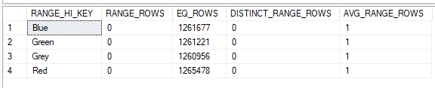
Ok, cool. Statistics and one predicate.
Queries are usually more complex
How many blue Toyotas are there in Sweden?
Question 1: How likely is it that any given row in the database is a Toyota?
469989 / 5049331 = 0.09308 => chance
Question 2: How likely is it that any given row in the database has the Color blue?
1261677 / 5049331 = 0.24987 => 24,987% chance
But from there: It depends
Version of SQL Server
Settings
Chance/luck/dark magic

Slide 17

Legacy Cardinality Estimation
Legacy = Pre SQL Server 2014.
Or database scoped configuration
Or trace flag
Assumption: Columns in a table are not functionally dependent
Sometimes true, sometimes not
For a car, Modelname is a functional dependency on Brandname
For most brands, Color is NOT a functional dependency on Brandname
In our Toyota example
9.308% it’s a Toyota. 24.987% it’s a blue car.
9.308% x 24.987% = 2.326% it’s a Blue Toyota.
We have 5049331 cars. 2.326% of 5049331 = 117,437 Blue Toyota

Slide 18


”New” Cardinality Estimation
New = SQL Server 2014 and later.
Unless we run SQL Server 2016 and later and enable Database Scoped Configuration ”Legacy Cardinality Estimation”
And unless we run SQL Server 2014 or later and enable traceflags to use Legacy Cardinality Estimation instance wide
For now, we skip the fancy SQL Server 2022 IQP and CE Feedback stuff, because:
Most of us don’t run SQL Server 2022. And if we do, most IQP features are Enterprise Edition only features.
Assumption: Columns in a table ARE functionally dependent
Again, sometimes true, sometimes not
For a car, Modelname IS a functional dependency on Brandname
For most brands, Color is NOT a functional dependency on Brandname
$selectivity of most selective predicate × \sqrt{selectivity of second most selective predicate }× \sqrt[3]{selectivity of third most selective predicate}$
Exponential backoff
In our Toyota example
9.308% it’s a Toyota. 24.987% it’s a blue car.
9.308% x SQRT(24.987%) = 4.653% it’s a Blue Toyota.
We have 5049331 cars. 4.653% of 5049331 = 345,935 Blue Toyota

Slide 19
New CE vs Legacy CE
Legacy Cardinality Estimation
Independence: Columns are assumed to be independent.
Uniformity: Values between histogram steps are evenly distributed and have the same frequency.
Simple containment: Users query for data that exists (more later)
Inclusion: Equality predicates are assumed to represent matching row(s) in the table.
New Cardinality Estimation
Correlation: Columns are assumed to be related
Uniformity: See Legacy CE
Base containment: Users might query for data that does not exist.
Inclusion: See Legacy CE

Slide 20

DEMO

Slide 21

But wait, there’s more
What if we have more than one table? Many databases do ☺
Joining two tables can basically be done three ways:
Nested loop join: For Each row in dataset A, loop through each row of dataset B. Or make a lookup or seek into something that for each row in A produces a dataset B.
Hash join: Read all the rows from dataset A (usually the smaller of the two). Using a hash function, create a hash bucket for each of the values from dataset A. For each row in table B, run the same hash function and see which bucket the row falls in to (if it doesn’t fit in any, throw the row away).
Merge join: When two datasets are both ordered by the join key.

Slide 22

What’s the cardinality of the combined sets?
Legacy Cardinality Estimation
The assumption is that users query for data that exists. Factor in predicate selectivity before calculating join selectivity.
Simple Containment
New Cardinality Estimation
The assumption is that users sometimes query for data that does not exist. First calculate the join selectivity and then factor in the predicates selectivity.
Base containement

Slide 23

DEMO

Slide 24

Missing statistics
Auto Create Statistics is default
Auto Update Statistics is also default
I recommend using auto update stats async
Sometimes statistics are still missing

Slide 25
The ascending key problem
Orders and orderliness come into an order system
Statistics are updated nightly
In the morning and at noon every day, the warehouse system downloads the orders, to start picking.

Slide 26
What to do about ascending key?
Old-school: Enable trace flags, Optimize for unknown
Since SQL Server 2016: SQL Server try detecting ascending key and estimate accordingly

Slide 27
Other reasons for missing stats values
Add a new color to an assortment
Auto Update Stats is disabled
Or auto update stats async is enabled and we’re unlucky No.1

Slide 28
What to do about missing stats values?
Optimize for a known value
Optimize for unknown
Force a good plan
Be careful!!

Slide 29

Btw, when does auto update stats kick in?
Old-school: 20% of the table has changed
Since long: $\sqrt{1000}×TableCardinality$
Dbo.Car has 5,049,331 rows
$\sqrt{\left(1000×5049331\right)}$ = $\sqrt{5049331000} \sim 71059$

Slide 30


Slide 31
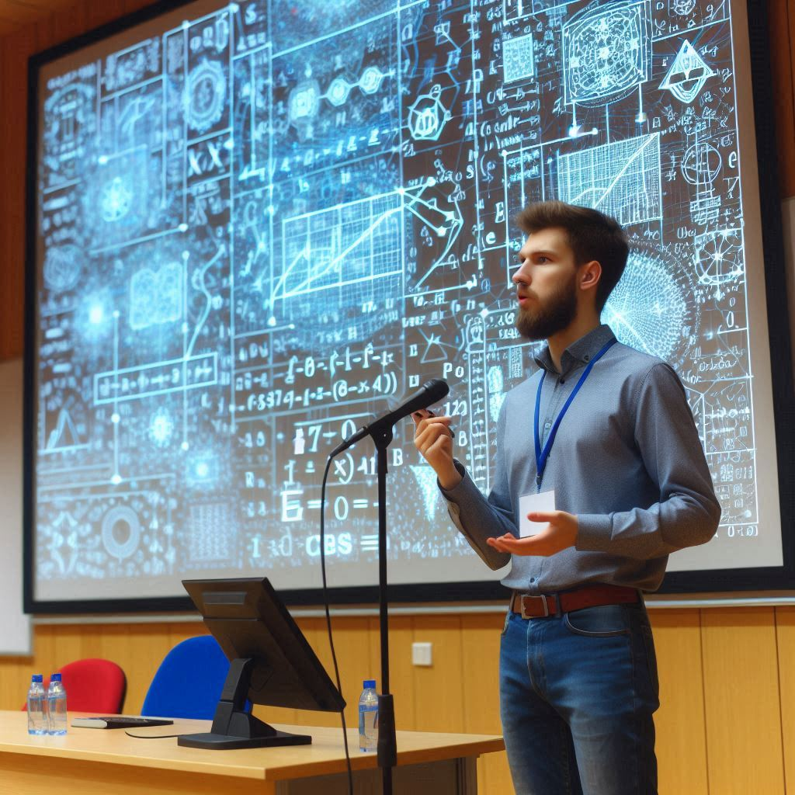
DEMO

Slide 32
Deeper dives – get into the head of SQL Server
Dive deeper into the decision tree of SQL Server
Trace flags (with QUERYTRACEON)
Or with extended event sqlserver.query_optimizer_estimate_cardinality
Be careful – there’s a lot of data coming out from this event.

Slide 33
The deep dive – scratching the surface
Figure out selectivity (and thus cardinality) for predicates in Logical Operator Select (LogOp_Select)
CSelCalcColumnInterval or CSelCalcUniqueKeyFilter for equality on unique columns.
Figure out join selectivity (and thus cardinality) using LogOp_Join
Compare either two previously calculated statistics collections or compare a statistics collection with table cardinality (Based Containment) depending on how the JOIN-predicate and the rest of the query looks.

Slide 34

DEMO

