Slide 1



An Introduction to Sql Server Database Projects
Magnus Ahlkvist
Transmokopter SQL AB
SQL Server consultant, Data Platform MVP

Slide 2

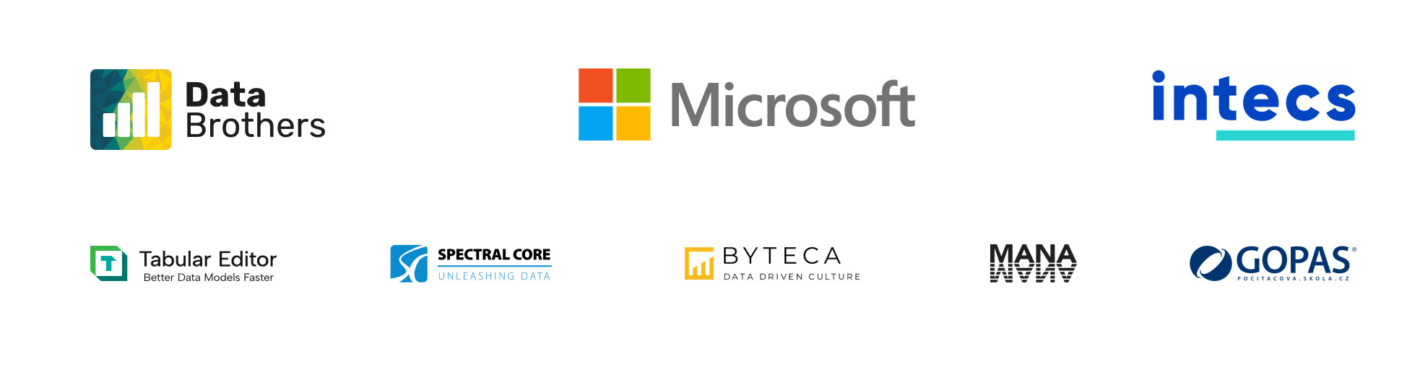
Talk to sponsors. They are nice people

Slide 3

Content
Migration based deployments
Model based deployments
Sql Server Database projects
.NET Framework based project type
SDK Style database projects
Start with a clean sheet
Start with an existing database
Dependencies
Refactoring data objects

Slide 4






Magnus Ahlkvist
🏭 Transmokopter SQL AB, SQL Server consultant
Microsoft Data Platform MVP
github.com/transmokopter
transmokopter
linkedin.com/in/magnusahlkvist
📧 magnus@transmokopter.se
youtube.com/c/transmokopter

Slide 5

Migration based deployments
To upgrade database from version 1 to version 7, run upgrade scripts for versions 2, 3, 4, 5, 6 and 7.
Often together with some sort of SchemaVersions table.
Entity Framework migrations
Flyway
Liquibase
DbUp
Many more
Often idempotent scripts
Most often to avoid problems when old-school manual deploys happened
Migrations based deployments. What they are and why I don’t like them.
https://www.youtube.com/watch?v=-WR-XA_1aXA

Slide 6

Migrations initialization
-- Initiatialize empty database
IF DB_ID('MigrationDb') IS NULL
BEGIN
CREATE DATABASE MigrationDb;
END
GO
USE MigrationDb
IF NOT EXISTS( SELECT * FROM sys.tables WHERE name='SchemaVersions’ )
BEGIN
CREATE TABLE dbo.SchemaVersions(
SchemaVersion VARCHAR(30) NOT NULL
CONSTRAINT pk_SchemaVersion PRIMARY KEY CLUSTERED,
Applied DATETIME NOT NULL
);
END

Slide 7
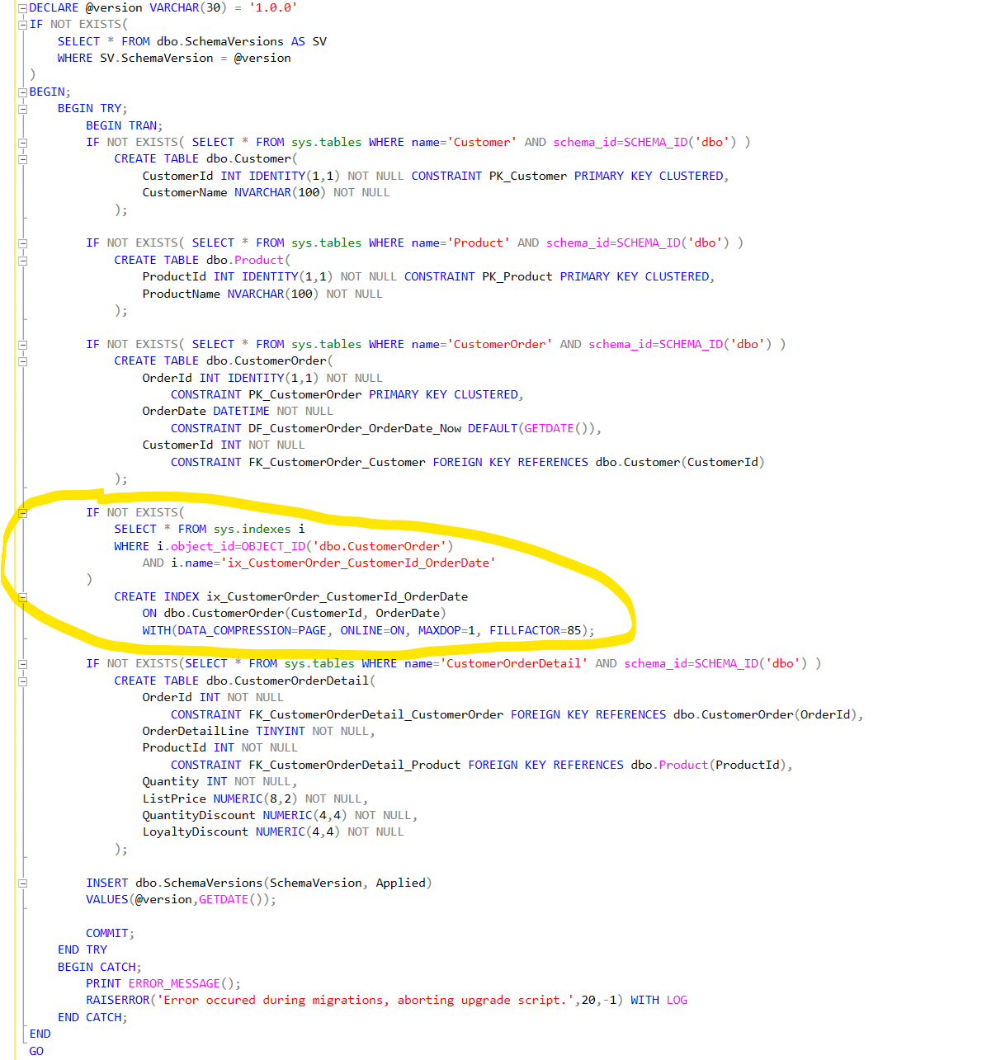

Version 1.0.0

Slide 8
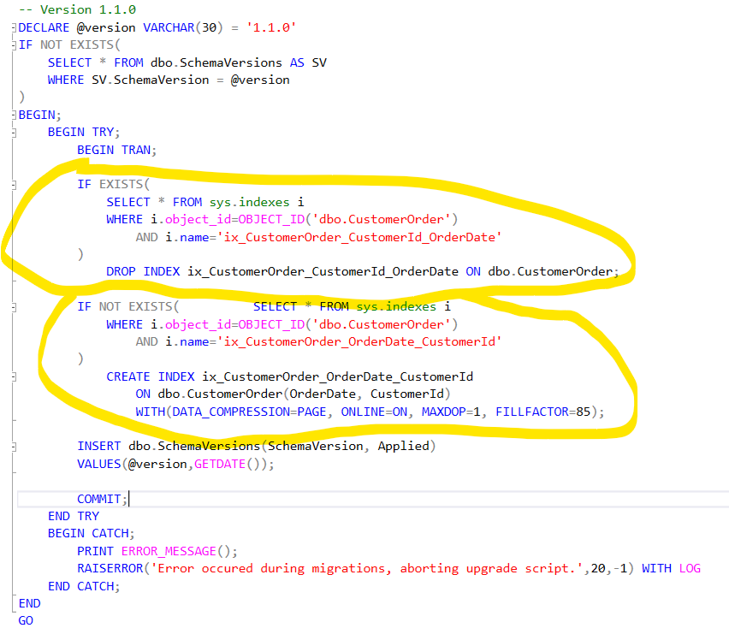

Version 1.1.0

Slide 9

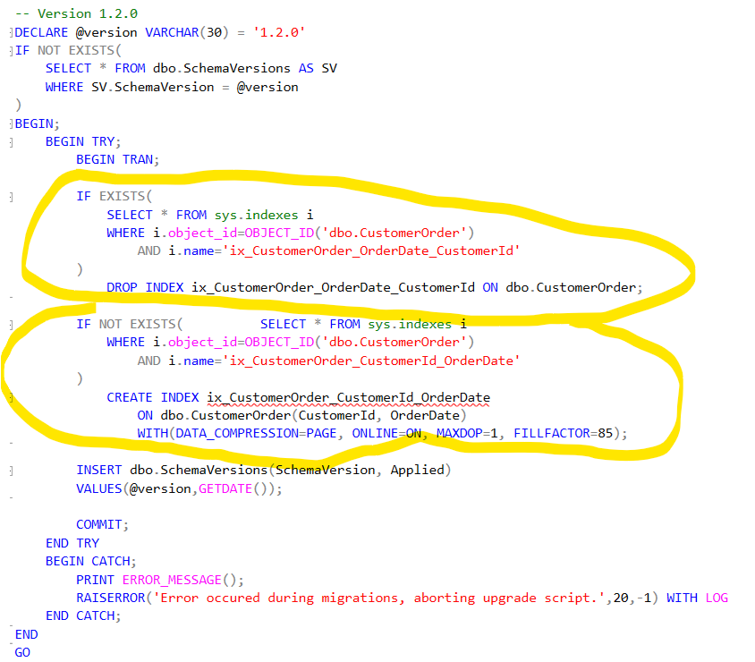
Version 1.2.0

Slide 10

Short demo
Migrations

Slide 11
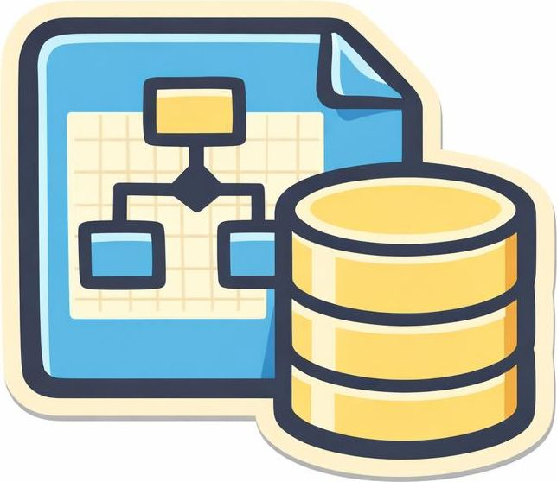
Model based deployment
Create a data model in code
SSDT Database Projects
SDK Style Database Projects
Compile the model to a dacpac
sqlpackage
dotnet build
Deploy using a tool that can compare the model with the target data model and make corrections to the target
Sqlpackage

Slide 12

SQL Server Database Projects
Mainly a tool for model based deployments
Supports migrations with Pre- and Post Deploy scripts and refactor-log.

Slide 13

SDK Style Database Projects
Warning!
Copy/Paste of these commands from PowerPoint won’t work.
Because hyphens are broken.
-o is not the same as –o
.NET Core based project file
Minimalistic project file compared to SSDT Database Project
Create using dotnet cli, Azure Data Studio or VSCode (or preview of SDK Style projects in Visual Studio 2022)
Install sqlpackage and the sqlproj project template
dotnet tool install --global microsoft.sqlpackage
dotnet new install Microsoft.Build.Sql.Templates
Create a new DB-project with target platform = Sql Server 2022 or Azure Sql (default)
dotnet new sqlproj –n ArtyPartyDatabaseName –o c:\git\ArtyPartyDatabaseName –tp Sql160
Create a new DB-project with target platform = Fabric DW
dotnet new sqlproj –n FabricateStuff –o c:\git\Fabric\db\FabricateStuff –tp SqlDwUnified
Get some help with options for dotnet new sqlproj
dotnet new sqlproj -h

Slide 14

SSDT Database Projects
.NET Framework based project type
Visual Studio support since long

Slide 15
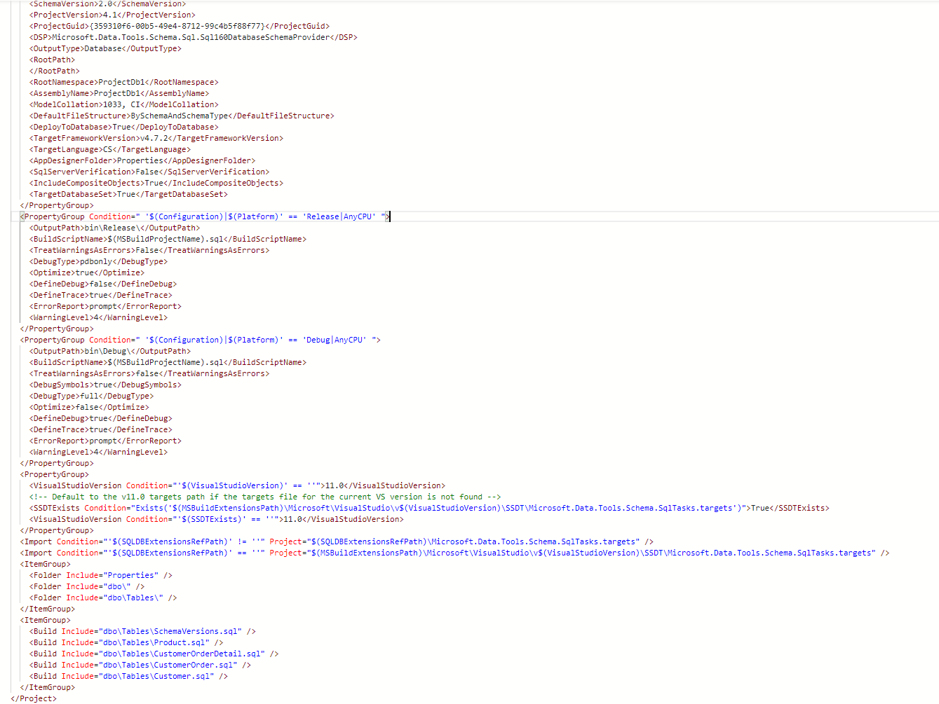

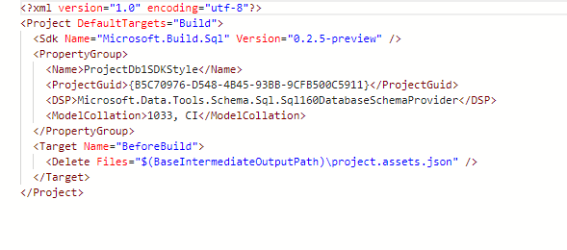
Project file differences

Slide 16

Create, don’t alter
…except in pre- and post-deploy

Slide 17

Get started
Start clean
Import existing database with Schema Comparison

Slide 18

Database references
Cross database
Reference system databases
Reference user databases
Database project reference
Dacpac reference
Nuget reference (SDK-style only)
Reference as inheritance
Useful eg when using tSQLt for tests

Slide 19
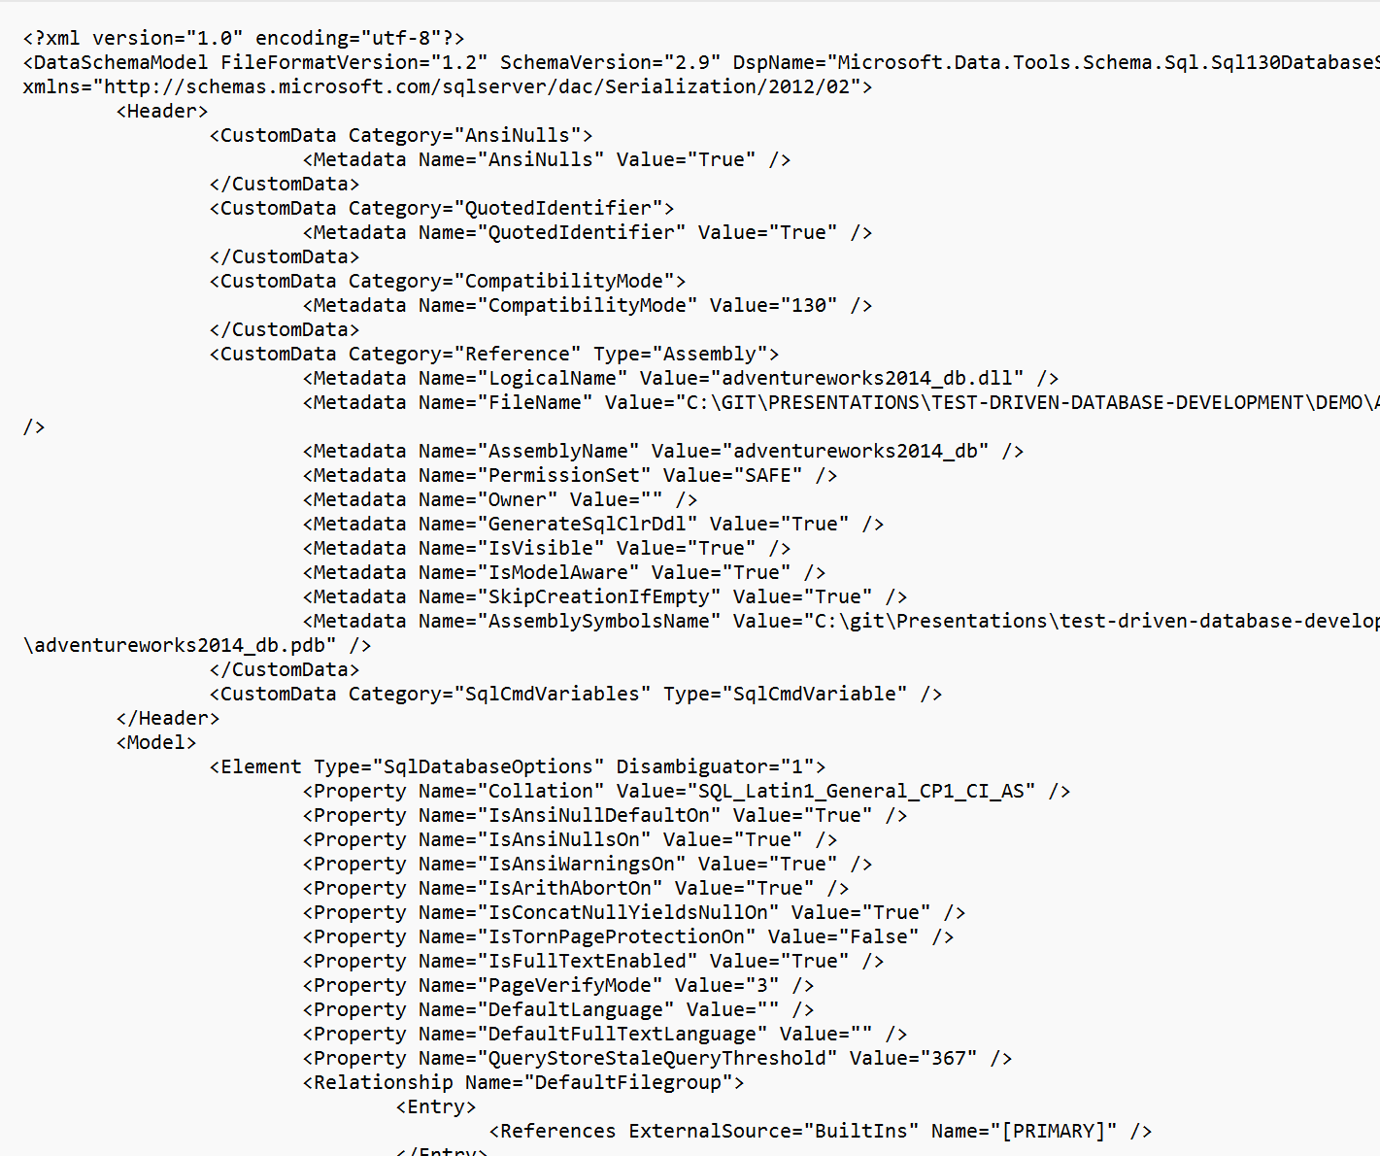
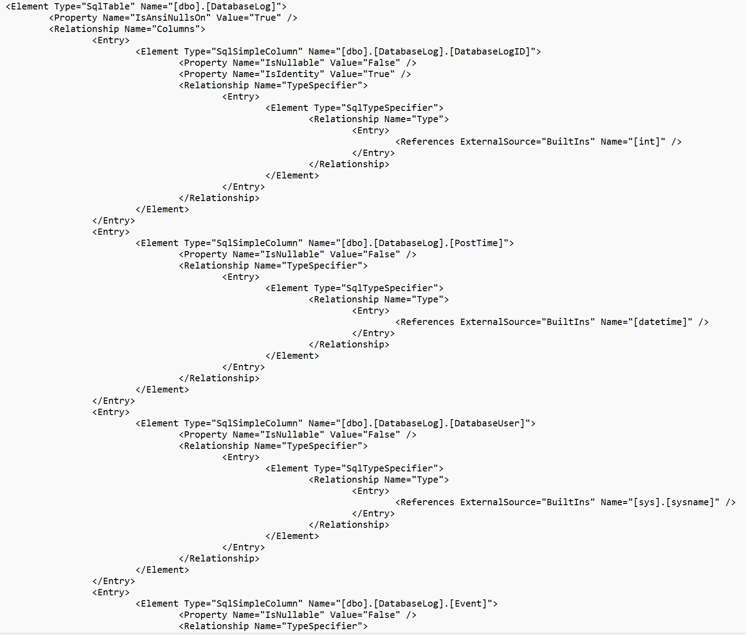

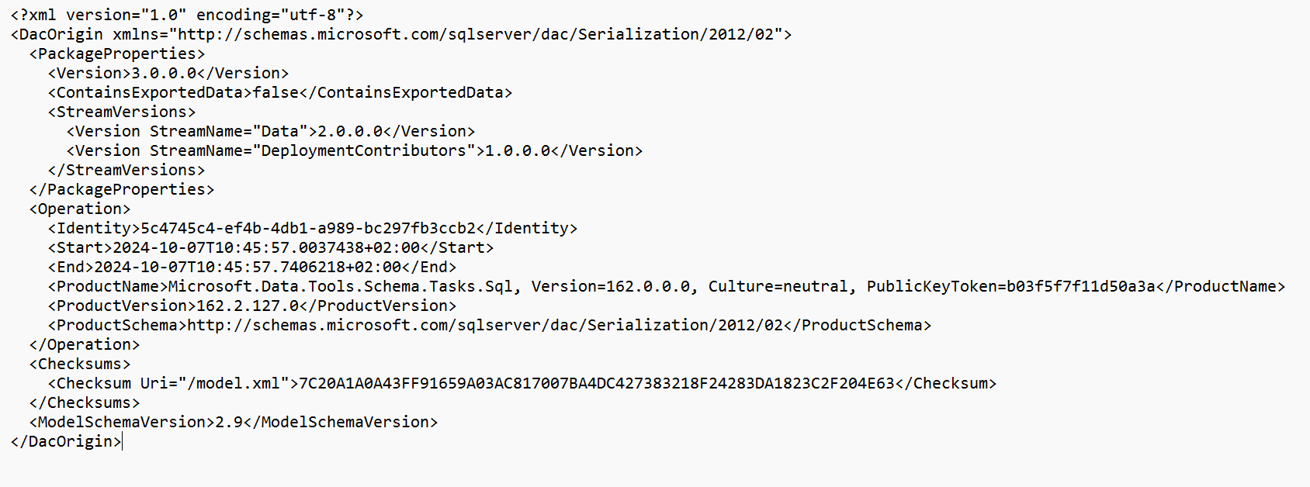
The dacpac
Zip-file with .dacpac extension
Contains xml-files
[Content types.xml]
DacMetadata.xml – Build version of the dacpac
Origin.xml – Schema version of model-file
Model.xml – the data model for the database

Slide 20

Deploy dacpac
Publish action from Visual Studio/Azure Data Studio/VSCode
Sqlpackage.exe /Action=Publish
Azure DevOps pipeline
GitHub action
…
…
…

Slide 21

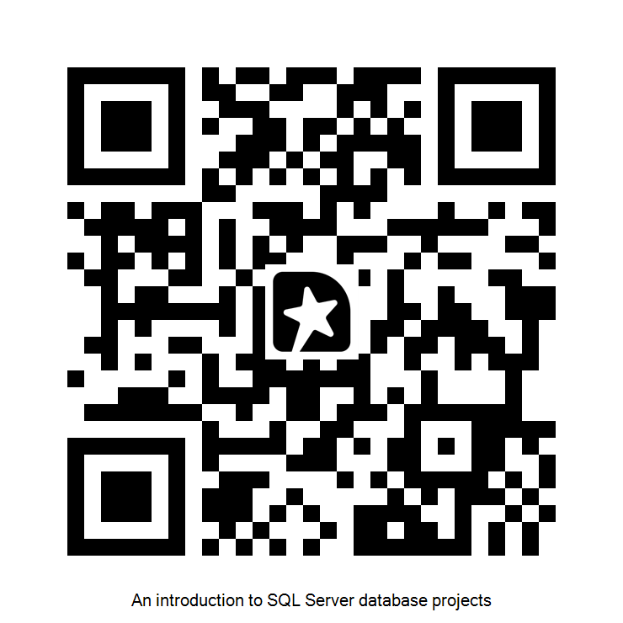
DEMO
Create database project
Import existing database
Database references
Refactoring objects
Deploy using publish action

