Slide 1

Containerize something something
Magnus Ahlkvist

Slide 2
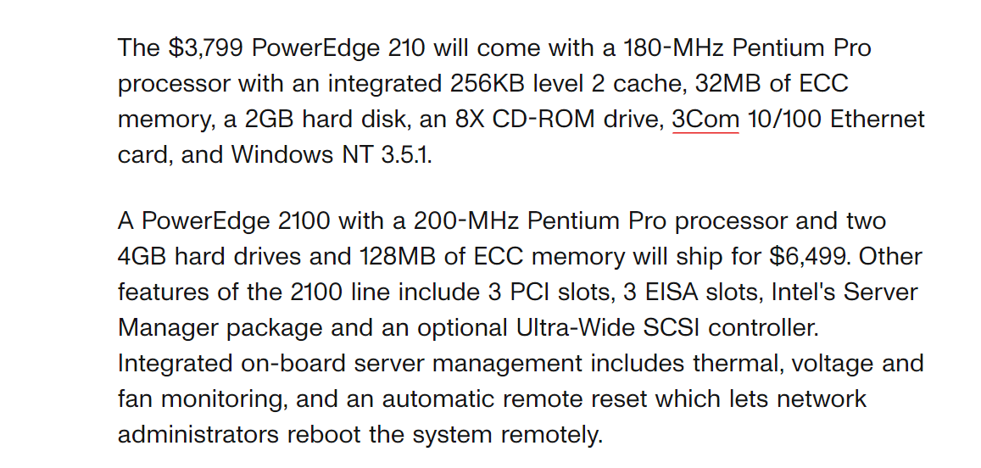
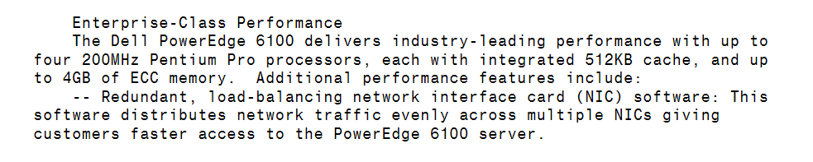

Slide 3
Deploying a new system in year 2000
Order hardware
Assemble hardware
Configure network
Configure OS
Install SQL
Deploy database

Slide 4
Some of my tasks as an accidental DBA in year 2000
Check if disks are near capacity
Order new disks and controllers and build a new RAID array in the server
Replace faulty disks
Add a new CPU to the database server
Deploy database changes with manual script execution

Slide 5
Since then, a thing or two changed

Slide 6
Magnus Ahlkvist
Mail: magnus@transmokopter.se
BlueSky: @transmokopter (ask me for invites later)
Github: github.com/transmokopter
Blog: www.tsql.nu
SQL Friday: www.sqlfriday.net
Business website: www.transmokopter.se
YouTube: www.youtube.com/c/transmokopter

Slide 7
Revolution 1 Storage Area Network

Slide 8
Revolution 2 Virtualisation

Slide 9
Revolution 3 Containers

Slide 10
And that’s just on the hardware side of things

Slide 11
Demo
Dockerfile walkthrough
Build container images
Azure container registry
Size matters – keep your containers small
Containerize application with app and database
Deploy containerised app as container group to Azure Container Instance
Deploy with docker-compose.yml. To wherever you want. Sort of.

