Slide 1
APIs
David Rios-Lazo
Notes:
Hi everyone. Today I will be discussing APIs, what they are and how they work.

Slide 2
What is an API?
API stands for Application Program Interface.
It is a set of definitions and protocols used to integrate applications, allowing communication between two or more applications through a set of rules.
Basically, APIs allow users to interact with a company’s server data, by sending instructions or requests, and receiving responses.
One of the best analogies is to think about an API as if it were a waiter. If you’re at a restaurant, you can request the food you want from the kitchen, through the waiter, the waiter goes to the kitchen, and comes back with the food.
Notes:
This means that the APIs work as an intermediary between the data server and the client, which is the same as your computer or smartphone.

Slide 3
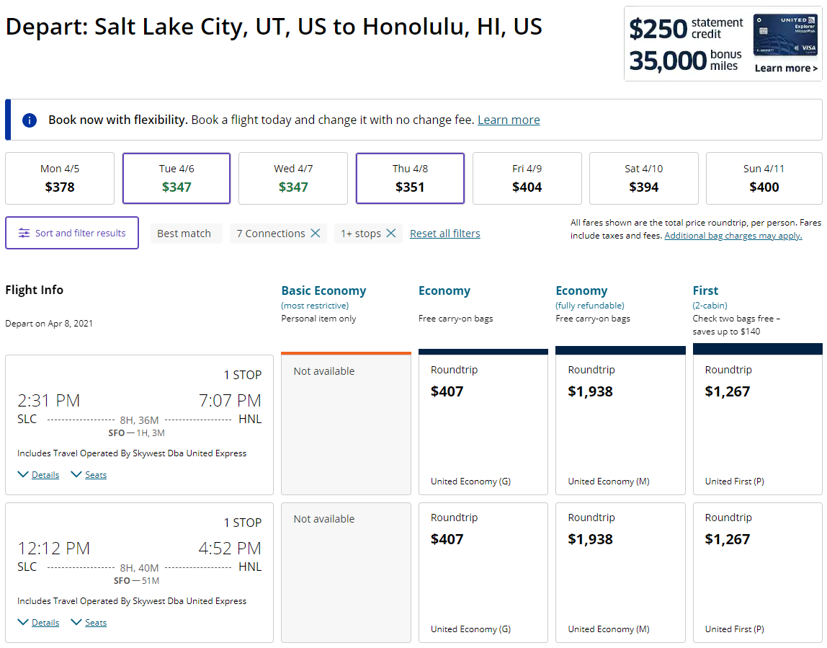
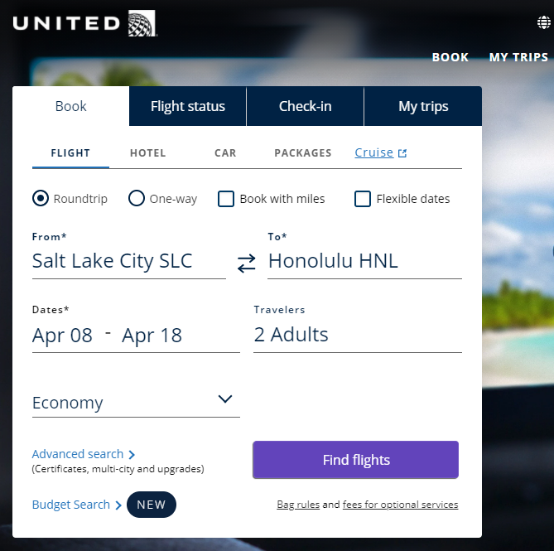
API Example
Notes:
As an example, let’s say you want to go on vacation from Salt Lake City to Honolulu, and you start looking online for prices. Here we have the website for United Airlines, and you use this website to look for plane tickets and prices, you are using United Airlines API to send a request to their server, and the server sends a response back to you and shows you their ticket prices.

Slide 4
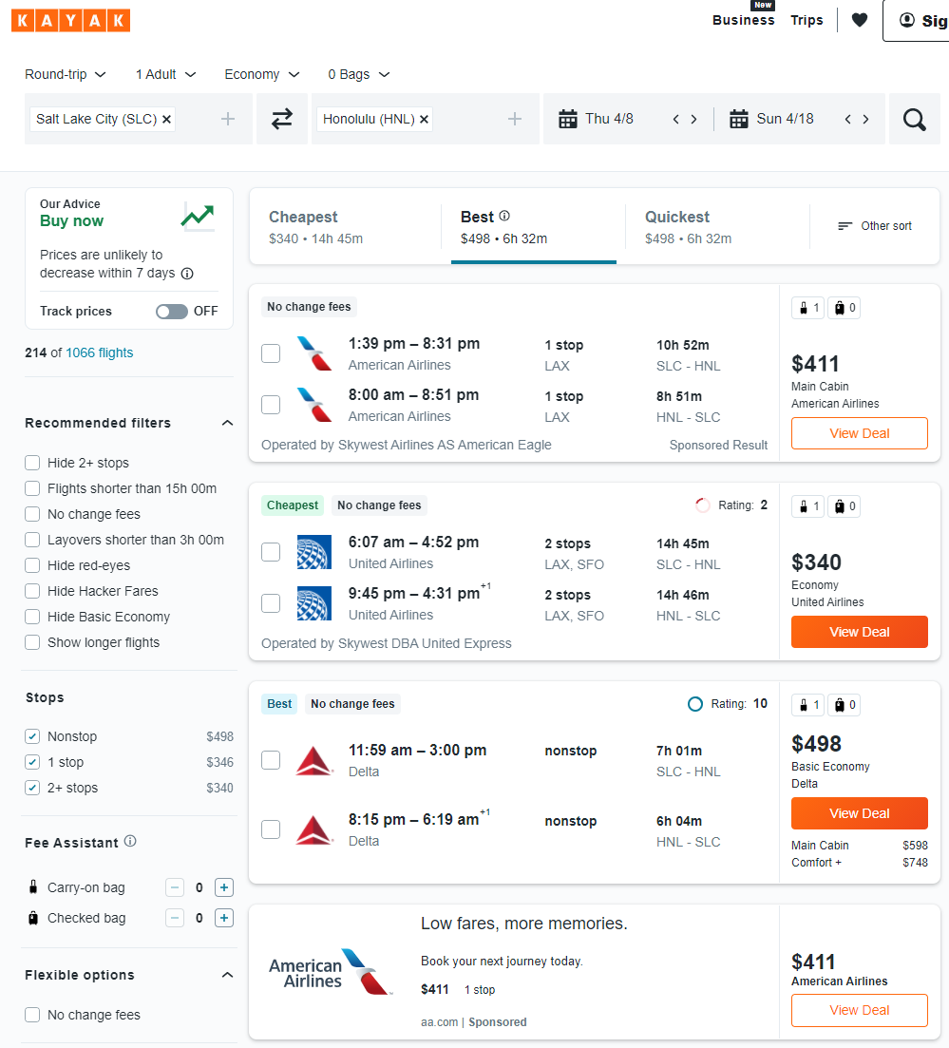
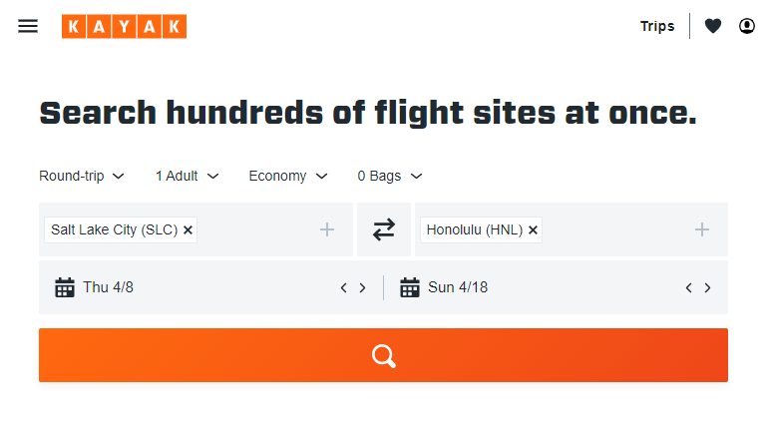
API Example
Notes:
Here’s another example, in this case we’re using a third party website to look for plane tickets. In this case, you’re using Kayak’s website, and their API interacts with all of the Airline companies APIs to look for the information you’re requesting, and it provides you with a detail of all the responses so you can find the best price at a glance, instead of going through all of the different companies websites by yourself. This is an example of how APIs can be useful and save time.

Slide 5
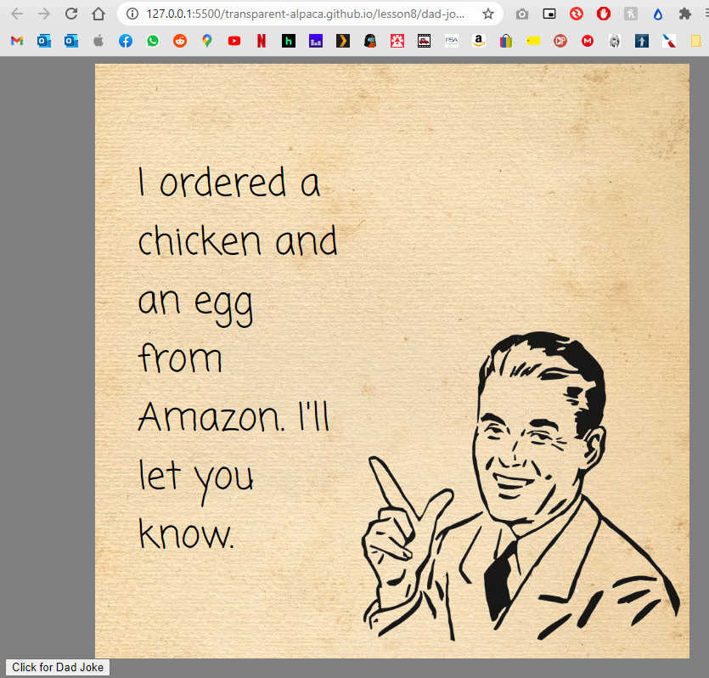
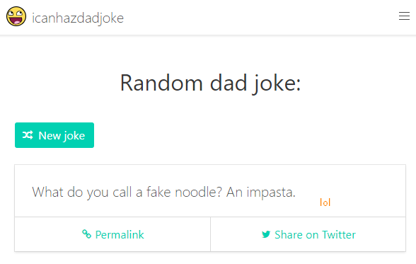
API Example
Notes:
In this course we’ve already used an API to send a request to a server and get a response. Now, it’s important to understand that an API is not the same as a server, but it is the part of the server that receives requests and sends responses. Also, the API is not the interface, it is not visible to the user, but it is programmed in the server to handle the requests and send responses back to the user.

Slide 6
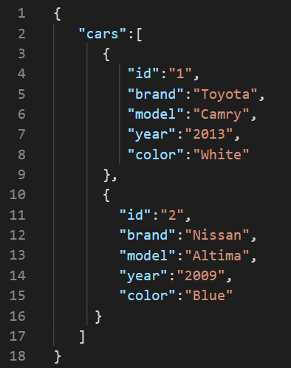
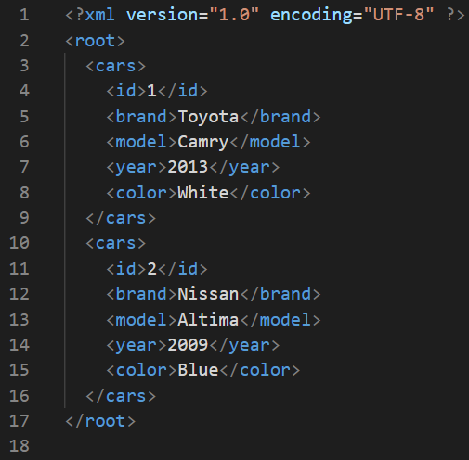
API Responses
XML: eXtensible Markup Language
JSON: JavaScript Object Notation
Notes:
Also, it is important to understand that APIs do not respond with something that is visually appealing, but something that a web browser or a program needs to interpret and convert to a visually appealing response for the final user to see. Some of the most common types of responses are sent in JSON or in XML, and the web browser or program needs to be able to interpret and handle these responses for it to be valuable for the user.

Slide 7
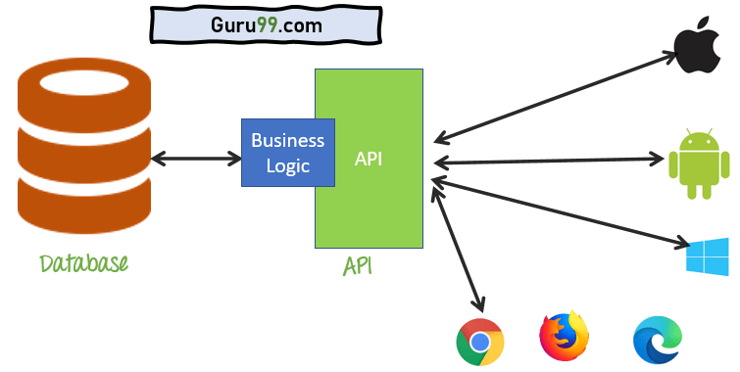
APIs and their importance
Notes:
APIs are very important in our daily lives. Without these, most software couldn’t exist. For maps, we use Google Maps API that shows us where we are and wat road to follow to get where we want to go. For shopping, we use Amazon’s API that lets us see their inventory and make purchases from our cell phone. We use Venmo’s API to send payment to friends and family. Basically, every app or web service we use connects us to a server through an API, and it’s important to learn more about these to know how they work and how they benefit our lives. Thank you.

