Slide 1
Java Collections
Vintage Guitars
Why do you need collections
Regardless of what you are sorting, searching, or categorizing the steps (algorithm) are always the same.

Slide 2
Java Collections
Collections from the Java standard library.
ArrayList
LinkedList
Vector
Stack
SortedMap
HashMap
TreeMap
PriorityQueue
ArrayQueue
HashSet
LinkedHashSet
TreeSet

Slide 3
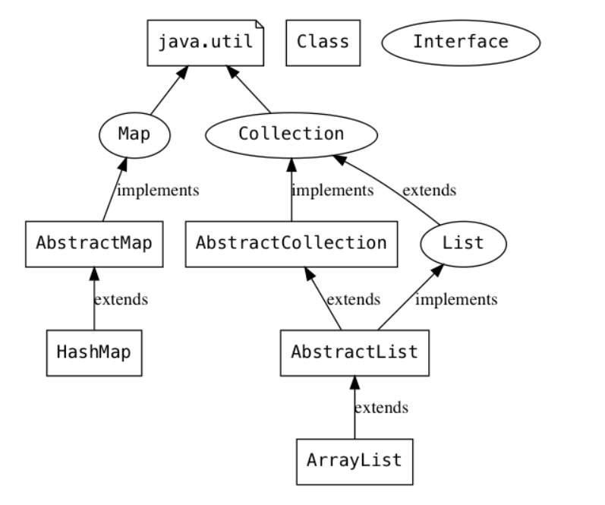
Class Hierarchy

Slide 4
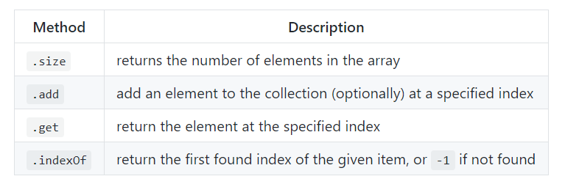
ArrayList
A representation of an array that can change sizes
    Can be thought of as a wrapper around an array, that can change size
Elements must be an object. (can add primitives through Autoboxing)
Elements must be of same type
ArrayList handle data a little differently from arrays. They have methods that handle common operations.

Slide 5
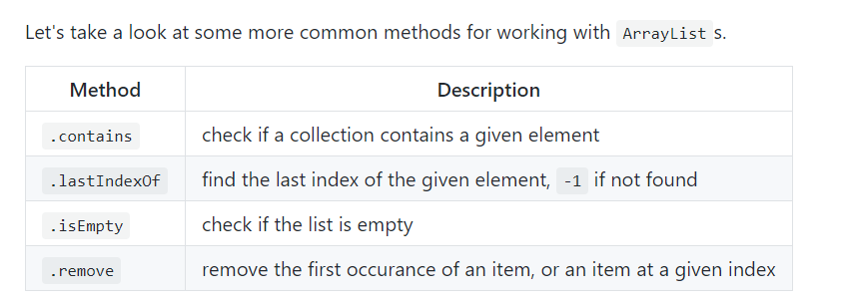
Additional Methods

Slide 6
ArrayList Demos
NOTES
Use angle brackets to specify type <>
Specify class Integer instead primitive int.
The add method is overloaded
ArrayLists use method "size()" instead of property length.
Unlike native Java arrays, we can use System.out.println to show the contents.
Note that the return value of .remove depends on how it is invoked.
  When an index is passed, the removed element is returned. When an object is passed, a boolean indicating whether or not an item was removed is returned.

Slide 7
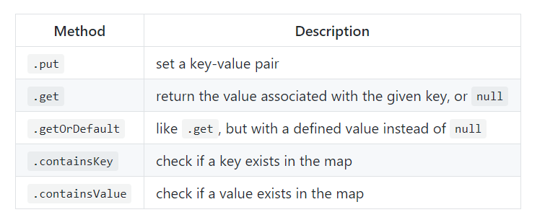
HashMap
A hash map is a data structure for key-value pairs
Very fast access to elements because the key goes straight to the element
All of the keys in the hash map must be of the same type
All of the values must be of the same type
The Keys and the values do not have to be the same type

Slide 8
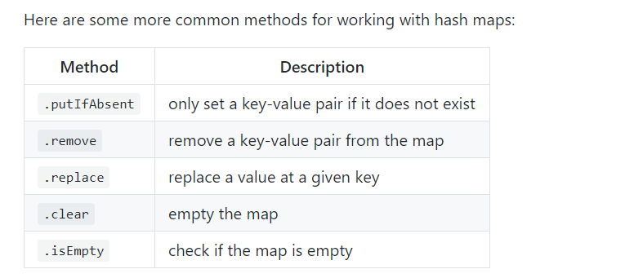
Additional Methods

Slide 9
HashMap Demos
Notes
Like ArrayLists, we must define the type of the keys and values when the hash map is created.
Hash maps also have a nice string representation.

