Slide 1
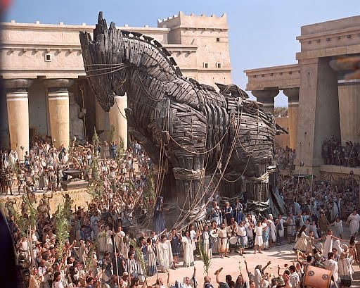
User Inputs
Trojan Horse
Something designed to be attractive to you, so you will take it inside of your defensives. Once inside, it attacks you from within the perimeter.
SQL Injection Attack
XSS: Cross Site Scripting Attack

Slide 2
SQL Injection Attack
An SQL Injection Attack is when a hacker uses a user input to alter the SQL command that is run on the server.
EXAMPLE:
"select * from user where username = ' " + username + " ' ";
The user enters, jayesh'; delete from user where id='1
So the final query run against your database is:
select * from user where username =
'jayesh'; delete from user where id='1’;
Lets demo and example...

Slide 3
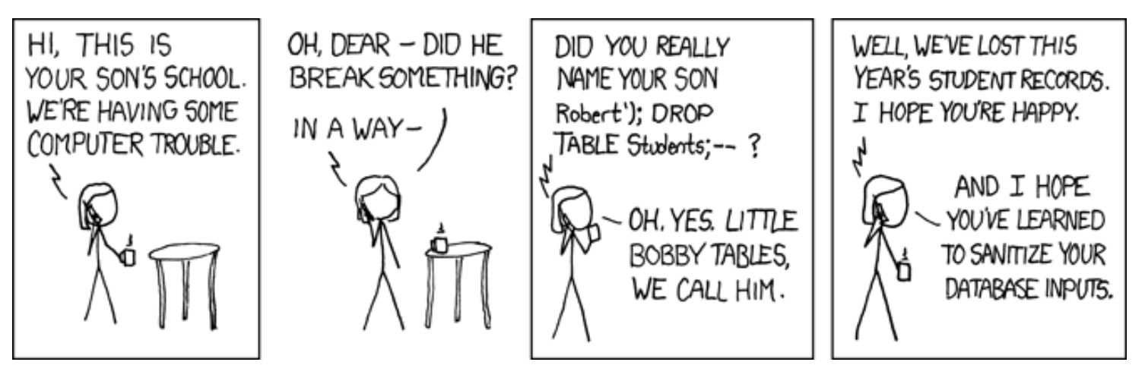
SQL Injection Attack

Slide 4
Prepared Statement
So what do you do?
Use Prepared Statements.
A prepared statement is similar to the regular statement object we previously covered, with one key difference: it uses placeholders for potentially dangerous values (i.e. value that come from the user).

Slide 5
Prepared Statement
EXAMPLE
// First create the statement
String sql = "SELECT * FROM products WHERE name LIKE ?";
// Add the wildcards to the search term
String searchTermWithWildcards = "%" + searchTerm + "%";
// Create the Prepared Statement object
PreparedStatement stmt = connection.prepareStatement(sql);
// set the values for the placeholders
stmt.setString(1, searchTermWithWildcards);
// execute the query
ResultSet rs = stmt.executeQuery();
while(rs.next()) {
// do something with the search results
}

Slide 6
Prepared Statement
Things to notice:
We define the SQL ahead of time and the query is passed to the prepareStatement method, as opposed to being passed to executeQuery.
We defined the query with a placeholder, a ? to indicate where the value will go.
We used the setString method to safely insert the search term into the query. There are other methods that start with .set for the other SQL data types.

Slide 7
Prepared Statement
Second example:
String sql = "INSERT INTO products(name, category, price) VALUES (?, ?, ?)";
PreparedStatement stmt = connection.prepareStatement(sql, Statement.RETURN_GENERATED_KEYS);
// For the sake of easier demonstration we are using literals here
stmt.setString(1, "hammer"); // set a String
stmt.setString(2, "tools");
stmt.setFloat(3, 19.99); // set a floating point number
stmt.executeUpdate();
ResultSet generatedIdResultSet = stmt.getGeneratedKeys();
We pass Statement.RETURN_GENERATED_KEYS in order to obtain the ids that were generated by the database.

Slide 8
Prepared Statement
REVIEW:
connection.prepareStatement(sql):
Create the prepared statement object, when used with INSERT, Statement.RETURN_GENERATED_KEYS can be added
statement.setXXX(idx, value):
XXX is the type of the value, and idx is the number of the placeholder -- Bind a value to the statement
statement.executeQuery():
Execute the prepared SELECT query
statement.executeUpdate():
Execute an INSERT or UPDATE query
statement.getResultSet :
Get the results of a SELECT query
statement.getGeneratedKeys :
Get the generated ids from an INSERT query

Slide 9
Cross Site Scripting
A Cross Site Scripting, or XSS, attack is one in which malicious JavaScript is inflicted on your users. This type of vulnerability can occur if we carelessly display user input on our pages.
Consider a search results page:
<h1>Product Search Results</h1>
<h2>Showing Results for ${searchTerm}</h2> <%-- <-- note this line --%>
<c:forEach var="product" items="${searchResults}">
<h3>
${product.name}
<small>${product.price}</small>
</h3>
</c:forEach>
What if a user searches for "<script>alert('xss!')</script>"?

Slide 10
Cross Site Scripting
A more dedicated, determined, and malicious individual could write some JavaScript that does much worse things, like stealing usernames and passwords, or hijacking sessions.
Any time you display user entered data on the screen you have to watch out for XSS attacks.
How can we protect against these attacks?
We can use the JSTL library's c:out tag for this. In general, whenever we are displaying a value that comes from the user, we should display it this way.

Slide 11
Cross Site Scripting
The earlier example can be fixed like this
<h1>Product Search Results</h1>
<h2>Showing Results for <c:out value="${searchTerm}" /></h2>
<c:forEach var="product" items="${searchResults}">
<h3>
<c:out value="${product.name}" />
<small><c:out value="${product.price}" /></small>
</h3>
</c:forEach>
Lets look at a demonstration in the code...

Slide 12
Cross Site Scripting
REVIEW:
What is XSS?
A Cross Site Scripting, or XSS, attack is one in which malicious JavaScript is inflicted on your users.
When do they occur?
This type of vulnerability can occur if we carelessly display user input on our pages.
How can we protect against these attacks?
We can use the JSTL library's c:out tag for this.
What might an experienced hacker try to do with an XSS attack?
A dedicated, determined, and malicious individual could write some JavaScript to steal usernames and passwords, or hijacking sessions.

