Slide 1

Employee
Wellness Program
Sneak Peek

Slide 2

New Wellness Program
Geb BioFuels will be implementing its new Wellness Program in January.
The program will provide resources and opportunities for employees to improve their overall health.

Slide 3
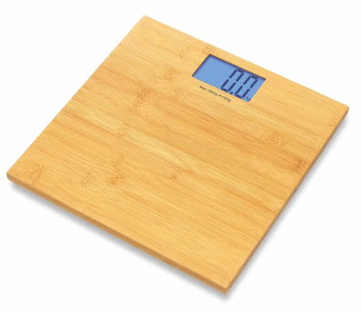
Healthy Weight Seminars
Nutrition education
Healthy food preparation
Food shopping tips
Responsible weight-loss planning
Tips for long-term weight management

Slide 4

Web Tools for Tracking Your Health Goals
Learn about free online tools that can help you keep track of your goals.

Slide 5
Stress Management Tips
Relaxation techniques
Positive communication
Time management
Establishing priorities
Conflict resolution
Counseling programs

Slide 6

Health and Wellness Screenings
Screenings for blood pressure, cancer, heart attack/stroke risk, diabetes, and more
Provided by University Hospital Community Outreach and Health Education Programs

Slide 7
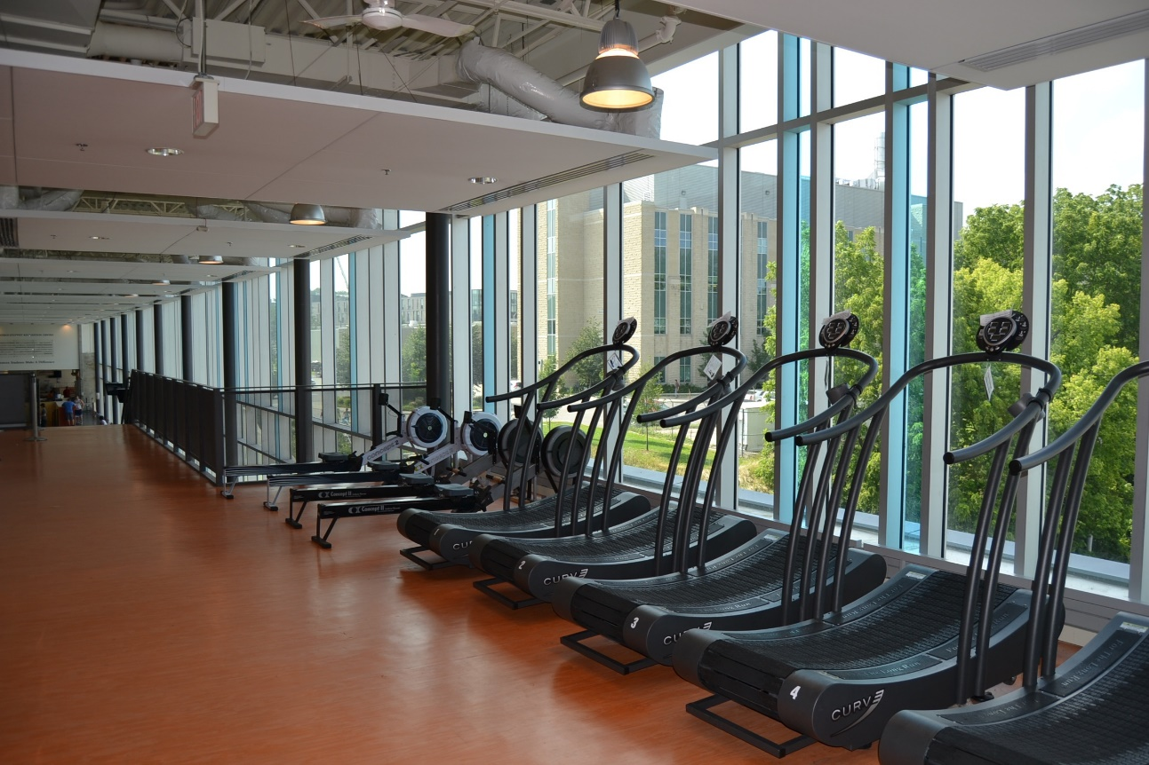
Employee Fitness Center
Flexible hours
Multiple TVs
Group classes
New machines

Slide 8



Get Active Today!

Slide 9



Healthy Recipes Available
Breakfast
Lunch
Dinner

