Slide 1
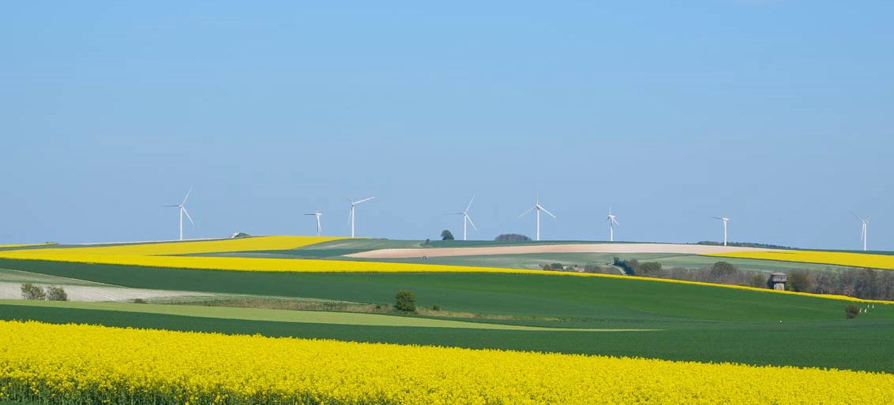
Clean Energy Conference
Presented by SW Eco-Action Alliance

Slide 2
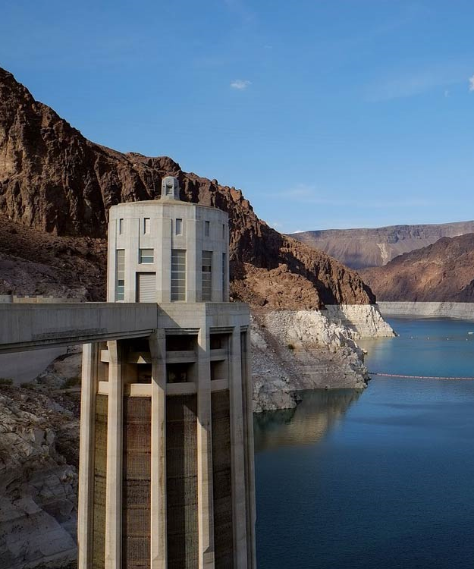
Highlights
Industry leaders in wind power, solar power, and hydropower
Insight from energy policy experts
Emerging technologies in renewable energy
Keynote: Tanisha Lowery-Crews (CEO, Alter Energy Solutions)

Slide 3
A Brighter Future
Empowering citizens to invest in renewable energy

Slide 4
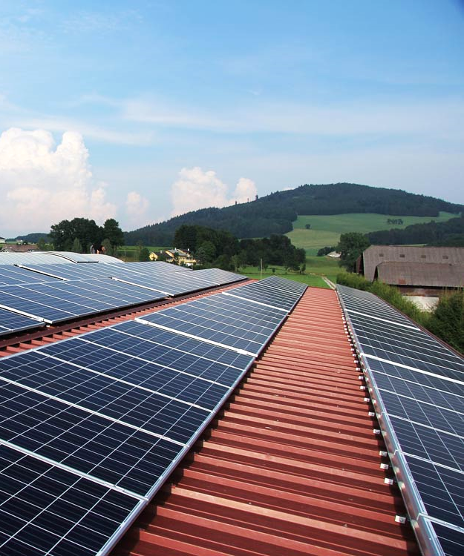
Energy will be the immediate test of our ability to unite this nation, and it can also be the standard around which we rally.
On the battlefield of energy, we can win for our nation a new confidence, and we can seize control again of our common destiny.
Jimmy Carter 39th U.S. President

Slide 5
Featured Speakers
Keynote: Tanisha Lowery-Crews (CEO, Alter Energy Solutions)
Panel: Examining the Clean Power Plan
Colleen Norton (Chair, Harmon Energy Consortium)
Trevor Garza (Founder, Garza Biotech Group)
Hank Hathaway (COO, Alter Energy Solutions)
Dr. Rachel Fleming (Director, Packard University Biotechnology Program)
Q&A: Tricia Nguyen (Director, Sanders Research Center)
Workshop: Trevor Garza (Founder, Garza Biotech Group)

Slide 6
Agenda
8:00 – 9:00a.m. Breakfast and Meet-and-Greet (Hotel Lobby)
Come meet our featured speakers! Complimentary Continental style breakfast will be available
9:15 – 10:15a.m. Keynote Address- Tanisha Lowery-Crews (Grand Conference Room)
10:15 – 11:15a.m. Panel Discussion (Grand Conference Room)
11:15 – 11:45a.m. Q&A (Grand Conference Room)
Please use our question submittal form found on our conference website. Time will be given at the end of the panel to write and submit your questions.
12:00 -1:00p.m. Lunch (Conference Room II)
Lunch will be catered by a local company. Vegetarian options available.
1:00 – 3:00p.m. Afternoon Workshop (Locations Vary)
Please find your small group assignment in your welcome packet. A list of small group meeting locations is also included in the packet.

