Slide 1
Mongibello Artisan Pasta
About Our Business

Slide 2
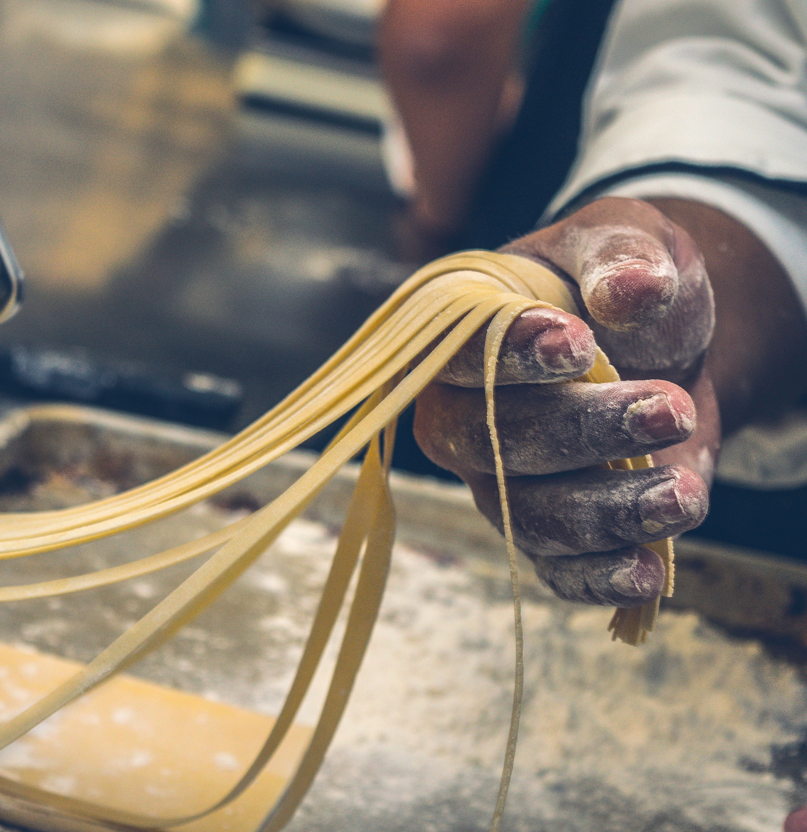
Our Mission
To create unique, high-quality pastas—made by hand without additives or preservatives—for individuals who seek fresh, one-of-a-kind ingredients.

Slide 3
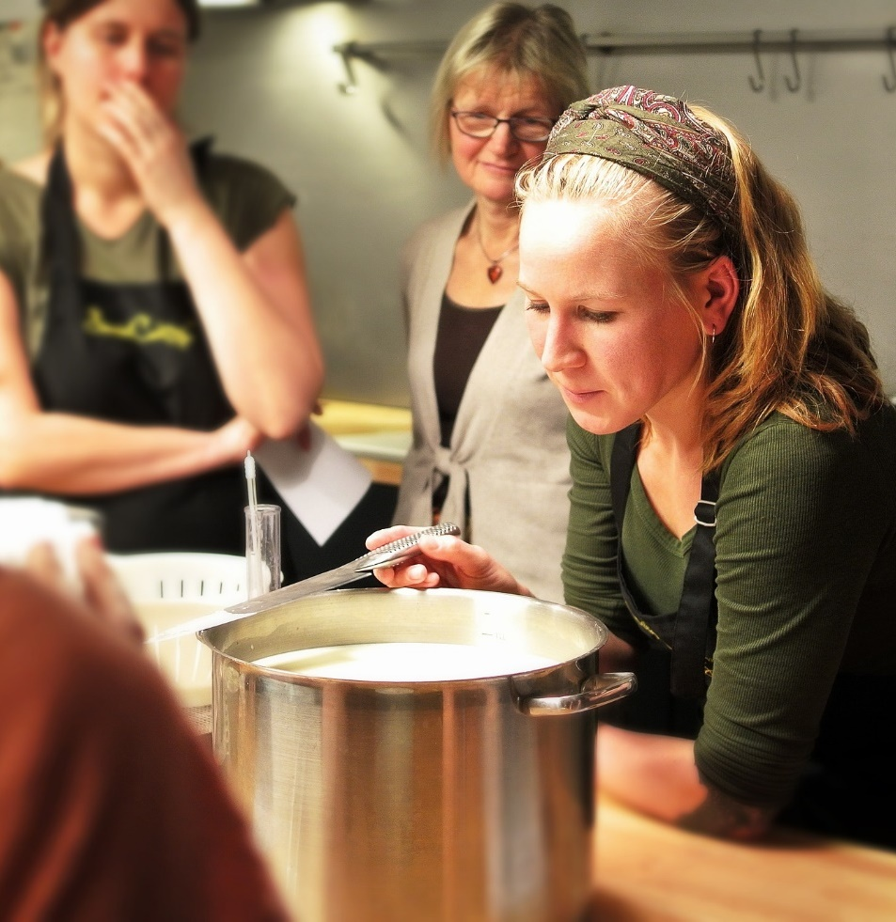
Our Team
Owner Shel Rheingold (with Manager Stefan Linn) leads a talented team with over 30 years of experience making pasta by hand, crafting unique flavors that tantalize the palate, and pushing the boundaries of traditional artisan pasta making.

Slide 4
Let’s Compare
Them
Us
Traditional pasta flavors
Conventional use of all-natural dyes; limited color palette
Repetitive die-cut process
Unique flavors built on tradition
Innovative use of all-natural dyes; wider color palette
Minimal die-cut process

Slide 5
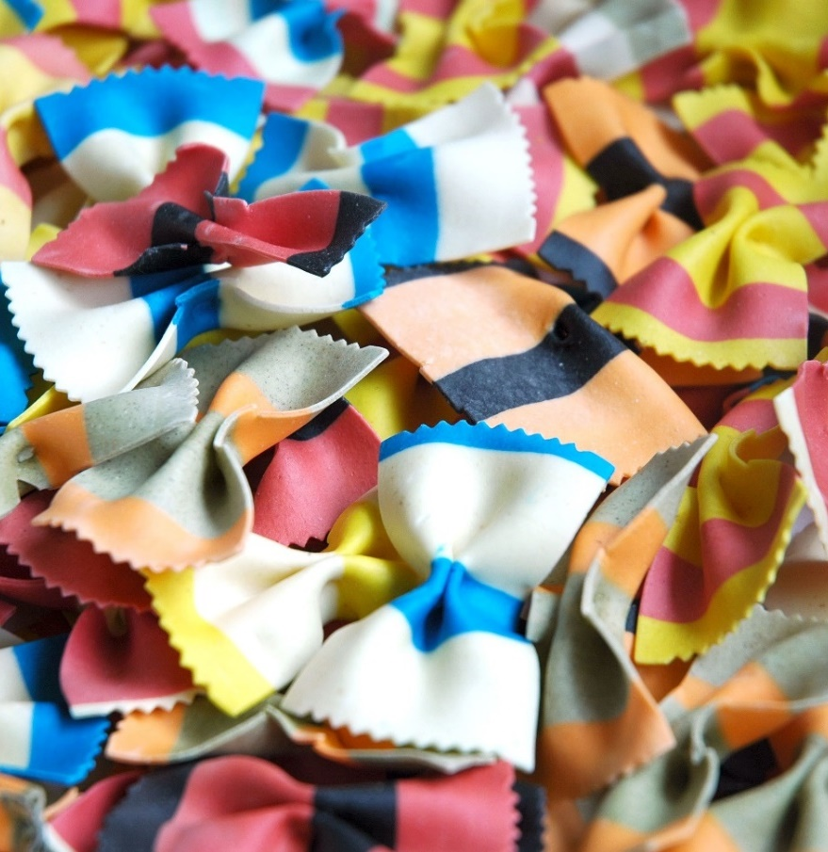
The Goods
Zesty Black Bean Fettuccine
Sun-Dried Tomato Fettuccine
Thai Basil Fettuccine
Roasted Red Pepper Penne
Massaman Curry Penne
Wild Mushroom Penne
Shel’s Spanakopita Bowties
Stefan’s Striped Bowties

Slide 6
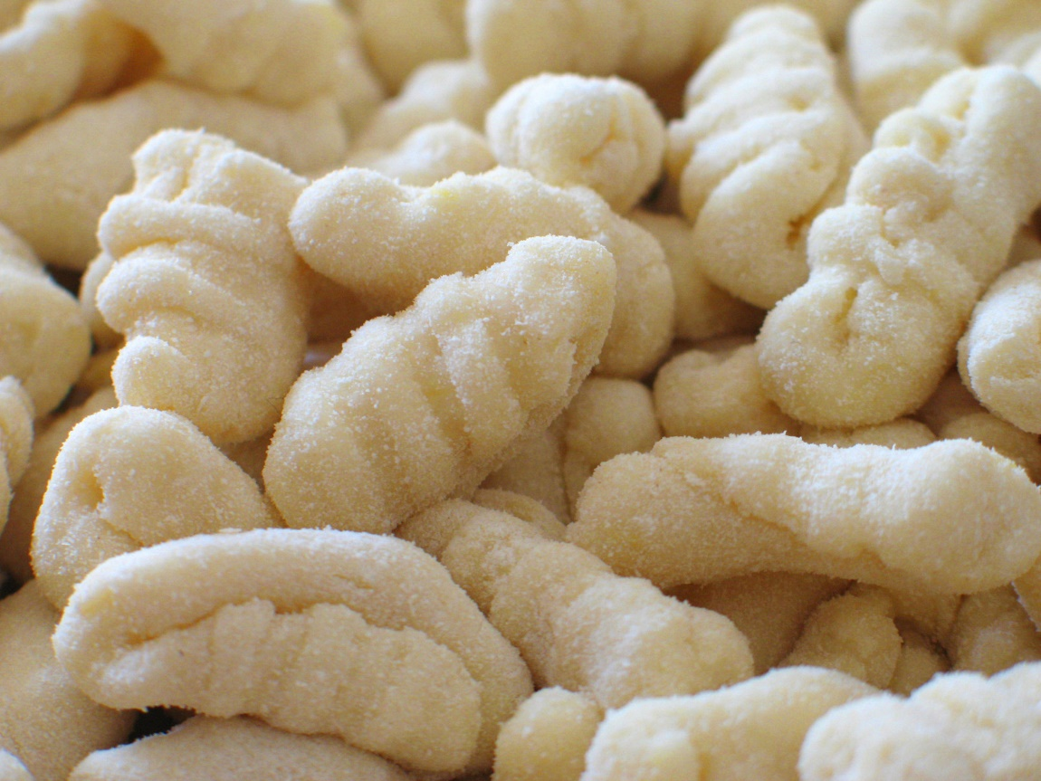
Homemade Gnocchi

Slide 7
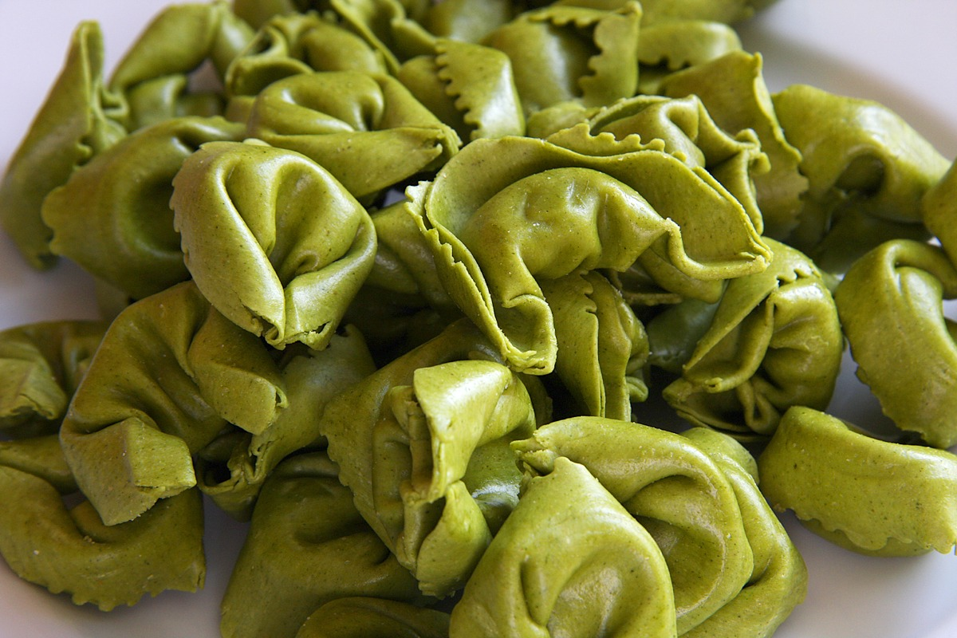
Fresh Tortellini

Slide 8
Shop or Visit Our Kitchen
1009 Craftsman Drive
Portland, Maine
9:00-5:00 Tues-Sun
207-555-1145
shel@bellopasta.com

