Slide 1
Texlahoma High School
Terrier Tough!
Band Boosters Meeting
July 1, 2016

Slide 2
Agenda
New Officers
Elections and Thank You
Announce New Officers
Distribute Officer Contact Info
Fundraising
Past and Present Ideas
Review Yearly Results

Slide 3
New Officer Announcement
2016-2017 School Year

Slide 4
Elections and Appreciation
Elections were held in june
for new Band Boosters officers for the
2016-2017 school year.
Before we welcome our new officers,
we want to give a huge THANK YOU to our previous year’s officers for a spectaculer year and for all their hard work!

Slide 5
New 2016-2017 Band Booster Officers
Officer Position | Member
President | Ms. Sara Morales
Vice President | Mr. Terrance Miller
Accounting | Ms. Sandra Lee
Fundraising Chair | Ms. Julia Stevens
Secretary | Mrs. GwePierce
Congratulations & Welcome!

Slide 6
Fundraising
Past and Future

Slide 7
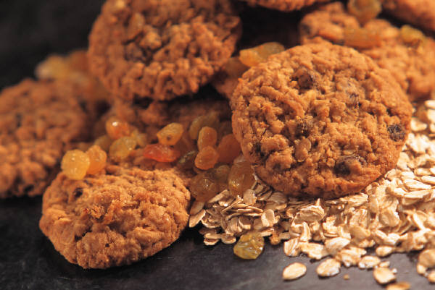
Possible Funraising Projects
Previous Projects
Bake Sale
Candybar Sale
Walk-a-Thon
Wrap Gifts at Local Mall
Card Kit Sales
New Project Ideas
Candygrams for Kids
Car Wash
Idol Contest – Pay Per Vote

Slide 8
Past Fundraising Results

Slide 9
Choose 2016-2017 Projects
Need to Choose Fundraising Projects
5 projects per school year
Each lasts 6 weeks, with a 2-week break in between
Need Project Coordinators
Review monetary benefits of projects
Project Coordinator’s Responsibility:
Best way to coordinate project
For Suggestions or Participation, Contact:
Julia Stevens, Fundraising Chair, at jstevens684576@163.com

Slide 10
Next Meeting
July 15, 2016

Slide 11
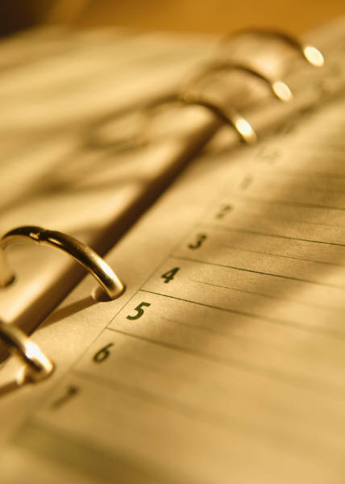
See You Next Month!
Next Meeting:
July 15 at 7 p.m.
Back to School – Recruit New Members
Finalize Fundraising Calendar and Assign Coordinators

Slide 12
Refreshmnts
Please stick around for refreshments brought to you by
Hot Cakez Bakery
owned an operated by band praent Melissa Santi.

