Slide 1
Attracting Bees, Butterflies, and Other Pollinators
Improving Your Garden and Outdoor Environment

Slide 2
Plant flowers rich in pollen & nectar
Pollinators love plants like lavender, aster, goldenrod, and sage

Slide 3
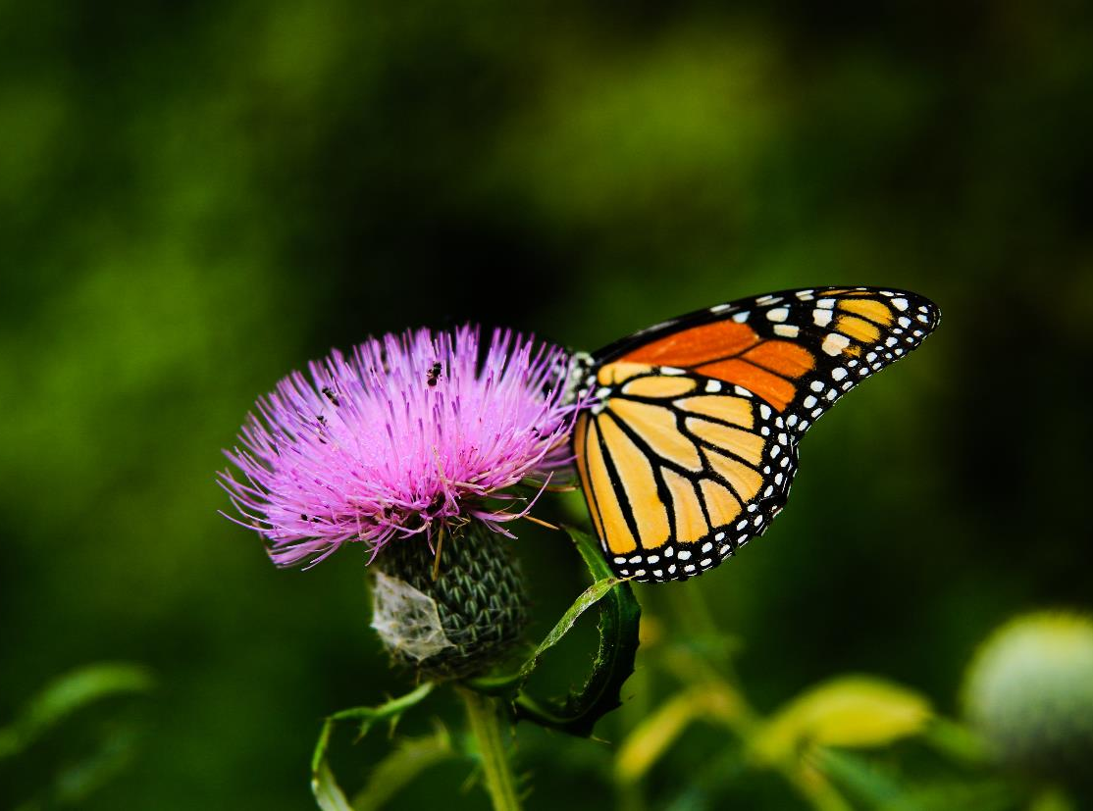
Avoid using harmful chemicals
Aggressive fertilizers and insecticides can kill or deter pollinators

Slide 4
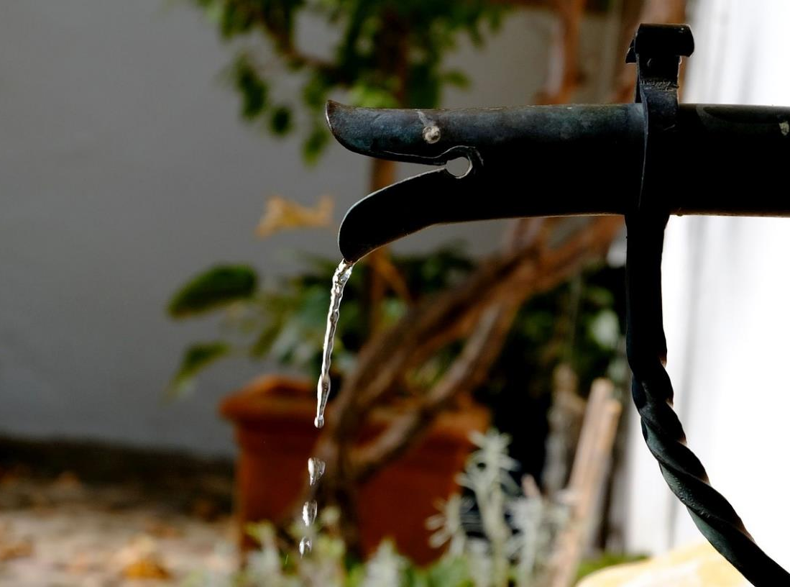
Provide food and water
A water garden, bird bath, or hummingbird feeder will provide rest and refreshment

Slide 5
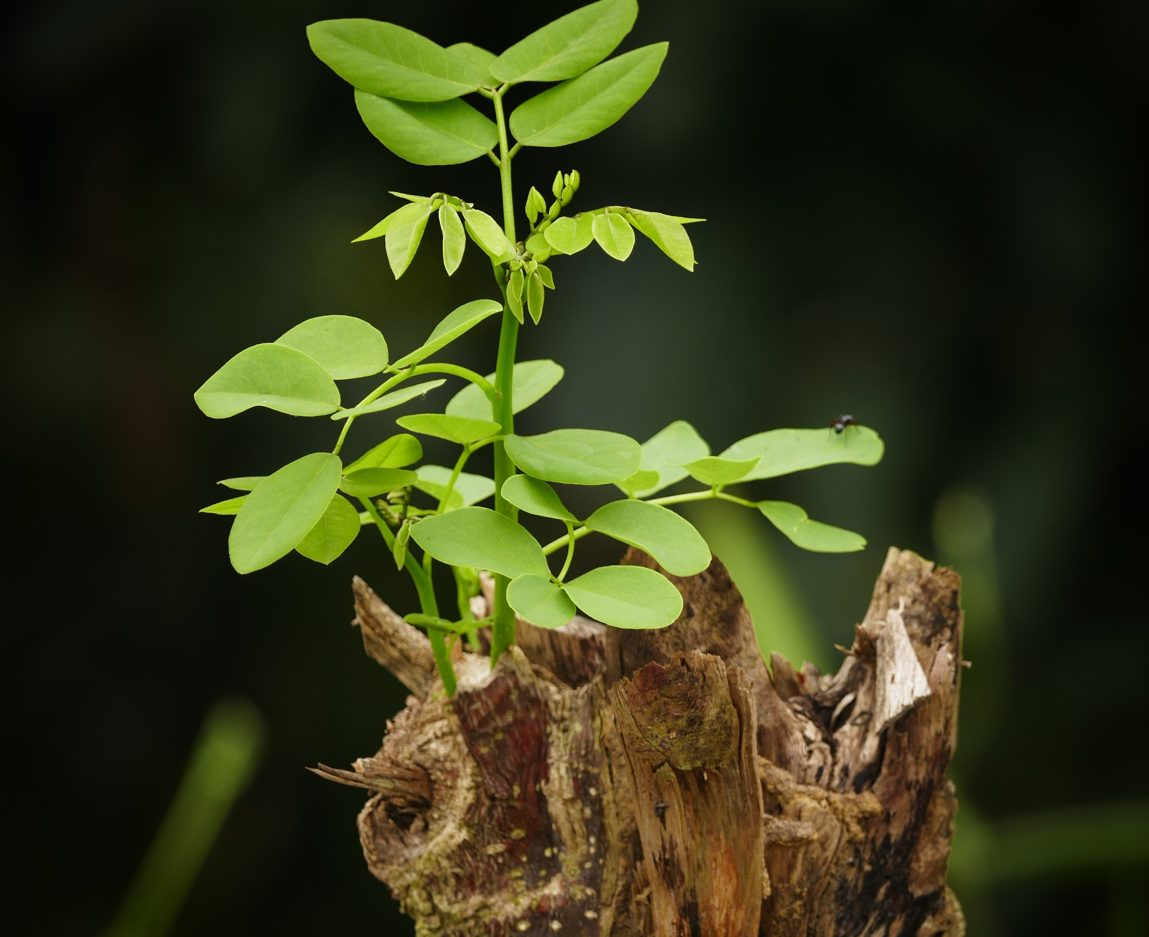
Give them shelter
Provide a hidden hideaway to keep your pollinators happy and protected

