Slide 1
Texlahoma High School
Terrier Tough!
Band Boosters Meeting
July 1, 2016

Slide 2
Agenda
New Officers
Elections and Thank You
Announce New Officers
Distribute Officer Contact Info
Fundraising
Past and Present Ideas
Review Yearly Results

Slide 3
New Officer Announcement
2015-2016 School Year

Slide 4
Elections and Appreciation
Elections were held in June
for new Band Boosters officers for the
2015-2016 school year.
Before we welcome our new officers,
we want to give a huge THANK YOU to our previous year’s officers for a spectacular year and for all their hard work!

Slide 5
New 2015-2016 Band Booster Officers
Officer Position | Member
President | Ms. Sara Morales
Vice President | Mr. Terrance Miller
Accounting | Ms. Sandra Lee
Fundraising Chair | Ms. Julia Stevens
Secretary | Mrs. GwePierce
Congratulations & Welcome!

Slide 6
Fundraising
Past and Future

Slide 7
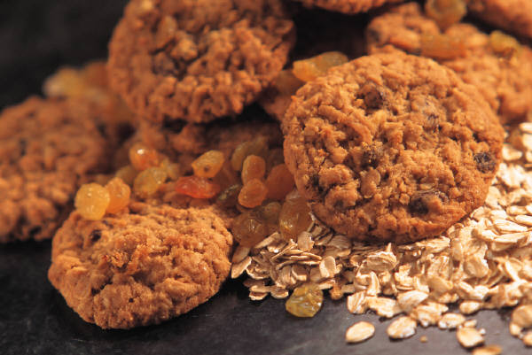
Possible Funraising Projects
Previous Projects
Bake Sale
Candy bar Sale
Walk-a-Thon
Wrap Gifts at Local Mall
Card Kit Sales
New Project Ideas
Candygrams for Kids
Car Wash
Idol Contest – Pay Per Vote

Slide 8
Past Fundraising Results

Slide 9
Choose 2015-2016 Projects
Need to Choose Fundraising Projects
5 projects per school year
Each lasts 6 weeks, with a 2-week break in between
Need Project Coordinators
Review monetary benefits of projects
Project Coordinator’s Responsibility:
Best way to coordinate project
For Suggestions or Participation, Contact:
Julia Stevens, Fundraising Chair, at jstevens684576@163.com

Slide 10
Next Meeting
July 15, 2016

Slide 11
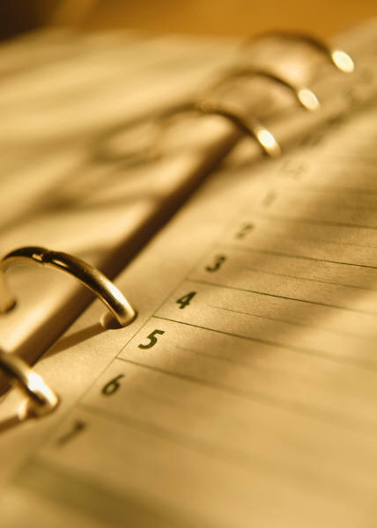
See You Next Month!
Next Meeting:
July 15 at 7 p.m.
Back to School – Recruit New Members
Finalize Fundraising Calendar and Assign Coordinators

