Slide 1
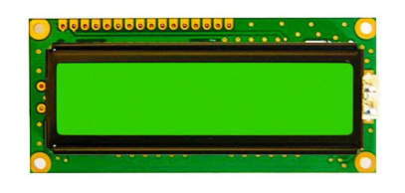
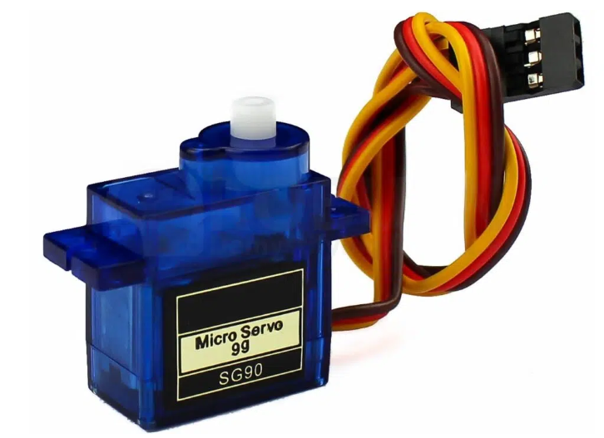
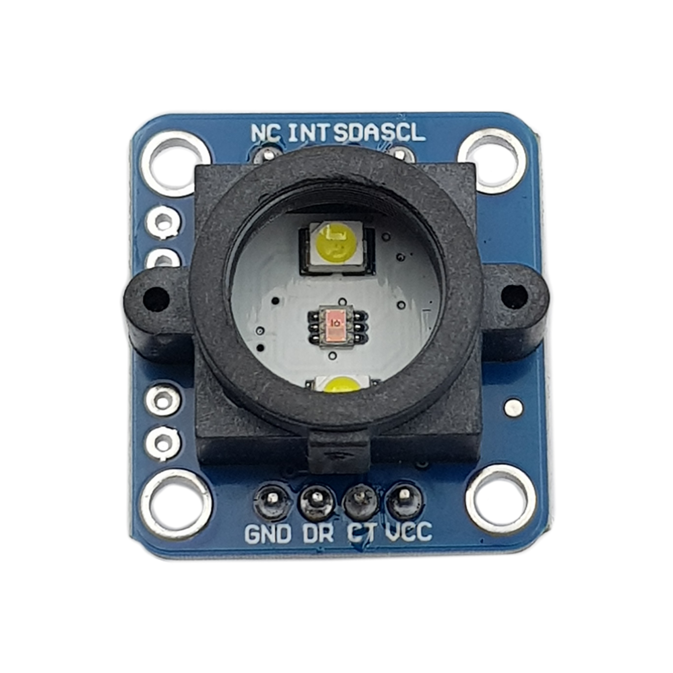
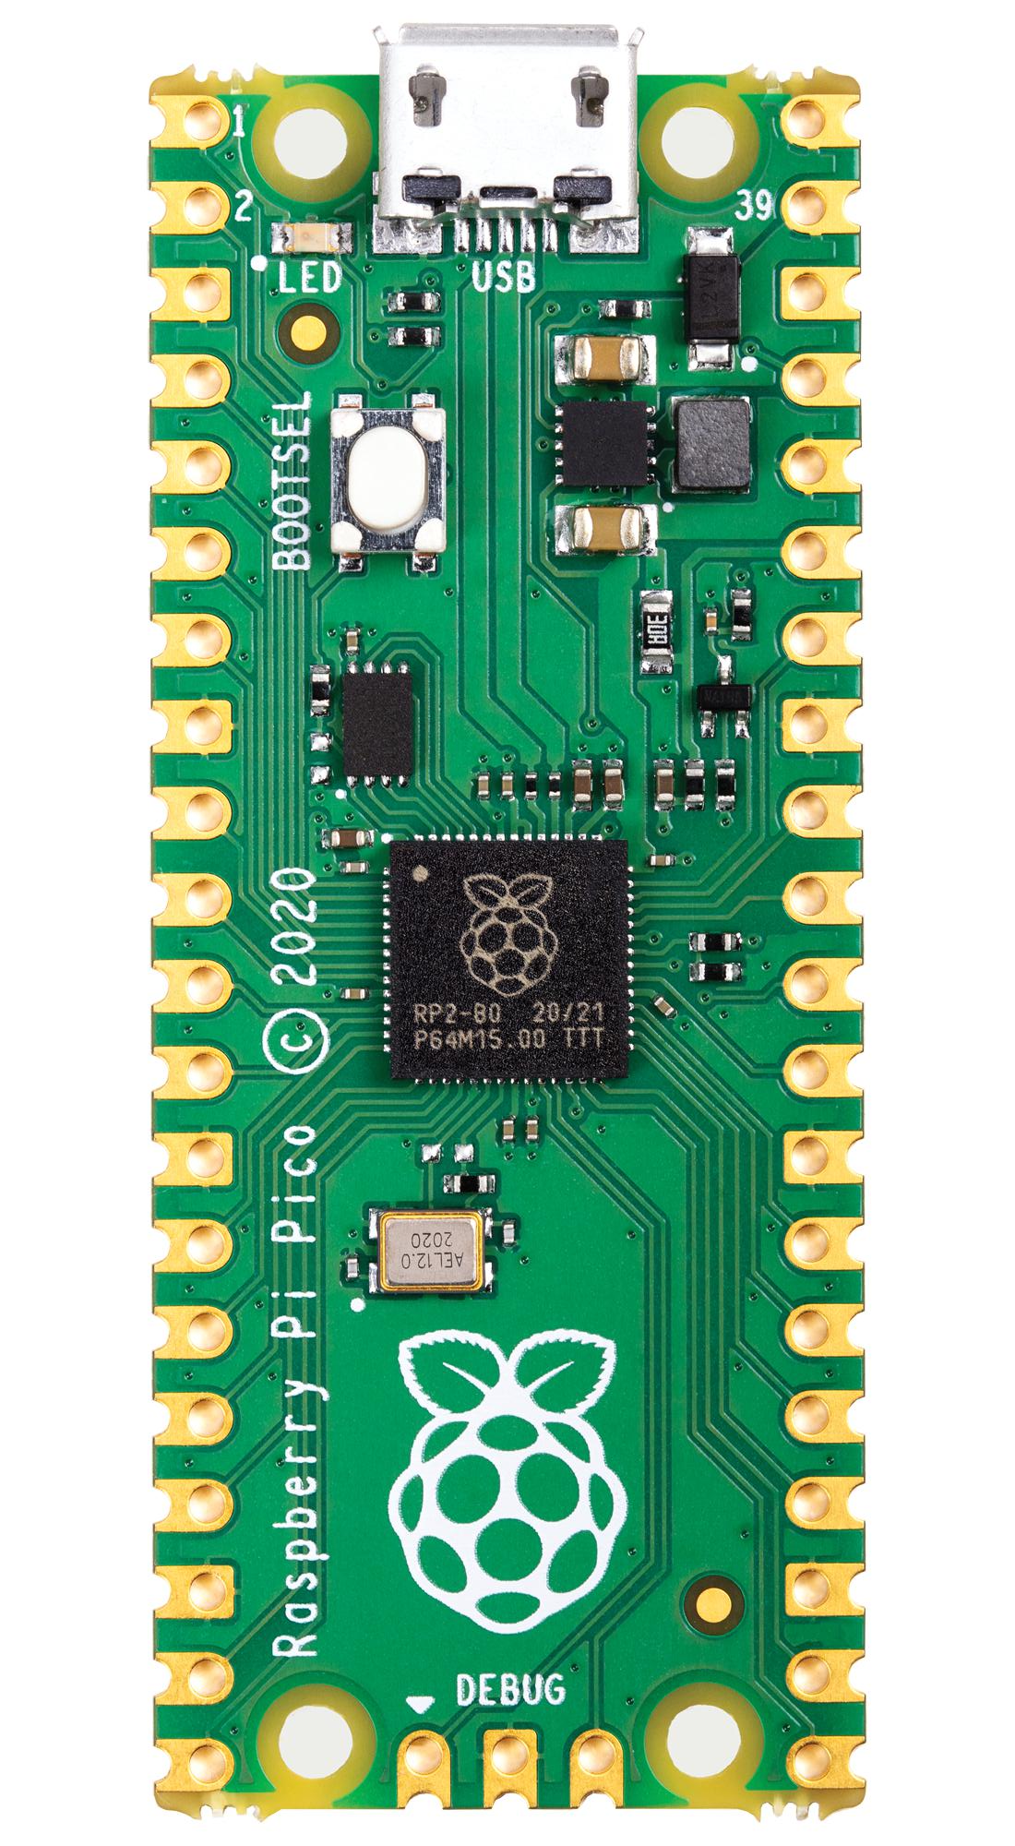
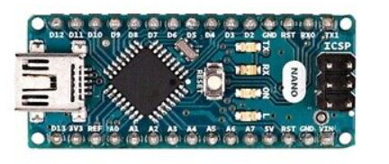
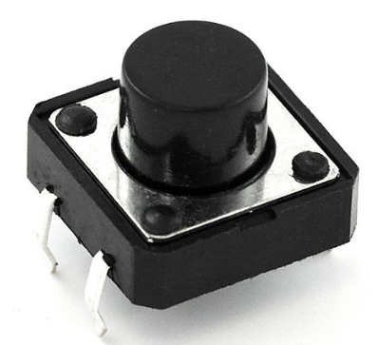
Main components
(7)
(1)
(2)
(8)
(3)
(5)
(6)
(9)
(10)
(11)
(12)
(1),(2),(3),(4): Servo SG90
(5): Arduino Nano
; (6): Raspberry Pi Pico
; (7): LCD 16x2
(4)
(8): TCS34725 Sensor
; (9),(10),(11),(12): Button

