Slide 1
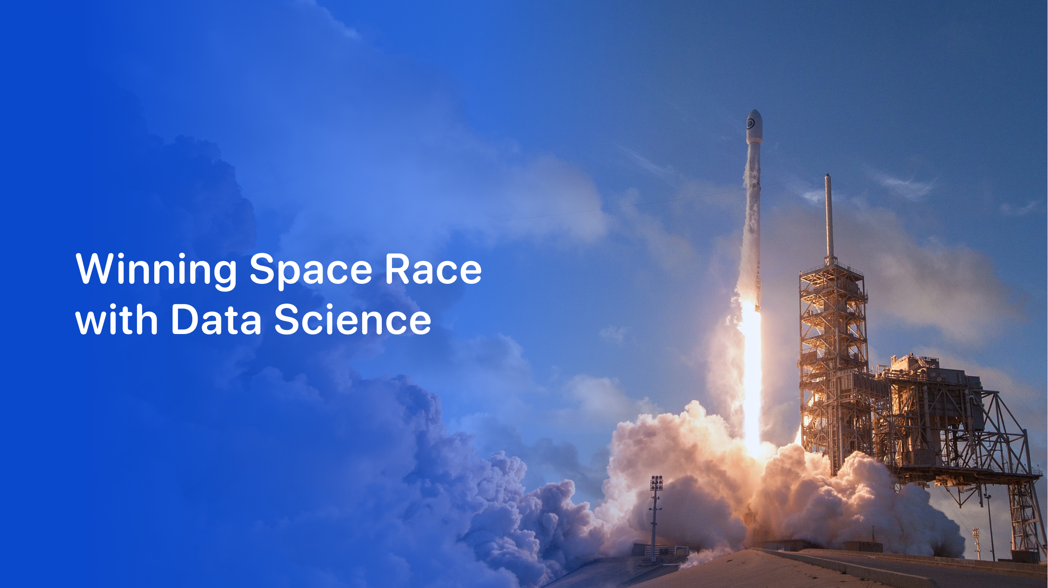

<Tran Thi Thao>
<22-04-2026>
https://github.com/ddtbnt/IBM-Applied-Data-Science-Capstone-Project-ddtbnt.git

Slide 2

Project Overview
Data Collection – Gather data from SpaceX API and Wikipedia web scraping.
Data Wrangling – Clean data, handle missing values, create Class column (0/1).
EDA – Analyze data using Seaborn, Matplotlib, and SQL queries.
Visual Analytics – Interactive Folium maps and Dash dashboard.
ML Prediction – Predict launch success with 4 ML models; evaluate using Accuracy/F1, Confusion Matrix, ROC curve.

Slide 3
Executive Summary
SpaceX API – Collect launch data.
Web Scraping – Gather additional data from Wikipedia.
Data Wrangling – Clean data, handle missing values, create Class column.
EDA – Analyze data with charts and SQL queries.
Visual Analytics – Interactive Folium maps and Dash dashboard.
ML Prediction – Predict launch success using 4 ML models.

Slide 4
Introduction
Background – Analyze SpaceX Falcon 9 launches to understand patterns of success and failure.
Problem Statement – Predict launch success and provide actionable insights.
Objective – Explore data, identify trends, and apply predictive models for decision-making.

Slide 5
Data Collection – SpaceX API
Purpose – Collect launch data from SpaceX API.
Steps:
Send GET requests to SpaceX API endpoints.
Process JSON responses and convert to Pandas DataFrame.
Inspect data with head() to verify results.
Reference File: SpaceX_Data_Collection_API.ipynb
GitHub URL: https://github.com/ddtbnt/IBM-Applied-Data-Science-Capstone-Project-ddtbnt/blob/main/SpaceX-API/SpaceX_Data_Collection_API.ipynb
Tip: Include a screenshot of API call code and sample DataFrame output.

Slide 6
Data Collection – Web Scraping
Purpose – Collect additional Falcon 9 launch data from Wikipedia.
Steps:
Use BeautifulSoup to scrape tables from Wikipedia pages.
Process HTML tables into clean Pandas DataFrame.
Verify and inspect data for completeness.
Reference File: SpaceX_Web_Scraping.ipynb
GitHub URL: https://github.com/ddtbnt/IBM-Applied-Data-Science-Capstone-Project-ddtbnt/blob/main/Web-Scraping/SpaceX_Web_Scraping.ipynb
Tip: Include screenshot of scraping code and sample scraped table.

Slide 7
Data Wrangling Methodology
Purpose – Clean and prepare the collected data for analysis.
Steps:
Handle missing values and remove duplicates.
Create Class column: 0 = failed, 1 = success.
Merge SpaceX API data with Web Scraped data into a unified DataFrame.
Reference File: SpaceX_Data_Wrangling.ipynb
GitHub URL: https://github.com/ddtbnt/IBM-Applied-Data-Science-Capstone-Project-ddtbnt/blob/main/Data-Wrangling/SpaceX_Data_Wrangling.ipynb
Tip: Include screenshot of key cleaning code and example table after wrangling.

Slide 8
EDA with Data Visualization
Purpose – Explore patterns and trends in the data using visualizations.
Steps / Visuals:
Distribution of payload and success rate.
Catplot, scatterplot, and bar charts using Seaborn.
Extract insights from visual trends.
Reference File: SpaceX_EDA_Visualization.ipynb
GitHub URL: https://github.com/ddtbnt/IBM-Applied-Data-Science-Capstone-Project-ddtbnt/blob/main/EDA-with-Visualization/SpaceX_EDA_Visualization.ipynb
Tip: Include 2–3 key charts as screenshots and brief notes on insights.

Slide 9
EDA with SQL
Purpose – Analyze SpaceX data using SQL queries to extract insights.
Steps / Queries:
Use SELECT, SUM, COUNT, GROUP BY to summarize launches.
Identify launches per year, success rates per launch site.
Explore trends in payloads and outcomes.
Reference File: SpaceX_EDA_SQL.ipynb
GitHub URL: https://github.com/ddtbnt/IBM-Applied-Data-Science-Capstone-Project-ddtbnt/blob/main/EDA%20with%20SQL/SpaceX_EDA_SQL.ipynb
Tip: Include screenshots of SQL code and result tables.

Slide 10
Interactive Visual Analytics
Purpose – Visualize SpaceX launch data interactively.
Steps / Tools:
Folium maps: Marker clusters, distance lines between launch sites.
Dash dashboard: Filter by payload, launch site, and booster version.
Explore patterns and correlations interactively.
Reference Files: SpaceX_Folium_Maps.ipynb & SpaceX_Dash_App.py
GitHub URLs:
Folium: SpaceX_Folium_Maps.ipynb
Dash: SpaceX_Dash_App.py
Tip: Include screenshots of interactive map and Dash dashboard.

Slide 11
EDA Visualization Results
Purpose – Show insights from data visualizations.
Key Visuals:
Scatter plots: Payload vs launch outcome.
Bar charts: Success rate by booster version.
Catplots: Launch site success comparison.
Reference File: SpaceX_EDA_Visualization.ipynb
GitHub URL: https://github.com/ddtbnt/IBM-Applied-Data-Science-Capstone-Project-ddtbnt/blob/main/EDA-with-Visualization/SpaceX_EDA_Visualization.ipynb
Tip: Include screenshots of 2–3 charts with brief insight notes.

Slide 12
EDA SQL Results
Purpose – Summarize insights using SQL queries.
Key Queries / Insights:
Total launches per year and per launch site.
Success vs failure rates by site.
Average payloads and other summary statistics.
Reference File: SpaceX_EDA_SQL.ipynb
GitHub URL: https://github.com/ddtbnt/IBM-Applied-Data-Science-Capstone-Project-ddtbnt/blob/main/EDA%20with%20SQL/SpaceX_EDA_SQL.ipynb
Tip: Include screenshots of SQL queries and resulting summary tables.

Slide 13
Folium Map Results
Purpose – Display interactive map insights for SpaceX launches.
Key Visuals / Features:
Marker clusters for launch sites.
Lines showing distances between sites.
Proximity analysis of launch locations.
Reference File: SpaceX_Folium_Maps.ipynb
GitHub URL: https://github.com/ddtbnt/IBM-Applied-Data-Science-Capstone-Project-ddtbnt/blob/main/Folium/SpaceX_Folium_Maps.ipynb
Tip: Include screenshots of interactive map with clusters and lines.

Slide 14
Plotly Dash Results
Purpose – Showcase interactive dashboard for launch data analysis.
Key Features / Visuals:
Pie chart: Success vs failure launches.
Scatter chart: Payload vs launch outcome.
Interactive filters: Filter by payload, site, booster version.
Reference File: SpaceX_Dash_App.py
GitHub URL: https://github.com/ddtbnt/IBM-Applied-Data-Science-Capstone-Project-ddtbnt/blob/main/EDA-with-Visualization/SpaceX_Dash_App.py
Tip: Include screenshot of Dash dashboard showing pie and scatter charts with filters.

Slide 15
Predictive Analysis Results
Purpose – Predict Falcon 9 launch success using Machine Learning models.
Models Used: Logistic Regression, SVM, Decision Tree, Random Forest.
Evaluation Metrics:
Confusion Matrix
Accuracy / F1 Score
ROC Curve
Highlight: Best performing model and key insights.
Reference File: SpaceX_Machine_Learning_Part_5.ipynb
GitHub URL: https://github.com/ddtbnt/IBM-Applied-Data-Science-Capstone-Project-ddtbnt/blob/main/SpaceX_Machine_Learning_Part_5.ipynb
Tip: Include screenshot of confusion matrix, accuracy table, and ROC curve.

