Slide 1
Netflix Shows and Movies
Thom Tran

Slide 2
OVERVIEW
Exploring datasets of Netflix TV shows and Movies. In this project, I’m going to use dataset on Kaggle to find out:
How many movies and TV shows are release in over years?
What were the top 10 countries that created highest content?
what were the top 10 genres that the audience of the Netflix platform liked the most?
Which durations are most popular?
Which rating takes majority portion on Netflix?

Slide 3

Two types on Netflix contain:
TV Show(30.4%)
Movie(69.6%)
=> 2/3 of the content on Netflix is Movie and remaining is TV Show

Slide 4
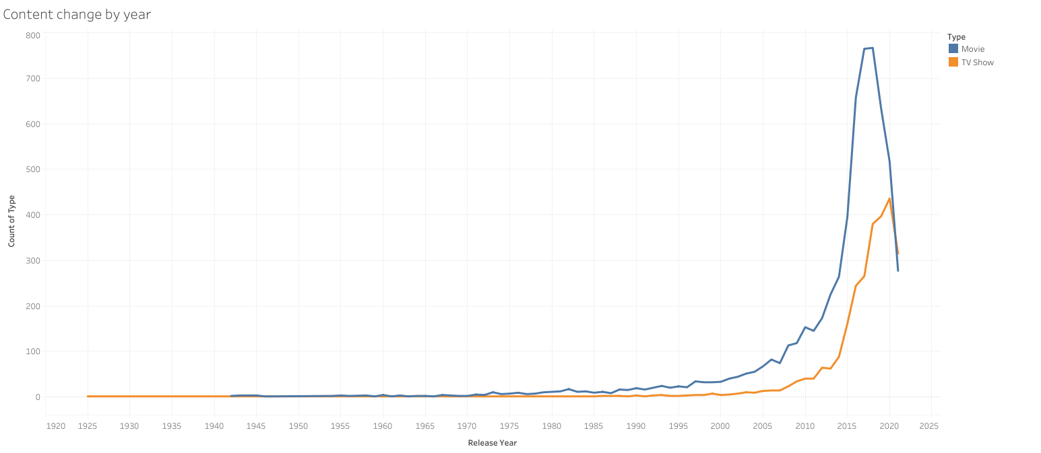
Number of two types increase over years
The growth in number of movies on Netflix is much higher than TV Shows. The gap between two types is getting higher and higher over the years
Movie is suddenly drop from 2018, while TV Show continued increase to 2020 and drop from there. It may be effected by Covid-19, social distancing makes it impossible for directors to make movies and tv shows

Slide 5
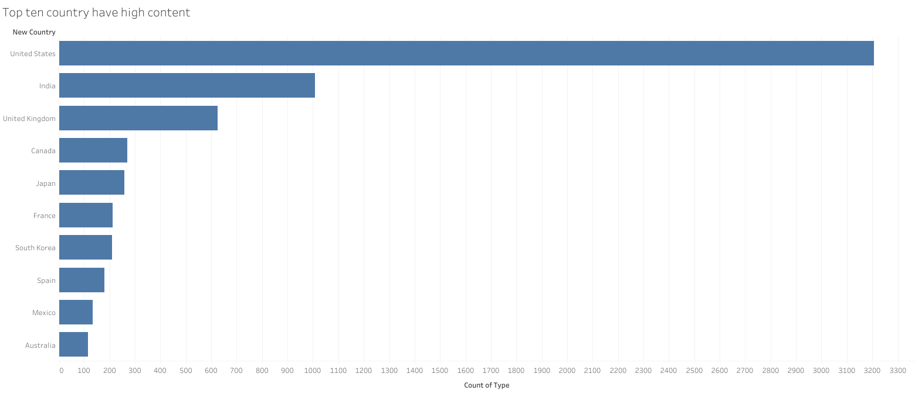
United State is the country with the highest content, follow by it is India, United Kingdom, Canada,…

Slide 6
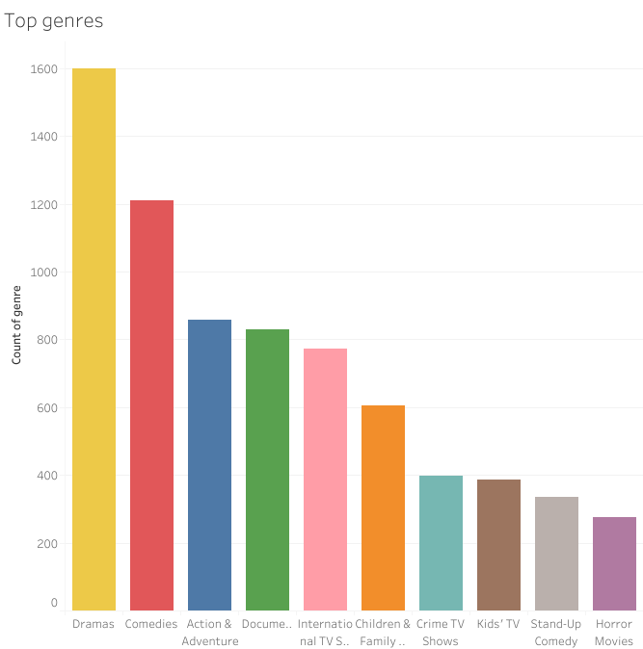
Dramas is the most popular genre on Netflix. Actually, people often is attracted by thrilling things

Slide 7
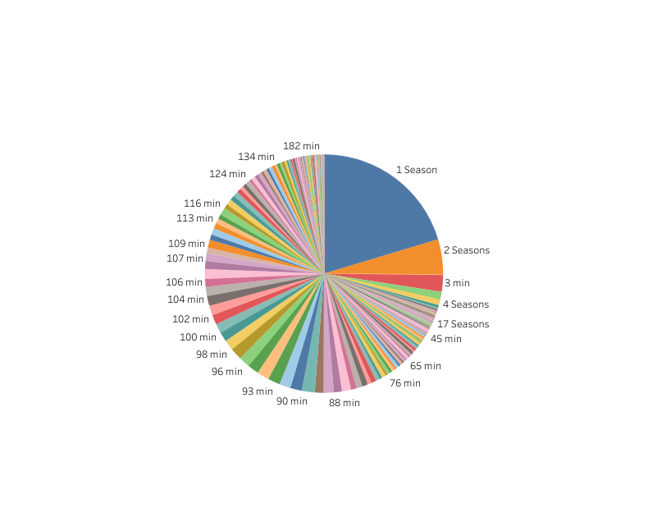
Movie and TV Show duration
Movies or TV Shows with one and two seasons is more often on Netflix than other durations

Slide 8
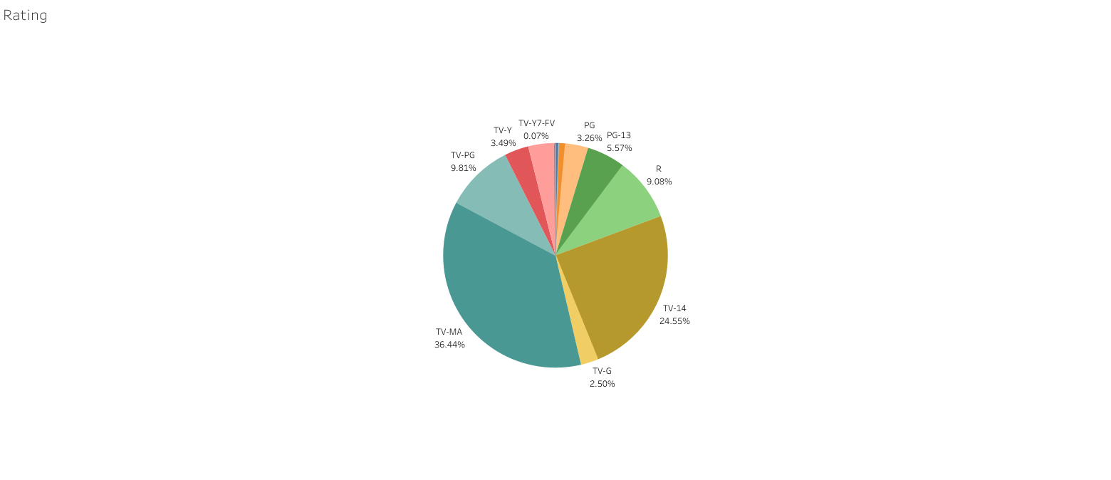
TV-MA take the majority portion of Rating with 36.5%. TV-14 is second with 24.6% of rating. Follow by them are TV-PG(9.81%), R(9.08%), PG-13(5.57%),…

Slide 9
CONCLUSION
Netflix has more Movie Shows than TV Shows
Number of Movie and TV Shows increase over years. From 2018 to 2021, because of Covid 19, number of them decreased
United State is the country has highest content on Netflix
The most popular duration on Netflix is one season
TV-MA is the top ratings given

Slide 10
APPENDIX
Rating and Abbreviation: https://www.montanapbs.org/schedule/ratings-and-abbreviations/

