Slide 1
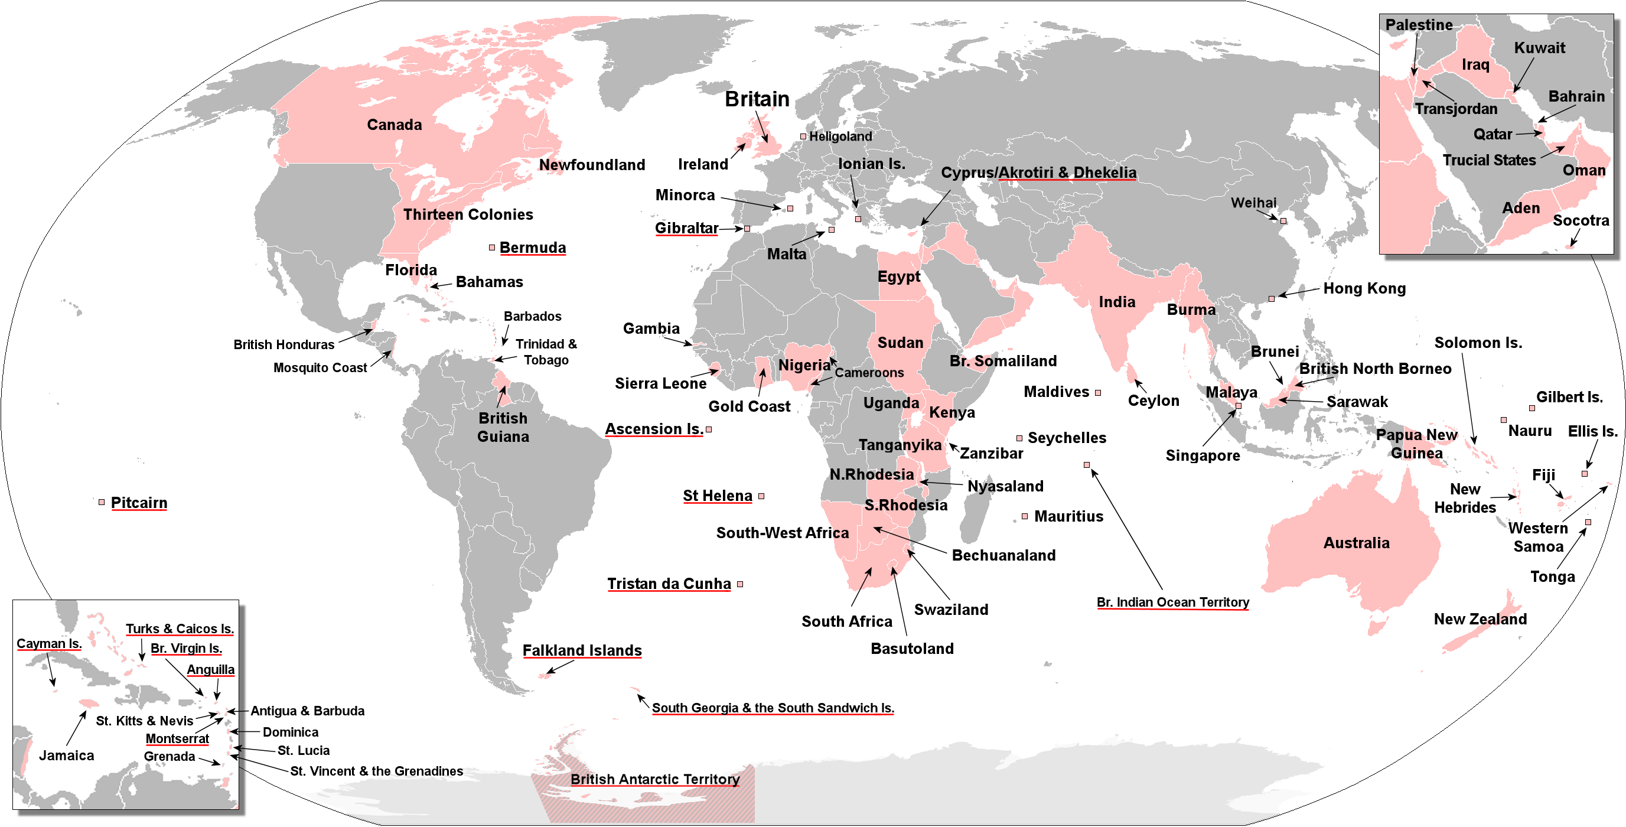

Travelling easily
Spoken commonly
Media industry
Common on the internet
8 reason to learn English
Get a good job
Access multiple culture
Meet new people
Science paper is written in English
5 Simple Ways to Learn English Effectively
Study phrases not words
Learn by listening
Prioritise quality over quantity
Learn grammar with “point of view” stories
Listen and answer, not listen and repeat
1
2
3
4
5

