Slide 1
WRITING THE STORY

Slide 2
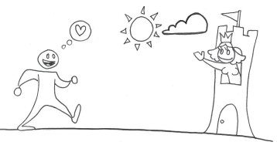

Slide 3
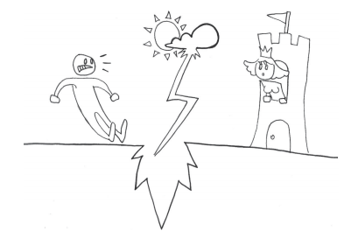

Slide 4
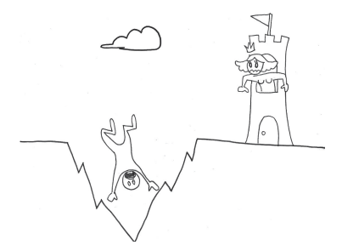

Slide 5
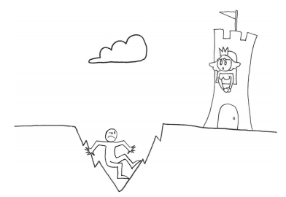

Slide 6
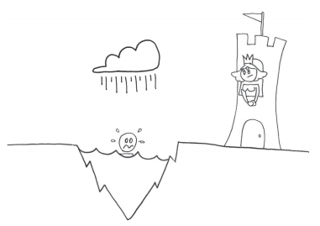

Slide 7
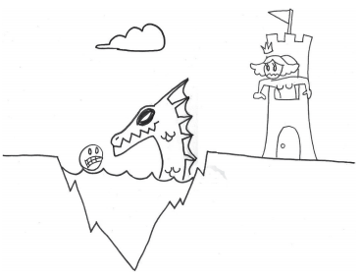

Slide 8
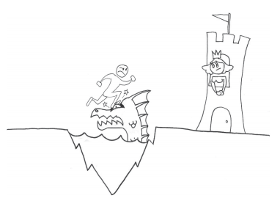

Slide 9
GAMES ARE AN INTERACTIVE MEDIUM
“The play’s the thing.”
William Shakespeare

Slide 10
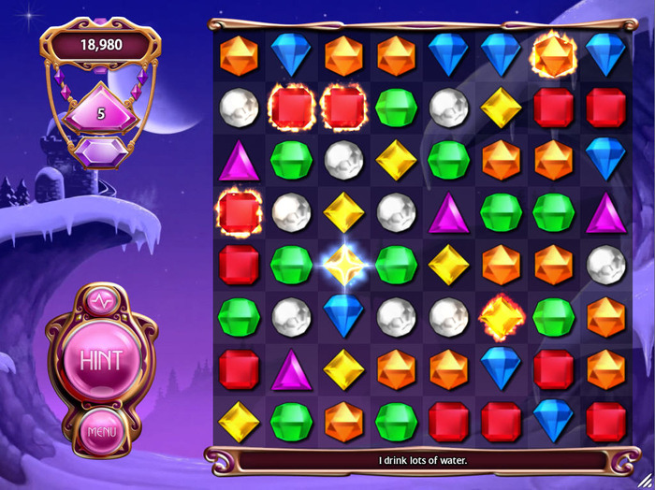

Slide 11

THE PLAYER IS THE HERO
Notes:
In a narrative, the player is the “hero” of the game. The designer
needs to look at the game from the player’s perspective and be
aware of the ordering of the events and experiences that will eventually
help the play create the narrative. As each experience builds on the next, the goal is to
create rising emotional states for the player. Then the designer can design systems to choreograph
these interesting experiences, which in turn create emotions. Savvy? How about an
example instead?

Slide 12
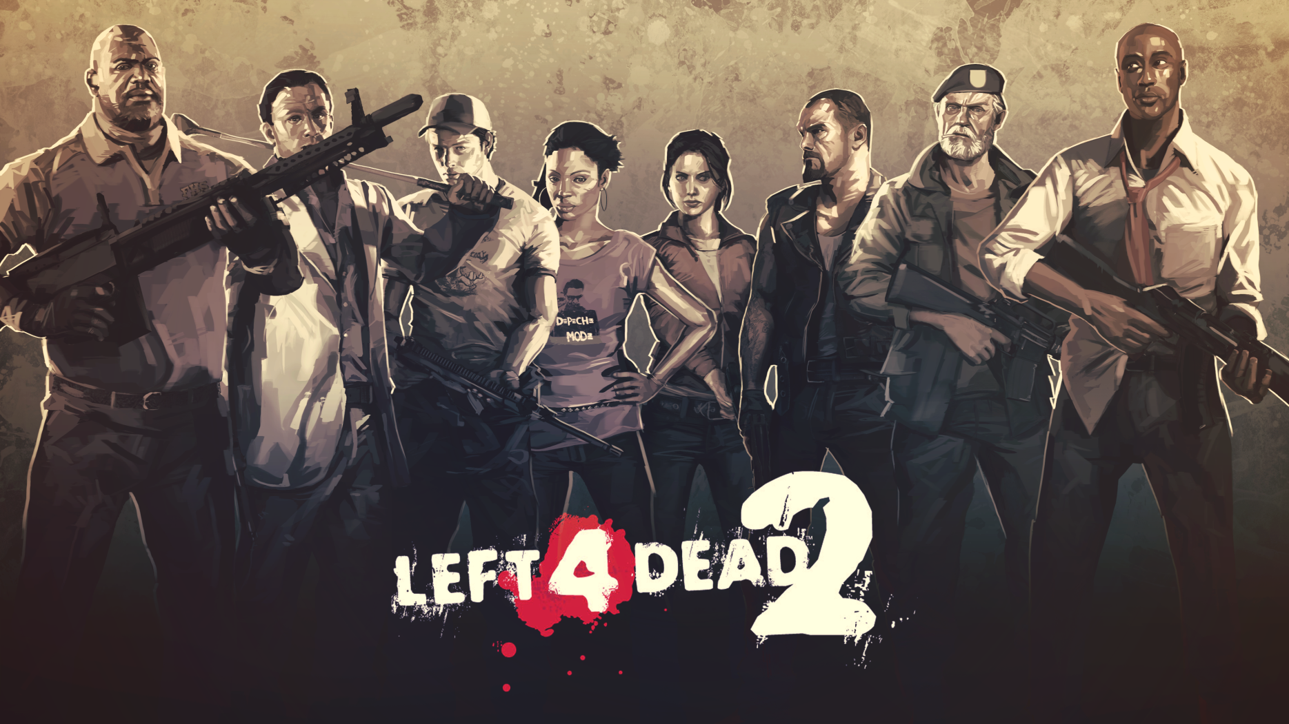
DIRECTOR
Notes:
Left 4 Dead uses an artificial intelligence called the “Director” to control the game’s pacing.
Depending on the player’s “stress level,” which is calculated using many variables including
health, skill, and location, the Director then adjusts the number of zombies that attack, what
items such as ammo and health are generated, and even the music. In the end, the game
itself generates a unique and dynamic play experience for the player. However, because most
developers don’t yet have technology like Left 4 Dead’s Director, it is up to designers to create
these situations as best they can within their own games.

Slide 13
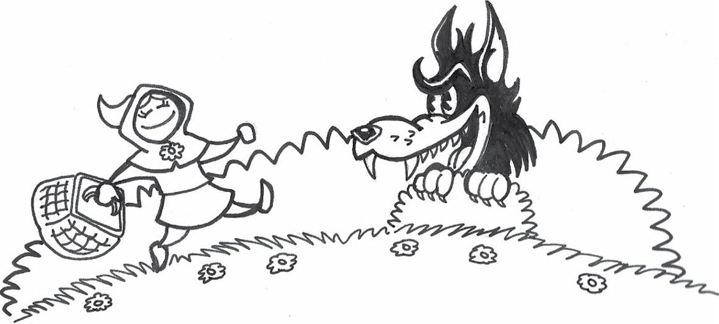
LITTLE RED RIDING HOOD
Notes:
1. Little Red Riding Hood walks through the forest to Grandma’s house = classic player
exploration. Give Red some goodies to collect to fill up her picnic basket (inventory
system) and have her jump over a fallen log or two on her way.
2. Red meets the Big Bad Wolf = the player has her first enemy encounter. Of course, you
can’t kill off the wolf yet . . . (unless the enemies are “wolf minions”).
3. Carrying a full basic set of goodies (gating mechanism), Red reaches Grandma’s house
(next level), where she finds “Grandma” waiting in bed.
4. Red questions “Grandma’s” true identity (“what big eyes you have”). This can take the
form of a quiz, a puzzle, or even a rhythm game.
5. “Grandma” is revealed as the Big Bad Wolf, and Red and the wolf battle to the death =
boss fight! 2

Slide 14
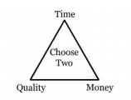
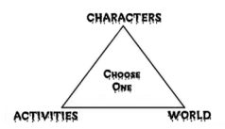
THE TRIANGLE OF WEIRDNESS

Slide 15
A LIKELY STORY
Players who are into your story as it happens
Players who want to get into your story in depth
Players who don’t care what the story is at all

Slide 16
ENDING GAMES
#SASTIFIED

Slide 17
NAMING
Literal title
Action/cool title
Punny title
Purple cow title
Dramatic title
Referential title
Notes:
A literal title makes it easy to figure out where the title came from. It can be the name
of your main character, like Sonic the Hedgehog or Voodoo Vince. It can be the main location
of your game, like Castle Wolfenstein or Saint’s Row. Or you can name your game
after a gameplay activity or component like Command and Conquer or Boom Blocks.
The action/cool title is one that captures the spirit of the game without mentioning
any of the game characters or locations. I think games like Darksiders, Brütal Legend,
and Gears of War all have cool titles.
The punny title is one that makes you appreciate its cleverness. System Shock, Half
Life, and Dead Space are all good examples of punny titles. As puns are word play, you
have to be careful because your audience may not get the reference or think the pun is
funny. As columnist Doug Larson said “A pun is the lowest form of humor, unless you
thought of it yourself.”
A purple cow title is one that makes your audience stop in their tracks and wonder
why the title was chosen.9 It is a title that captures your curiosity and begs your attention.
Purple cow titles include LittleBigPlanet, Resident Evil, and Naughty Bear. The
advantage to a purple cow title is that it becomes strongly associated with the game
because the title is so unique.
The dramatic title is one that sounds more like a movie than a game. Typically it’s a
phrase that sounds dramatic rather than a title. It often refers to the theme of the
game or tries to connote the feeling of the game. Examples include The Sum of All Fears,
The Suffering of Isaac, and The Last of Us.
The referential title refers to something in the game that you have no idea what it is
about unless you have played the game. After players have played the game, they
understand the significance of the title. For example, if you were to hear the word
“halo” before playing Halo, you might have thought of that glowing circular band over
an angel’s head. Now that everyone has played the game, it’s going to be a long time
before anyone thinks of using the word halo in a game title; it’s just too strongly associated
with that game. Other examples include Unreal, Portal, and Spore.

Slide 18
WRITING FOR LICENSES
#COPYRIGHT
#COPYLEFT

