Slide 1


Vietnam National University Ho Chi Minh
University of Science
Faculty of Electronics - Telecommunications
PROJECT REPORT
5G SMALL CELLS: POWERFUL MINI BASE STATION
FOR HIGH-CAPACITY NETWORKS

Slide 2



CONTENT
INTRODUCTION
1
NEW KNOWLEDGE
4
SYSTEM MODEL
2
CONCLUSION
5
TECHNICAL COMPONENTS
3

Slide 3













PART 1
INTRODUCTION

Slide 4



OVERVIEW
Rapid 5G growth → demand for high-speed, stable connectivity
Macro signals degrade indoors, however 80% of mobile traffic is indoor (Ericsson)
Small Cells boost local capacity & optimize indoor coverage.
Advantages: compact – low power – easy deployment – high efficiency in dense areas.
Major vendors (Ericsson, Huawei, ZTE)
are heavily investing in Small Cells.

Slide 5


VIETNAM CONTEXT & REAL RESULTS
Viettel self-develops and manufactures “made-in-Vietnam” Small Cells.
Optimized for local infrastructure, lowering cost & improving technological autonomy.
extremely high user density, surge in livestream demand.
A80 event
Small Cell deployment → higher speeds, reduced Macro load, stable connectivity.
Confirms the effectiveness of the Macro + Small Cell architecture in crowded areas.

Slide 6
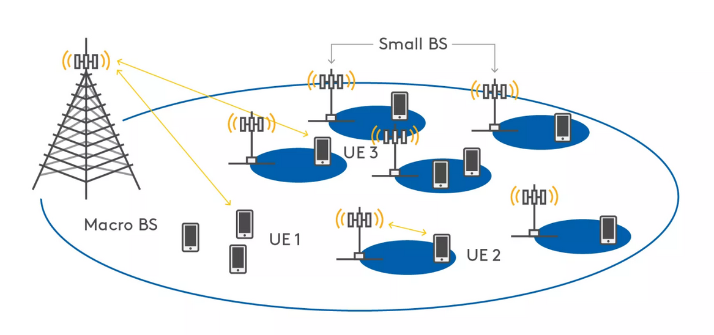
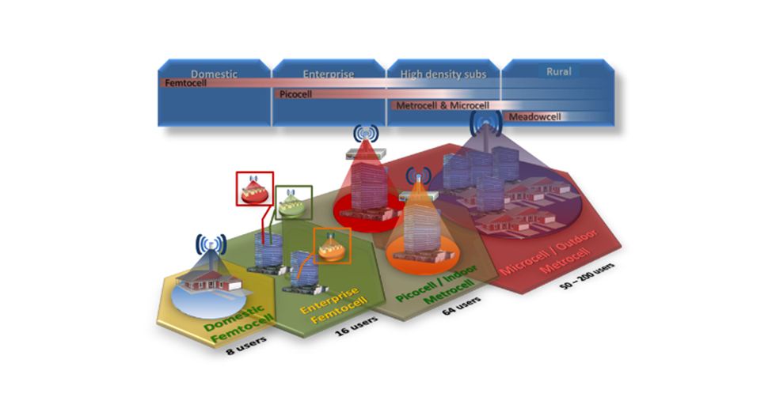
PART 2
SYSTEM MODEL

Slide 7
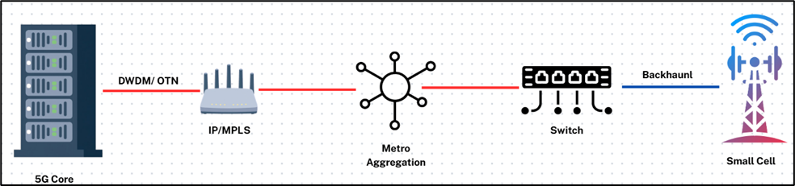
SYSTEM MODEL
DWDM: Combines 40–128 wavelengths, each 100–400 Gbps → high-capacity backbone
OTN: Encapsulates ODU0–ODU4, adds FEC & OAM for long-haul reliability and monitoring
IP/MPLS: Uses MPLS labels for fast routing and QoS for latency-sensitive services
Access Switch: VLAN, QoS, and rate-limiting to control traffic before backhaul.
Backhaul → Small Cell: 1G/10G/25G Ethernet, microwave, or mmWave links.
Small Cell: Converts and transmits the signal over 5G NR to the UE.

Slide 8



3.1
Modulation and Demodulation
3.2
Digital Transmission and Baseband Processing
PART 3
TECHNICAL COMPONENTS
3.3
Information Theory
3.4
Block Codes – CRC
3.5
Channel Coding

Slide 9
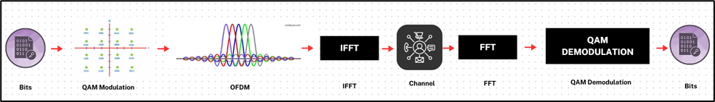
PART 3. TECHNICAL COMPONENTS
3.1. Modulation and Demodulation
+ 5G Small Cells map bits → symbols using QPSK, 16-QAM, 64-QAM (amplitude + phase).
+ QAM symbols are assigned to OFDM subcarriers to reduce indoor multipath effects.
+OFDM splits bandwidth into multiple orthogonal subcarriers → more robust transmission.
+ IFFT combines subcarriers into a time-domain signal; UE uses FFT to separate and demodulate.
+ High-order QAM + OFDM → high data rate, strong interference resistance, ideal for Small Cells.

Slide 10
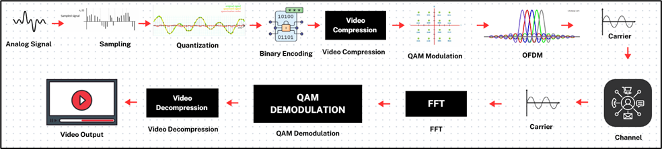
PART 3. TECHNICAL COMPONENTS
3.2. Digital Transmission and Baseband Processing
Livestream/video-call signals are analog
→ must be digitized (sampling, quantization, encoding).
Amplitude is quantized into discrete levels
→ converted into a bitstream.
Video is large → compressed using H.264/H.265.
H.265 reduces bandwidth by ~40–50% due to flexible blocks and better prediction.
Efficient compression helps Small Cells stay stable even with many simultaneous livestreams.

Slide 11
PART 3. TECHNICAL COMPONENTS
3.3. Information Theory
In 5G Small Cell, Information Theory is used to evaluate the capacity improvement with increased channel quality.
Channel capacity
The Signal - to - Noise Ratio (SNR)
SNR = S/N
S - Useful signal power (W or dBm)
N - Noise Power (W or dBm)
C = B x log2(1 + SNR)
C – Channel capacity (bps)
B – Bandwidth (Hz)

Slide 12
PART 3. TECHNICAL COMPONENTS
3.4. Block Codes – CRC
+CRC appends check bits to each data block to detect transmission errors
+Receiver checks the polynomial remainder; non-zero → error → retransmission needed.
Indoor Small Cell environments have multipath, strong reflections, and movement → higher OFDM error probability
Small Cells use CRC for each transport block and HARQ:
CRC fails → NACK → retransmit request.
CRC passes → ACK → packet accepted
CRC + HARQ ensure high reliability even in crowded environments.

Slide 13
PART 3. TECHNICAL COMPONENTS
3.5. Channel Coding
Small Cell indoor signals suffer attenuation & multipath → strong channel coding is required.
5G uses two techniques: LDPC for data and Polar Code for control.
LDPC: Block code using many parity equations from 5G matrices → corrects errors via violated parities.
Polar Code: Chia kênh thành “kênh tốt” (chứa bit thông tin) & “kênh xấu” (frozen = 0)
Highly parallel processing → suitable for Gbps 5G data throughput
High reliability for small blocks & low latency → ideal for control channels
LDPC + Polar maintain high speed & low error rate in dense environments.

Slide 14
4.1
Beamforming
PART 4
NEW KNOWLEDGE
4.2
Massive MIMO and MU-MIMO
4.3
Combining Beamforming and MIMO

Slide 15
PART 4. NEW KNOWLEDGE
4.1. Beamforming
Beamforming adjusts phase & amplitude of antenna elements to focus energy toward the UE.
+ Improves SNR → higher data rate & more stable connection.
+ Reduces interference to nearby areas, especially in dense indoor deployments.
+ Enhances coverage & supports static and moving users via dynamic beams.
+ Effective in malls, stadiums, and scattered-signal environments.

Slide 16
PART 4. NEW KNOWLEDGE
4.2. Massive MIMO and MU-MIMO
MIMO
Allows a UE with multiple antennas to simultaneously receive multiple data streams from the base station, increasing transmission speed without requiring additional bandwidth.
MU - MIMO
Allows Small Cells to transmit multiple data streams to multiple UEs at the same time. The streams are spatially separated, reducing cross-user interference. This is a key technique to increase the capacity of Small Cells in densely populated areas.

Slide 17
PART 4. NEW KNOWLEDGE
4.3. Combining Beamforming and MIMO
Beamforming directs and optimizes each data stream; MIMO creates multiple independent streams. This combination helps:
+ Increase overall cell speed,
+ Reduce interference between users,
+ Optimize coverage and spectral efficiency,
+ Ensure a stable experience even in complex indoor environments.

Slide 18
PART 5
CONCLUSION

Slide 19
PART 5. CONCLUSION
+ 5G Small Cells are essential complements to Macro networks, especially indoors and in crowded areas.
+ They operate on a low-latency, high-reliability optical–IP transport system (DWDM, OTN, IP/MPLS, Metro, Access, Backhaul).
+ Core DSP techniques: OFDM, QAM, sampling–quantization, baseband/passband, Shannon, CRC, LDPC/Polar.
+ Advanced Beamforming & MIMO/MU-MIMO → focused energy, higher throughput, more simultaneous users.
+ Real-world tests (A80 event) show stable speeds and significant congestion reduction.
+ In Vietnam, Viettel’s “made-in-Vietnam” Small Cells enhance technological autonomy and fit local deployment conditions.
+ Crucial for future services: industrial IoT, livestreaming, and low-latency applications.

Slide 20





ĐẶNG BÁ TRẦN TRUNG
GIAO HỮU LỰC
TEAM 1
NGUYỄN NGỌC DŨNG
NGUYỄN ĐỨC SƠN
LÊ QUANG THÔNG

Slide 21

THANK YOU FOR LISTENING AND FOR YOUR FEEDBACKS

