Slide 1

This content is licensed under Creative Common CC-BY-NC-SA version 4
TechKids - Coding School
Android - Gen3 - TechKids
App name: Math for Kids
Group 1:
Mentors in Android - Gen3
1. Trung Nguyen Tran
Bui Xuan Canh
Tran Duc Hung
Le Tien Dung
Vu Nhat Linh
Hanoi, 7 / 2016
techkids.edu.vn

Slide 2
Content
Why I choose Math for Kids?
Work progress
Difficulty in my final project
Inference
techkids.edu.vn
This content is licensed under Creative CommonsCC-BY-NC-SA versio n4

Slide 3
Why I choose Math for Kids?
Apply knowledge Android
Focus field: education
For children: learn Math via game
techkids.edu.vn
This content is licensed under Creative CommonsCC-BY-NC-SA versio n4

Slide 4
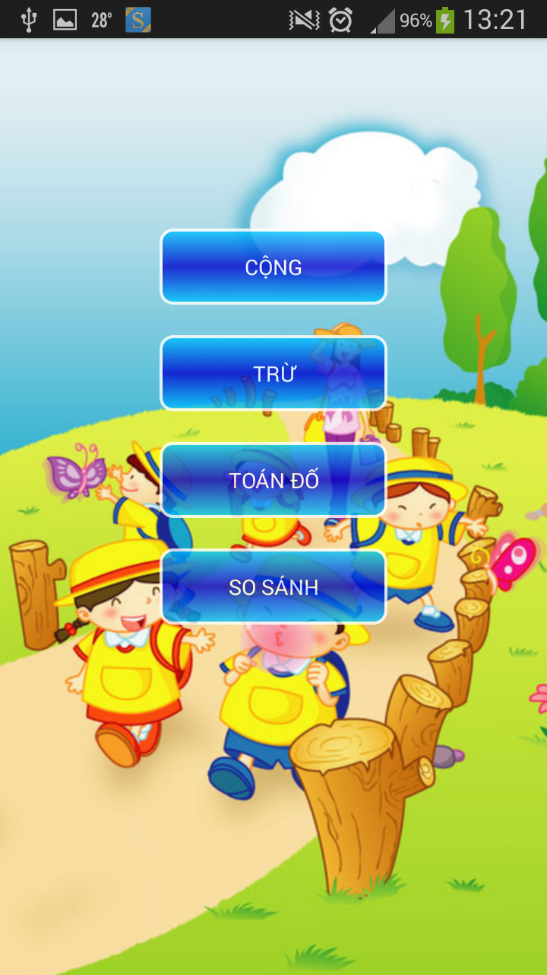
Why I choose Math for Kids?
This content is licensed under Creative CommonsCC-BY-NC-SA versio n4

Slide 5
Work progress
Design UI Main Activity, UI Category ....
Code 4 main functions
Process animation for Activity, Fragment, Buttons
Process data in sqlite
Process sounds
techkids.edu.vn
This content is licensed under Creative CommonsCC-BY-NC-SA versio n4

Slide 6
Difficulty in my final project
Find new functions in app Math for Kids
Fix bugs
Process animations for Buttons and UI in App
Work alone
1 member goes out
techkids.edu.vn
This content is licensed under Creative CommonsCC-BY-NC-SA versio n4

Slide 7
Inference
Code: Test function
Use: 3 Tiers Model in Android
Design UI: more friendly
Add many Kind of Math
techkids.edu.vn
This content is licensed under Creative CommonsCC-BY-NC-SA versio n4

Slide 8
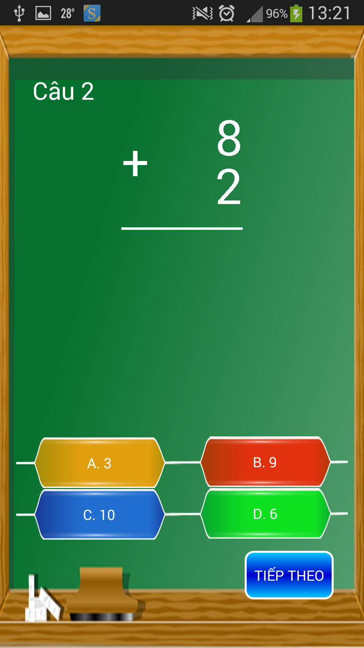
Demo app: Math for Kids
*Link video demo::
https://youtu.be/CdFUrdvhOVM
techkids.edu.vn
This content is licensed under Creative CommonsCC-BY-NC-SA versio n4

Slide 9

THANK YOU VERY MUCH!
techkids.edu.vn
This content is licensed under Creative CommonsCC-BY-NC-SA versio n4

