Slide 1

Magnetic Disk
- Đĩa từ -
Group C - CSI

Slide 2
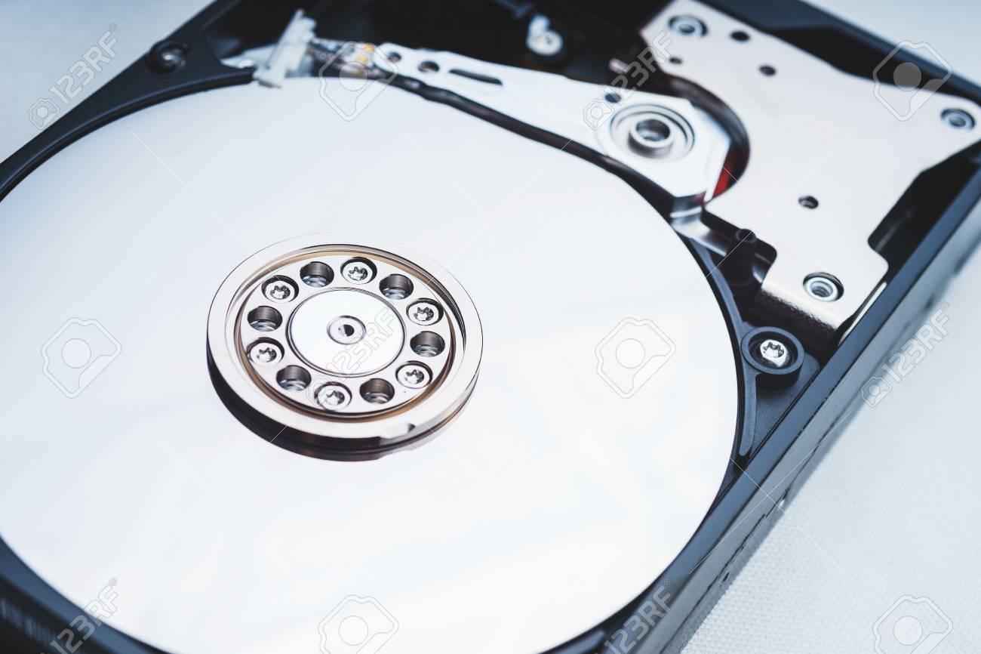
I. Magnetic Disk:
A magnetic disk is a storage device that uses a magnetization process through a magnetic coat to write, rewrite and access data.
Read
Magnetic
Disk
Magnetism
Write
Access

Slide 3
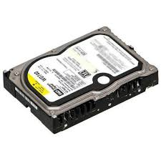
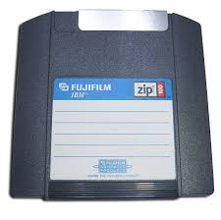
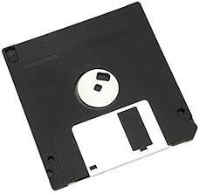
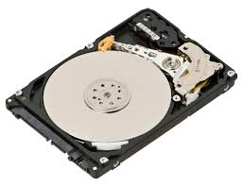
II. Type of Magnetic Disk:
Hard disk (ổ đĩa cứng - ổ cứng)
Floppy disk (ổ đĩa mềm)
Zip disk (ổ đĩa nén)

Slide 4
III. Hard disk drive:
Hard disk drive (HDD) - Hard drive, is a device used to store and retrieve data from the surface of platters (disks) coated with magnetic material.
HDDs are a type of non-volatile storage, retaining stored data even when powered off.
HDDs are made monolithically (nguyên khối) => Can’t switch components.

Slide 5

IV. History of HDDs:
IBM 350-Disk:
50 24“-disk
Storability:
5 million 6-bit characters
3340 Winchester Disk:
Hard Drive Assembly Technology (HDA*)
large and bulky
Storage Capacity multiply as time pass
1955
1961
1973
1990s
Today
IBM 1301:
One head per platter
External HDDs popularity rises:
Convenient and Mobile
HDA: sealed head/disk assembly

Slide 6
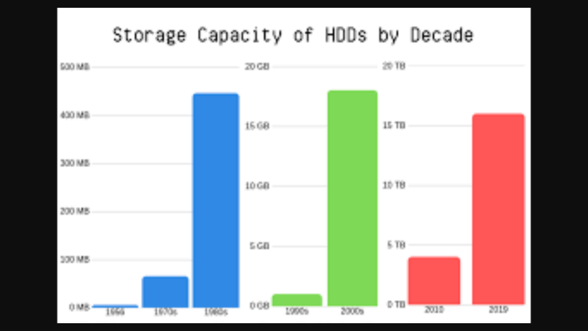
The development of HDDs through time:

Slide 7
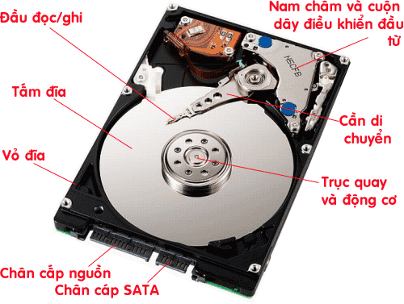
V. Components :
a, Platter Sector:
Platter – đĩa từ
Spindle – trục quay
Motor – động cơ

Slide 8
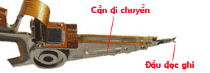
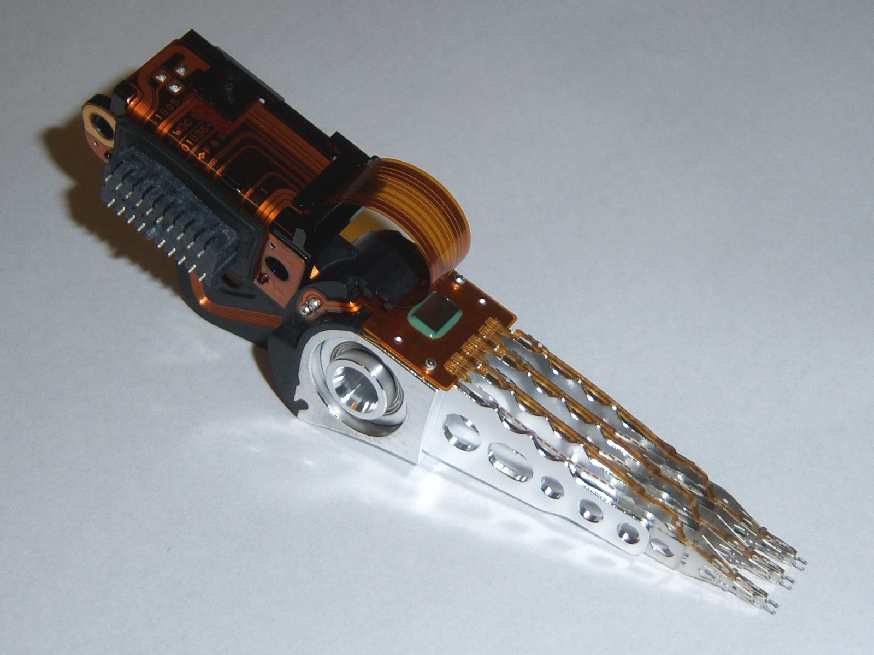
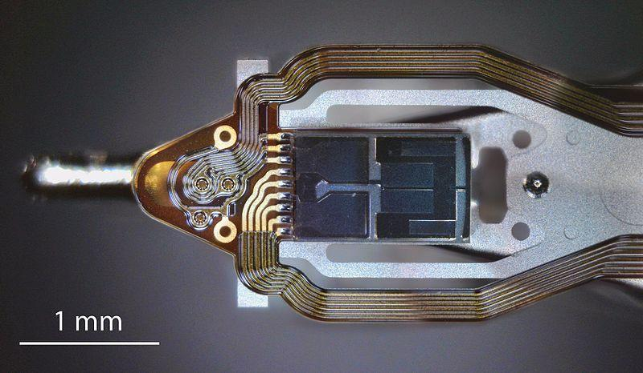
V. Components:
b, Actuator Sector:
Read-write head – đầu đọc ghi
Actuator arm – cần di chuyển

Slide 9
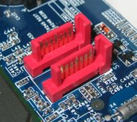
V. Components :
c, Circuit Sector:
Controller – Mạch điều khiển:
Processor - Mạch xử lý dữ liệu:
Buffer/cache – bộ nhớ đệm:
Power connector – cổng điện:
IDE connector – cổng kết nối:
Jumper – cổng giao thức:

Slide 10
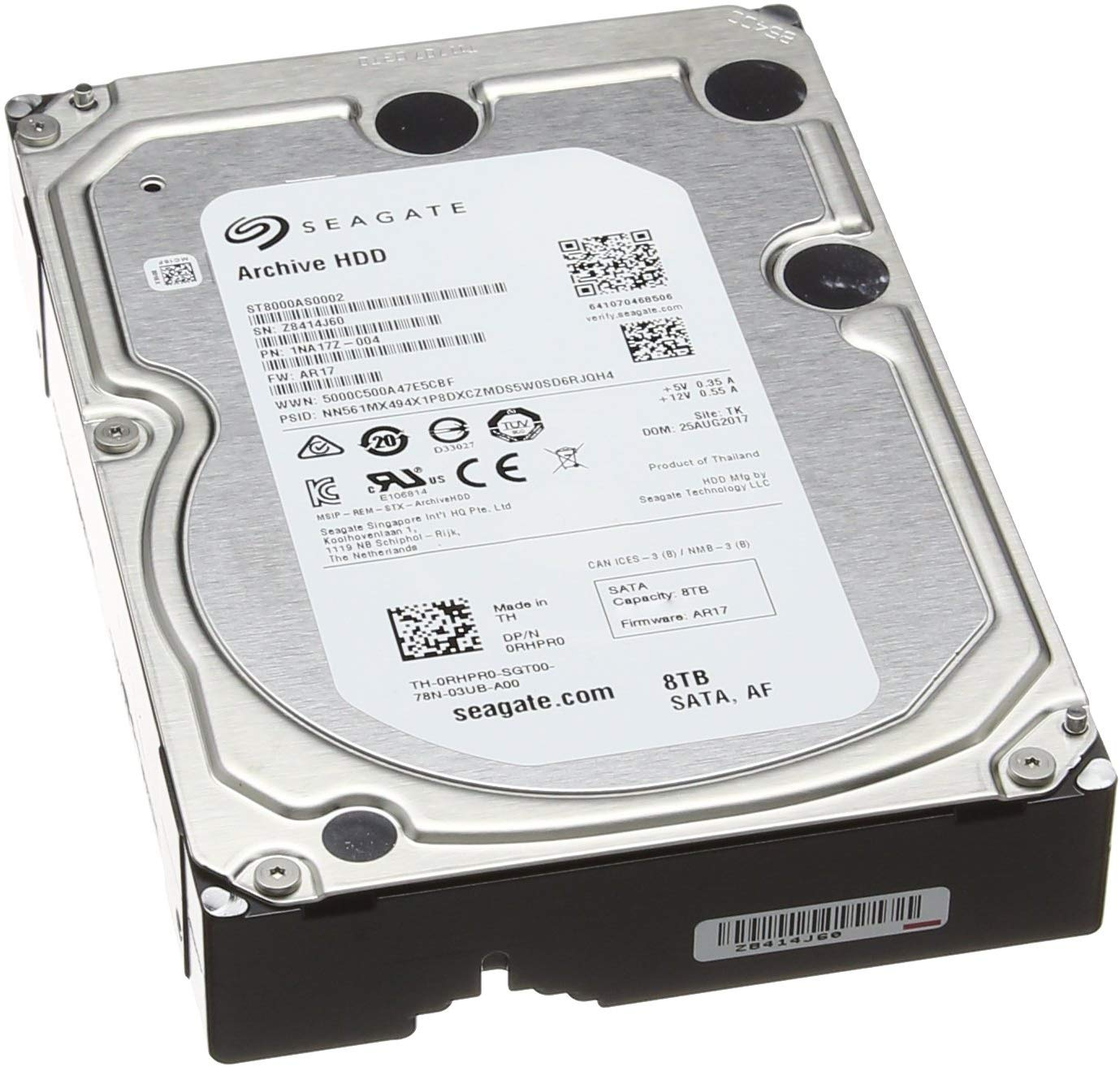
V. Components:
d, Chassis:
Cover the components and maintain tightness.
=> Prevent dusts from gathering inside.
Provide some resistance against impact and other factors.

Slide 11
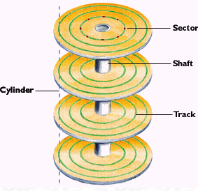
VI. Platter:
Platter: mostly made using glass or aluminium, covered with a magnetic coat.
Hard drives have several platters mounted parallelly, spin on the same spindle at the same speed.
Each platter can store information on both sides.
Platters are divided into tracks - concentric circles.
Each track is divided into sectors.
Cylinders: set of tracks on different platters.

Slide 12
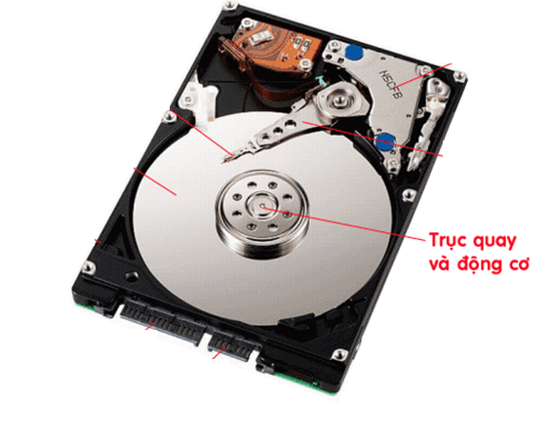
VII. Spindle:
Use energy from motor to spin platter.
Usually made from aluminium alloy.
Must be completely precise.

Slide 13
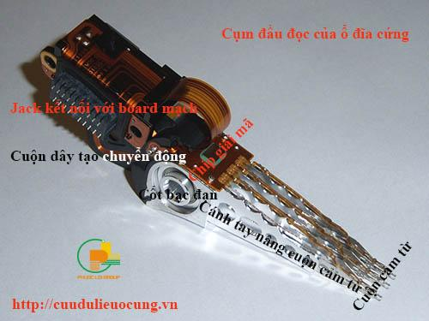
VIII. Read/write head:
Consist of an ferrite core and copper wire coil.
Read and write data on platter using magnetization.

Slide 14
Disk Physical Characteristics
Head Motion Platter
• Fixed head (one per track) • Single platter
• Movable head (one per surface) • Multiple platters
Disk portability Head mechanism
• Non-removable disk • Contact (floppy)
• Removable disk • Fixed gap
• Aerodynamic gap
Sides
• Single sided
• Double sided

Slide 15

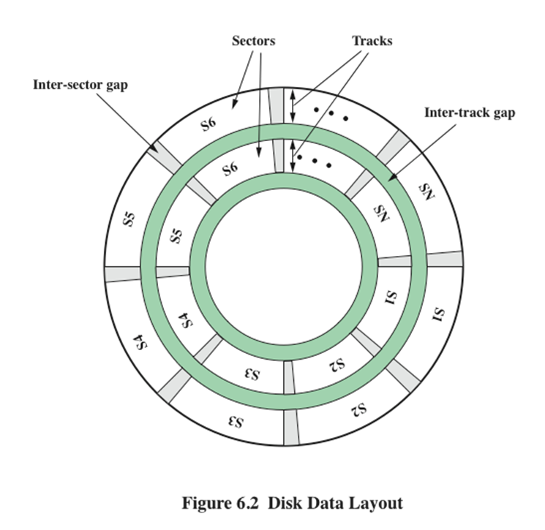
Disk
Data
Layout

Slide 16
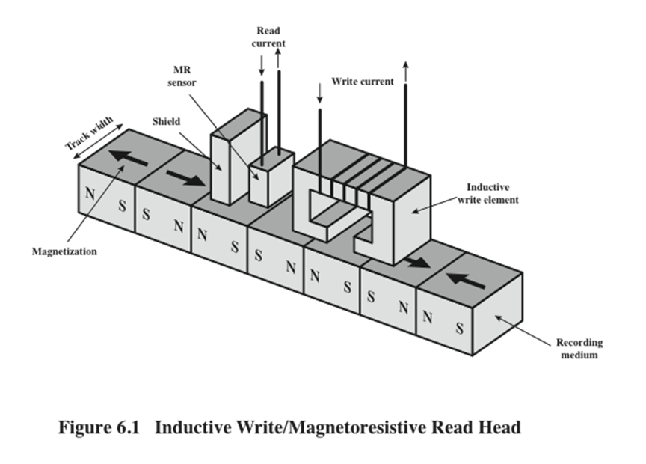

Slide 17
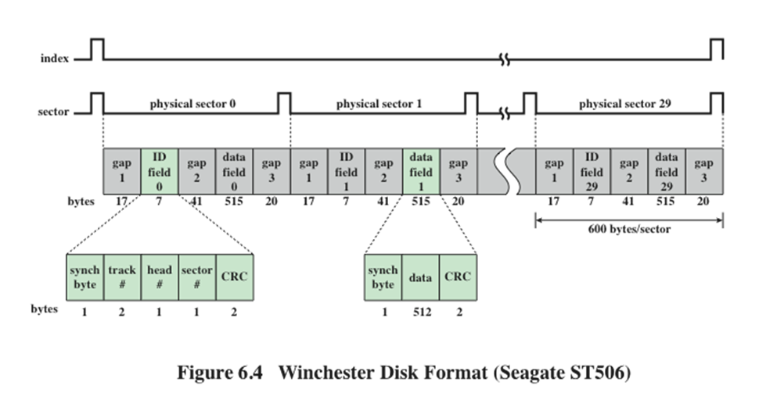

Slide 18
HDD Parameters
Disk Capacity:
Calculated by (bytes/sector) * (sectors/track) * (cylinders) * (write-read heads)
Units: byte, KB, MB, GB, TB
True capacity is usually lower in reality
Cache memory:
Temporarily store data while working
Units: KB, MB
Higher memory → better performance

Slide 19
HDD Parameters
Size:
Usually standardized for assembly
Unit: inch
Spindle Speed:
Unit: rpm (revolutions per minutes)
The higher the speed, the better the performance
Common speed: 5400 rpm, 7200 rpm, 10000 rpm, 15000 rpm

Slide 20
HDD Parameters
Seek Time (ms):
The time it takes to move the head from one cylinder to another
Unit: ms
Lower time → better performance
Rotational Delay/Latency (ms):
The time it takes for the sector to reach the head
Unit: ms
Lower time → better performance

Slide 21
HDD Parameters
Access Time (ms):
The sum of seek time and rotational delay
The time it takes to access random data
Lower time → better performance
Transfer Time (ms): T = with
Depend on:
  Spindle speed, the number of platters, cache memory
  Manufacture technology
Lower time → better performance
b
rN
b: Bytes transferred (Bytes)
N: Bytes per track (Bytes/track)
r: Spindle speed (rps)

Slide 22
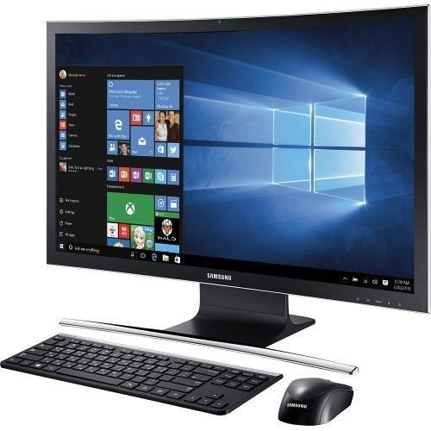


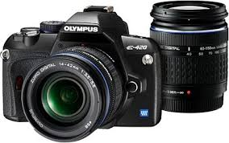
XI. Application:
Used mostly on Computers.
Provide storage for many devices, like Phone, Camera, Server,...

Slide 23
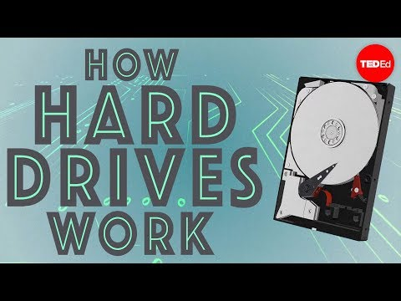
IX. Phương thức hoạt động:

Slide 24
References
1. Internet.
2. How do hard drives work? - Kanawat Senanan, 2015.
https://www.youtube.com/watch?v=wteUW2sL7bc

