Slide 1
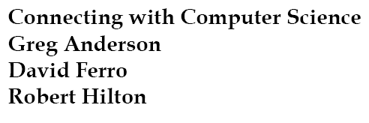
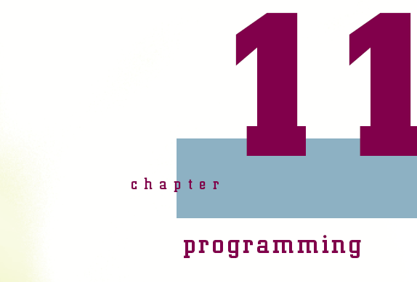

Slide 2
Objectives
Learn what a program is and how it can be developed
Understand the difference between a low-level and high-level language
Be introduced to low-level languages using the Assembly programming language as an example
Learn about the structure of a program, including algorithms and pseudocode
Connecting with Computer Science
2

Slide 3
Objectives (continued)
Gain an understanding of the basics of high-level programming languages using Java as an example
Learn about variables and how they are used
Be introduced to the Java operators
Explore the different control structures used in programming
Understand the terms associated with object-oriented programming
Connecting with Computer Science
3

Slide 4
What Is a Program?
A collection of statements (câu lệnh) that solve a problem
Must be converted into a language that the computer understands
  Algorithm: logically ordered set of statements
  Conversion process uses an interpreter or compiler
    Interpreter (trình thông dịch): translates statements one-by-one
    Compiler (trình biên dịch): reads all of the statements and creates a finished program
Connecting with Computer Science
4

Slide 5
I Speak Computer
Determine what language you want to use
  Assembly for controlling hardware
  Java and JavaScript for Internet applications
  Lisp for working with artificial intelligence
  Visual Basic for a simple yet powerful GUI (giao diện đồ họa người dùng) programming environment
  Others include. C, C++, Smalltalk, Delphi, and ADA, FORTRAN, and COBOL
Connecting with Computer Science
5

Slide 6
Types of
Programming Languages
Low-level
  Geared towards computer – less understandable or like human language
  Machine language is lowest-level language
  Assembly resides between lowest-level and higher-level languages
    Assembler converts assembly code to machine language
High-level
  Human-friendly language
Connecting with Computer Science
6

Slide 7
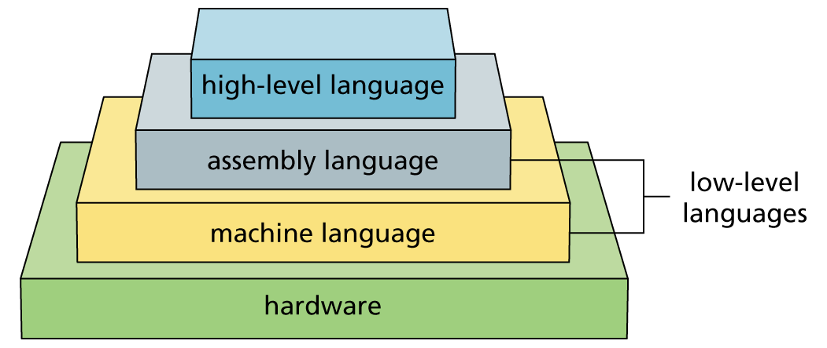
Figure 11-1
Different types of programming languages
Connecting with Computer Science
7

Slide 8
Low-level Languages
Machine language includes only binary numbers
Assembly uses more English-like statements
  Each statement corresponds to one machine instruction
  Programs run faster than programs in higher-level languages
  Closely tied to particular CPU type
  Harder to read and understand than higher-level languages
Connecting with Computer Science
8

Slide 9
Assembly Language Statements
Consists of alphabetic instructions with operations and register indications
  mov moves values around
    mov cx, 8
  add adds one to value to another
    mov cx, 3
    mov dx, 8
    add dx, cx
  sub subtracts one value from another
Connecting with Computer Science
9

Slide 10
Assembly Language Statements (continued)
  inc increments a value in the register
    inc dx
  cmp compares two values
    mov cx, 4
    mov dx, 7
    cmp dx, cx (zero flag is set if dx - cx = 0)
  jnz jumps to a specific location in the program
    jnz stop (Jumps to the section named stop if
    the zero flag is set)
Connecting with Computer Science
10

Slide 11
High-level Languages
Easier to write, read, and maintain than low-level languages
Accomplishes much more in a single statement
Generally slower
  Must be either compiled or interpreted
Many incorporate IDEs (integrated development environment’s)
  Interface that includes an editor, compiler, graphic designer, and more
Connecting with Computer Science
11

Slide 12
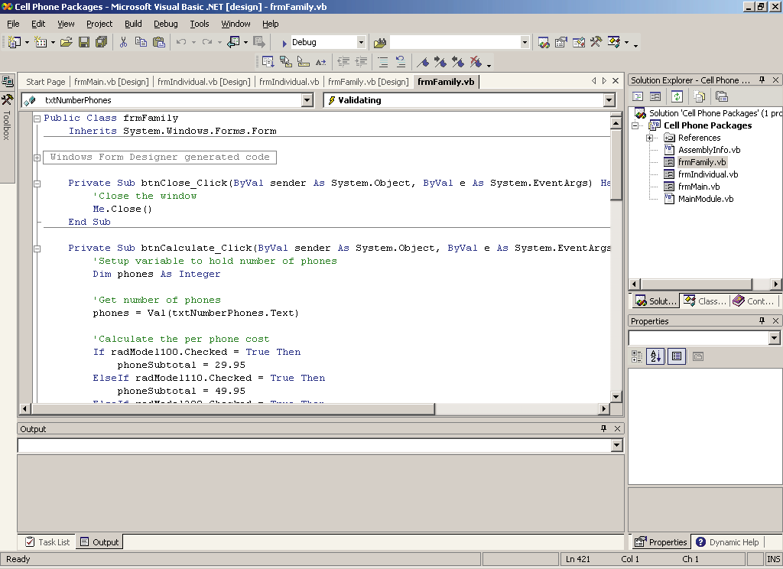
Figure 11-2
Microsoft Visual Studio .NET makes software development easier
Connecting with Computer Science
12

Slide 13
Structure of a Program
Program structure is based upon algorithms, and is often represented using pseudocode
  Algorithm: consists of executable steps to solve a problem
  Pseudocode (mã giả): readable description of an algorithm written in human language
    Template for what needs to be converted into programming language syntax
Connecting with Computer Science
13

Slide 14
Example of Pseudocode
Converting the temperature from Fahrenheit to Celsius
  Ask the user for a temperature in Fahrenheit
  Apply the entered temperature to the formula Celsius
  Temp = (5/9) * (Fahrenheit Temp - 32)
  Display the result saying Fahrenheit Temp ## converted to Celsius is XX
Connecting with Computer Science
14

Slide 15
Choosing and Testing the Algorithm
There can be many different ways to perform a task or accomplish a goal
Determine which algorithm is the best one to use for the project based on a myriad of factors
To test the algorithm, pretend that you are the end user and trying to run the program
  Celsius conversion example: What if the user does not enter a number value?
    Modify pseudocode to test for valid values
Connecting with Computer Science
15

Slide 16
Modifications to Pseudocode
Based on Testing
Ask the user for a temperature in Fahrenheit
If the value entered is numerical
  Apply the entered temperature to the formula
  Celsius Temp =
  (5/9) * (Fahrenheit Temp - 32)
  Display the result saying Fahrenheit Temp ## converted to Celsius is XX
Else
  Display a message stating that the value entered is NOT allowed
Connecting with Computer Science
16

Slide 17
Syntax of a
Programming Language
Writing a program can be compared to following a recipe (the algorithm and pseudocode) to correctly combine the ingredients to produce a result (program)
Ingredients include
  Variables (biến)
  Operators (toán tử)
  Control Structures (cấu trúc điều khiển)
  Objects (đối tượng)
Connecting with Computer Science
17

Slide 18
Learning to Cook With Java
Java is a high-level programming language developed by Sun Corporation
  Familiar syntax (similar syntax to C++)
  Portable (di động)
    Can run on other computers without recompiling
  Powerful
    Rich library of routines for many tasks
  Popular
    Used to develop a variety of applications
Connecting with Computer Science
18

Slide 19
Variables
Variable: name used to identify a certain location and value in computer memory
  Provides way to access computer memory without knowing actual hardware address
  When you associate an identifier (định danh) with a variable, it is called declaring (khai báo) that variable
  Declarations usually define attributes (thuộc tính) such as identifier name, type, and content
    int numTicketsBought;
Connecting with Computer Science
19

Slide 20
Identifiers and Naming Conventions
Rules for declaring a variable in Java
  Use only letters, underscores, and numbers
  Begin the name with a letter
  Avoid Java reserved words that have specific programming meanings.
Naming conventions (quy ước đặt tên)
  Give variables meaningful names
  Lowercase the first character of the first word and uppercase the first letter of subsequent words
  int numTicketsBought;
Connecting with Computer Science
20

Slide 21
Variable Types
All variables are strongly typed
  Must declare the type of data each variable can hold
  Eight different types (see Tables 11-1 to 11-4)
Syntax for declaring a variable
    type variableName;
Examples
    float salary;
    boolean deserveRaise;
Connecting with Computer Science
21

Slide 22
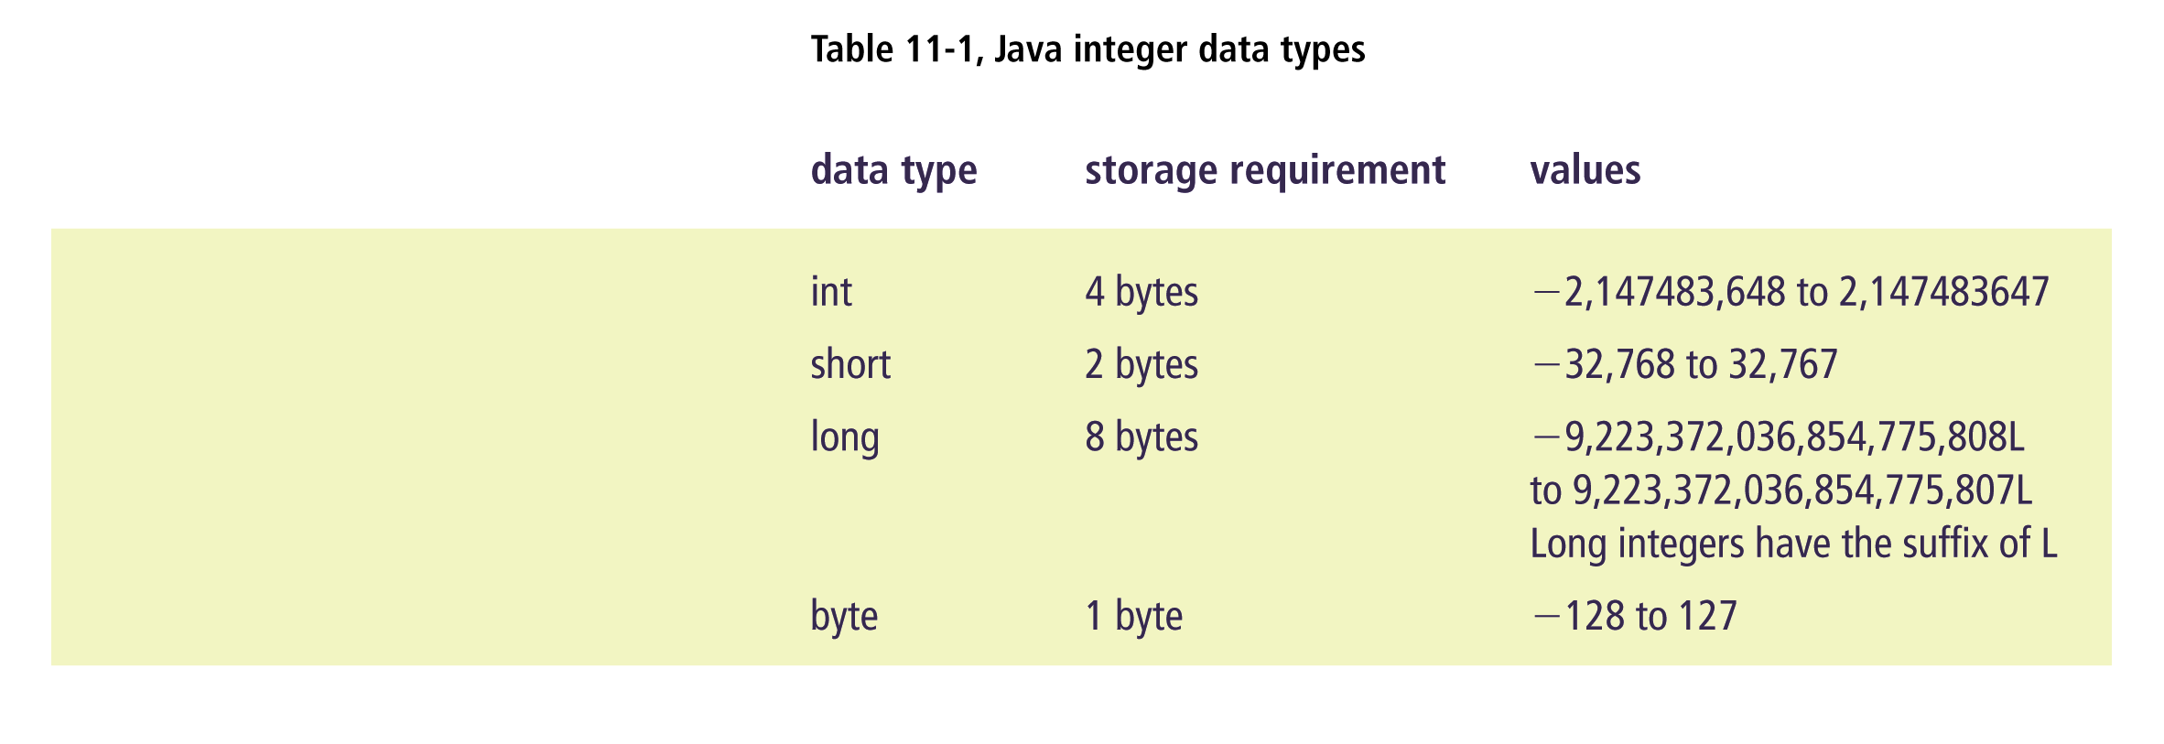
Connecting with Computer Science
22

Slide 23
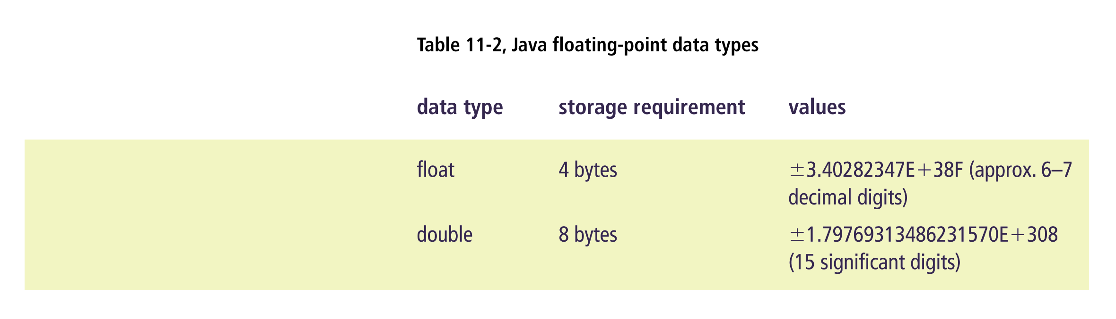
Connecting with Computer Science
23

Slide 24
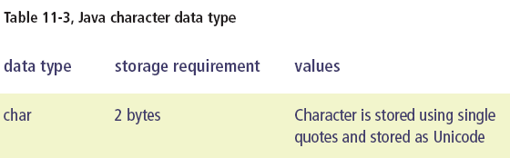
Connecting with Computer Science
24

Slide 25

Connecting with Computer Science
25

Slide 26
String Data Type
The char data type contains one character within a single quotation mark
The String data type contains one or more characters inside a pair of double quotes
  String sFirstName = “Joe”;
  String sLastName = “Blow”;
The String concatenation operator (toán tử nối chuỗi) (+) combines strings into one value
  String sFullName;
  sFullName = sLastName + “, ” + sFirstName;
Connecting with Computer Science
26

Slide 27
Hungarian Notation
Variable naming method
  Gives each variable an identifier at the beginning of the variable name describing the data type of the variable
  Only used for the sake of readability
  Does not require the variable to hold the specified data type
Connecting with Computer Science
27

Slide 28
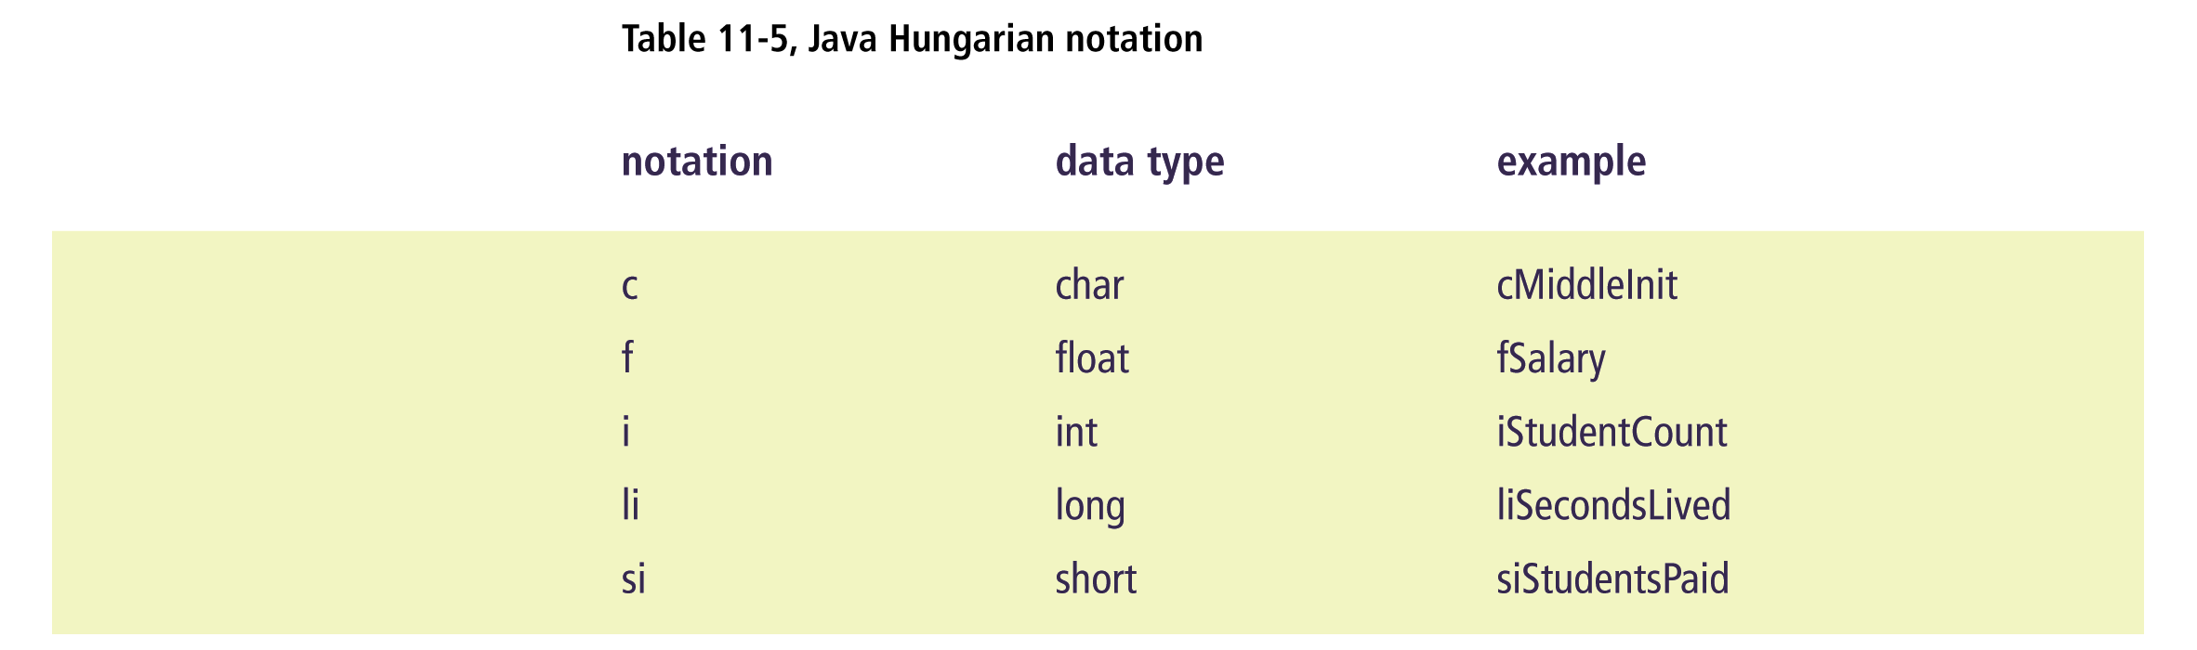
Connecting with Computer Science
28

Slide 29
Variable Content
Variable initialization provides an initial value when the variable is first declared
  Best to initialize variables rather than to assume the programming language will assign a default value
Use two statements
  int iStudentCount;
  iStudentCount = 456;
Or combine into one statement
  int iStudentCount = 456;
Connecting with Computer Science
29

Slide 30
Operators
Symbols used to manipulate data
Classified by data type
  Math operators for addition, subtraction, multiplication, division, and modulus
  Mathematical shortcuts for binary arithmetic shortcuts
  iFirstNum = iFirstNum + iSecondNum;
    is the same as
    iFirstNum += iSecondNum;
Connecting with Computer Science
30

Slide 31
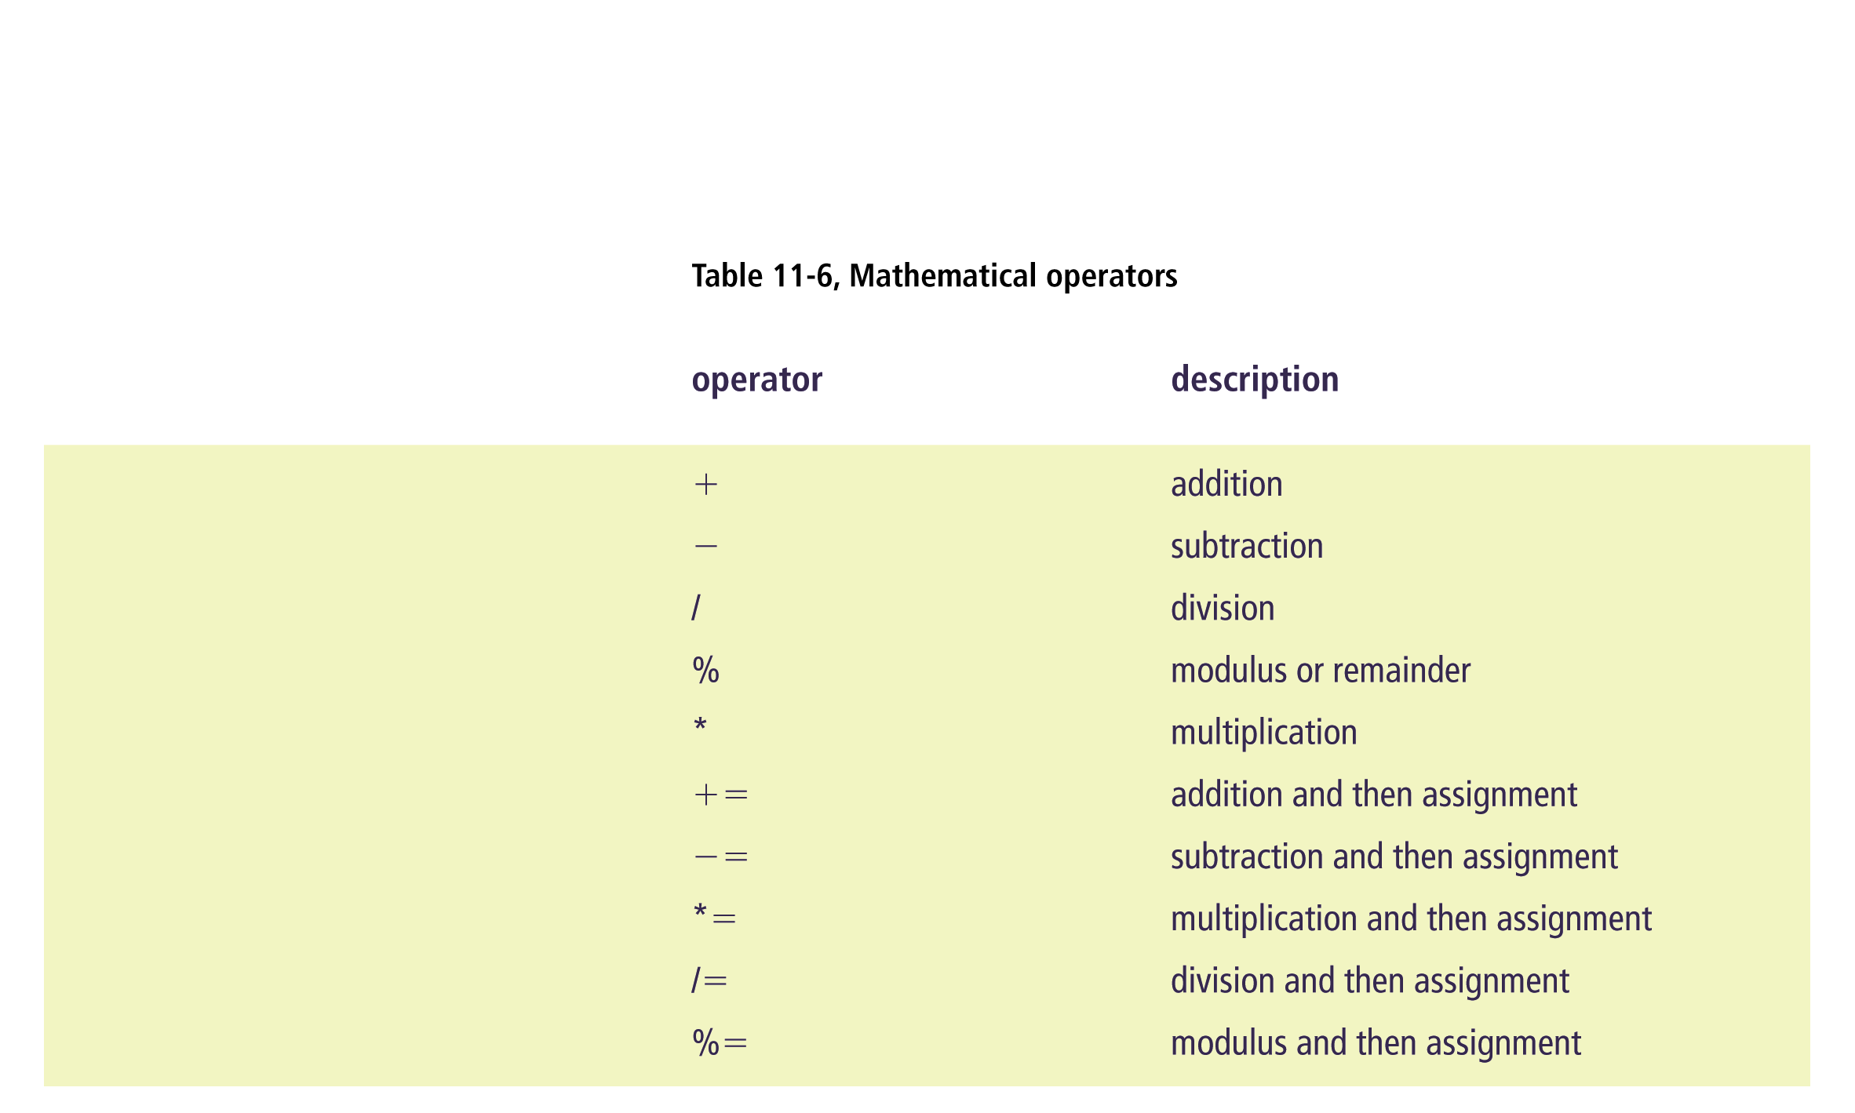
Connecting with Computer Science
31

Slide 32
Operators (continued)
  Increment and decrement operators (++, --)
    Adds or subtracts 1 from the value of the variable
    Preincrements or predecrements execute the increment or decrement first on the line of code
    Postincrements or postdecrements execute the increment or decrement last on the line of code
        int iCount = 5;
        int iResult = 0;
        iResult = iCount++ + 10;
      Sum of the variables is 15; iCount is incremented last, giving it the value of 6 after sum is calculated
Connecting with Computer Science
32

Slide 33
Operators (continued)
  Relational operators (Table 11-7)
    Compares values
  Logical operators (Table 11-8)
    Builds a truth table (bảng chân lý) when comparing expressions
      An expression is a programming statement that returns a value when executed
Connecting with Computer Science
33

Slide 34
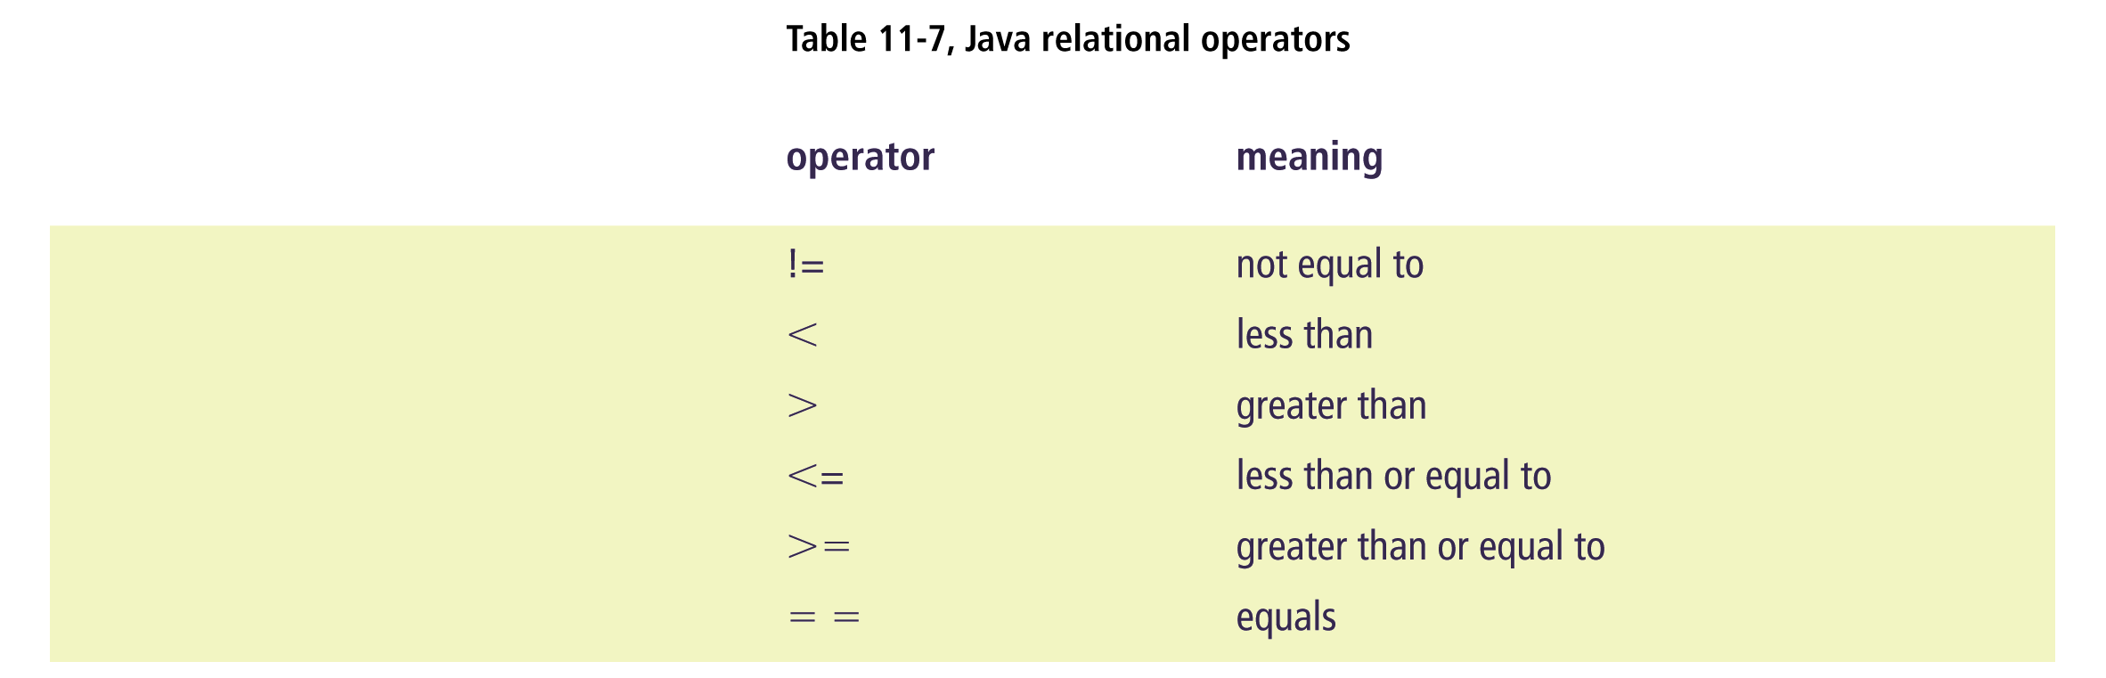
Connecting with Computer Science
34

Slide 35
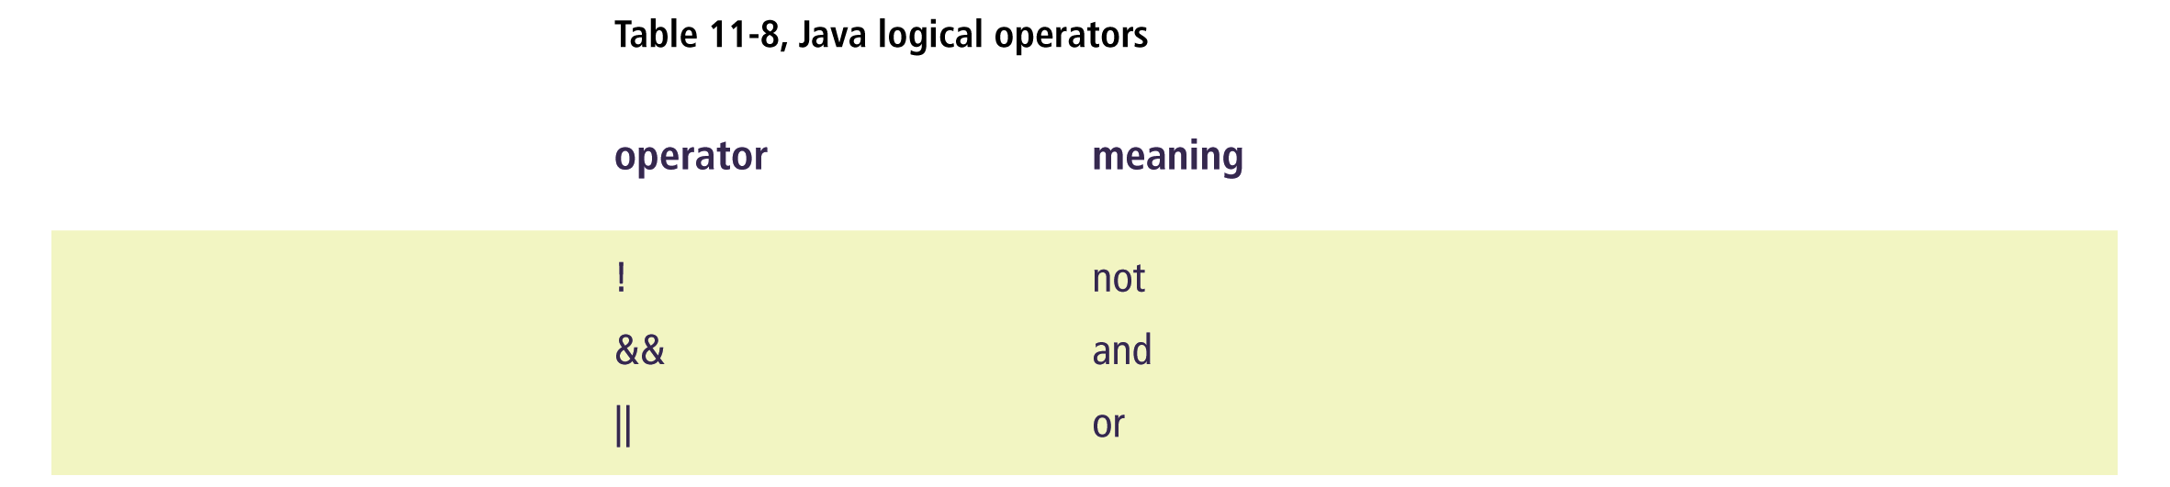
Connecting with Computer Science
35

Slide 36
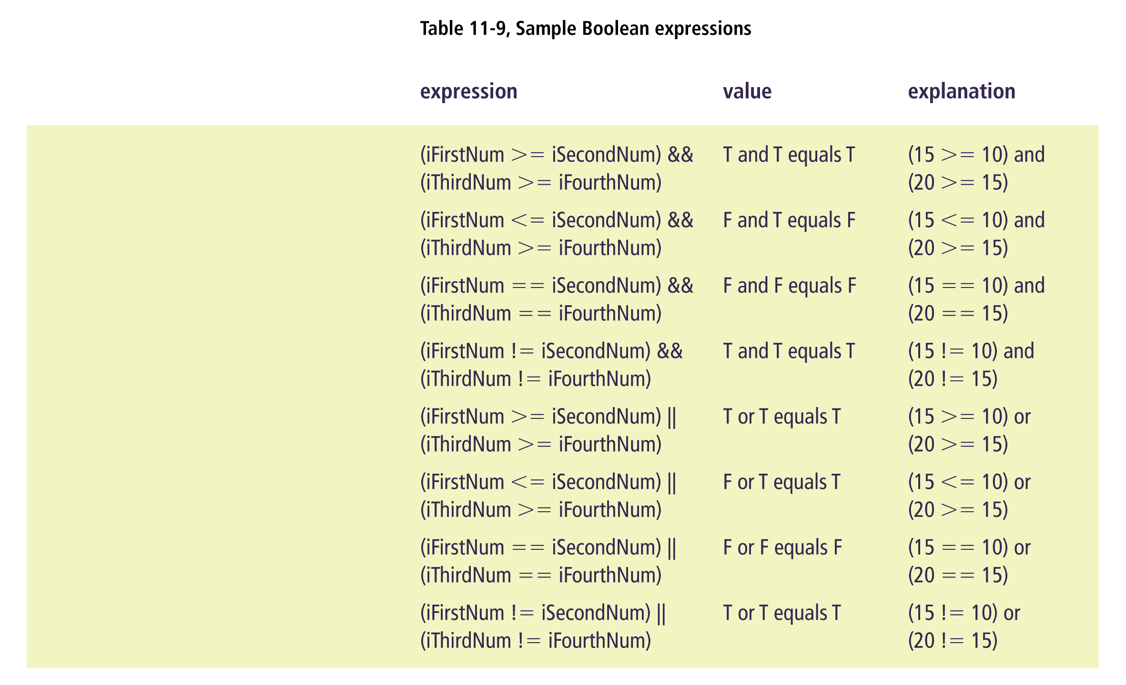
Connecting with Computer Science
36

Slide 37
Precedence (Độ ưu tiên)
The order in which operators appear can determine the output
Symbols that have a higher precedence are executed before those with a lower precedence
    (2+3) * 4 outputs 20
    2 - 5 * 2 outputs -8
Connecting with Computer Science
37

Slide 38
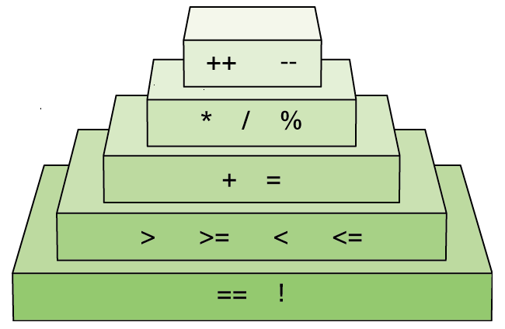
Figure 11-5
Order of relational and mathematical precedence
Connecting with Computer Science
38

Slide 39
Java Control Structures and Program Flow
A control structure is an instruction that dictates the order in which program statements are executed
Four type of control structures in high-level languages
  Invocation (gọi hàm)
  Top down (từ trên xuống)
  Selection (lựa chọn)
  Repetition (lặp lại)
Connecting with Computer Science
39

Slide 40
Invocation
Every Java program has a function called “main” as the starting point
    public static void main(String[] args) {}
  “public” scope means that it is visible for any other source code to use
  “static” indicates that the function belongs to the class
  “void” indicates that there is no return value
  “String[] args” can receive parameters or values when the program is executed
Connecting with Computer Science
40

Slide 41
Top Down (Also Called Sequence)
Program statements are executed in series, from the top line to the bottom line one at a time
Most common form of programming control structure, found in every programming language
Implemented by typing in statements that do not call other pieces of source code
Connecting with Computer Science
41

Slide 42
Blocks of Code
A single block statement encloses several statements with an opening and closing brace
  Enclosed statements are related in functionality
  Leaving out braces can cause your program to function incorrectly
  Braces are required in some circumstances
    Most often used when working with control structures such as invocation, selection, and repetition
Connecting with Computer Science
42

Slide 43
Output Data
You can output data to the current output device through the use of the System.out.print() or System.out.println() statements
  print() leaves the current insertion point of the cursor at the end of the data being output
  println() moves the insertion point to the next line after the data is output
  The “\n” (newline escape sequence) tells the system to move to the next line
  The expression can use concatenation (+ operator)
Connecting with Computer Science
43

Slide 44
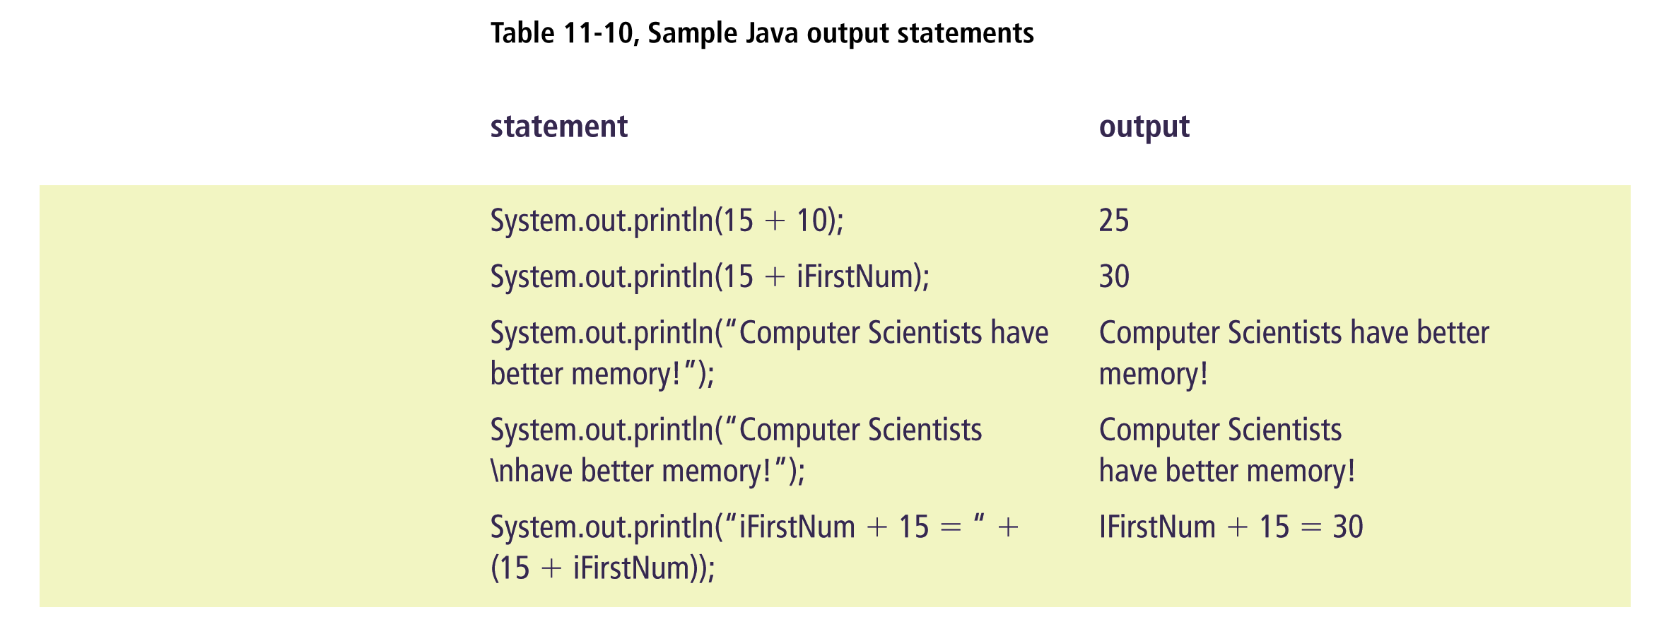
Connecting with Computer Science
44

Slide 45
Input Data
System.in provides methods for retrieving data from the current input device
  Involves creating new variables to read in characters from the input stream
  The characters are read one by one into another variable that acts as a memory buffer holding the newly created string
  This value can then be assigned to a declared String variable by calling the readLine() method
Connecting with Computer Science
45

Slide 46
More on Invocation
Invocation is the act of calling something or someone
Java implements invocation through the use of calling functions and methods
  A function performs a task and can return a value
  A method is a function that belongs to a class
  When a function name is encountered, the system passes control to the first line of code within that function
  The system returns control to the original calling point after the function is executed
Connecting with Computer Science
46

Slide 47
Selection
if statement syntax
  if (condition)
  { one or more statements }
if-else statement syntax
  if (condition)
  { one or more statements }
  else
  { one or more statements }
Connecting with Computer Science
47

Slide 48
Selection (continued)
if-else-if statement syntax
  if (condition)
  { one or more statements }
  else if
  { one or more statements }
  … // can contain multiple else ifs
  else
  { one or more statements }
  Performs certain blocks of code depending on the state of a variable within the program while it is running
Connecting with Computer Science
48

Slide 49
Selection (continued)
switch statement syntax
  switch (expression)
  {
  case value_1:
  statement_1;
  break;
  case value_2:
  statement_2;
  break;
  default: // optional
  statement_3;
  }
Connecting with Computer Science
49

Slide 50
Repetition (Looping)
for statement syntax
  for (variable declaration; expression;
  increment/decrement)
  { statements(s); }
  Post- or pre-operations are commonly used when updating the variable used as the counter in the for loop
  for (iCount = 1; iCount <= 5; iCount++)
for and while loops are precondition loops
  The expression is checked before any code is executed within the loop
Connecting with Computer Science
50

Slide 51
Repetition (continued)
while statement syntax
  while (expression)
  { statements; }
do while statement syntax
  do
  {
  statement(s);
  } while (expression);
  do while loops are postcondition loops
    Executes at least once before expression is evaluated
Connecting with Computer Science
51

Slide 52
Ready, Set, Go!
Purchase and download Java
  Sun Microsystems offers a version of Java and the JDK for free
Choose an editor to write the program
  Use an IDE or a simple text editor such as NotePad
Compile the program with the javac command
    javac MyProg1.java
Execute the program with the java command
    java MyProg1
Connecting with Computer Science
52

Slide 53
Object-Oriented Programming
A style of programming that involves representing items, things, and people as objects rather than basing the logic around actions
An object includes three distinct features
  Characteristics (attributes)
  Work
  Responses (to events)
OOP provides reusability and maintainability
Connecting with Computer Science
53

Slide 54
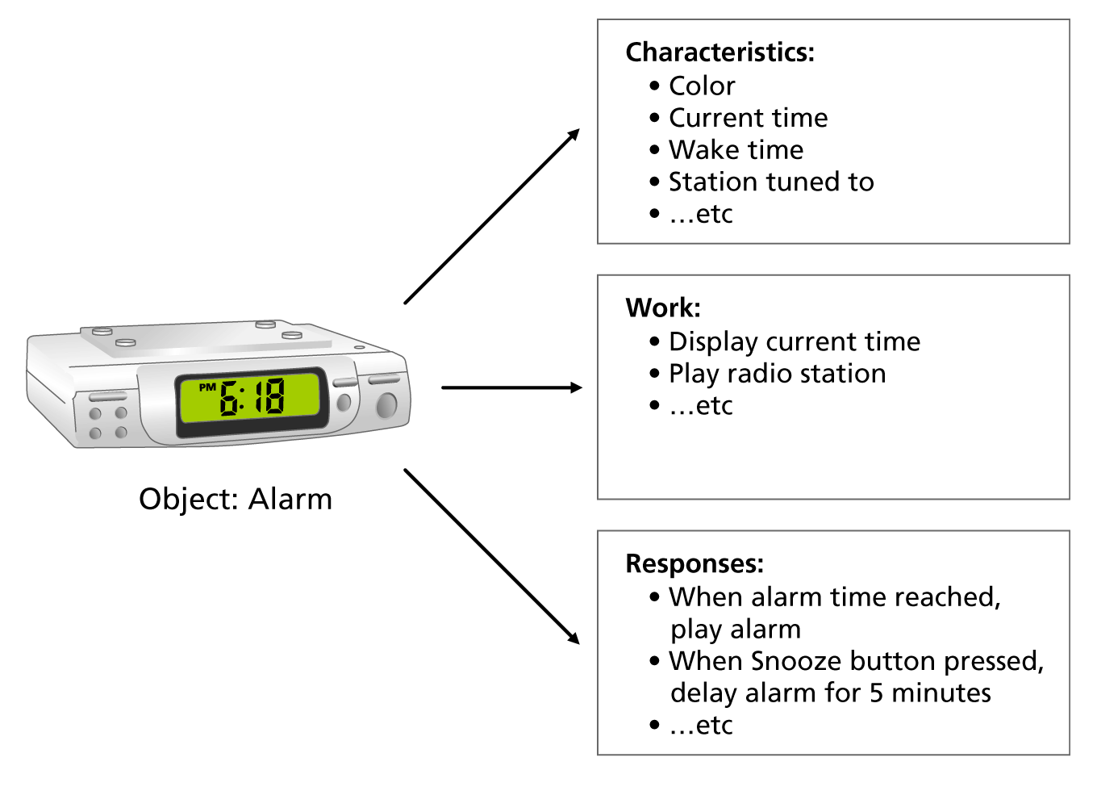
Figure 11-7
An object has characteristics,
work, and responses
Connecting with Computer Science
54

Slide 55
How OOP Works
Making a mold (khuôn)
  Implement a class or template
Creating the figure (hình thể)
  Define the characteristic of the mold
Putting the figure to work
  Define the actions the figure can perform, as well as its responses to certain events
Connecting with Computer Science
55

Slide 56
OOP Terminology
Class (lớp)
  A template used for defining new object types along with their properties and behavior
Object (đối tượng)
  A self-contained entity that consists of both data and procedures
Instantiation (thực thể hóa)
  The process of creating an object based on a class
Constructor (hàm tạo)
  A class method used for instantiating an object
Connecting with Computer Science
56

Slide 57
OOP Terminology (continued)
Property (also called attribute) (thuộc tính)
  Characteristic of an object
Method (phương thức)
  Work performed by an object; defined within the class
Event (sự kiện)
  An action recognized by a class
Event handler (xử lý sự kiện)
  How a class responds to an event
Connecting with Computer Science
57

Slide 58
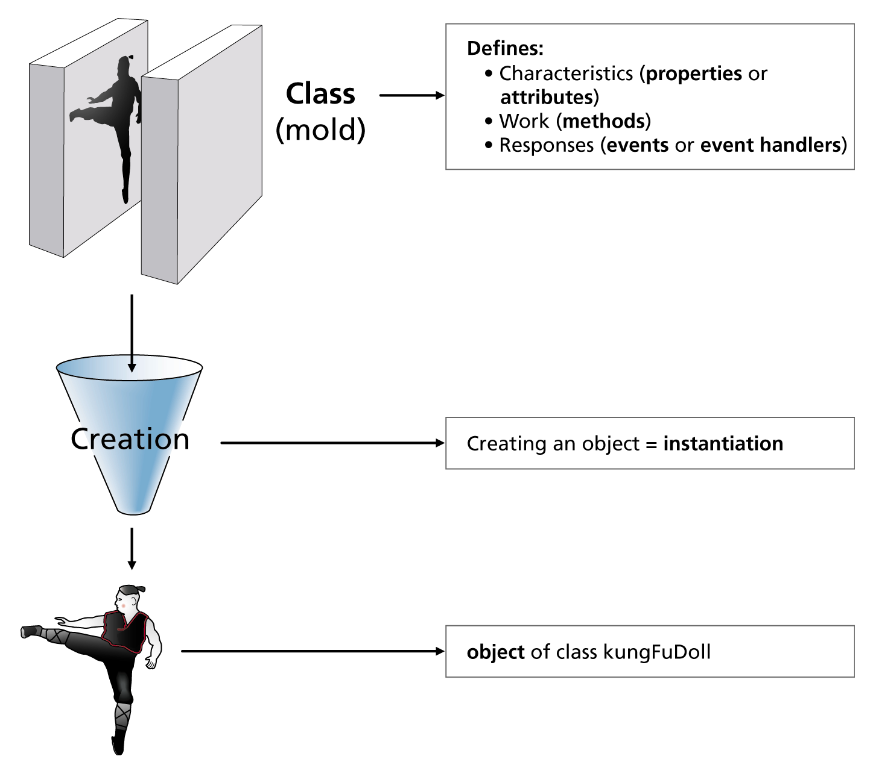
Figure 11-8
Making a plastic doll shows OOP concepts in action
Connecting with Computer Science
58

Slide 59
Inheritance (Tính kế thừa)
The process of providing more class functions by creating more specific classes based on generic classes
Parent class
  Generic class from which other classes can be created
Subclass
  A more specific class based upon a parent class
  Calling a method is a chain reaction up through parent classes until it is found
Connecting with Computer Science
59

Slide 60
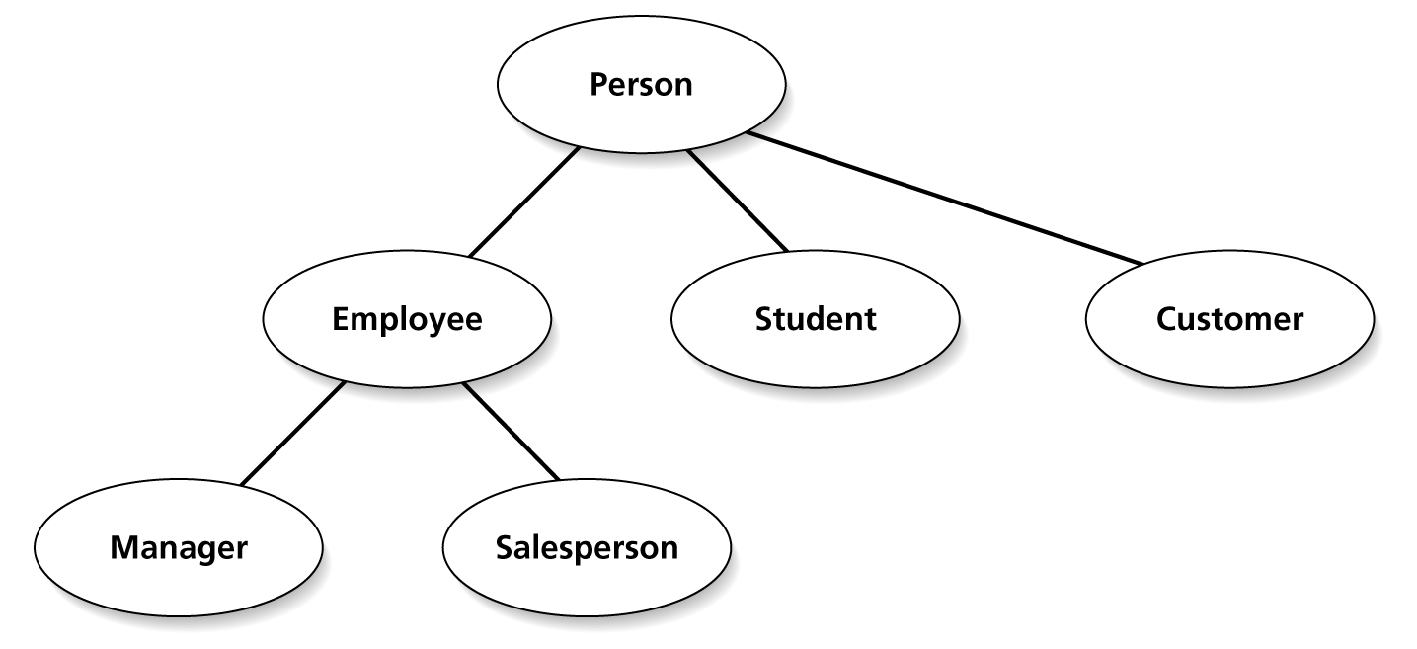
Figure 11-9
Inheritance promotes code reusability
Connecting with Computer Science
60

Slide 61
Encapsulation (Tính đóng gói)
Process of hiding an object’s operations from other objects
Treats an object as a black box
  Do not have to know how an object works in order to use it
Helps cut down on the potential errors to occur
  Isolates errors to the problem object
Connecting with Computer Science
61

Slide 62
Polymorphism (Tính đa hình)
An object’s ability to use the same expression to denote different operations
When an operation is called, the system at runtime determines how the operation is used
  Example: Using the Draw operation for all geometric shapes (squares, triangles, and circles)
    When Draw is called, the system decides which object’s method to call to display the shape correctly
Connecting with Computer Science
62

Slide 63
Java and OOP
Everything in Java revolves around classes and their properties and methods
You can reduce the amount of code you are producing by reusing objects you have created or by using someone else’s objects
Use resources to show the available objects and libraries you can use
    Programs, algorithms and tasks have already been implemented by someone else
Connecting with Computer Science
63

Slide 64
Choosing a
Programming Language
Considerations
  Functionality
  Vendor stability
  Popularity
  Job market
  Price
  Ease of learning
  Performance
Connecting with Computer Science
64

Slide 65
One Last Thought
A program will do whatever you tell it to do
In most cases, if the program doesn’t work correctly, it is the fault of the person who wrote the program, not the computer
  Be a responsible programmer
    You can create new and wonderful programs to help society
    Or…the program you write might have serious ramifications on society
Connecting with Computer Science
65

Slide 66
Summary
A program is only as good as the programmer(s) who wrote it
Programs are used everywhere and in almost everything you do
A program can either be interpreted or compiled
Low-level languages are more closely related to the machine languages that a computer understands
Assembler is a low-level programming language
Connecting with Computer Science
66

Slide 67
Summary (continued)
High-level languages are more closely related to human language
Algorithms are created for solving problems through some logical method
Pseudocode is a way to use human language to map out how a program is suppose to work
Creating the algorithm is one of the most important steps in writing a program
Connecting with Computer Science
67

Slide 68
Summary (continued)
Java is a high-level programming language that was initially designed for the Internet
Variables are temporary storage locations with a specific data type
  Used for calculations and storage
Java uses mathematical, relational, and logical operators
Four control structures used within a program: top down, invocation, selection, and repetition
Connecting with Computer Science
68

Slide 69
Summary (continued)
Object-oriented programming (OOP) allows programmers to reuse code and make their programs more maintainable
OOP creates classes, which are like templates or molds from which objects can be created
Objects can have properties, methods, and event handlers
Java is tied very closely to the OOP model
In order to become a good programmer you must practice, practice, and practice some more!
Connecting with Computer Science
69

