Slide 1
Ho Chi Minh:
Pinnacle of
Democratic Leadership

Slide 2
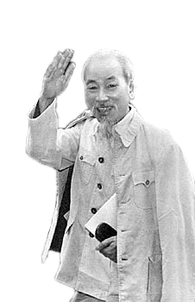
Info:
Name: Nguyen Sinh Cung
Renowned revolutionary,
Founder of the Vietnamese Communist Party,
Leader of Viet Minh independence movement.

Slide 3
Distributing responsibility among the membership, empowering group members, and aiding the group’s decision-making process.

Slide 4
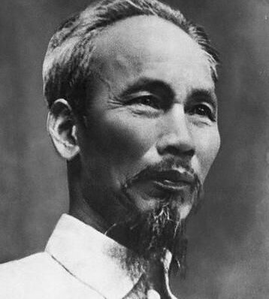
Ho Chi Minh’s Leadership Style*
Democratic, but decisive
Deeply understand people
Treasure the talented
Revolutionary and scienctific
Now let’s dive deep into the 1st and 3rd point.
* Source: bqllang.gov.vn/, tuyengiao.vn/, Hồ Chí Minh toàn tập – tập 5

Slide 5
1. Democratic&Decisive
The first and most important principle.

Slide 6
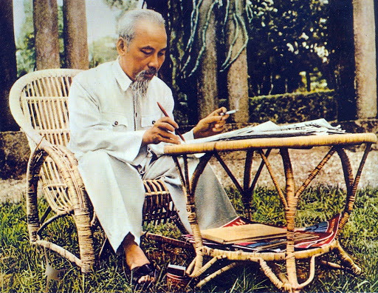
“Our country belongs to the Viet people.
Therefore, leadership shall be of democratic style.”
- Ho Chi Minh

Slide 7
Democracy
Ideas
Productivity

Slide 8
3. Treasure the talented
Also imporant in democratic leadership.

Slide 9
Ho Chi Minh
Ministry of Political Affairs
Close assistants
Anyone
could propose their ideas.
Then ideas underwent discussion.
Final decision was then made by the leader.

Slide 10
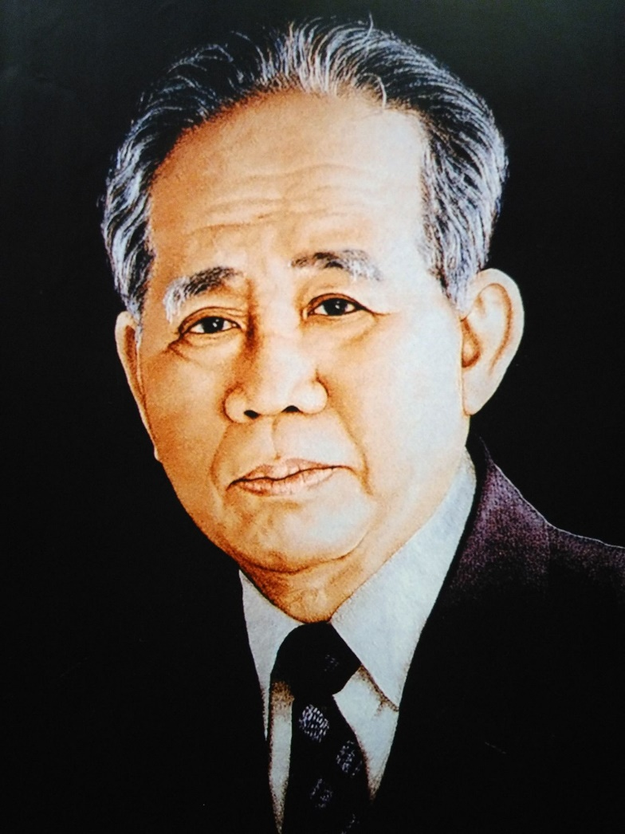
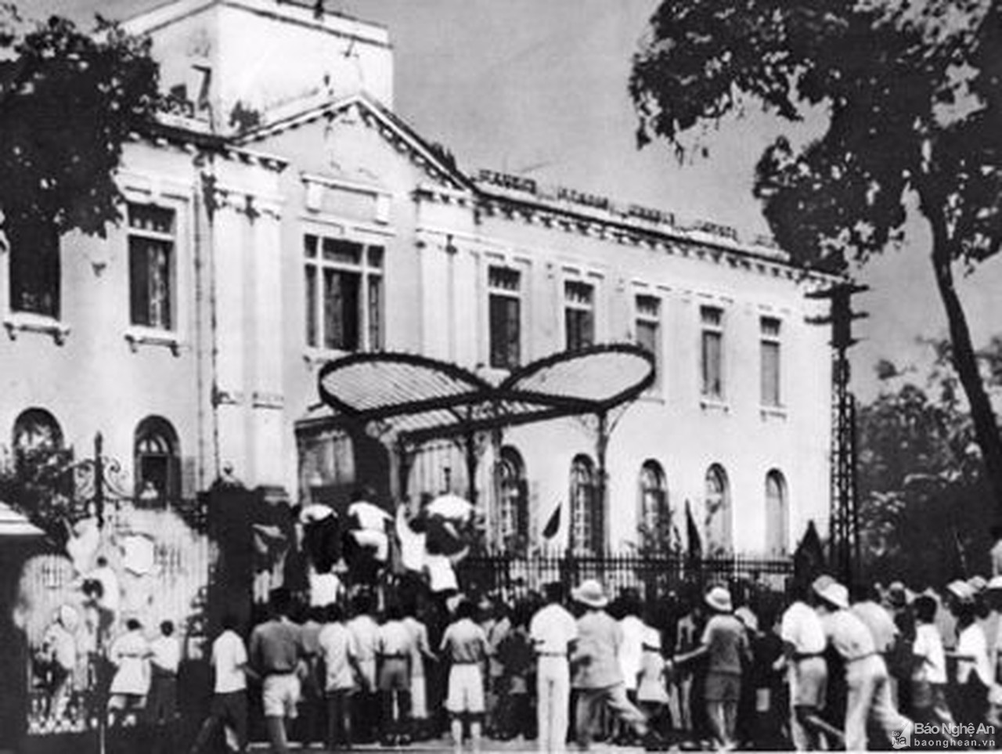
Ho Chi Minh
Ministry of Political Affairs
Close assistants
Anyone
could propose their ideas.
Then ideas underwent discussion.
Final decision was then made by the leader.
August Revolution
Le Duan

Slide 11
Thanks!

