Slide 1
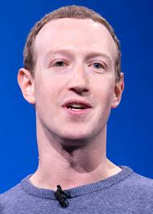

Mark Zuckerberg
Co-founder of Facebook

Slide 2
Introduction
Early life
Mark Zuckerberg was born in 1984 in White Plains, New York.
He developed an interest for computers at an early age.
  Zuckerberg began using computers and writing software in middle school.

Slide 3
Introduction
Leader becoming
Zuckerberg is considered a leader with intellectual ability.
  He has build one of the largest and successful global social networks by being a college dropout.
  Mr. Zuckerberg dropped out of Harvard to fulfill his dream which was to “build something that only a few on the planet had the privilege to build” (Walter, 2014).

Slide 4
Mark Zuckerberg
a laissez-faire leader

Slide 5

Laissez-faire leader
Zuckerberg has created an open communication culture:
  Allow employees to share their ideas, speak their minds.
  According to Walter, Facebook is committed to its product and innovation to further its goal which is to connect people.

Slide 6

Open communication culture

Slide 7
Laissez-faire leader
Zuckerberg builds strong relationships with his employees and partners:
  Partnering with the right investors and having a strong management team is vital for a successful company.
  An article by Walter states, “Success is a team sport. Great leaders recognize their own weaknesses as much as their strengths and bring in the right people in to form partnerships that drive success.”

Slide 8
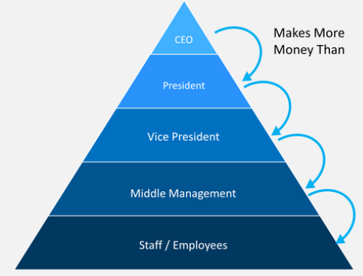
Laissez-faire leader
He is Throwing Away Traditional Hierarchies:
  Rather than slotting people into roles based on age and experience, everyone’s ideas are valued in clear and obvious ways.

Slide 9
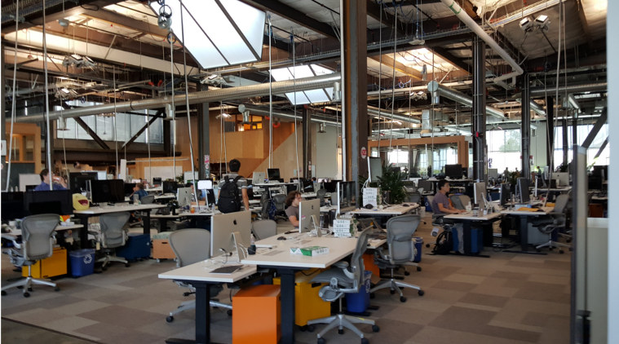
Laissez-faire leader
He is Removing Barriers:
  Part of doing away with hierarchies is breaking down the barriers between executives and other employees. Zuckerberg’s office has “glass walls”.

Slide 10
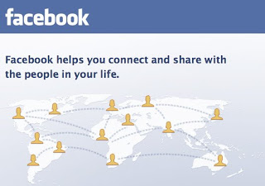
Laissez-faire leader
He has a Clear Vision:
  Mark Zuckerberg’s life’s ambition is to create a more open and connected world and his commitment to that goal is unwavering.

Slide 11
Laissez-faire leader
He Empowers Employees:
  Employees at Facebook are able to act in creative ways outside the confines of bureaucracy and tradition that exist at many other larger companies. It is a difficult thing to run a company with thousands of employees in a way that maintains adaptability at the individual level.

Slide 12
Pros
Cons
Can work for motivated teams with high expertise and skills
Creative teams may value the independence
Works well when leader provides needed information and materials at start of project
Not good for groups lacking needed skills, motivation, adherence to deadlines
Can result in poor performance and outcomes
Leader may appear uninvolved
Confusion over roles in the group

