Slide 1

ONE DIRECTION
The heartbreaking fall of

Slide 2
I. Introduction
II. Conflict
  1. Substantive Conflict
  2. Affective Conflict

Slide 3
I. Introduction

Slide 4

I. Introduction
Founded in 2010
An English-Irish pop boy band
Composed of 5 members

Slide 5

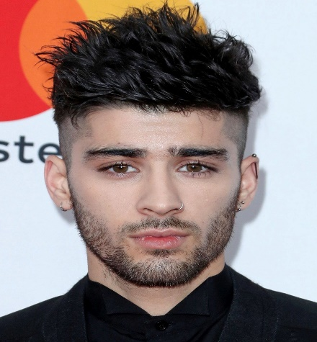


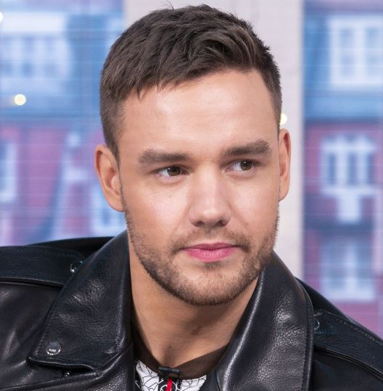
Harry Styles
Zayn Malik
Louis Tomlinson
Niall Horan
Liam Payne

Slide 6
~200
awards earned

Slide 7
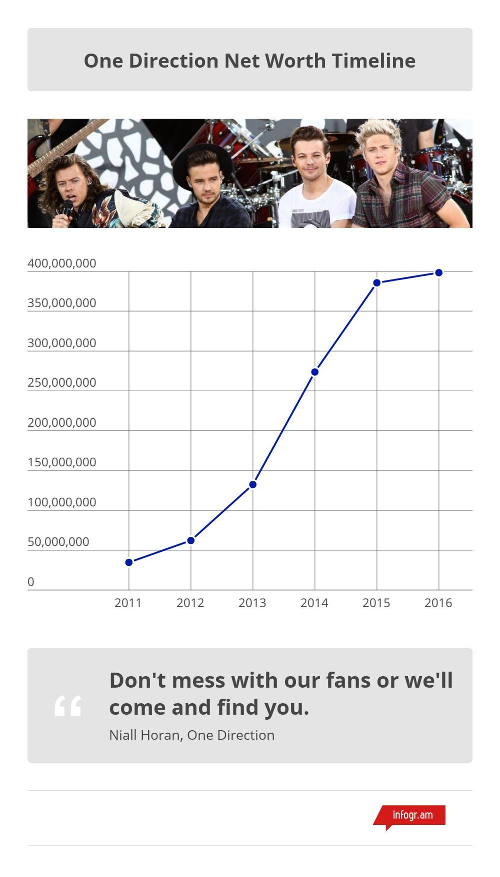
$398,313,661
earned in 2016

Slide 8
With the departure of Zayn Mailk (March 2015), the group slowly breaks apart and was eventually disbanded.

Slide 9
II. Conflict

Slide 10
II. Conflict
Substantive Conflict
Zayn left the group to pursuit his own career
Affective Conflict
Louis - Zayn's Rivalry, lack of friendship - affectionate in the group, weak group link/bondage...

Slide 11

1. Substantive Conflict:
On March 25, 2015, Zayn Malik, one-fifth of the massively popular boy band One Direction, officially left the group...

Slide 12
1. Substantive Conflict:
The reason for Malik's departure was announced not long after he departed from his band's world tour because of stress.

Slide 13
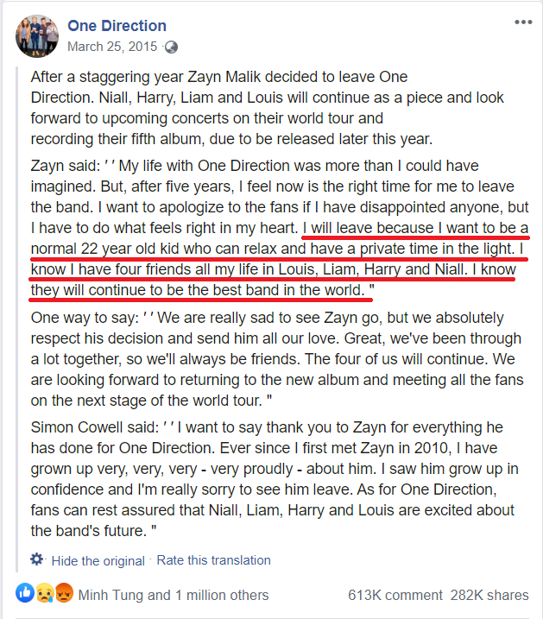
1. Substantive Conflict:
The reason for Malik's departure was announced not long after he departed from his band's world tour because of stress.
https://www.facebook.com/onedirectionmusic/posts/869295683125227

Slide 14
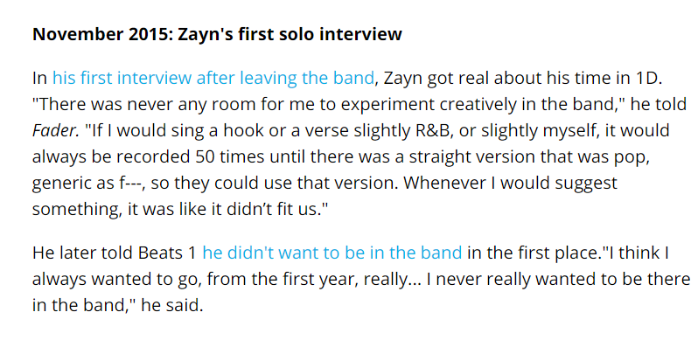
Want big impact?
USE BIG IMAGE.
https://www.billboard.com/articles/columns/pop/9357414/zayn-left-one-direction-timeline

Slide 15
“I think I always wanted to go, from the first year, really... I never really wanted to be there in the band.”
-- Zayn Malik

Slide 16
One Direction handled its substantive conflicts poorly, trying to avoid it instead of actually facing it.

Slide 17
2. Affective Conflict:
Normally, One Direction would be depicted as 5 friends who shared one hobby: Music.
But, ever since the leaving of Zayn, many of the darker side started to reveal themselves...
This was initially the outcome of an substantive conflicted left untreated. Yet, thing is much more complicated than that.

Slide 18
2. Affective Conflict:
In reality, not even one of the members tried to talk to Zayn about the matter, let alone stopping him.
Zayn was actually secluded from the group, having no voice at all.

Slide 19
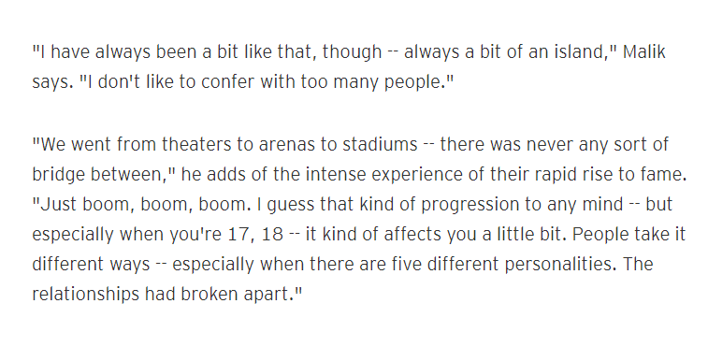
Want big impact?
USE BIG IMAGE.
https://www.etonline.com/zayn-malik-says-he-didnt-make-a-single-friend-while-in-one-direction-113109

Slide 20
Feeling lonely and having no one to talk to, stress start build up and soon overcome Zayn, leading to his leaving the group.

Slide 21
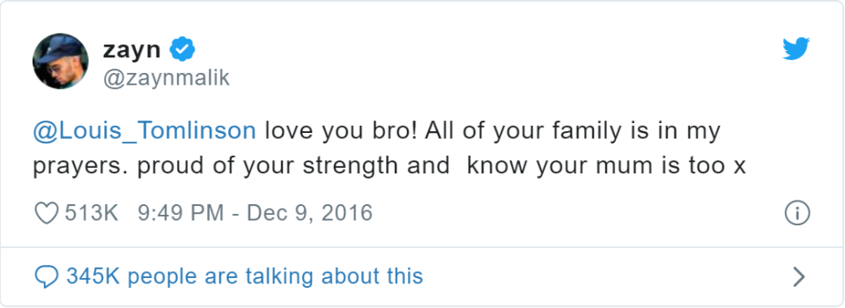
2. Affective Conflict:
The one Zayn considered closest, Louis, started to turn back on him → rivalry between the two.

Slide 22

FINAL WORDS

Slide 23
THANK FOR WATCHING

