Slide 1
503073 / RELAY CHAT
WebSockets and real time communication
A PHP application for conversations that move in both directions.
Shared rooms, stored messages, visible connection state.
Team members ____________________________________
RELAY / 503073
01 / 12
Notes:
We present Relay, a PHP application demonstrating WebSockets and real-time communication. Our application is a multi-room chat workspace. It combines ordinary HTTP endpoints with a persistent connection for chat, typing and presence. In this presentation, we explain the communication model, show how the system is organized, demonstrate the running application, and discuss measured results and limitations. Our names and student IDs are left blank in this editable presentation so the team can fill them in. Each member must deliver their own assigned part of the final English recording. This deck supports that recording and does not replace participation.

Slide 2
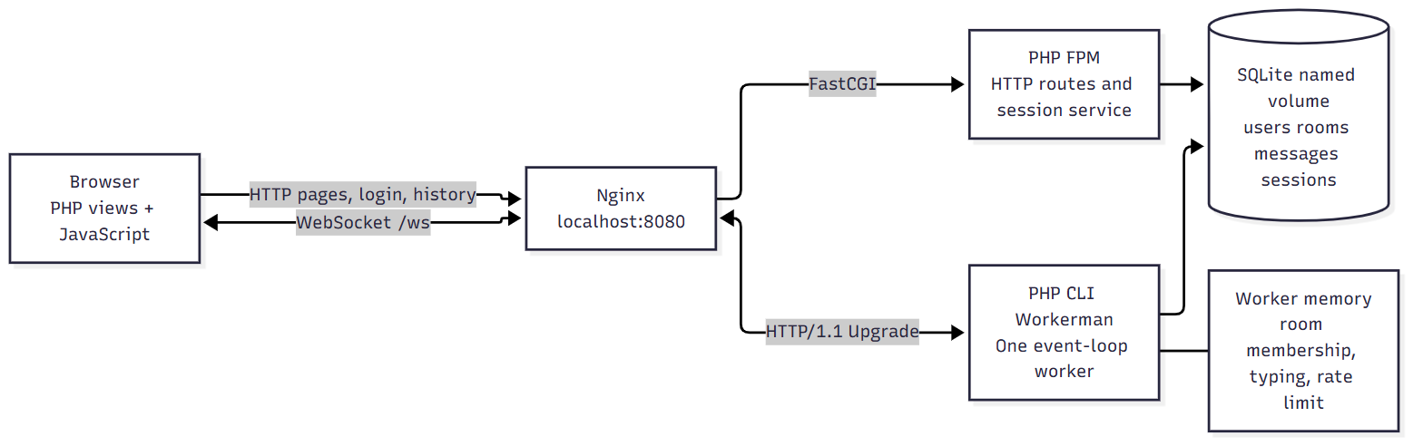
THEORY / A
HTTP and persistent communication
HTTP remains useful for login, room discovery and history.
WebSocket lets either endpoint initiate a message over the established channel.
Chat, typing and presence use named JSON events.
RELAY / 503073
02 / 12
Notes:
HTTP request and response is a natural model for a bounded operation. We submit credentials and receive a result, or request a history snapshot and receive records. A receiving chat participant, however, wants updates without initiating another request for every possible change. WebSocket establishes a persistent framed channel. Both browser and server can initiate messages on that channel. Our application therefore keeps HTTP for login, rooms and history, and uses WebSocket for live events. This is a division by purpose. WebSocket does not make all HTTP operations obsolete. The architecture also separates PHP-FPM from the long-running Workerman process. They share durable records through SQLite, rather than relying on a PHP variable that exists only inside one process. Sources: RFC 6455; MDN WebSocket API; Nginx WebSocket proxying.

Slide 3
PROTOCOL / A
Handshake identity and message boundaries
HTTP/1.1 Upgrade → validate Origin and session → 101
Workerman handles RFC 6455 frames, fragments and ping/pong.
The application validates JSON, identity and room membership.
Masking is not encryption. Public deployment needs TLS and wss.
RELAY / 503073
03 / 12
Notes:
In our HTTP/1.1 deployment, the browser requests an upgrade at slash ws. Nginx explicitly forwards Upgrade and Connection headers to Workerman. Before the connection is accepted, our gateway validates the Origin and signed session cookie against SQLite. The successful response is 101 Switching Protocols. That status proves protocol negotiation, not permanent authorization for every later event. Workerman handles frame parsing, continuation frames, masking and control frames. Our validator handles the JSON object inside a text message. We distinguish a chat event name from a protocol opcode. Client masking does not encrypt content, so a public deployment must use TLS and WSS. The verified local demo runs on loopback HTTP and WS; we do not claim a public TLS deployment was tested. During the live recording, open the browser's Network WebSocket request and explain the 101 response and messages, with cookies hidden. Sources: RFC 6455 sections 4, 5 and 10; OWASP WebSocket Security Cheat Sheet.

Slide 4
COMPARISON / B
Transport alternatives
Transport | Delivery model | A useful fit
Short polling | Repeated HTTP checks | Infrequent changes
Long polling | Held request, then reissue | Streaming fallback
SSE | Server to browser stream | Feeds and progress
WebSocket | Persistent bidirectional messages | Interactive conversation
Our choice: WebSocket for live interaction; HTTP for finite operations.
RELAY / 503073
04 / 12
Notes:
We compared short polling, long polling, server-sent events and WebSocket. Short polling is simple, but the receiving browser discovers an update only when a request completes. Long polling holds a request while waiting for data and then opens another. SSE provides a server-to-browser event stream with browser reconnect behavior, while upstream actions need a separate request or channel. WebSocket supports independent sending in both directions. For this application, typing, room activity and chat fit a shared bidirectional event channel. This does not mean WebSocket is always better. A low-frequency status page may work well with polling, and a server-only feed may be simpler with SSE. We implement a controlled short-polling comparison, while long polling and SSE are researched alternatives rather than benchmark implementations. Sources: RFC 6455; WHATWG HTML Server-sent events; MDN WebSocket API.

Slide 5
ARCHITECTURE / C
One origin two PHP processes
Nginx is the only published service. SQLite sessions connect the HTTP and WebSocket identity model.
RELAY / 503073
05 / 12
Notes:
The browser sees one origin at localhost port 8080. Nginx sends ordinary requests to PHP-FPM and forwards slash ws to Workerman. Workerman runs exactly one worker, so its room hub sees every socket in the demo. Both PHP processes open their own PDO connection to a shared SQLite named volume. Users, rooms, messages and sessions are durable. Membership, typing and rate counters are transient worker memory. This boundary explains what survives a restart. We initially encountered a Windows source-mount permission problem with SQLite writes. Moving the complete database directory to a named volume and setting ownership fixed the issue for both processes, including WAL and SHM files. Increasing the worker count would require shared room state, fanout and account limiting before it could be considered correct. Sources: SQLite Write-Ahead Logging; Workerman 5.2.3 installed source; Nginx WebSocket proxying.

Slide 6
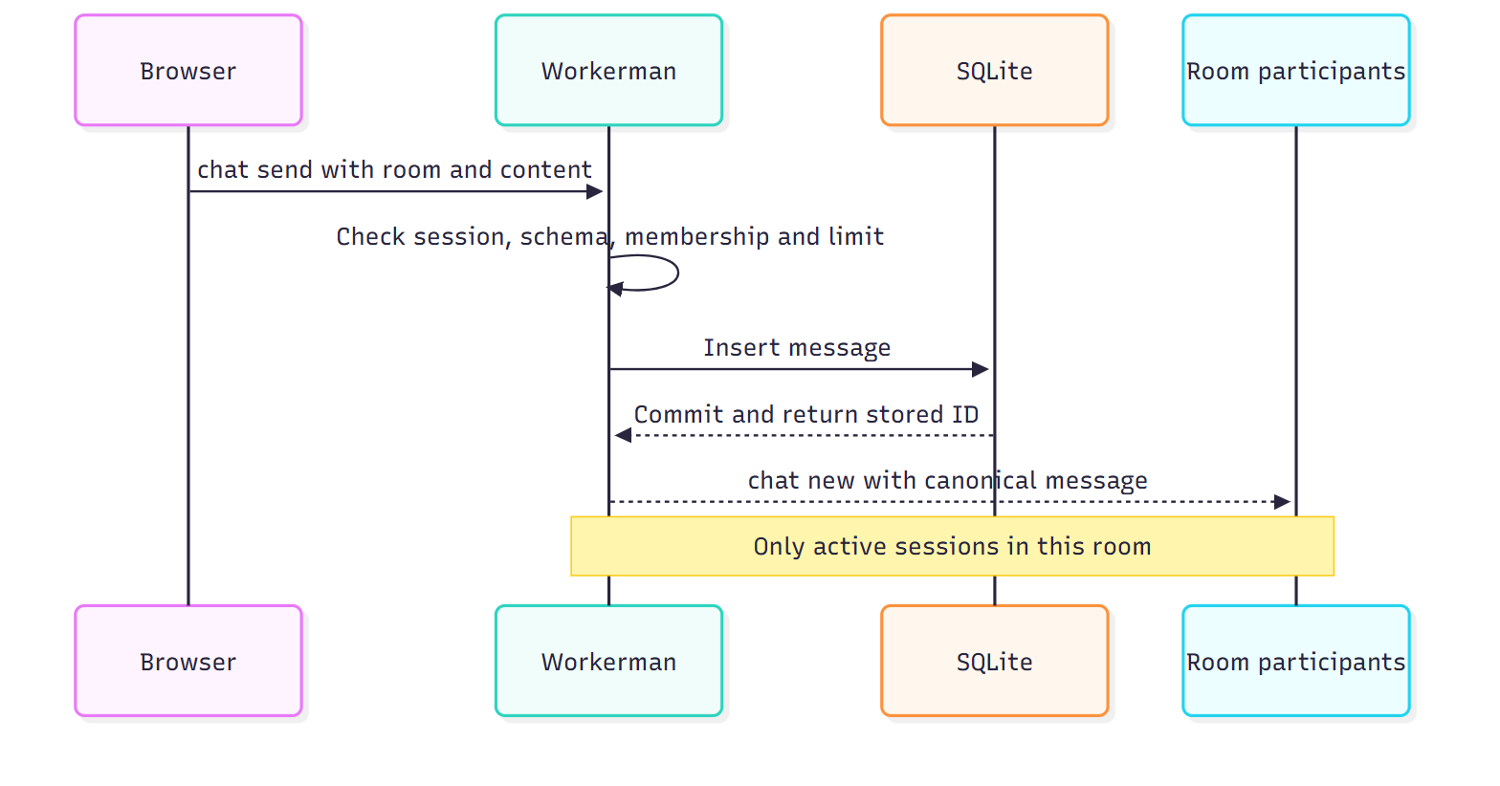
DESIGN / C
Stored data and event flow
users / rooms / messages / sessions
Validate → check membership and account limit → insert → broadcast
A stored message ID is shared by HTTP history and live delivery.
RELAY / 503073
06 / 12
Notes:
Our four tables separate account identity, room identity, stored conversation and revocable sessions. Messages reference users and rooms with foreign keys. The room and ID index supports the latest-history query. On a send event, the server validates the active session, exact schema, membership and message budget. The repository inserts the record, and only after that succeeds does the hub broadcast the canonical Message object. That object has the same ID and shape in HTTP history and WebSocket delivery. A unit test deliberately aborts insertion and verifies that no message is broadcast and no successful-send slot is consumed. This demonstrates why persistence ordering matters. ID-based display deduplication is useful, but it is not an exactly-once protocol. A future request ID and server uniqueness rule would be needed to retry uncertain sends safely. Evidence: tests/Realtime/ChatTest.php, tests/Database/MessageRepositoryTest.php.

Slide 7
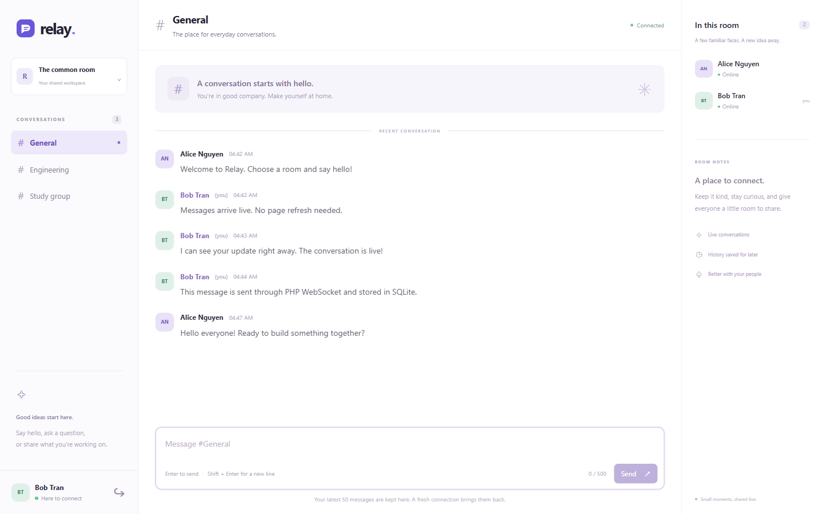
LIVE DEMO / B
Live room conversation
Two browser profiles. Two accounts. Matching message IDs without a page reload.
RELAY / 503073
07 / 12
Notes:
Now we switch to the actual application. In one browser profile, sign in as Alice. In another profile, sign in as Bob. Ordinary tabs share cookies, so they are not suitable for demonstrating two different users. Choose General in both browsers and send a clear marker from Alice. Bob receives it without reloading, and Alice receives the same canonical stored message. Send a reply from Bob to show the channel works in both directions. Open the WebSocket Messages view briefly to relate chat send and chat new to the UI. Next move Bob to Engineering. Send a General message and typing activity from Alice. Bob must not receive that room's events. The automated integration checks compare actual stored IDs and verify isolation; this live demonstration makes the behavior understandable. Show the online member list and explain that it is scoped to the current room. Evidence: integration room test, EV-06 screenshot.

Slide 8
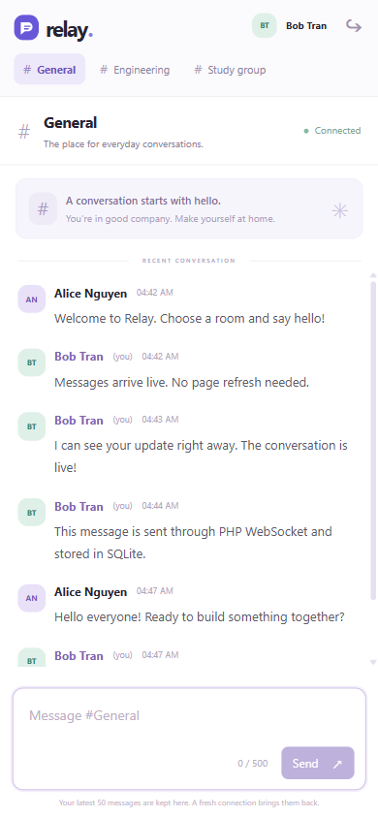
LIVE DEMO / B
Presence typing and connection recovery
One account with two tabs still appears once.
Typing expires after three seconds.
Reconnect rejoins and merges the newest 50 messages by ID.
Uncertain sends are never automatically repeated.
RELAY / 503073
08 / 12
Notes:
Open a second tab for one account and point out that presence still shows one person. Closing one tab should not remove that person while another socket remains in the room. Type briefly and stop. The server expires typing after three seconds even when a stop message never arrives. Then demonstrate offline state and restore connectivity. The composer is disabled, the client reconnects with bounded backoff, rejoins the selected room and merges history by stored ID. We also tested changing rooms while an older history request was delayed. The stale response could not replace the new room. On a phone-sized viewport, the important controls remain usable and the document does not overflow horizontally. Recovery is bounded to 50 recent messages. If the offline interval exceeds that history, older missing messages may not return. A message stored just before disconnect may be uncertain, so the client never automatically resends it. Evidence: browser acceptance JSON and runtime checks.

Slide 9
VERIFICATION / C
Persistence and defensive behavior
Check | Observed outcome
PHPUnit | 28 tests / 78 assertions passed
HTTP and WS integration | 7 of 7 groups passed
Restart | Stored marker remained
No pong client | Closed after 55.828 seconds
Room / payload / rate limit | Invalid operations rejected
Tests use an isolated stack. Browser checks supplement protocol checks.
RELAY / 503073
09 / 12
Notes:
We use several verification layers. PHPUnit checks validation, sessions, SQL, room state, the limiter and persistence failure. Real HTTP and WS integration tests check authentication boundaries, room isolation, binary and fragmented messages, multi-tab presence, logout and rate limiting. Browser acceptance checks literal script-like text, recovery, stale response handling and shared-session logout. For persistence, we sent a unique marker and restarted HTTP and WS without deleting the volume. The marker remained in history. For cleanup, we connected a client that never sent pong. The server closed it after 55.828 seconds. The account limiter is shared across tabs: opening another socket does not create another budget. A blocked message is not stored. These results support specific behavior, not a claim that the product has no defects or is production secure. During recording, show the test summary and one meaningful code path rather than scrolling through all source. Evidence: evidence/logs/phpunit.xml, integration.json, runtime-verification.json and browser-acceptance.json.

Slide 10
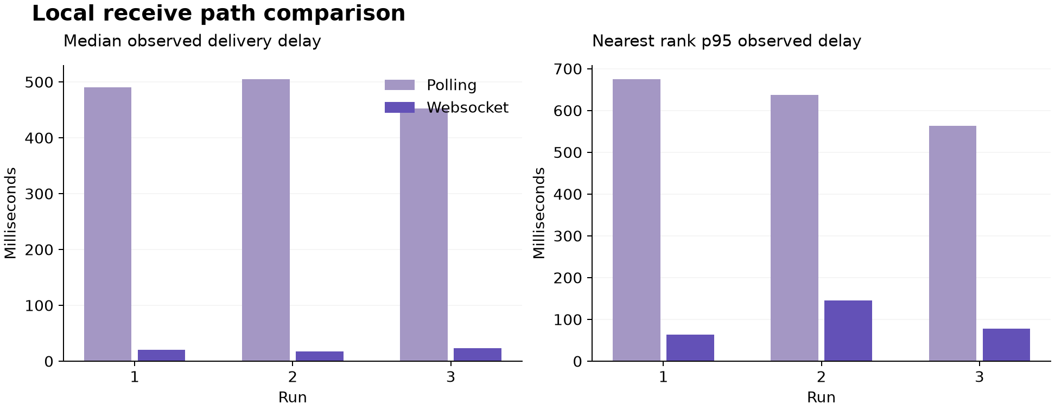
EXPERIMENT / C
Local polling and WebSocket results
Three 120-second runs per transport. 20 messages per run. All 120 received.
Polling median: 452.95–504.52 ms / WS median: 17.63–23.73 ms.
RELAY / 503073
10 / 12
Notes:
The experiment changes the receiving transport while keeping the sender, database, room, authentication and machine common. Each transport has three 120-second runs with twenty messages at six-second intervals. Polling checks for new IDs once per second. The run order alternates, and a single Python monotonic clock measures send to observed receive. All 120 messages across the six runs were received with no recorded timeout or server error. Polling median delays ranged from 452.95 to 504.52 milliseconds; WebSocket medians ranged from 17.63 to 23.73 milliseconds. These values include storage and scheduling, and polling includes its wait for the next request. They are local exploratory results, not pure network latency. Polling made 360 receiving HTTP requests across the active trials. The WS receive path made no repeated HTTP polling requests, but it still maintained a connection and heartbeat traffic. JSON body counts exclude headers and framing and include extra WS room-state events, so they are not a normalized bandwidth comparison. Evidence: raw per-run JSON, benchmark-summary.json and chart source.

Slide 11
EVALUATION / B
Results within clear limits
Functional fanout passed at 2, 10 and 20 simultaneous sockets.
One worker owns transient state. SQLite writes remain synchronous.
Latest-50 history is bounded recovery, not exactly-once delivery.
Local HTTP/WS is verified; public TLS and production capacity are not.
RELAY / 503073
11 / 12
Notes:
The implementation demonstrates the intended concepts with a useful chat workflow. The concurrency test received the same stored message ID on every joined socket at two, ten and twenty connections. Several sockets share accounts, so this is not a test of twenty independent users or a capacity ceiling. The strongest conclusion is functional fanout at those levels. Our limits are explicit. One worker owns room and rate state, synchronous SQLite writes can block its event loop, and the UI restores only the latest fifty messages. The local transport experiment uses a small sample and one polling interval; it should not be generalized to WAN deployment or every workload. Host development activity may affect scheduling, so the results are exploratory. A future controlled performance study should isolate resources and normalize event content. We retain these qualifications in the report and chart interpretation so the evidence remains useful rather than overstated.

Slide 12
CONCLUSION / A
Application reliability beyond a socket
Identity, room authorization, storage and recovery are application responsibilities.
Next steps: durable replay cursor, idempotent send IDs, shared multi-worker state and verified WSS.
Source, setup commands, test evidence and raw measurements accompany the report.
RELAY / 503073
12 / 12
Notes:
The main lesson is that real-time communication is a system behavior rather than a single socket call. WebSocket provides a channel, while the application must define identity, permissions, event schemas, storage and recovery. Relay connects those responsibilities in a PHP implementation and verifies them through source, tests, browser checks and raw measurements. Useful next steps are durable history replay, client request IDs with server deduplication, shared multi-worker state and a verified public WSS deployment. The source README explains how to install, seed, run and test the project, including fictional credentials. The report contains the design rationale, comparison, results and limitations. Our final English video must include each real team member explaining their own part. Thank you. Selected sources: RFC 6455, WHATWG Server-sent events, MDN WebSocket API, OWASP WebSocket Security Cheat Sheet, PHP documentation, SQLite WAL documentation, Workerman documentation and Nginx WebSocket proxying.

