Slide 1
IMAGE PROCESSING 2
Topic: Coin detection
Member
Tran Viet Hung _ 229050
Tran Viet Quan _ 229051
Hochschule Heilbronn
June 2026

Slide 2
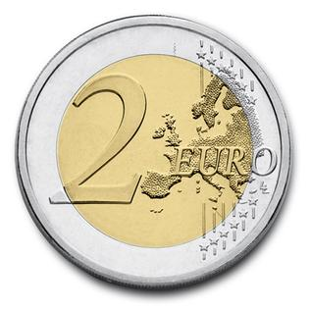
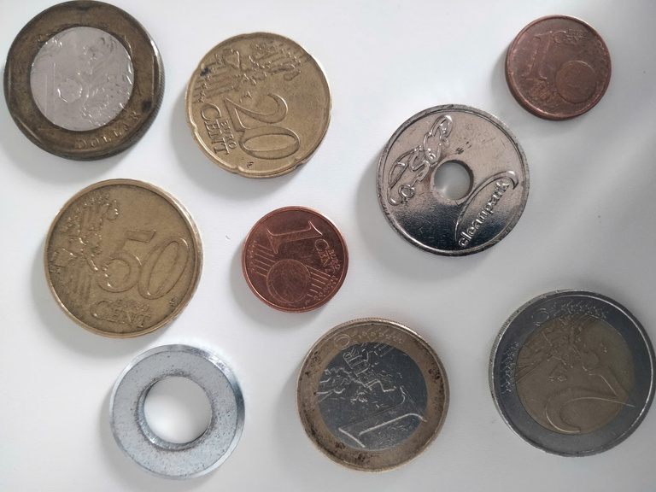
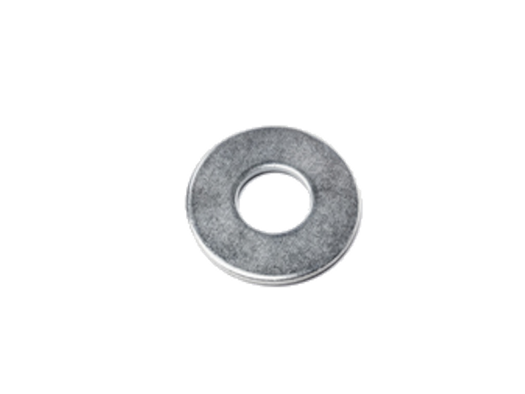
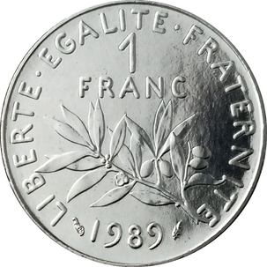
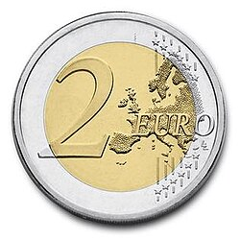
Overal pipeline of the program
Run the program
Put the 2 euro coin in
press C to start calibrate
Press D to start detect
Put coin in
The program will detect circular objects and classfies them into 3 main categories
None euro coin
Euro coin with its value
Not coin

Slide 3
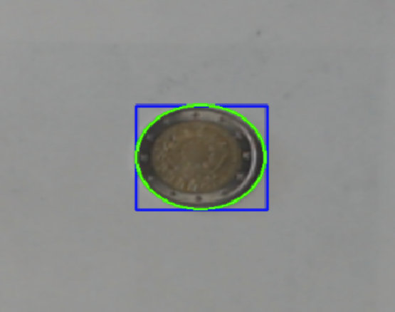
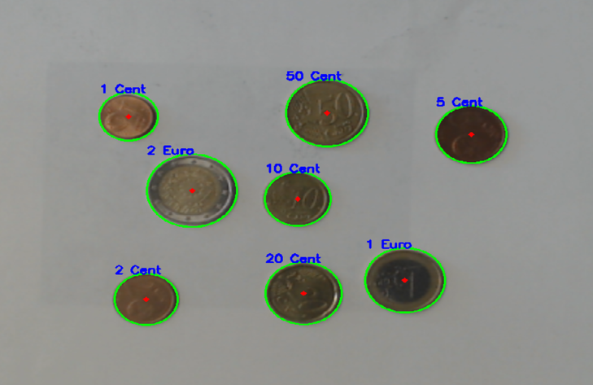
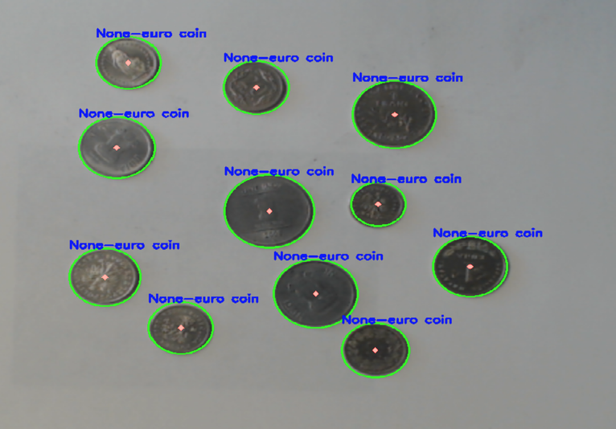
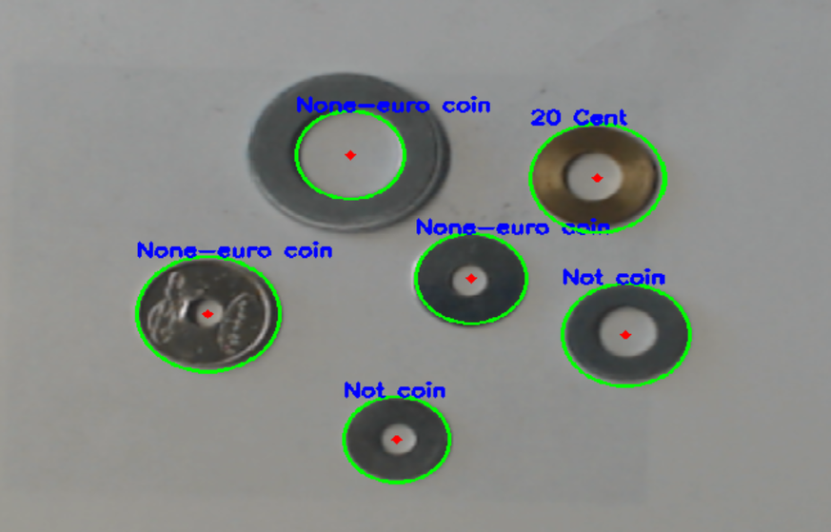
Overview of how the program run
Calibrate
Detect

Slide 4

Calibration mode
Adaptive threshold
Using Median Filter to eliminate noise and smooth the gray image.
Adaptive Threshold convert the image to binary image and adjust the threshold automatically.
Using a brush to erode or close some gaps/holes.
Contours
Extract the area and perimeter of the shape.
Calculate circularity of the coin.
If 0.62 < circularity <= 1
⟶ Draw contour and extract features (radius and center)

Slide 5
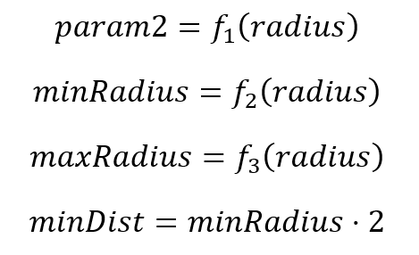
Detection mode
Hough Circle
Hough circle’s parameters are calculated using “radius” (in pixel) obtained from calibration mode.
Non-linear best fit function:
https://www.standardsapplied.com/nonlinear-curve-fitting-calculator.html
Linear best fit function:
https://www.graphpad.com/quickcalcs/linear1/
Detect inner circle
Extract the coin
Apply Hough circle again with smaller “maxRadius”
If inner circle has saturation < 20
⟶ Holes exist

Slide 6
Classification
Initial class: None euro coin
Check radius, saturation and hue value
2 euro
1 euro
50 cent
20 cent
10 cent
5 cent
2 cent
1 cent
None-euro coin
-----------------------------------------------------Check if there is holes -------------------------------------------------------------
2 euro
not coin
1 euro
not coin
50 cent
not coin
20 cent
not coin
20 cent
not coin
5 cent
not coin
2 cent
not coin
1 cent
not coin
none-euro
coin
not coin

Slide 7
Limitations
The camera quality is not always stable to remain/detect coins exactly.
If the inner circle is not clear ⟶ it’s claimed to be non-Euro coin.
Reflections from metallic surfaces cause the saturation of inner circle to fluctuate.
⟶ Holes not detected.
Coin detection work best if object is placed around the center, not on edge of the image.
Circular object that bigger than the 2 euro coin may not be correctly detected.
Only work on certain lighting condition.

Slide 8
THANK YOU

