Slide 1
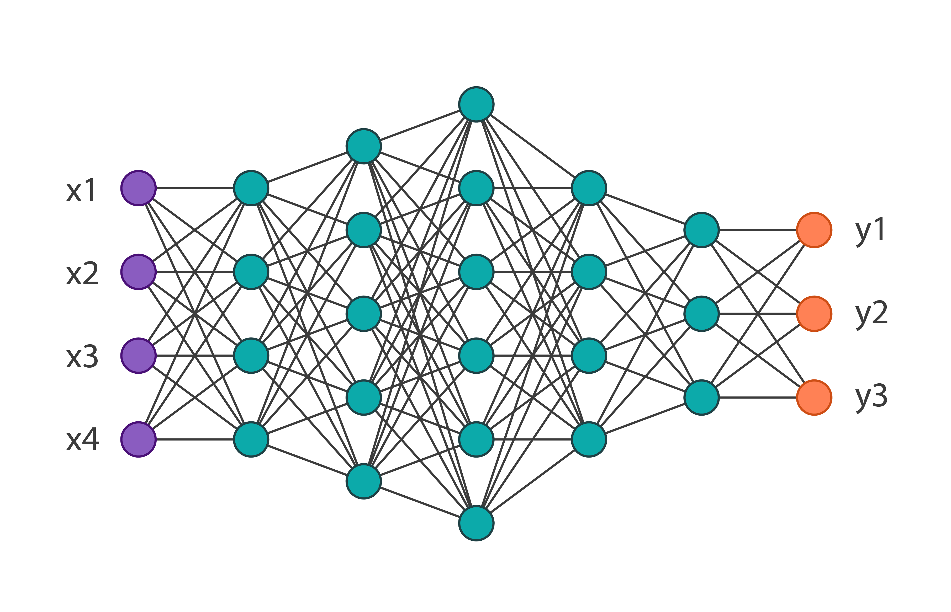
Selectivity, Activity, Stability
Descriptors

