Slide 2

Microsoft Visual C# Under the Covers: An In-Depth Look at C# 3.0
DEV 346
Luke Hoban
Visual C# Compiler Program Manager

Slide 3




C#3.0 Design Themes
Improve on C#2.0
Language Integrated Query (LINQ)
100% Backwards Compatible

Slide 4
C#3.0 Design Themes
Improve on C#2.0
Language Integrated Query (LINQ)
100% Backwards Compatible

Slide 5

C#3.0 Improving on C#2.0
demo
Luke Hoban
C# Compiler Program Manager
Microsoft

Slide 6
The LINQ Project
C# 3.0
VB 9.0
Others
.NET Language Integrated Query
LINQ to Objects
LINQ to DataSets
LINQ to SQL
LINQ to Entities
LINQ to XML
<book>
<title/>
<author/>
<year/>
<price/>
</book>
Objects
Relational
XML

Slide 7
The LINQ Project
C# 3.0
VB 9.0
Others
.NET Language Integrated Query
LINQ to Objects
LINQ to DataSets
LINQ to SQL
LINQ to Entities
LINQ to XML
<book>
<title/>
<author/>
<year/>
<price/>
</book>
Objects
Relational
XML

Slide 8
Building LINQ in C#3.0
demo
Luke Hoban
C# Compiler Program Manager
Microsoft

Slide 9
C# 3.0 – New Language Features
Local Variable Type Inference
Object Initializers
Collection Initializers
Anonymous Types
Auto-Implemented Properties
Extension Methods
Lambdas
Expression Trees
Query Expressions
Partial Methods
Implicitly-Typed Arrays

Slide 10
C# 3.0 – New Language Features
Local Variable Type Inference
Object Initializers
Collection Initializers
Anonymous Types
Auto-Implemented Properties
Extension Methods
Lambdas
Query Expressions
Expression Trees
Partial Methods
Implicitly-Typed Arrays

Slide 11
Summary
Improve on C#2.0
Language Integrated Query (LINQ)
100% Backwards Compatible

Slide 12
C#3.0 - Summary
Improve on C#2.0
Language Integrated Query (LINQ)
100% Backwards Compatible

Slide 13

Resources
Monday
A Lap around Microsoft Visual Studio Code Name “Orcas” (10:30am, S330)
ADO.NET Entity Framework 1: Introduction (4:45pm, S230 E)
*Hands-on Labs (10:00am – 9:00pm)
Tuesday
The .NET Language Integrated Query (LINQ) Framework (8:30am, N320 A)
LINQ and XML for the Microsoft Visual Basic Developer (10:15am, N320 E)
Microsoft Visual C#: Tips and Tricks for the Microsoft Visual Studio Codename "Orcas" IDE (1:00pm, N310 E)
Microsoft Visual Basic: Tips and Tricks for the Microsoft Visual Studio Code Name “Orcas” IDE (2:45pm, S310 E)
*Hands-on Labs (7:00am – 10:00pm)
Wednesday
*Hands-on Labs (7:00am – 10:00pm)
Thursday
Microsoft Visual C# Under the Covers: An In-Depth Look at C# 3.0 (8:00am, S230 E)
Applied ADO.NET Entities: How to Leverage the Entity Framework in Your Application (9:45am, S220 D)
Meet the LINQ team (1:00pm, Blue Theater 14)
*Hands-on Labs (7:00am – 5:45pm)
Friday
Using the .NET Language Integrated Query (LINQ) Framework with Relational Data (9:00am, N220 F)
A Lap around Microsoft Visual Studio Code Name “Orcas” (Repeat) (1:00pm, S310 A)
ADO.NET Entity Framework: Provider Model and Integration with Third-Party Databases (1:00pm, Blue Theater 12)
*Hands-on Labs (7:00am – 4:00pm)
*Hands-on Labs
DAT06-HOL | Understanding the ADO.NET Entity Framework
DEV19-HOL | Introduction to LINQ
DEV20-HOL | Mapping Your Objects to Database Tables with LINQ to SQL

Slide 14
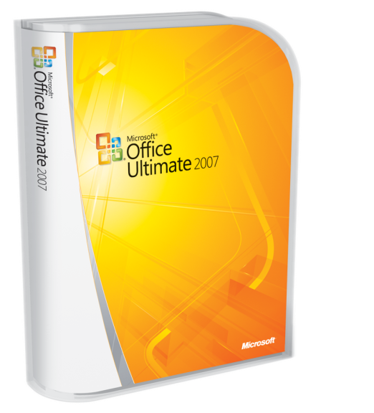






Required slide
Complete an evaluation on CommNet and enter to win!

Slide 15
Questions?
Q&A

Slide 16
Related Content
Breakout Sessions DEV324 The .NET Language Integrated Query (LINQ) Framework
DEV338 Microsoft Visual C#: Tips and Tricks for the Microsoft Visual Studio 2008 IDE
DEV346 Microsoft Visual C# Under the Covers: An In-Depth Look at C# 3.0
DEV348 Using the .NET Language Integrated Query (LINQ) Framework with Relational Data
Chalk-Talks WEB13-TLC Meet the LINQ team
Notes:
7/23/2007 2:49 PM
© 2005 Microsoft Corporation. All rights reserved.
This presentation is for informational purposes only. Microsoft makes no warranties, express or implied, in this summary.
16

Slide 17
Resources
Technical Communities, Webcasts, Blogs, Chats & User Groups
http://www.microsoft.com/communities/default.mspx
Microsoft Learning and Certification
http://www.microsoft.com/learning/default.mspx
Microsoft Developer Network (MSDN) & TechNet
http://microsoft.com/msdn
http://microsoft.com/technet
Trial Software and Virtual Labs
http://www.microsoft.com/technet/downloads/trials/default.mspx
Visual C# Developer Center
http://msdn2.microsoft.com/en-us/vcsharp/default.aspx
Visual Studio 2008 Beta1 Download Page
http://msdn2.microsoft.com/en-us/vstudio/aa700831.aspx
Visual Studio 2008 Samples
http://msdn2.microsoft.com/en-us/bb330936.aspx

Slide 18
Resources
Monday
A Lap Around Microsoft Visual Studio 2008 (Session repeats on 6/8) 10:30
Overview of Microsoft Visual Studio 2008 for Devices and .NET Compact Framework 3.5 4:45
Tuesday
The .NET Language Integrated Query (LINQ) Framework 8:30
LINQ and XML for the Microsoft Visual Basic Developer 10:15
Building Smart Client Applications in Microsoft Visual Studio 2008 10:15
Building a Complete Web Application Using ASP.NET "Orcas" and Microsoft Visual Studio 2008 (Two parts) 10:15 and 1
Microsoft Visual C#: Tips and Tricks for the Microsoft Visual Studio 2008 IDE 1:00
Microsoft Visual Basic: Tips and Tricks for the Microsoft Visual Studio 2008 IDE 2:45
Building Microsoft Windows Presentation Foundation Applications with Microsoft Visual Studio 2008 and Microsoft Expression Blend 4:30
Wednesday
Building Microsoft Windows Communication Foundation and Windows Workflow Foundation Applications with Microsoft Visual Studio 2008 5:30
Thursday
Microsoft Visual C# Under the Covers: An In-Depth Look at C# 3.0 8:00
Friday
Using the .NET Language Integrated Query (LINQ) Framework with Relational Data 9:00
A Lap Around Microsoft Visual Studio 2008 (Repeated from 6/4) 1:00
What's New in Microsoft Visual Studio Team System for Testers, New Features in Visual Studio 2008 and Best Practices for Testing AJAX, SharePoint, and Reporting Services 1:00

Slide 19

Resources
Monday:
A Lap Around Silverlight 4:45
Thursday:
Enhancing ASP.NET AJAX Applications with Silverlight 8:00
Silverlight Tips and Tricks 4:30
Friday:
Creating and Delivering Rich Media and Video on the Web with Silverlight, Expression Studio, and Windows Server 2008 9:00
Building Rich Internet Applications with Silverlight 1:00
Building Interactive Media Experiences with Silverlight 2:45
Links:
Scott Guthrie on Channel 9 - http://channel9.msdn.com/showpost.aspx?postid=304508
Silverlight Developer Center - http://msdn2.microsoft.com/en-us/silverlight/default.aspx
Silverlight Alpha 1.1 SDK - http://msdn.microsoft.com/vstudio/eula.aspx?id=c8bf88e7-841c-43fd-c63d-379943617f36

Slide 20
Resources
Required slide
Technical Communities, Webcasts, Blogs, Chats & User Groups
http://www.microsoft.com/communities/default.mspx
Microsoft Learning and Certification
http://www.microsoft.com/learning/default.mspx
Microsoft Developer Network (MSDN) & TechNet
http://microsoft.com/msdn
http://microsoft.com/technet
Trial Software and Virtual Labs
http://www.microsoft.com/technet/downloads/trials/default.mspx
Visual C# Developer Center
http://msdn2.microsoft.com/en-us/vcsharp/default.aspx
Visual Studio Orcas Beta1 Download Page
http://msdn2.microsoft.com/en-us/vstudio/aa700831.aspx
Visual Studio Orcas Samples
http://msdn2.microsoft.com/en-us/bb330936.aspx

Slide 21


