Slide 1
Proxy!
Design Patterns

Slide 2
Intent
Provide a surrogate or placeholder for another object to control access to it.
Wait, that’s it? EASY…

Slide 3
Questions

Slide 4
What Is It
Defer Cost of Creation
(Create On Demand)
Act as Placeholder for something else
Replace Coffee with Folgers Crystals
They won’t know the difference!

Slide 5
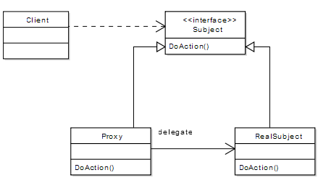
UML

Slide 6
Code Examples
Web Services
Nhibernate
Where are the Pirates?!

Slide 7
Consequences
Introduce Level of Indirection
Hide True Cost
Real Object may be Far, Far Away.
Optimization Possibilities
Uncomfortable pauses as that 100MB class has to haul itself from the far end of the world….
Interceptor Requirements

Slide 8
Questions

