Slide 1
Data Curation & Management
Research & Modelling
Practitioners
Decision Making

Slide 2
?
Data Curation & Management
Research & Modelling
Practitioners
Decision Making

Slide 3
?
Data Curation & Management
Research & Modelling
Practitioners
Decision Making
???

Slide 4
Integrated Data Products
Modelling

Slide 5
Integrated Data Products
Software
Modelling

Slide 6
Integrated Data Products
Software
Decision Making
Modelling

Slide 7
Integrated Data Products
Modelling
Integrated Population Models
Software
Decision Making

Slide 8
Integrated Data Products
Abundance
Mark-recapture
Modelling
Integrated Population Models
Software
Decision Making

Slide 9

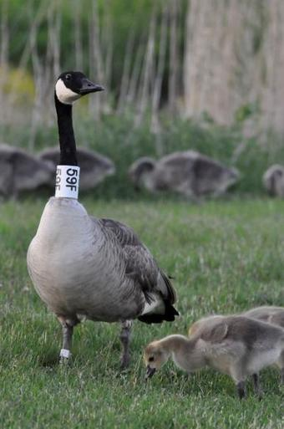
Integrated Data Products
Abundance
Mark-recapture
Modelling
Integrated Population Models
Software
Decision Making

