Slide 1
Findable
Accessible
Interoperable
Reusable

Slide 2
Avian Ecology

Slide 3
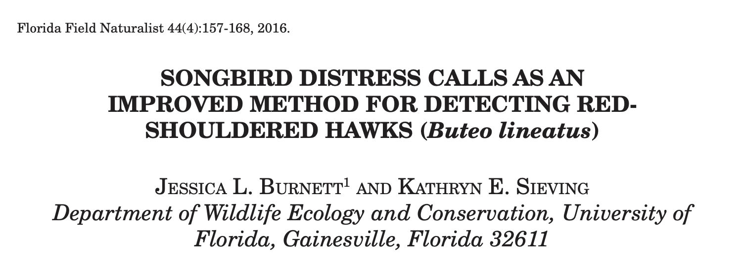
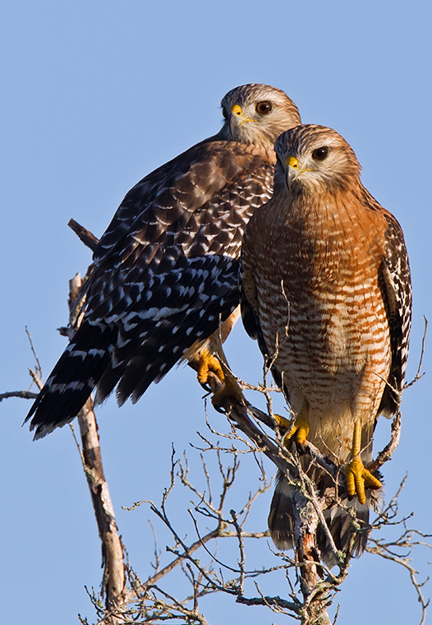
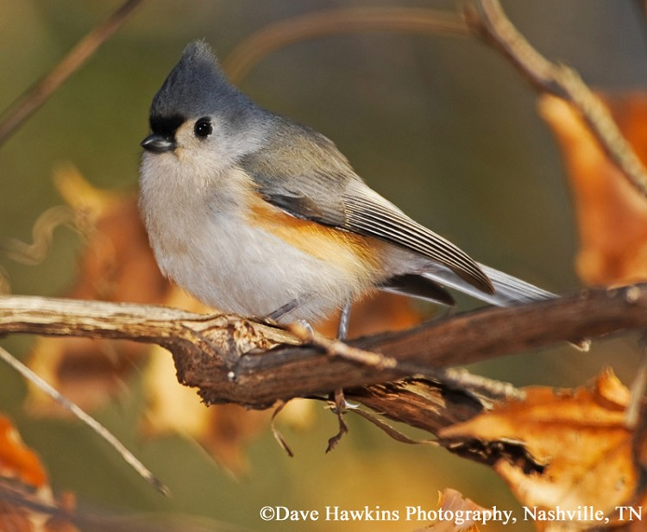
Avian Ecology

Slide 4
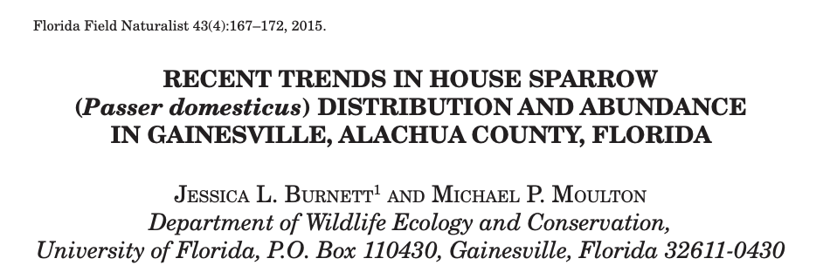
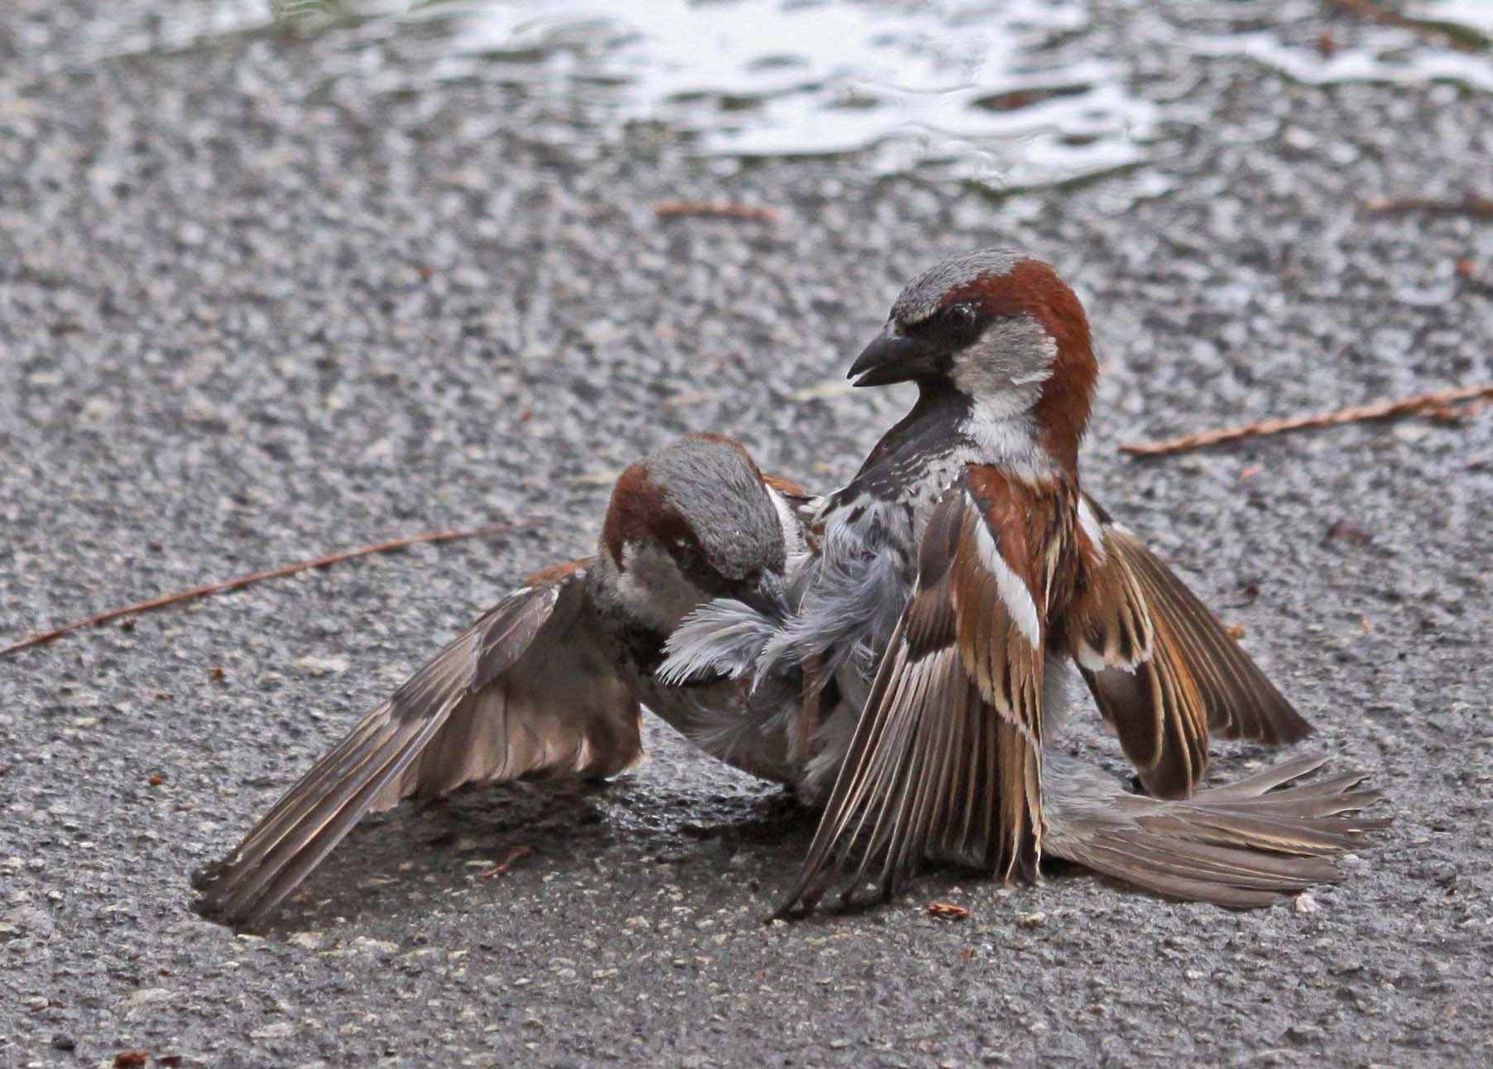
Avian Ecology

Slide 5
Invasion Ecology
Avian Ecology

Slide 6
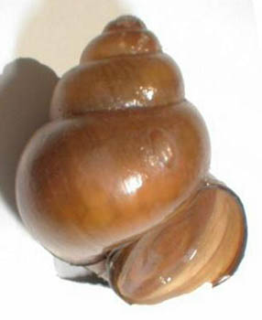
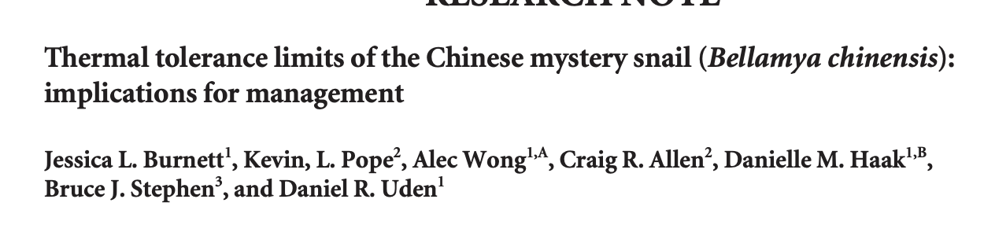
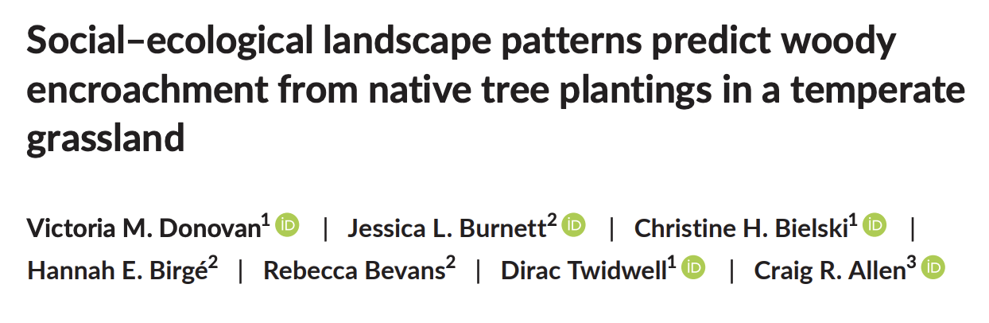
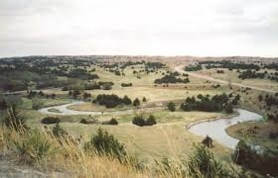
Invasion Ecology
Avian Ecology

Slide 7
Ecological Modelling
Invasion Ecology
Avian Ecology

Slide 8
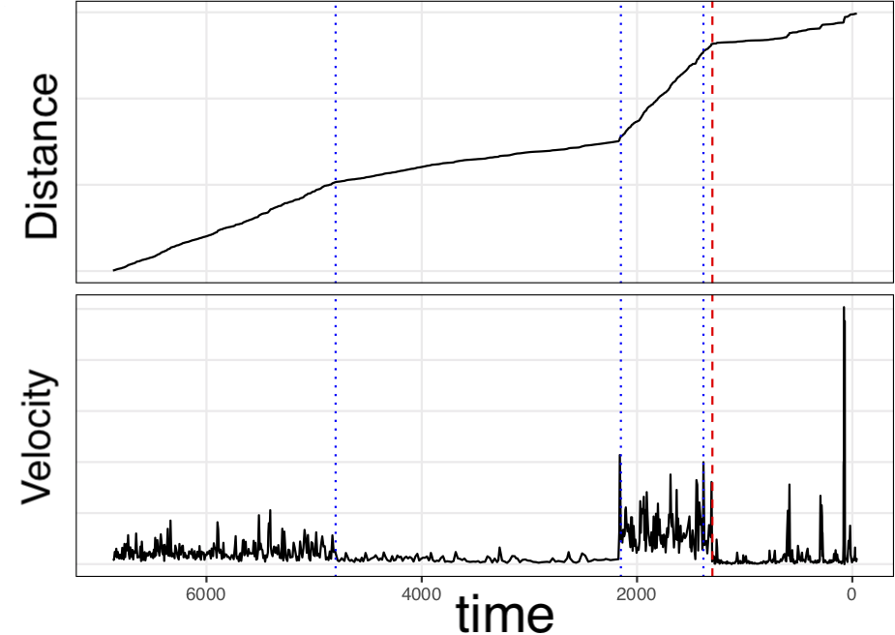
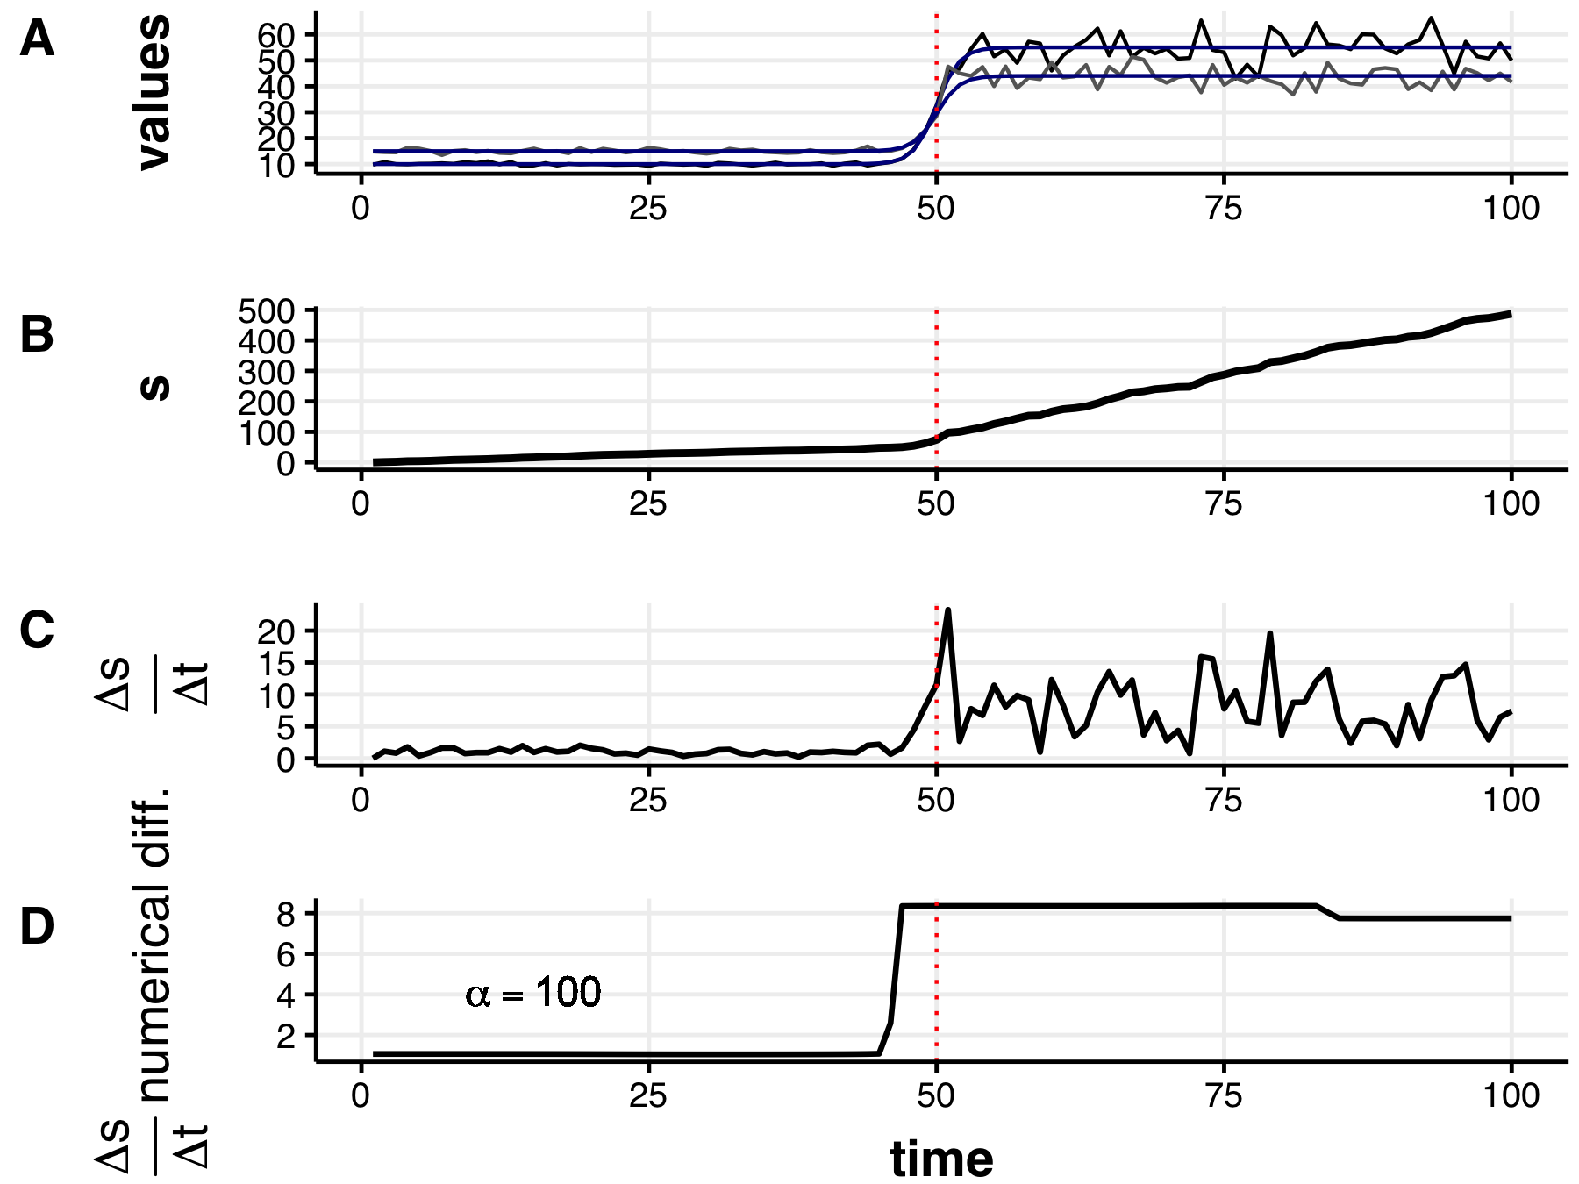
Ecological Modelling
Invasion Ecology
Avian Ecology

Slide 9
Information Science
Ecological Modelling
Invasion Ecology
Avian Ecology

Slide 10
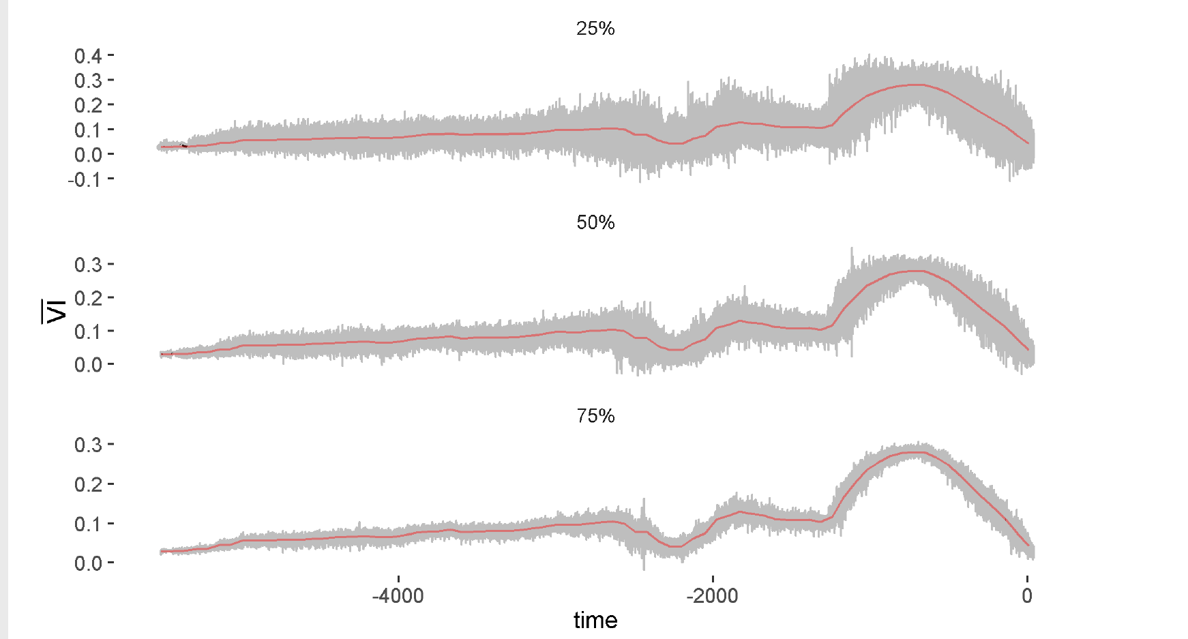
Information Science
Ecological Modelling
Invasion Ecology
Avian Ecology

Slide 11

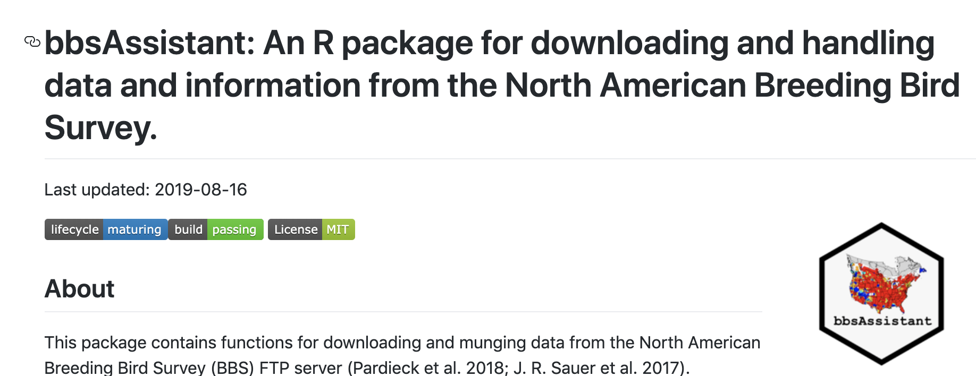
Information Science
Ecological Modelling
Invasion Ecology
Avian Ecology

Slide 12
OPEN SCIENCE
Information Science
Ecological Modelling
Invasion Ecology
Avian Ecology

Slide 13
OPEN SCIENCE
Information Science
Ecological Modelling
Invasion Ecology
Avian Ecology

Slide 14
End-users
Practitioners
Decision Makers
OPEN SCIENCE
Information Science
Ecological Modelling
Invasion Ecology
Avian Ecology

