Slide 1
TMA3093 Formal Methods
Expressions and Pattern Bindings
(Part 1)
Resources
1. P.G. Larsen, Lecture Note, Defining Data and Functionality, iha.dk.
2. John Fitzgerald, et al., Validate Designs for OO Systems, Springer, 2005.
3. CSK Corp, VDMTools: The VDM++ Language, Ver6.8.1, 2005
Assoc Prof Dr Edwin Mit
Dept of Computing and Software Engineering
Faculty of Computer Sc. & IT., UNIMAS
Tel : 082-58(3799)
edwin@unimas.my

Slide 2
VDM++ Class Outline
class <class-name>
end <class-name>
instance variables
...
Internal object state
types
values
functions
operations
...
Definitions
thread
...
Dynamic behaviour
sync
...
Synchronization control

Slide 3
Agenda
Understand syntax & semantic, and examples of the application of :
Expressions
Pattern Binding

Slide 4
Introduction
Expressions are used to describe calculation that never affect the value of instance variable unless it contains a call to an operation.
Used in explicit function definition, within pre-conditions, post-conditions and invariants.
The evaluation of expression results in a single value.

Slide 5
Expressions (Part 1)
let and let-be expressions
define expressions
if-then-else expressions
cases expressions
Quantified expressions
Set expressions
Sequence expressions
Map expressions
Tuple expressions
Record expressions
is expressions
New and Self expressions
Class membership expressions
Object comparison expressions
Object reference expressions

Slide 6
Let and Def Expressions
Let and Def expressions are used to improved the readability of complex expression.
The value of entire let expression is the value of expression2
Def expression typically used in operations; and expression1 may contain references to instance variables (i.e., can modify value of instance variable).
let pattern = expression1
in expression2
def pattern = expression1
in expression2

Slide 7
Let Expression: Syntax
expression = let expression
| let be expression
let expression =
‘let’, local definition { ‘,’, local definition },
‘in’, expression ;
let be expression =
‘let’, bind, [ ‘be’, ‘st’, expression ],
‘in’, expression ;
local definition = value definition
| function definition ;

Slide 8
Let Expression: Semantics
Let expressions are used
to improved the readability of complex expression.
A simple let expression has the form:
where
p1, ..., p_{N} are patterns,
e1, ..., e_{N} are expressions which match the corresponding pattern p1,…,pn,
and e is an expression, of any type, involving the pattern identifiers of p1, ..., p_{N}.
let p1 = e1,
...,
p_{N} = e_{N}
in e

Slide 9

Example Let Expressions
More simple form of let expression:
Where pattern=expression1 may repeatedly occur,
Separated by commas, and pattern may associated with type.
Examples:
let a = 2,
b: nat = a+7
in a+b+15 (-- yield 26)
(ii) let d = b ** 2 - 4 * a * c
in mk_((-b – sqrt(d))/2a,(-b + sqrt(d))/2a)
let pattern = expression1
in expression2

Slide 10
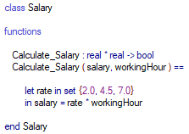
Example: Calculate Salary
let pattern = expression1
in expression2
The value of entire let expression is the value of expression2

Slide 11
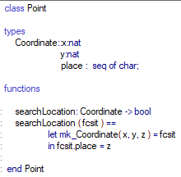
Example : Search Location

Slide 12
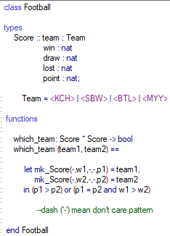
Example : Football Score
They are also convenient for decomposing complex structures into their components.
For instance, using record type Score we can test whether one score is greater than another:

Slide 13
let-be expression
A let-be-such-that expression has the form:
let b be st e1 in e2
where
b is a binding of a pattern to a set value (or a type),
e1 is a boolean expression, and
e2 is an expression, of any type, involving the pattern identifiers of the pattern in b.
The be st e1 part is optional

Slide 14
Example Let-be expressions
Let-be-such-that expressions are even more powerful. A free choice can be expressed,
Examples:
let L in set Permutations(list) be st forall i,j in set inds L & i < j => L(i) <= L(j) in L
Permutation relates to the act of arranging all the members of a set into some sequence or order

Slide 15
Define Expressions
This expression can only be used inside operations
It denotes the value of the expression e in the context in which the patterns (or binds) pb₁, ...,pb_{n} are matched against the corresponding expressions e₁, ..., e_{n}
Semantics: A define expression has the form:
def pb₁ = e₁;
...
pb_{n} = e_{n}
in
e

Slide 16
Define Expression
Example
def user = public
in
if user = <SoftwareEngineering>
then true
else false

Slide 17
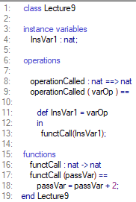
Define Expressions
The right-hand side of a define
expression has access to the
instance variables.
The state could be changed by an operation call:
def a = OpCall(arg1,arg2)in f(a)

Slide 18
Conditional Expressions Syntax
expression = . . .
| if expression
| cases expression
| . . . ;
if expression = ‘if’, expression, ‘then’, expression,
{ elseif expression }, ‘else’, expression ;
elseif expression =
‘elseif’, expression, ‘then’, expression ;
cases expression = ‘cases’, expression, ‘:’,
cases expression alternatives,
[ ‘,’, others expression ], ‘end’ ;

Slide 19
Semantics
If expressions and cases expressions allow the choice of one from a number of expressions on the basis of the value of a particular expression.
The if expression has the form:
if e1
then e2
else e3
where e1 is a boolean expression, while e2 and e3 are expressions of any type.

Slide 20
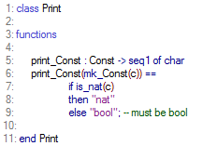
If expressions Example
If-then-else expressions are similar to those known from programming languages.
The function print_Const would be defined

Slide 21
An example of the use of conditional expressions is provided by the specification of the mergesort algorithm:
The sorting algorithm mergesort produces a sorted sequence by sorting its two halves and merging them
MergeSort : seq of nat * seq of nat -> seq of nat
MergeSort (s1,s2) ==
if s1 = [] then s2
elseif s2 = [] then s1
elseif (hd s1) < (hd s2)
then [hd s1]^(MergeSort (tl s1, s2))
else [hd s2]^(MergeSort (s1, tl s2));
What is hd and tl? – head & tail
hd [1,2,3,4,5] = [1]
tl [1,2,3,4,5] = [2,3,4,5]

Slide 22
cases expression
The cases expression has the form:
The cases expression denotes the value of the e_{i} expression
evaluated in the context in which one of the p_{ij} patterns has been matched against e.
where e is an expression of any type, all p_{ij}’s are patterns which are matched one by one against the expression e. The e_{i}’s are expressions of any type, and the keyword others and the corresponding expression em_{plus1} are optional.
cases e :
p₁₁, p₁₂, ..., p_{1n} -> e₁,
...,
p_{m1}, p_{m2}, ..., p_{mk} -> e_{m},
others -> em_{plus1}
end

Slide 23
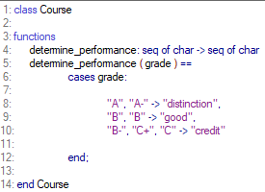
Example

Slide 24
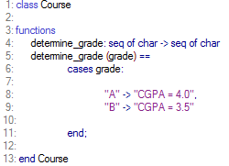
Cases Expressions
Cases expressions are very powerful because of pattern matching:
Simple example function determine grade of the course

Slide 25
Set Expressions
Set enumeration: {e1, e2, … . en}
where e1; e2 and en are expressions of the set.
Set comprehension can either use set binding: {e | b1, b2, … , bn & P}
which will construct a set by evaluating the expression e on all binding b1, b2, …, bn
for which the predicate P evaluates to true.
or type binding: {a | a: nat & a<10}
Set range expression: {3,...,10}

Slide 26
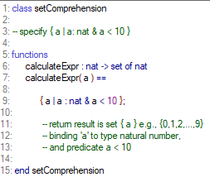
Example

Slide 27
Sequence Expression
Sequence is an ordered and finite collection of elements of same type indexed by 1,2, …, n.
e.g., [a,b,c,d]
Sequence comprehension can only use a set bind with numeric values (numeric order is used):
Syntax
[e | id in set S & P]
Examples
(i) [i*i | i in set {1,2,4,6}] (ii) [i | i in set {6,3,2,7} & i mod 2 = 0]

Slide 28
subsequence of a sequence
A subsequence of a sequence L is a sequence formed from consecutive elements of L; from index n1 up to and including index n2. It has the form:
L(n1, ..., n2)
where n1 and n2 are positive integer expressions
Example, subsequence expression:
[1, 23, 45, 67](3) will yield 45
[“ma”, “me”, “mu”](1) will yield “ma”
[4,5,8,9,12,10](2,...,4) = ?
Notes:
[4,true,”string”,9,4](2,...,4) will yield [true, “string”, 9]

Slide 29
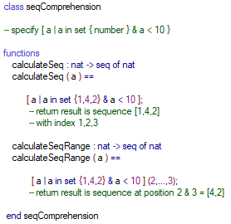
Example

Slide 30
Map Expressions
Map enumeration has the form:
{d1 |-> r1, d2 |-> r2, ..., dn |-> rn}
where all the domain expressions d_{i} and range expressions r_{i} are general expressions.
The empty map must be written as {|->}. Map examples {1|->true, 7 |-> 6}.
A map comprehension has the form:
{e_{d} |-> e_{r} | mbd₁, ..., mbd_{n} & P}
The map comprehension constructs a mapping by evaluating the expressions e_{d} and e_{r} on all the possible bindings (mbd₁, mbd₂) for which the predicate P evaluates to true.
Mapping symbol

Slide 31
Map comprehension can either use type binding: {i |-> mk_(i,true) | i: bool}
or set binding: {a+b |-> b-a | a in set {1,2}, b in set {3,6}} and {i |-> i | i in set {1,...,10} & i mod 3 = 0}
One must be careful to ensure that every domain element maps uniquely to one range element.
e.g., {StudentName |-> StudentID}

Slide 32
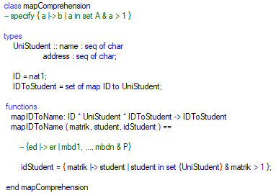
Example

Slide 33
Tuple Expressions
The tuple constructor expression has the form:
mk_(e1, e2, ..., en)
where e_{i} is a general expression.
Example
mk_Coordinate (x,y,z)

Slide 34
Summary Expressions (Part 1)
The VDM++ syntax and semantics and some examples related to the following expressions had been explained:
let and let-be expressions
define expressions
if-then-else expressions
cases expressions
Quantified expressions
Set expressions
Sequence expressions
Map expressions
Tuple expressions

Slide 35
Thanks
If you have any question(s)/comment(s)/ suggestion(s), please email to me at edwin@unimas.my or post in eLEAP forum.

