Slide 1
Software Maitenance Taxonomy

Slide 2
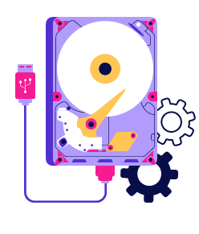
Software Maintenance Activities Classification
Software maintenance is a crucial lifecycle phase that keeps software functional, efficient, and adaptable to changing needs.
To manage it effectively, maintenance activities can be classified from different perspectives.
Maintenance activities from three perspectives:
Intention-based classification of software maintenance
Activity-based classification of software maintenance
Evidence-based classification of software maintenance

Slide 3
A) Intention-based Classification of Software Maintenance
Based on the objective behind the task. Clarify the purpose of the maintenance activity and align tasks with their intended impact or outcome (the ‘Why’). Maintenance activities are divided into four groups:
Corrective maintenance
Purpose - to correct failures, processing failures and performance failures.
Adaptive maintenance
Purpose - to enable the system to adapt to changes in its data environment or processing environment.
Perfective maintenance
Purpose - to make a variety of improvements, namely, user experience, processing efficiency, and maintainability.
Preventive maintenance
Purpose - to prevent problems from occurring by modifying software products.

Slide 4
Example
Corrective Maintenance Scenario: A university’s student portal system suddenly stops displaying students’ grades after a recent semester update. When students try to view their results, the page shows an error message: “Data retrieval failed: NullPointerException in GradeController.java” Purpose : To correct failures in the system — specifically processing failures and performance failures — that prevent the software from functioning as intended. | Adaptive Maintenance Scenario: A banking application was originally designed to run on Windows Server 2016. The bank decides to upgrade its infrastructure to Windows Server 2022 and migrate its database from Oracle to PostgreSQL to reduce licensing costs. Purpose: To enable the system to adapt to changes in its processing environment (new operating system) and data environment (new database system).

Slide 5
Example
Perfective Maintenance Scenario: An online food delivery system is working fine, but users often complain that it takes too long to find restaurants because of the slow search feature. The interface also looks outdated and cluttered. Purpose: To improve user experience, processing efficiency, and maintainability of the system. | Preventive Maintenance Scenario: A hospital management system is running smoothly, but the development team notices that some modules use outdated third-party libraries that may become incompatible with newer operating systems or could contain security vulnerabilities in the future. Purpose: To prevent problems from occurring by making proactive changes that reduce the risk of future failures.

Slide 6
B) Activity-based Classification of Software Maintenance
Organizes maintenance activities based on the specific tasks performed (Which activities need to be done?). This facilitates easier task management and ensure a structured workflow. The activities are typically categorized as:
a) Bug Fixing:
Correcting defects and issues in the software that hinder its proper functioning.
b) Enhancement:
Modifying the software to improve functionality, add new features, or enhance the user experience.
c) Migration:
Transferring the software to a new platform, framework, or hardware environment.
d) Configuration Management:
Ensuring that the software's configuration is properly maintained and updated.
e) Performance Tuning:
Optimizing the system’s efficiency to handle increasing workloads or improve response times.

Slide 7
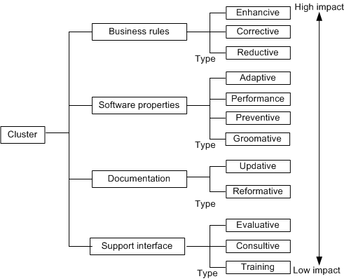
C) Evidence-based Classification of Software Maintenance
Organizes maintenance activities based on the evidence or data that triggers the maintenance task (What is driving the need for maintenance?). e.g., error logs, user feedback, system performance.
Highlights the issues or areas needing improvement, helping prioritize maintenance tasks based on actual, observed problems or potential improvements.
12 types of maintenance activities are grouped
into 4 clusters based on modifications to the
following entities:
Whole software
External documentation
Program code properties
System functionality (as experienced by the customer)
Evidence of changes to those entities is
gathered by comparing relevant portions of
the software before and after the activity.
Figure 2.1 Groups or clusters and their types

Slide 8
C) Evidence-based Classification of Software Maintenance - Support interface Cluster
1. Training:
Train stakeholders on system implementation.
2. Consultive:
Estimate costs and time for maintenance work.
Manage help desk operations.
Assist customers in preparing maintenance work requests.
Share expert knowledge about the available resources and the system to others in the organization to improve efficiency.
3. Evaluative:
Review program code and documentation.
Examine ripple effects of proposed changes.
Design and execute tests.
Assess OS programming support.
Finding the required data and debugging.
Notes:
Ripple effects - When you modify software, one change rarely affects only one part. It can create a ripple effect — where the impact spreads outward.
In software systems, ripple effects may occur because:
Components depend on each other
Modules share data
Functions call each other
UI, database, and business logic are connected

Slide 9
C) Evidence-based Classification of Software Maintenance – Documentation Cluster
4. Reformative:
Improve documentation readability.
Ensure consistency with system changes.
Prepare training materials.
Add entries to the data dictionary.
5. Updative:
Replace outdated documentation with up-to-date versions.
Use semi-formal methods (e.g., UML) to document current code.
Update documentation with test plans.

Slide 10
C) Evidence-based Classification of Software Maintenance – Software Properties Cluster
6. Groomative:
Replace components and algorithms with more efficient, simpler ones.
Modify data naming conventions.
Change access authorizations.
Compile source code and perform backups
7. Preventive:
Perform changes to enhance maintainability.
Establish a foundation for transitioning to emerging technologies.
8. Performance:
Activities in performance type produce results that impact the user.
Improve system uptime and performance.
Replace components and algorithms with faster alternatives.
9. Adaptive:
Port software to different execution platforms.
Increase utilization of COTS (Commercial Off-The-Shelf) components.
.

Slide 11
C) Evidence-based Classification of Software Maintenance – Business Rules Cluster
10. Reductive:
Remove customer-generated data to reduce input.
Decrease the amount of data produced by the system.
11. Corrective:
Correct identified bugs.
Add defensive programming strategies.
Modify exception handling methods.
12. Enhancive:
Add and modify business rules to improve system functionality.
Introduce new data flows into or out of the software.

Slide 12
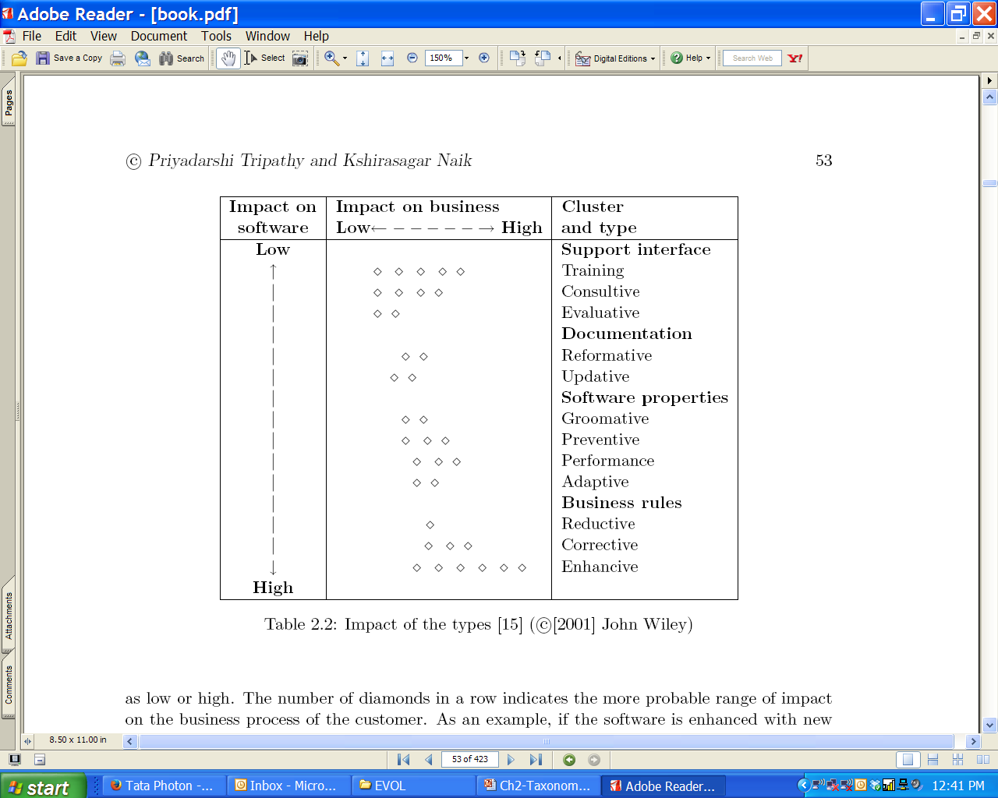
c) Evidence-based Classification of Software Maintenance
The impacts of the different types of maintenance activities are summarized in Table 2.2.
The first dimension is the customer’s ability to perform its business function while continuing to use the system. This is arranged based on the # of diamonds (horizontal ).
The second dimension is the software. This is arranged from top to bottom. (vertical )

Slide 13
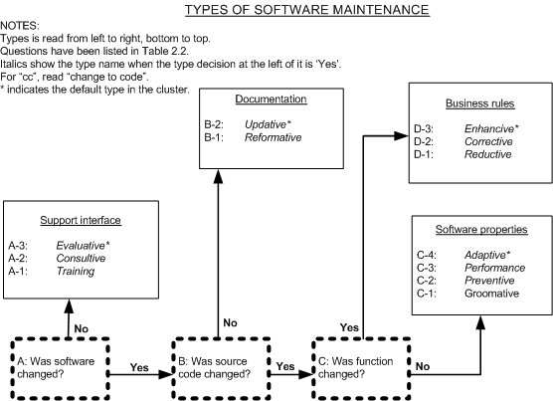
c) Evidence-based Classification of Software Maintenance
Decision Tree Based Criteria
Activities are classified into different types by applying a two-step decision process:
First, apply criteria-based decisions to make the clusters of types.
Next, apply the type decisions to identify one type within the cluster.
Figure 2.1 Decision Tree Types: © Wiley, 2001
Notes:
Software maintenance involves many different kinds of work.To manage it properly, we need a clear way to decide what type of maintenance each task belongs to.But sometimes it's hard to judge because activities overlap.So researchers created a decision tree to help us classify maintenance in a consistent way.
The decision tree uses a two-step process:
You first look at what general area the maintenance activity belongs to.
Example clusters: Software Properties Support interface Documentation Business Rules
Once you know the group, choose the exact type within that group.
Example (inside Software Properties cluster): Adaptive, Performance, Preventive, Groomative
This helps classify the task accurately.

Slide 14
c) Evidence-based Classification of Software Maintenance
Decision Tree Based Criteria
For example
“Imagine you updated the system because the function wasn’t working properly. What type is that?”
Was software changed? → Yes
Was source code changed? → Yes
Was a function changed? → Yes → Go to Business Rules
Choosing the correct type → Corrective
Figure 2.1 Decision Tree Types: © Wiley, 2001

Slide 15
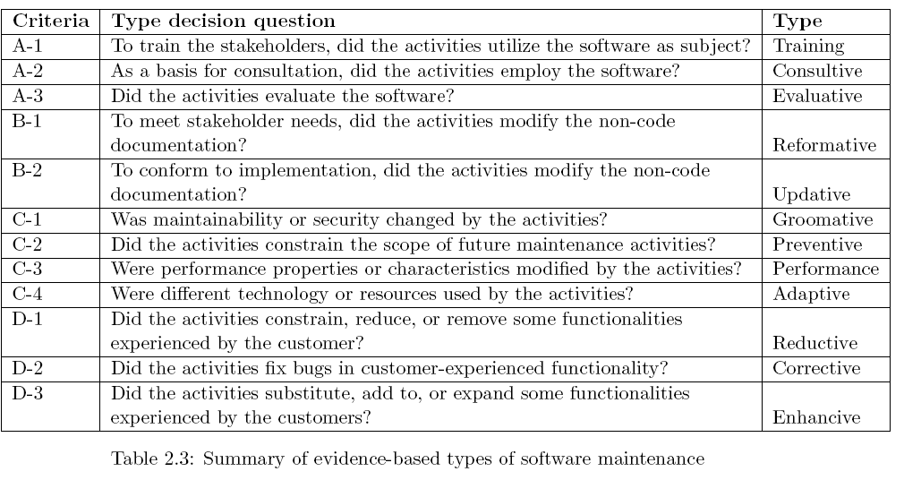
c) Evidence-based Classification of Software Maintenance
Sometimes, an objective evidence may be found to be ambiguous. In that case, clusters have their designated default types for use. The overall default type is evaluative, if there are ambiguities in an activity.

Slide 16
How to choose maintenance activities - Intention-based Classification
Evidence
Identify Intention
Determines Activities
Perform Maintenance
Triggers
Change
Request (proof)
E.g. user feedback,
error logs,
performance issues
Determine the purpose (Why?)
Corrective
Adaptive
Perfective Preventive
Choose
activities (What?)
Bug Fixing
Enhancement
Migration Configuration Management
Performance Tuning.
Execute selected
Activities
Analyze,
Design,
Implement
Test
Example: Performance Optimization
Evidence (What is driving the Change Request?):
Users of a web application complain about slow loading times, especially during peak usage hours.
Identify Intention (Why?):
The intention is perfective maintenance to optimize performance and improve the responsiveness of the web application.
Choose Activities (Which?):
Performance Tuning
Conduct performance profiling and analysis to identify bottlenecks, such as database queries taking longer than expected or inefficient code segments.
Optimize database queries by adding indexes, rewriting queries, or optimizing data retrieval strategies.
Etc.

Slide 17
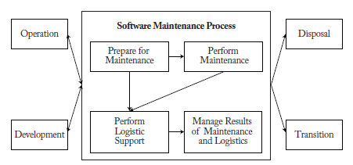
Software Maintenance Processes (ISO/IEC/IEEE 14764) 2022
a) Prepare for Maintenance
Input: Maintenance request, system documentation, and resource requirements.
Activities:
Reviewing existing documentation to understand the system.
Planning maintenance tasks, resources, tools, and procedures.
Setting up infrastructure for implementation (e.g., development/testing environments).
Outcome: Maintenance plan with well-defined objectives and resources.
b) Perform Maintenance
Input: Maintenance plan, software system, tools, and identified issues.
Activities:
Implementing the planned changes, such as:
Corrective, Adaptive, Perfective, Preventive maintenance
Testing and verifying changes to ensure correctness.
Outcome: Updated software ready for deployment.
Operation: Software in active use may require fixes, updates, or enhancements based on performance issues or user feedback.
Disposal: Retire the software due to obsolescence, cost inefficiency, or system replacement.
Development: New development efforts may identify maintenance needs for existing components (e.g., integration issues, platform upgrades).
Transition: Updated or migrated software ready for deployment.
c) Perform Logistic Support
Input: Updated software and resources for deployment.
Activities:
Managing tools, environments, and resource coordination.
Handling configuration and version control for changes.
Providing user training, if required, for updated or migrated software.
Coordinating with stakeholders to ensure smooth transitions.
Outcome: Deployment-ready software supported by updated infrastructure and processes.
d) Manage Results of Maintenance and Logistics
Input: Post-maintenance data, test results, and performance reports.
Activities:
Documenting all changes, including bug fixes, enhancements, and test outcomes.
Evaluating maintenance effectiveness through feedback and quality assurance processes.
Maintaining historical records for future reference.
Outcome: Comprehensive maintenance documentation and insights for process improvement.

Slide 18
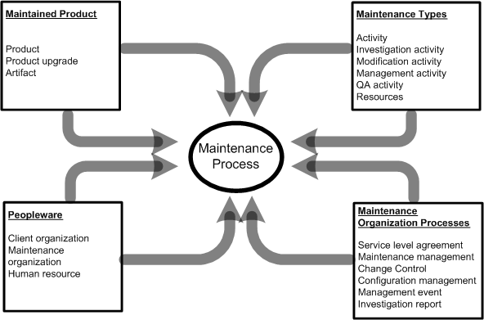
Categories of Maintenance Concepts
The four categories and the concepts that influence the maintenance process
Figure 2.3 Overview of concept categories affecting software maintenance

Slide 19
1. Maintained Product
The maintained product dimension is characterized by three concepts:
Product: A product is a coherent collection of several different artifacts. Source code is the key component of a software product.
Product upgrade: Baseline is an arrangement of related entities that make up a particular software configuration. Any change or upgrade made to a software product relates to a specific baseline.
An upgrade can create a new version of the system being maintained, a patch code for an object, or even a notice explaining a restriction on the use of the system.
Artifacts: A number of different artifacts are used in the design of a software product. One can find the following types of artifacts: textual and graphical documents, component off-the-shelf products, and object code components.
The key elements of the maintained product are size, age, application type, composition and quality.
Notes:
This dimension describes what exactly is being maintained in a software system. It focuses on three concepts:
Product: The product is the whole software package that the team maintains. Source code is the most important part because it is what developers modify when fixing bugs or adding features.
Product upgrade: A product upgrade refers to any improvement or change made to a specific version (or baseline) of the software.
Artifacts: are all the supporting items used to build, maintain, or understand a software product. For example: Test cases, design docs, source files, Graphical diagrams (UML, architecture diagrams)

Slide 20
2. Maintenance Types
Four types of maintenance activities are defined:
a) Investigation activity: Evaluates the potential impact of proposed changes on the system.
b) Modification activity: Involves implementing changes to the system's code or behavior.
c) Management activity: Focuses on configuration control and overseeing the maintenance process.
d) Quality assurance activity: Ensures that changes maintain the system's integrity and functionality.
Activity: An activity accepts some artifacts as inputs and produces new or changed artifacts.
Artifacts: Artifacts include plans, documents, system representations, and source and object code items. Artifacts are created during the software development process and changed during maintenance.

Slide 21
3. Maintenance Organization Processes
Two different levels of maintenance processes are followed within a maintenance organization:
Individual-level maintenance processes followed by maintenance personnel to implement a specific change request, and
Organization-level process followed to manage the change requests from maintenance personnel, users, and customers/clients.

Slide 22
3. Maintenance Organization Processes
Three major elements of a maintenance organization are
Event management: The stream of events, namely, all the change requests from various sources, received by the maintenance organization is handled in an event management process.
Configuration management: A system’s integrity is maintained by means of a configuration management process. Integrity of a product is maintained in terms of its modification status and version number.
Change control system: Evaluation of results of investigations of maintenance events is performed in a process called change control. Based on the evaluation, the organization approves a system change.

Slide 23
3. Maintenance Organization Processes
A maintenance organization handles maintenance change requests from:
Users,
Customers, and
maintainers.
After an initial investigation of a change request, a management process is put in place for approving change activities.
Approval of a change request is normally the responsibility of a change control board.
A proposed modification activity is scheduled only after the modification is approved by the board and a Service Level Agreement (SLA) is signed with the client.
Service level agreement (SLA) is a contract between the customers and the providers of a maintenance service. Performance targets for the maintenance services are specified in the SLA.

Slide 24
3. Maintenance Organization Processes
In general, maintenance organizations use three different support levels to organize the staff:
Level 1: This group files problem reports and identifies the technical support person who can best assist the person reporting a problem.
Level 2: This level includes experts who know how to communicate with users and analyze their problems. These people recommend quick fixes and temporary workarounds.
Level 3: This level includes programmers who can perform actual changes to the product software.

Slide 25
4. Peopleware
Maintenance activities cannot ignore the human element, because software production and maintenance are human intensive activities.
The three people-centric concepts related to maintenance are as follows:
Maintenance organization: This is the organization that maintains the product(s).
Client organization: A client organization uses the maintained system.
Human resource: Human resource includes personnel from the maintenance and client organizations.

Slide 26
4. Peopleware
Finally, the following user and customer issues affect maintenance:
Size: The size of the customer base and the number of licenses they hold affect the amount of effort needed to support a system.
Variability: High variability in the customer base impacts the scope of maintenance tasks.
Common goals: The extent to which the users and the customer have common goals affect the SLAs.
Ultimately, customers fund maintenance activities.
If the customers do not have a good understanding of the requirements of the actual users, some SLAs may not be appropriate to the end users.

Slide 27
Maintenance of COTS-based Systems
A commercial off-the-shelf (COTS) component is defined as:
A unit of composition with contractually specified interfaces and explicit context dependencies only.
A software component can be deployed independently and is subject to composition by third parties.
The use of COTS components is increasing in modern software development because of the following reasons:
There is significant gain in productivity due to reusing commercial components;
the time to market the product decreases;
The product quality is expected to be high, assuming that the COTS components have been well tested; and
There is efficient use of human resources due to the fact that development personnel will be freed up for other tasks.
The black-box nature of COTS components prevents system integrators from modifying the components to better meet user’s requirements.
The integrators have no visibility of the details of the components, their evolutions, or their maintenance.

Slide 28
Maintenance of COTS-based Systems
The only source code being written and modified by the integrators is what is needed for integrating the COTS based systems.
This includes code for:
(i) Tailoring and Wrapping the individual components, and
(ii) Glue code required to put the components together.
Wrapper: It is a piece of code that one builds to isolate the underlying components from other components of the system.
Glue: A glue component provides the functionality to combine different components.
Tailoring: Components tailoring refers to the ability to enhance the functionality of a component.is done by adding some elements to a component to enrich it with a functionality not provided by the ven Tailoring does not involve modifying the source code of the component.

Slide 29
Why Maintenance of COTS-based Systems is Difficult?
Frozen functionality.
Incompatibility of upgrades.
Trojan horses.
Unreliable COTS components.
Defective middleware.
Notes:
Frozen functionality - COTS products come with fixed features that you cannot freely change.If your organization needs a new function or a modification, you depend on the vendor to add it.
Incompatibility of upgrades - When COTS vendors release new versions, the upgrade may conflict with: your existing customizations, your integrations, other systems you connect to
Trojan horses - COTS components may include: hidden malicious code, unwanted features, security vulnerabilities. Because you don’t have access to the source code, you cannot fully inspect what is inside.
Unreliable COTS components - Some COTS products are not fully tested or contain bugs. Even established vendors may release unstable versions.

Slide 30
Maintenance Activities for COTS-based Systems
Vigder and Kark have surveyed several organizations maintaining systems with a significant portion of COTS elements.
In their study, they identified the following cost-drivers:
Component reconfiguration.
Testing and debugging.
Monitoring of systems.
Enhancing functionality for users.
Configuration management.

Slide 31
Thank You

Slide 32
Acknowledgment
Priyadarshi Tripathy, & Kshirasagar Naik. (2015). Software evolution and maintenance : a practitioner’s approach. Wiley.

