Slide 1
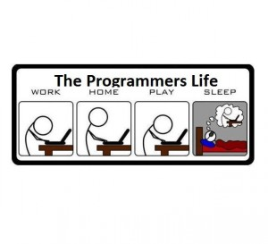

Slide 2

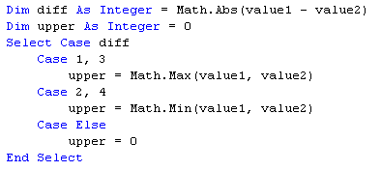

Slide 3
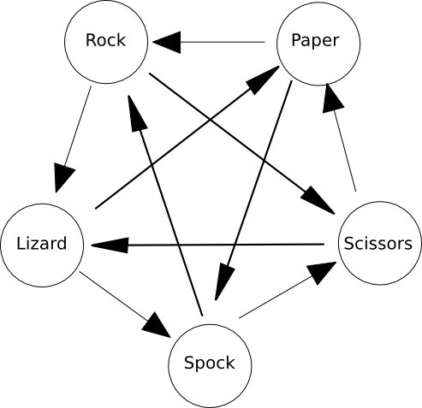
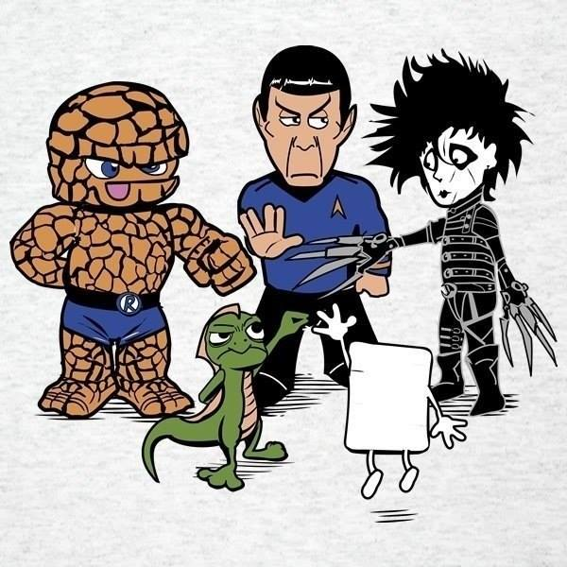
1
2
3
5
4

Slide 4
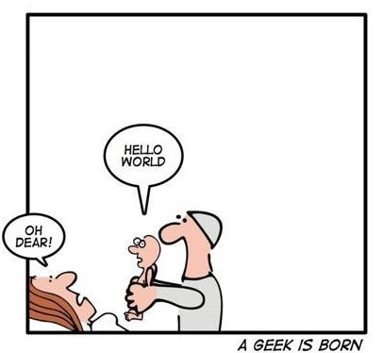
“the most obvious approach
may not be the most efficient
or most elegant solution”
“don’t reinvent the wheel”

Slide 5
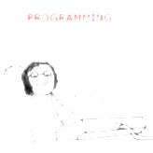
Design Patterns
Design patterns represent the best practices used by experienced object-oriented software developers
Design patterns are solutions to general problems that software developers faced during software development
These solutions were obtained by trial and error by numerous software developers over quite a substantial period of time

Slide 6

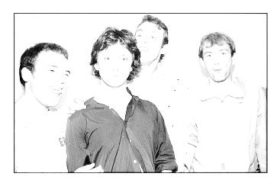
In 1994, four authors Erich Gamma, Richard Helm, Ralph Johnson and John Vlissides published a book titled Design Patterns - Elements of Reusable Object-Oriented Software which initiated the concept of Design Pattern in Software development.

Slide 7
<p> According to these authors design patterns are primarily based on the following principles of object orientated design : </p>
Program to an interface not an implementation
Favor object composition over inheritance

Slide 8
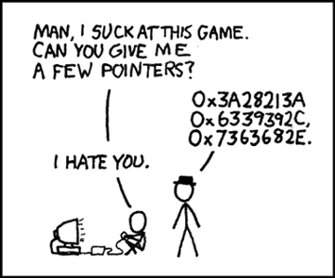
<Usage/>
Common platform for developers
Standard terminology for a particular scenario. Same lingo to describe a solution.
Best practices
Design patterns have been evolved over a long period of time and they provide best solutions to certain problems faced during software development

Slide 9
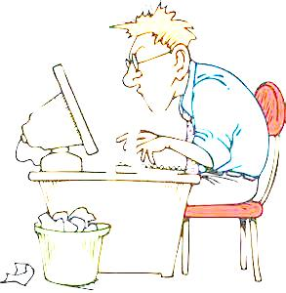
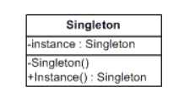
Singleton Pattern
Ensure a class has only one instance and provide a global point of access to it.

Slide 10

Some points to remember
The class must be sealed ( NotInheritable )
The constructor should be private
A public method/function named GetInstance will be used to create/return the instance of the class.

Slide 11
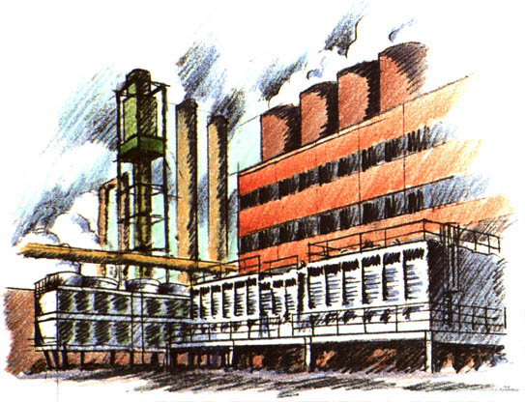
Factory Method Pattern
Defines an interface for creating an object, but let subclasses decide which class to instantiate.
Defers instantiation to subclasses
Provides one of the best way to create an object
Lets user create an object without exposing the creation logic to the client and refer to the newly created object using a common interface.

Slide 12
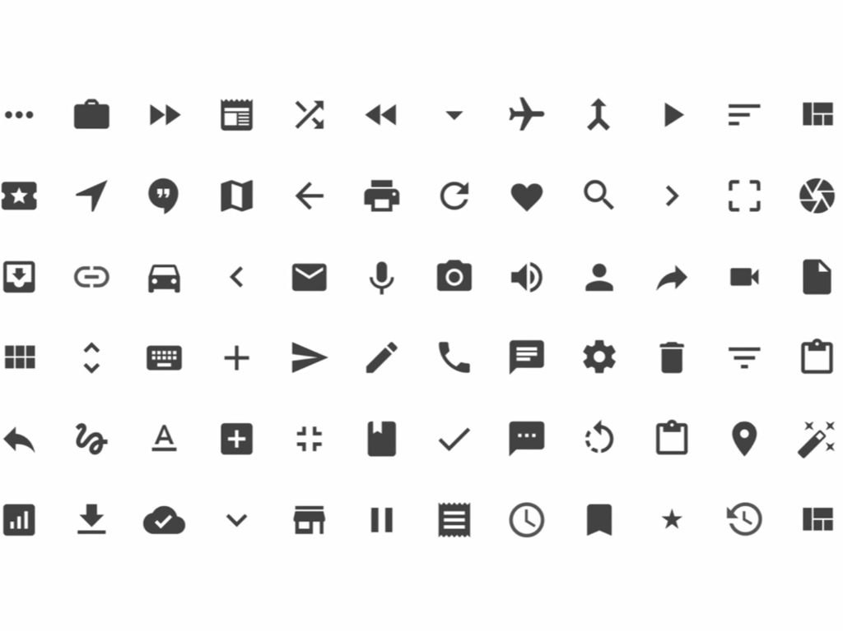
Some points to remember
An interface is used to describe the object returned by the factory
Each concrete objects returned by the factory should be represented by a class implementing the common interface.
A factory class is used to create the instance.

Slide 13
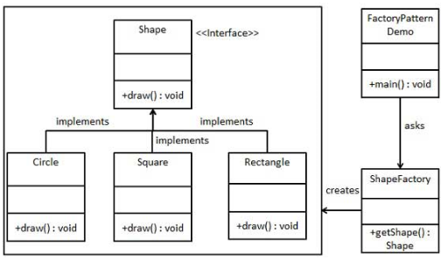

Slide 14
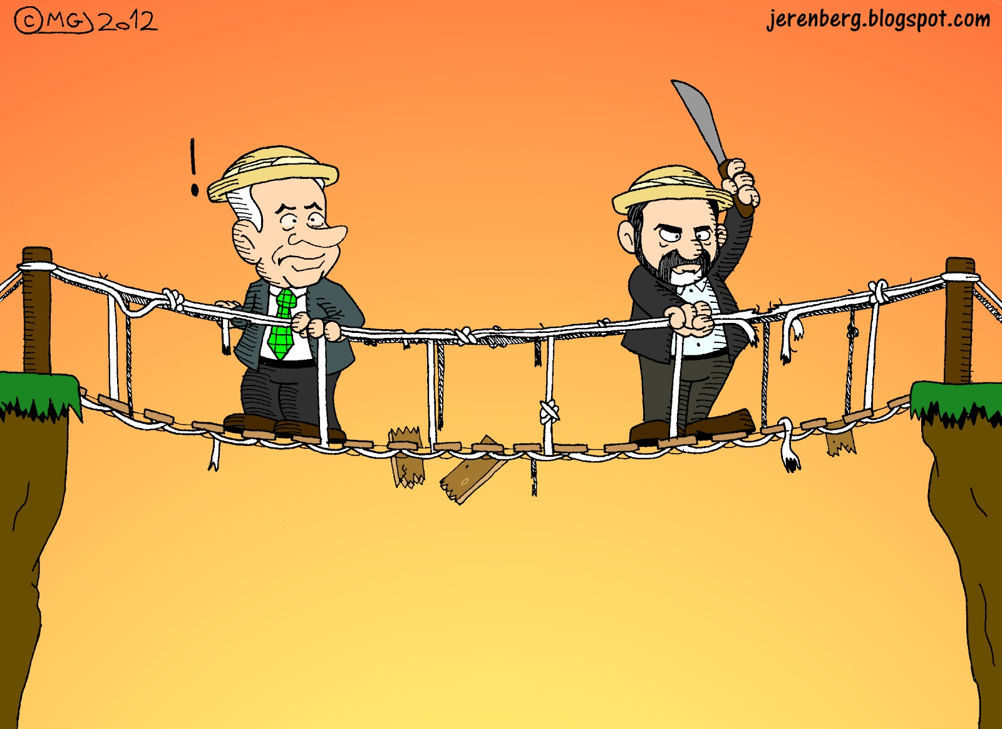
Bridge Pattern
bridge is used when we need to decouple an abstraction from its implementation so that the two can vary independently.

Slide 15
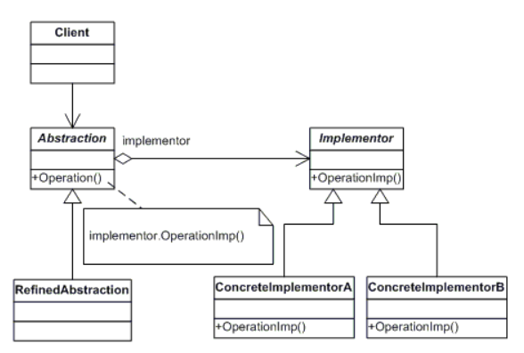
Hi, I am the Bridge

Slide 16
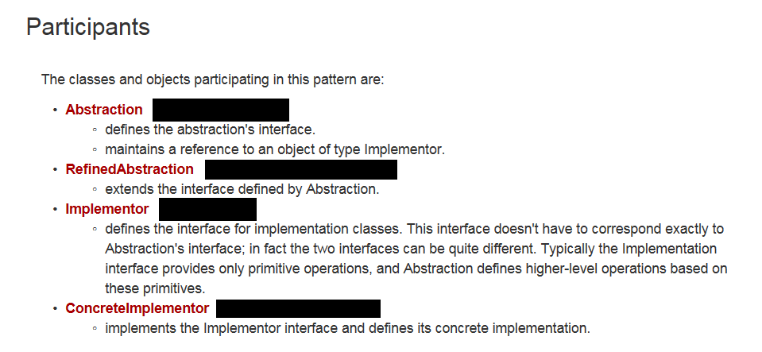

Slide 17
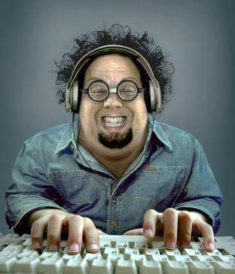
This pattern involves an interface which acts as a bridge which makes the functionality of concrete classes independent from interface implementer classes.
All concrete class of the abstract class can be altered structurally without affecting each other.

Slide 18

Observer Pattern

Slide 19
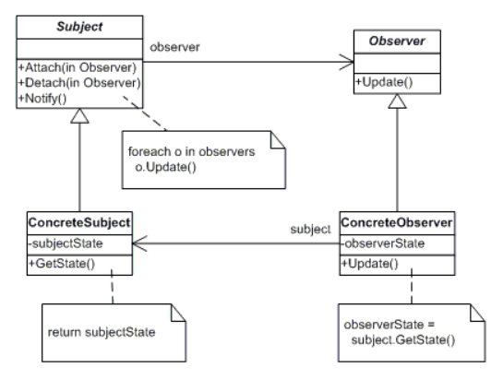

Define a one-to-many dependency between objects so that when one object changes state, all its dependents are notified and updated automatically.

Slide 20
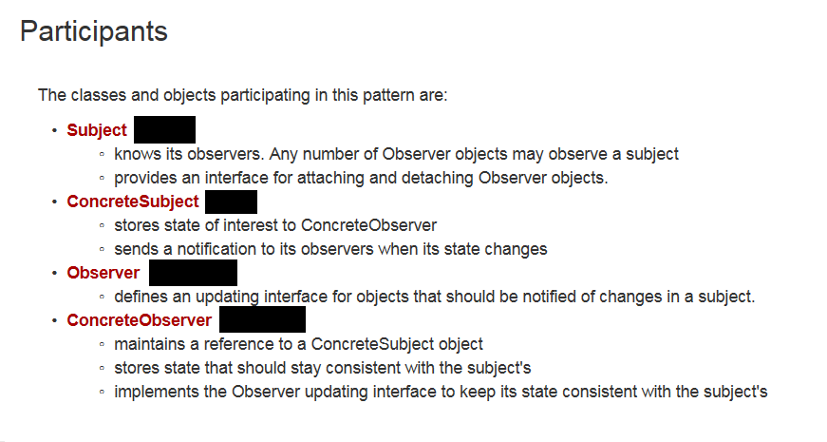

Slide 21
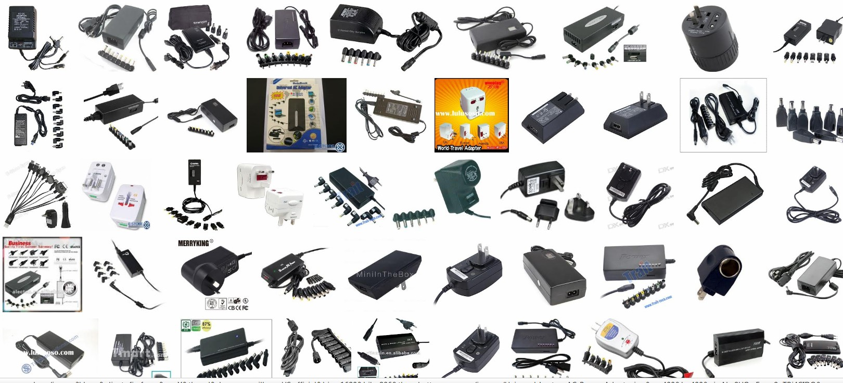
Adapter Pattern
Convert the interface of a class into another interface clients expect. Adapter lets classes work together that couldn't otherwise because of incompatible interfaces.

Slide 22
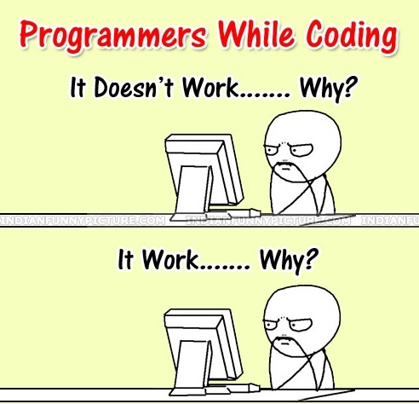
End of Part 1

Slide 23
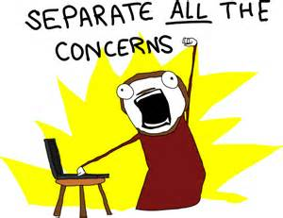
SoC

Slide 24
Separation of Concerns
is a design principle for separating a computer program into distinct sections, such that each section addresses a separate concern. A concern is a set of information that affects the code of a computer program
Concern ?
A concern is a set of information that affects the code of a computer program. A concern can be as general as the details of the hardware the code is being optimized for, or as specific as the name of a class to instantiate.
A program that embodies SoC well is called a modular^{[1]} program. Modularity, and hence separation of concerns, is achieved by encapsulating information inside a section of code that has a well-defined interface. Encapsulation is a means of information hiding.[

Slide 25

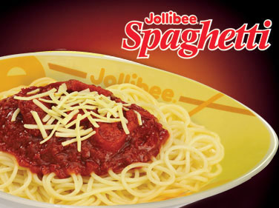
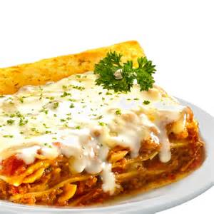
A source code with complex and tangled control structure is called a SPAGHETTI CODE
A modular program with too much and too complicated layering (SoC) is called a LASAGNA CODE

Slide 26
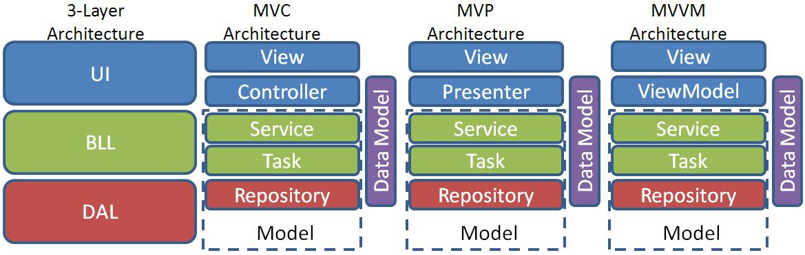
Common Architectural
Design Patterns

Slide 27
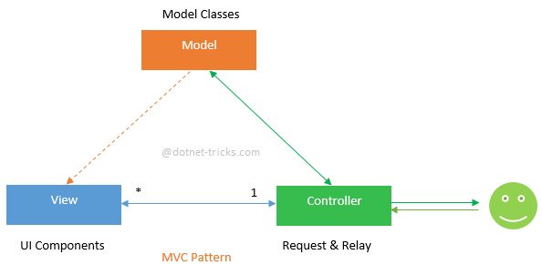
MVC Pattern
MVC stands for Model-View-Controller. It is a software design pattern which was introduced in 1970s. Also, MVC pattern forces a separation of concerns, it means domain model and controller logic are decoupled from user interface (view). As a result maintenance and testing of the application become simpler and easier.

Slide 28
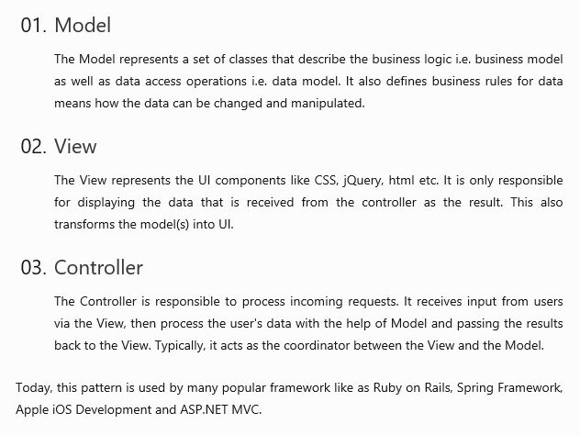

Slide 29
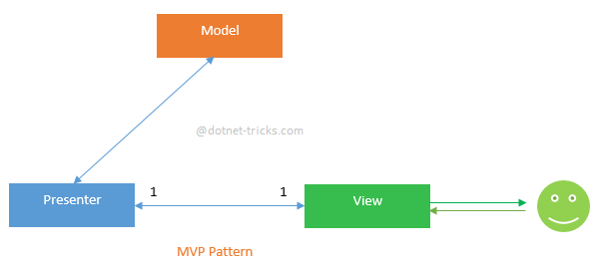
MVP Pattern

Slide 30
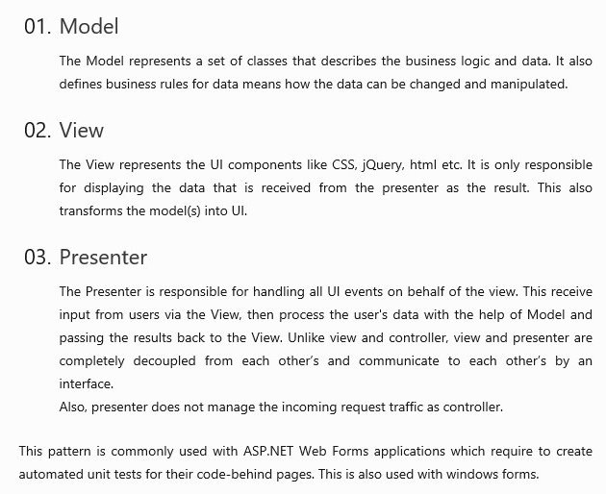

Slide 31
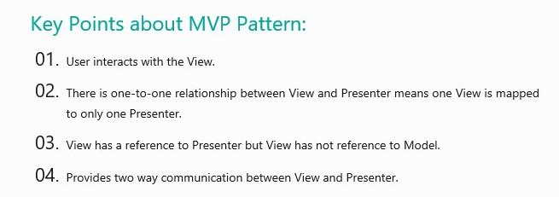

Slide 32
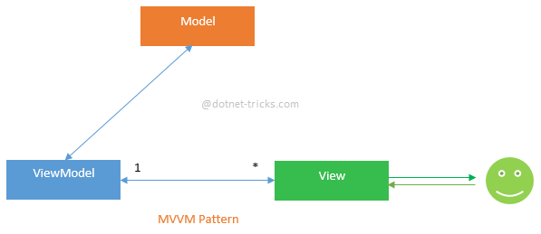
MVVM Pattern
MVVM stands for Model-View-View Model. This pattern supports two-way data binding between view and View model. This enables automatic propagation of changes, within the state of view model to the View. Typically, the view model uses the observer pattern to notify changes in the view model to model.

Slide 33
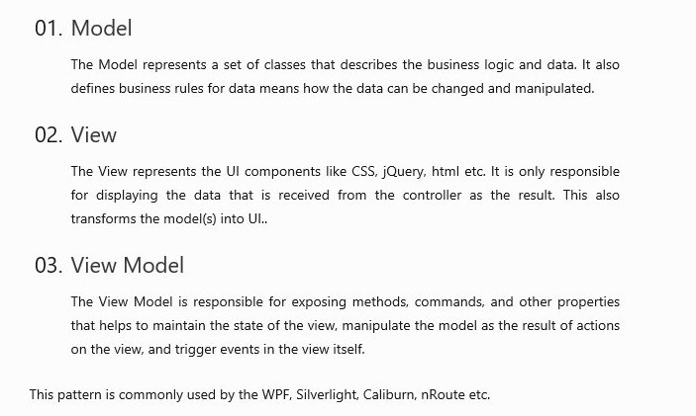

Slide 34
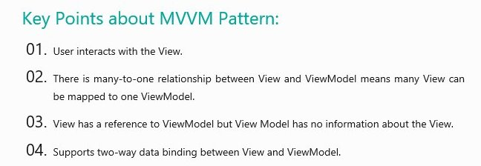

Slide 35


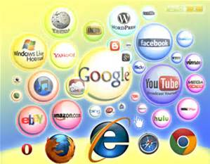
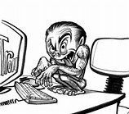

Resources :

Slide 36

Thank You!

