Slide 1


<hg_catalyst
{ workshop }
Build an Autonomous Agent
in 30 Minutes _
Tristan Ratchford
CTO, HG Catalyst
/ hg_catalyst | Build an Agent Workshop | April 2026

Slide 2
<hg_catalyst
What is an agent?
In a workflow, you hardcode the logic.
In an agent, you describe the goal.
The LLM reasons about next steps.
/ hg_catalyst | Build an Agent Workshop | April 2026

Slide 3
<hg_catalyst
The Agent Loop_
Runs until the goal is met — or it decides it can't be
01
02
03
04
PERCEIVE
THINK
ACT
OBSERVE
Read everything available:
input, history, memory, context
>
LLM decides what to do next
based on what it knows
>
Execute the chosen tool
or API call
>
Read the result and add it
back into context
e.g. "Find competitors of Acme Corp and email me a summary"
e.g. "I should search the web for Acme's competitors first"
e.g. web_search("Acme Corp competitors 2024")
e.g. Search returned 5 rivals — loop back to think
loops until stop_reason = end_turn
/ hg_catalyst | Build an Agent Workshop | April 2026

Slide 4
Agents vs. Workflows
<hg_catalyst
Fixed Workflow
AI Agent
Path through the system
Dynamic, based on observations
Fixed, predetermined
Who decides the next step?
The LLM does — at runtime
You do — at design time
Role of the LLM
The orchestrator
One node in a pipeline
Handles unexpected inputs
Reasons its way through
Breaks or falls through
Iteration
Loops until task complete
Defined number of steps
/ hg_catalyst | Build an Agent Workshop | April 2026

Slide 5
Case Study: Bits AI SRE
<hg_catalyst
{ before }
Multi-agent scaffolded framework
INITIAL INVESTIGATION
GENERATE HYPOTHESES
H₀₀
H₁₀
...
TEST HYPOTHESIS
TEST HYPOTHESIS
TEST HYPOTHESIS
GENERATE HYPOTHESES
H₁₁
H₁₂
...
END INVESTIGATION
/ hg_catalyst | Build an Agent Workshop | April 2026
datadoghq.com/blog/building-bits-ai-sre

Slide 6
Case Study: Bits AI SRE
<hg_catalyst
{ after }
Single ReAct loop + MCP tools
alert fires
ReAct
Loop
fetch_metrics
run_playbook
via MCP
query_logs
page_engineer
resolution
"The scaffolding was compensating for the absence of a real agent loop."
/ hg_catalyst | Build an Agent Workshop | April 2026
datadoghq.com/blog/building-bits-ai-sre

Slide 7
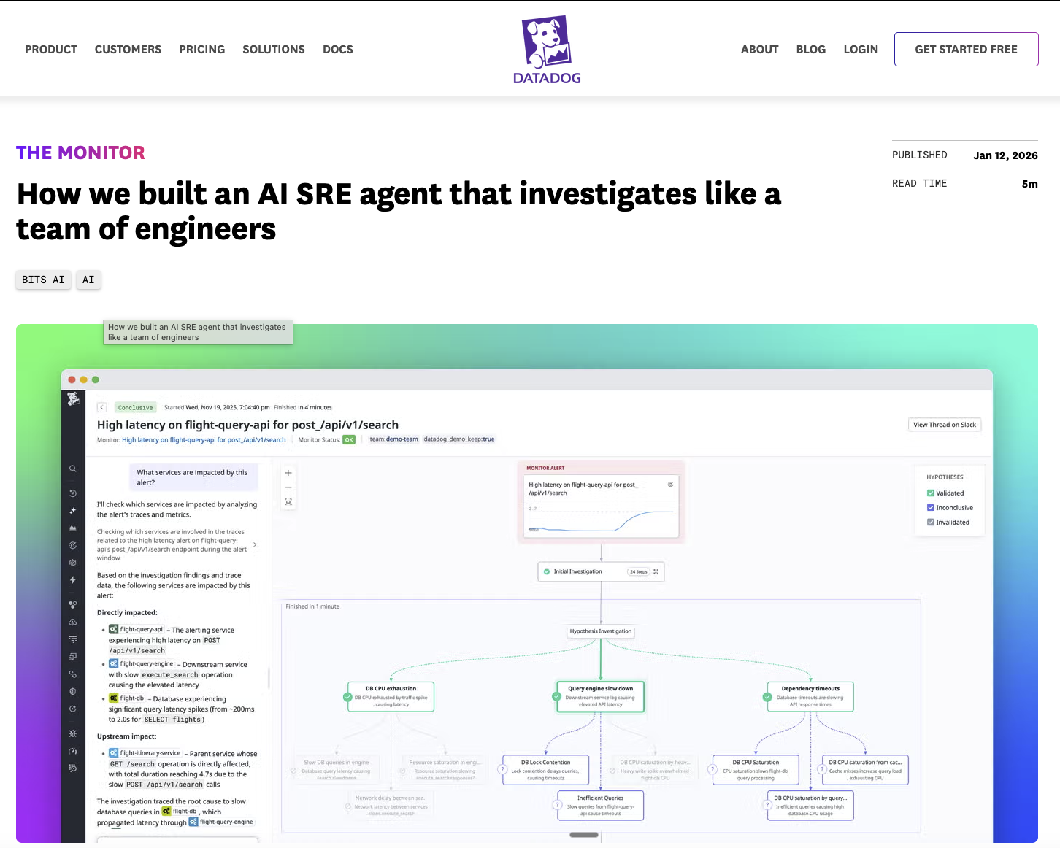
<hg_catalyst
5m
🔗 datadoghq.com/blog/building-bits-ai-sre
/ hg_catalyst | Build an Agent Workshop | April 2026

Slide 8
Tools: How Agents Take Action
<hg_catalyst
A tool is a function Claude can call. You define what it does — Claude decides when and how to use it.
execute_code
edit_file
web_search
Write and run Python on the fly — no pre-existing script needed.
Read, write, and modify files on the filesystem.
Search the web for real-time information — no API key needed.
Parse a CSV or JSON file
Read logs or config files
Look up competitor pricing
Read messy data and extract the fields you care about.
Inspect the current state of a system before taking action.
Find current pricing pages, news, or product updates.
Run calculations
Write results to disk
Research a company or person
Financial models, data analysis, or transformations in seconds.
Save a report, patch a config, or update a document.
Gather background context before writing a report.
Generate structured output
Patch code
Fetch documentation
Turn raw text or API responses into clean, usable data.
Make targeted edits to source files as part of an automated fix.
Look up API references, error codes, or release notes.
/ hg_catalyst | Build an Agent Workshop | April 2026

Slide 9
Workshop
Time
github.com/tratch-hg/catalyst-hackathon-agent-workshop
/ hg_catalyst | Build an Agent Workshop | April 2026

Slide 10
<hg_catalyst
Three files. Three levels.
workshop.py
Start here
agent.py
Go deeper
competitor-intel-agent.py
Full example
The Simple Agent Loop
The ReAct Loop
Competitive Analysis Agent
Walks through six self-contained steps — from a single
client.messages.create() call all the way to a full
agent loop with tools, web search, and observability.
A portable ReAct agent that works across multiple LLM
providers — Anthropic, OpenAI, DeepSeek, Groq, Ollama.
Swap providers by changing one variable at the top.
A complete autonomous agent that researches a company
and writes a self-contained HTML intelligence report,
with optional Datadog observability tracing.
›
Step 1 — Hello World
›
Reasoning + Acting interleaved
›
web_search, fetch_page, save_report tools
›
Step 2 — Define a tool
›
Provider-agnostic loop
›
Multi-turn agentic loop
›
Step 3 — Execute a tool
›
Calculator + web search tools
›
Structured HTML output
›
Step 4 — Agent loop
›
Same logic, any model
›
Datadog spans out of the box
›
Step 5 — Full agent
›
Step 6 — Observability
/ hg_catalyst | Build an Agent Workshop | April 2026

Slide 11
Competitor Intelligence Agent Loop
<hg_catalyst
Turn 1
Turn 2
Turn 3
Turn N
tool_use
tool_use
tool_use
end_turn
web_search("HubSpot overview")
web_search("HubSpot pricing")
web_search("HubSpot vs Salesforce")
save_report(
"hubspot_intelligence.html",
"<html>...")
›
›
›
web_search("HubSpot competitors")
web_search("HubSpot reviews")
fetch_page("comparison page")
web_search("HubSpot news")
fetch_page("hubspot.com/products")
fetch_page("g2.com/hubspot")
Thought: I have a broad overview. I need pricing and customer sentiment.
Thought: I have pricing and reviews. One more competitive search and I can write.
Thought: Comprehensive data across all areas. Ready to write the report.
Loop exits → hubspot_intelligence.html saved to disk
web_search(query) — Searches DuckDuckGo — returns titles, URLs, snippets
fetch_page(url) — Fetches a page and strips to clean text (6 000 char cap)
save_report(filename, html) — Writes the finished HTML report to disk — called exactly once
/ hg_catalyst | Build an Agent Workshop | April 2026

Slide 12
Agent Taxonomy
<hg_catalyst
Foreground
Reactive
Background
Co-pilots
Event-triggered
Scheduled / Cron
Human in the loop. Interactive, real-time. The agent acts alongside you.
Triggered by an event. Runs a reasoning loop, produces an output.
No human in the loop. Runs on a schedule. Does real maintenance work.
Claude Code
Bits AI SRE
Dependency update agent
Describe a feature in plain English — it writes the code, runs tests, and iterates until it works.
Gets paged when something breaks, pulls logs, reasons through the cause, applies a fix.
Scans repos weekly for vulnerable packages, evaluates breaking changes, opens a PR with the fix.
Live support agent
Competitor intelligence
Infrastructure right-sizer
Handles a user query in real time, looks up account data, resolves the issue, escalates if needed.
Give it a company name — it searches the web, synthesises findings, writes a structured report.
Reviews cloud spend on a schedule, identifies over-provisioned resources, scales them down automatically.
/ hg_catalyst | Build an Agent Workshop | April 2026

Slide 13
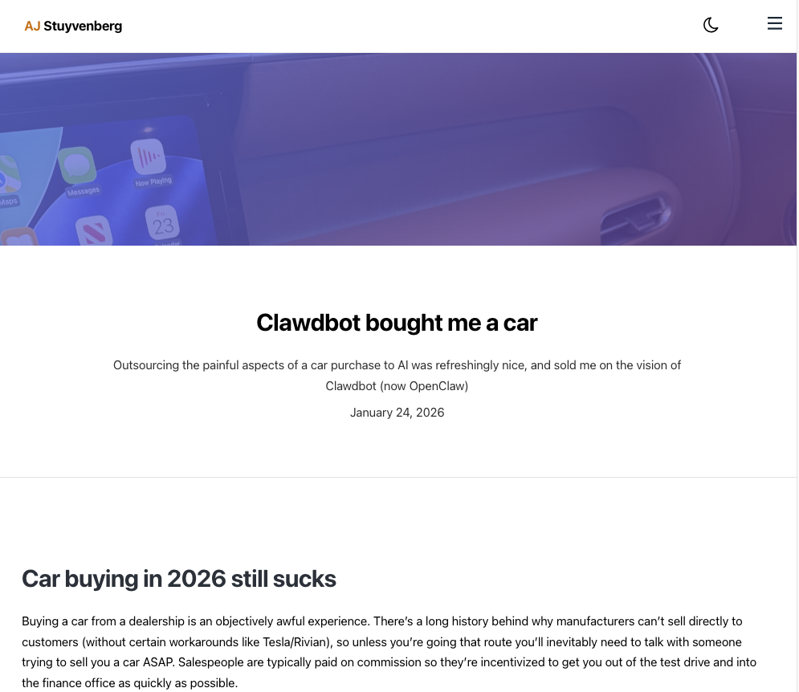
Agent Taxonomy
<hg_catalyst
/ hg_catalyst | Build an Agent Workshop | April 2026

Slide 14
<hg_catalyst
Why Evals Matter
85% reported having AI agent pilots underway. Only 5% had moved those agents into production.
— Jeetu Patel, President & CPO, Cisco (2026)
That 80-point gap is an evals problem.
/ hg_catalyst | Build an Agent Workshop | April 2026

Slide 15
Eval Frameworks for Agents
<hg_catalyst
Test task completion, tool call accuracy, trajectory faithfulness, and output quality.
Braintrust
DeepEval
LangSmith
PromptFoo
Production-ready
Open source
Tracing + evals
CLI-first
LLM-as-judge scoring, dataset management, and tracing in one platform. Best DX for teams shipping agents to production.
Purpose-built for LLM apps. Has agent-specific metrics out of the box: tool correctness, task completion, trajectory.
Pairs observability with evaluation — log every trace, then run evals over the same dataset. Works with any LLM framework.
Fast, open-source testing via a YAML config. Great for regression testing prompts and tool schemas before shipping.
› LLM-as-judge scoring
› Tool call correctness metric
› Trace full agent runs automatically
› YAML-based test definitions
› A/B test prompts and models
› Task completion & G-Eval scoring
› Human annotation + LLM grading
› Red-teaming & safety checks
› Trace every agent step
› pytest-style test runner
› Online evals in production
› Compare models side by side
braintrust.dev
github.com/confident-ai/deepeval
smith.langchain.com
promptfoo.dev
/ hg_catalyst | Build an Agent Workshop | April 2026

Slide 16
AI Agent Observability
<hg_catalyst
You can't improve what you can't see. Observability tells you what your agent did, why, and how much it cost.
Traces
Metrics
Alerts
A trace captures the full execution path of one agent run — every LLM call, tool invocation, and its inputs and outputs, stitched together in order.
Aggregate signals across many runs — so you can understand cost, speed, and reliability at a system level rather than one run at a time.
Set thresholds on cost, latency, or behaviour so you're notified the moment something breaks or drifts — before your users notice.
› See exactly which tools were called and why
› Token usage and cost per run
› Alert on cost spikes or runaway loops
› Spot unnecessary steps or loops
› Latency per step and end-to-end
› Catch unexpected tool sequences
› Replay any run to debug failures
› Tool call frequency and error rates
› Detect prompt injection attempts
Datadog LLM Observability
Arize Phoenix
W&B Weave
Helicone
Enterprise-grade. Nested spans for every agent step.
Open source. Trace any LLM app, no vendor lock-in.
Popular with ML teams. Traces pair with experiments.
Lightweight proxy. Zero code changes to get started.
datadoghq.com/llm-obs
phoenix.arize.com
wandb.ai/weave
helicone.ai
/ hg_catalyst | Build an Agent Workshop | April 2026

Slide 17
<hg_catalyst
Thank You.
Tristan Ratchford
CTO, HG Catalyst
tristan.ratchford@hgcapital.com
/ hg_catalyst | Build an Agent Workshop | April 2026

