Slide 1
Big Mountain Resort

Slide 2
Problem Identification
How can Big Mountain Resort use its key features to determine a pricing strategy, and how can they reduce operational costs by $1.45 Million by the end of this season?

Slide 3
Recommendations and Key Findings
Ticket prices should be between $85. 52 and $106.24
Adding 1 run, 150 ft to vertical drop, and 1 lift
Closing down unused runs
First, close down 1 run
Second, close down 2 runs
Third, close down 5 runs

Slide 4
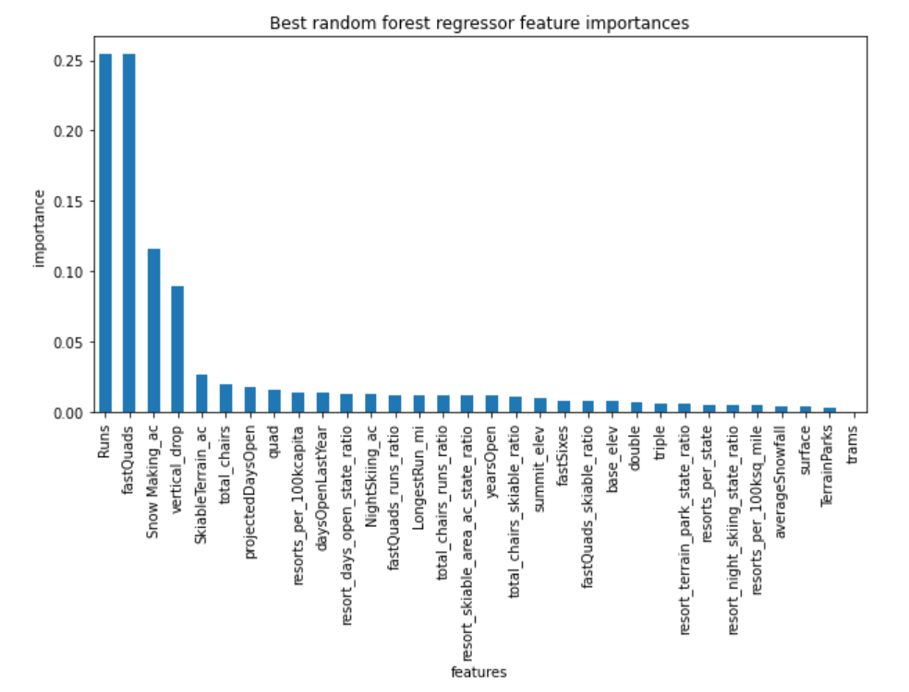
Results
Random Forest Model
Predicted ticket price of $95.88 with an error of $10.36
Most important features: Runs, fastQuads, snow making, and vertical drop

Slide 5
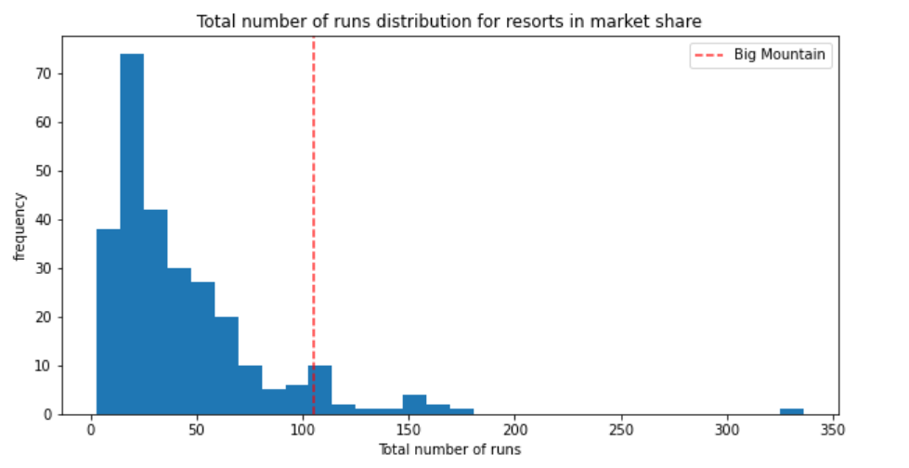
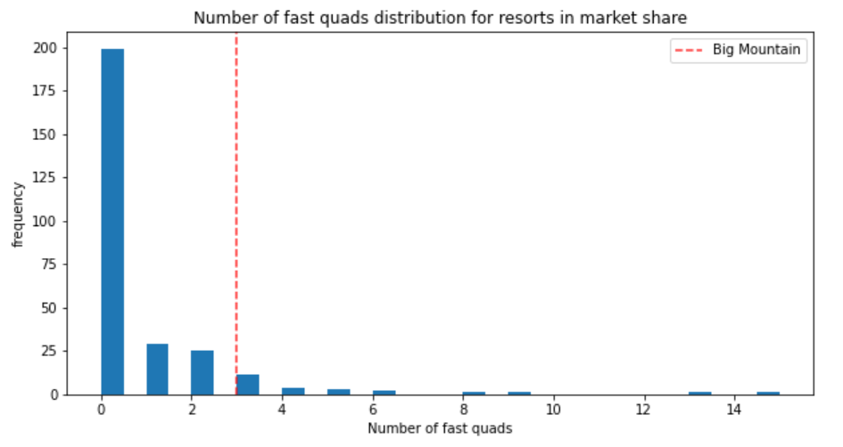
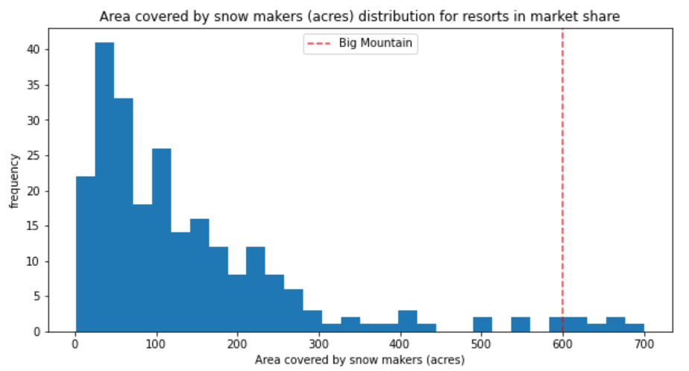
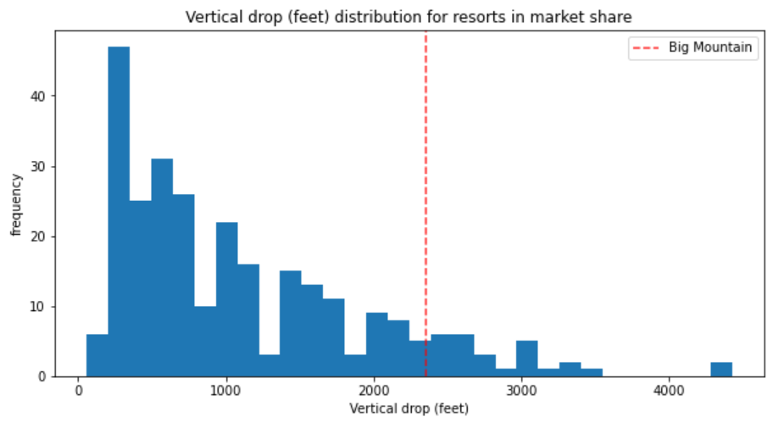
Analysis
Ranks high in the top 4 features

Slide 6
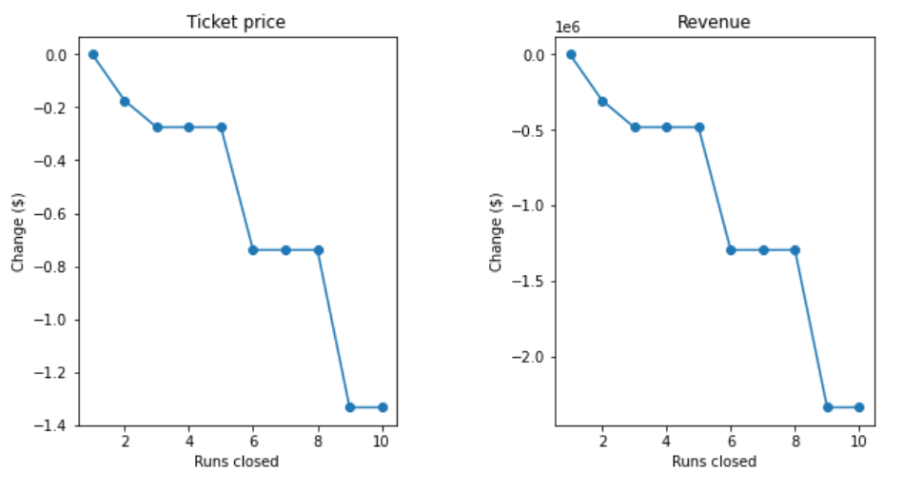
Scenarios
First Scenario
Close down 10 most unused runs
1 run has no impact
3-5 has the same impact
Second Scenario
Adding 1 run, increase vertical drop by 150 ft, and adding a lift
Increase ticket price by $ 8.70, which would increase revenue by $15,217,391
Third Scenario
Same as second, but adding 2 acres of snow making
Has same results as second scenario
Fourth Scenario
Increase longest run by .2 miles, and adding 4 acres of snow
Has zero impact on ticket price and revenue

Slide 7
Summary and Conclusion
Recommend setting ticket prices between $85. 52 and $106.24
Adding additional run, increasing vertical drop by 150 ft, and adding additional lift
When closing least used runs proceed in following manner
Close 1 run
Close 2nd run
Close 3rd, 4th, and 5th run

