Slide 1
Movie Recommendation System
Thomas Rauzi

Slide 2
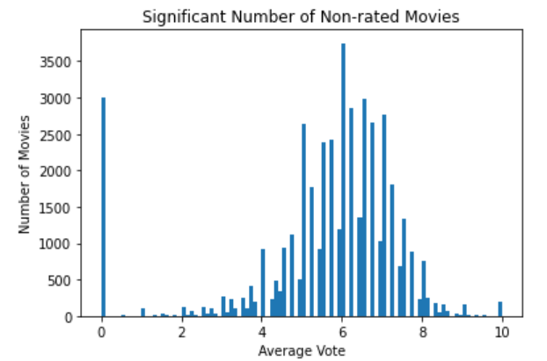
Content Based Dataset
22,709 movies
3,154 genres (18 categories)

Slide 3
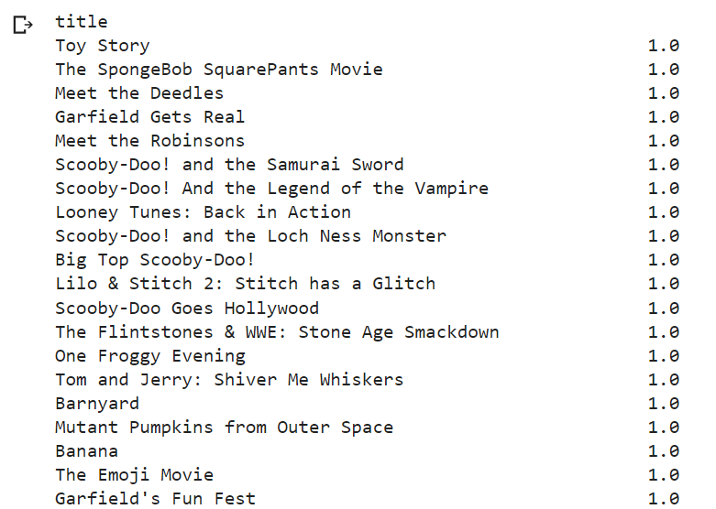
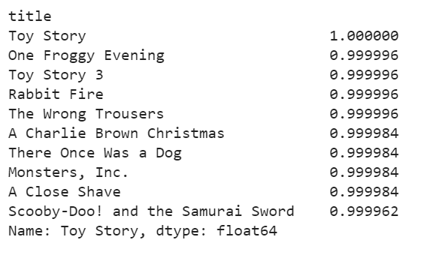
Content Based Model Genre and Popularity
Genre Based Model
Genre and Popularity Based Model

Slide 4
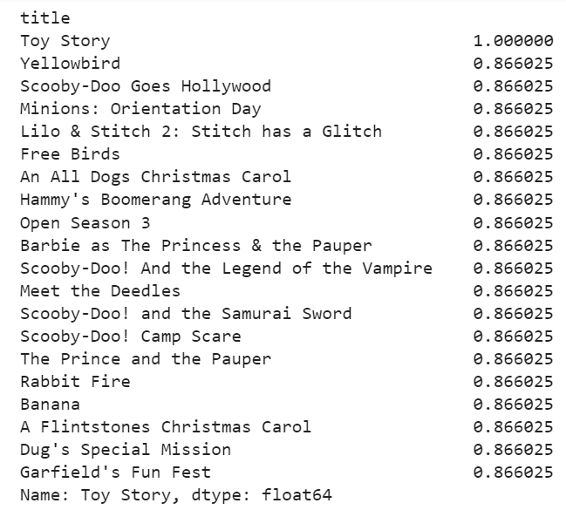
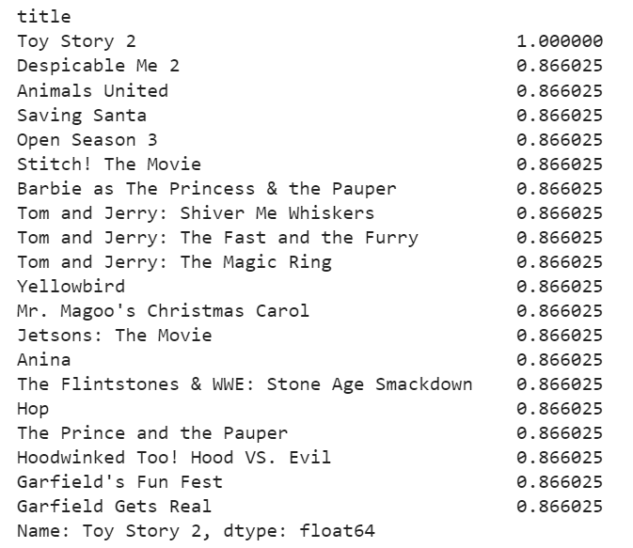
Content Based Model Genre and Keyword
Toy Story
Toy Story 2
Genre and keyword Model

Slide 5
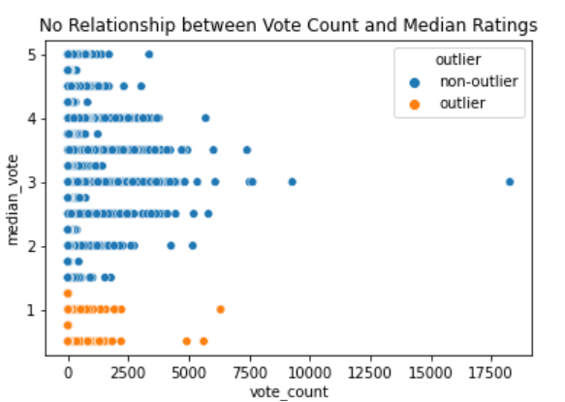
User Ratings

Slide 6
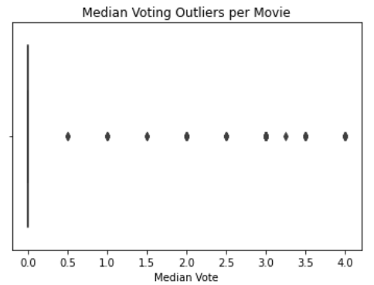
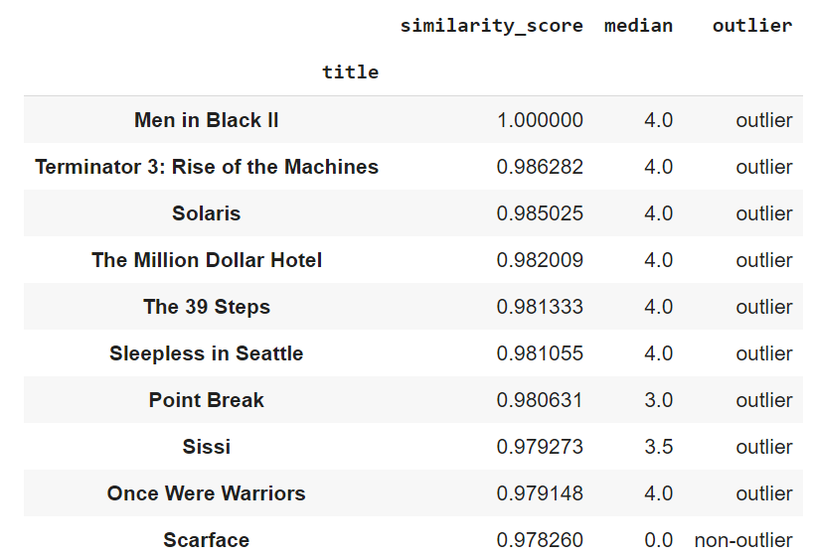

Item Collaborative Filtering
Men in Black II

Slide 7
Future Works
Movie descriptions
Hybrid system

