Slide 1
Movie Recommendation System
Thomas Rauzi

Slide 2
Content Filtering

Slide 3
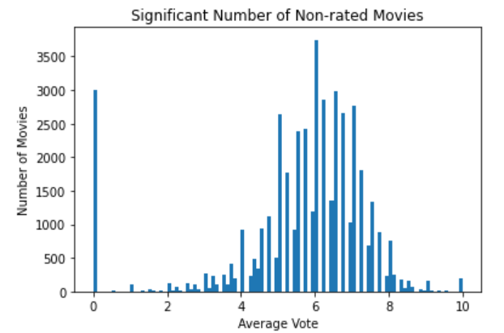
Content Based Dataset
22,709 movies
3,154 genres (18 categories)

Slide 4
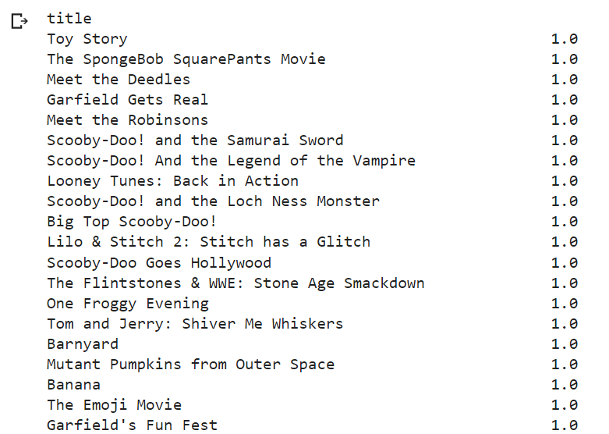
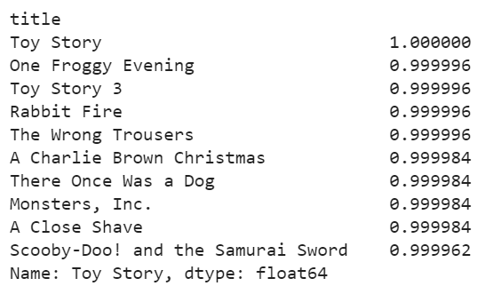
Content Based Model Genre and Popularity
Genre Based Model
Genre and Popularity Based Model

Slide 5
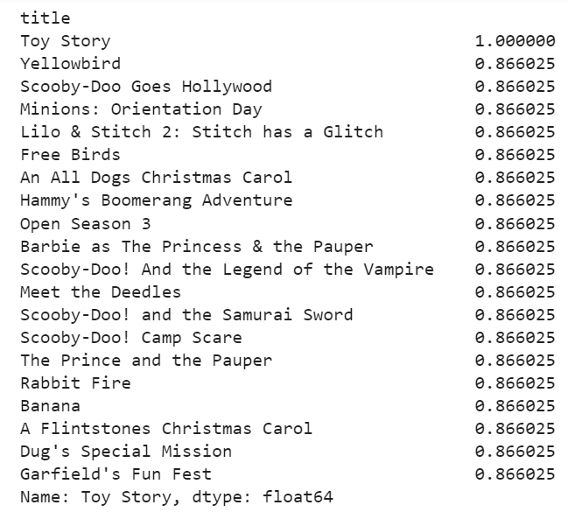
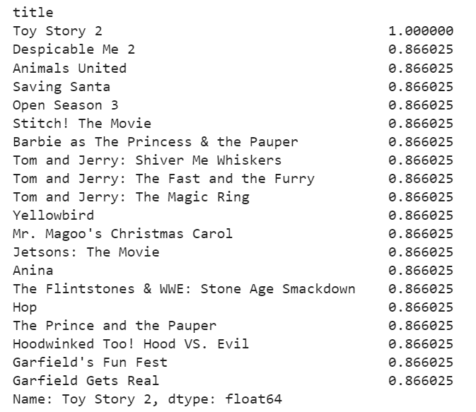
Content Based Model Genre and Keyword
Toy Story
Toy Story 2
Genre and keyword Model

Slide 6
Collaborative Filtering

Slide 7
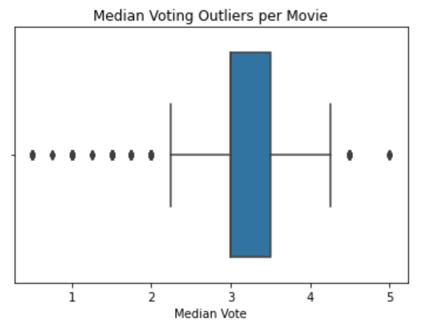

User Ratings
26,666 users
3,967 movies
5,019,231 ratings

Slide 8
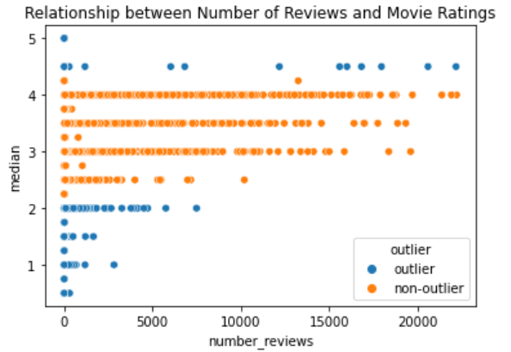
Item Collaborative Filtering

Slide 9
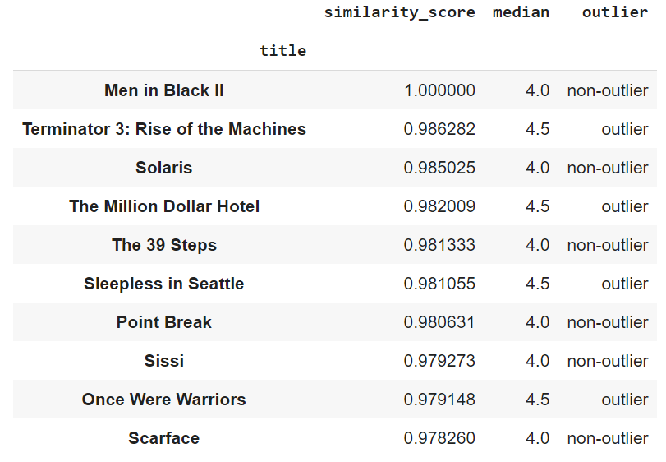
Item Based Recommendation
Men in Black II

Slide 10
Future Works
Movie descriptions
Hybrid system

