Slide 1
Predicting Data Breach Size
Thomas Rauzi
April 30, 2020

Slide 2
Introduction
Motivation
Models
Methods
Data
Results
Conclusion
Notes:
As e-commerence becomes more popular, companies store more customer information. This information is valuable to criminals who use the information to steal identities and collect financial information such as credit card numbers. Criminals gain access to this information through data breaches. Along with being valuable to criminals, firms require this information to conduct business, and their reputations and financial liability requires them to protect the information. Therefore, being able to predict data breach size based on company characteristics allows firms to better mitigate data breaches.

Slide 3
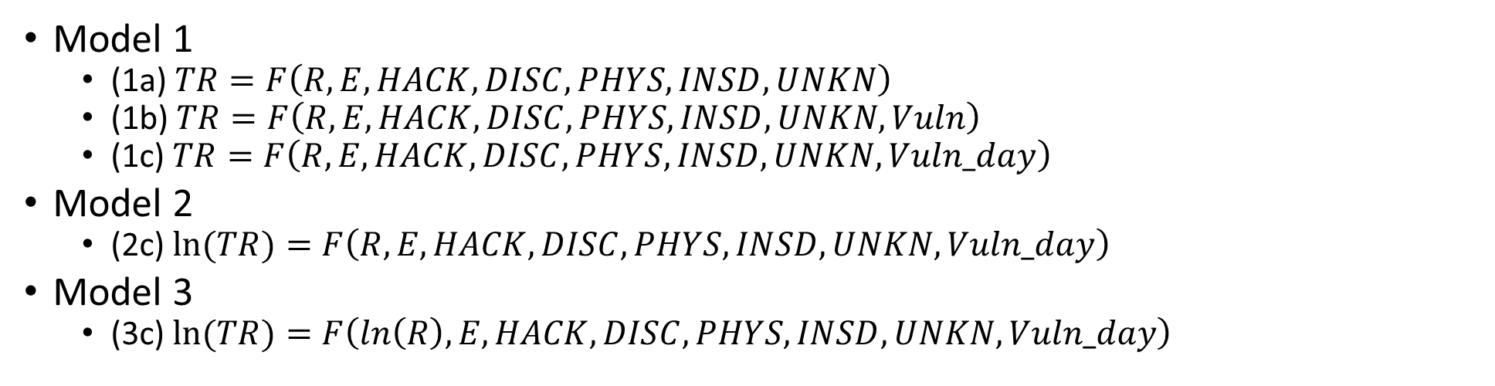
Models
Model 1
(1a) $TR=F\left(R,E,HACK,DISC,PHYS,INSD,UNKN\right)$
(1b) $TR=F\left(R,E,HACK,DISC,PHYS,INSD,UNKN,Vuln\right)$
(1c) $TR=F\left(R,E,HACK,DISC,PHYS,INSD,UNKN,Vuln_day\right)$
Model 2
(2c) $ln(TR)=F\left(R,E,HACK,DISC,PHYS,INSD,UNKN,Vuln_day\right)$
Model 3
(3c) $ln(TR)=F\left(ln\left(R\right),E,HACK,DISC,PHYS,INSD,UNKN,Vuln_day\right)$
PHYS: Physical breach
INSD: Insider
UNKN: Unknown
Vuln: Monthly Vulnerabilities
Vuln_day: Daily Vulnerabilities
TR: Total Records
R: Revenue
E: Employment
HACK: Hack
DISC: Unintentional disclosure

Slide 4
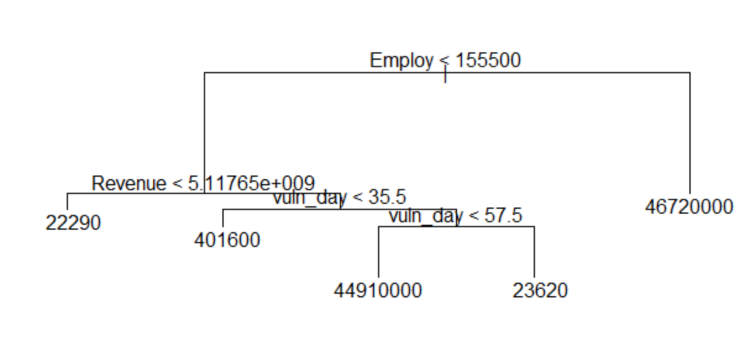
Methods
Training and validation set
OLS
Non-normal
T and F stats
Decision Tree
Easy to interpret
Weak predictor

Slide 5
Methods Continued
Random Forest
Bootstrapping
500 trees
Variables tried each level
Black Box
XGBoosting
500 trees
Parameters
Eta
Variables select
Max depth
Gamma
Black box

Slide 6
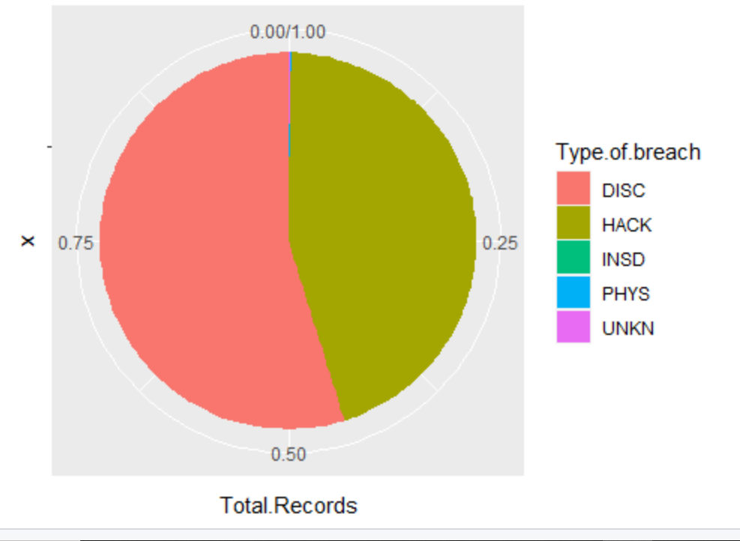
Initial Data Set
U.S. firms breached 2018
Data Sources
Privacy Rights Clearinghouse
National Vulnerability Database (NVD)
S&P Global Netadvantage
Data description
1,369,452,400 records
668 incidents
622 companies
36 multiple breaches

Slide 7
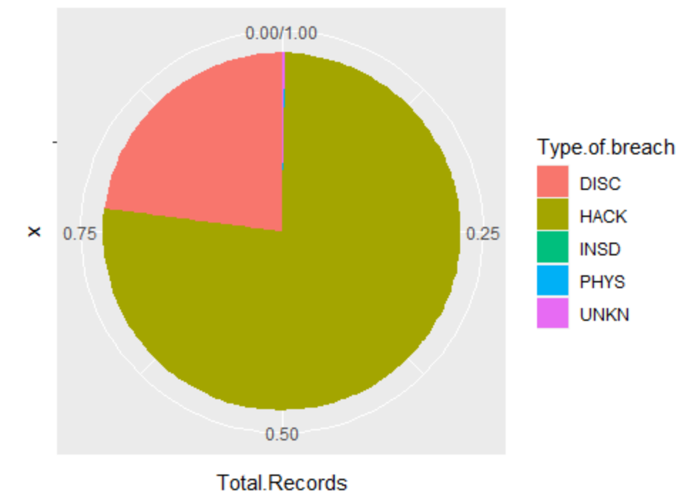
Reduced Data Set
Model 1 data set
Remove 210
796,212,977 (-41.86%)
458 incidents
429 companies
26 multiple breaches
Model 2 data set
451 incidents
422 companies
26 multiple breaches
Model 3 data set: same as model 2
https://thomasrauzi88.shinyapps.io/Data_Breach_Project/

Slide 8
Results
Table 3: Root Mean Squared Errors
 | Linear Reg | Decision Tree | Random Forrest | Xgboosting
Model 1 | 6,751,696 | 8,124,606 | 7,576,915 | 8,116,182
Model2 | 5,938,007 | 5,937,954 | 5,936,752 | 5,924,783
Model3 | 5,937,790 | 5,937,954 | 5,934,981 | 5,473,966**

Slide 9
Results with Vulnerability
Table 3: Root Mean Squared Errors
 | Linear Reg | Decision Tree | Random Forrest | Xgboosting
Model 1 | 6,743,803 | 8,124,606 | 7,903,935 | 6,653,011
Model2 | 5,938,006 | 5,937,954 | 5,934,858 | 5,897,600
Model3 | 5,937,814 | 5,937,954 | 5,932,418 | 5,539,106*

Slide 10
Results with Daily Vulnerability
Table 3: Root Mean Squared Errors
 | Linear Reg | Decision Tree | Random Forrest | Xgboosting
Model 1 | 6,757,254 | 10,482,822 | 8,413,389 | 6,381,924
Model2 | 5,937,994 | 5,937,954 | 5,936,404 | 5,927,716
Model3 | 5,937,759 | 5,937,954 | 5,935,168 | 4,399,552***

Slide 11
Conclusion
XGBoosting
Model 3
Mixed Data Sets
Limitations
Excluded data
Specification
Omitted variable

Slide 12
Questions?

